Slide 1
Computing Connected Components with Linear Communication Cost in Pregel-like Systems
Computer Science and Engineering
Xing Feng⁺, Lijun Chang⁺, Xuemin Lin⁺, Lu Qin*, Wenjie Zhang⁺
Presenter: Xing Feng
⁺University of New South Wales, Australia
*University of Technology Sydney, Australia

Slide 2
Outline
Introduction and Related Work
Computing Connected Component
Computing BiConnected Component
Experiment
Conclusion
Notes:
Here is the outline of this presentation.

Slide 3
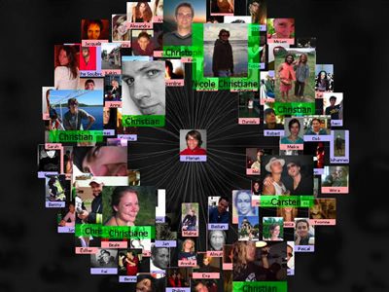
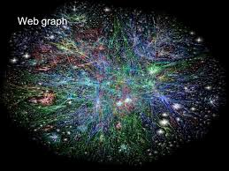
Increasing Size of Real-world Graphs
 | Facebook: 1.4+ billion users, 0.4 trillion relationships (in 2014)
 | WebGraph 2012: 0.98 billion pages, 42.6 billion hyperlinks (in 2012).
Disk size of WebGraph 2012: 435GB
Far exceed the memory size of a moderate machine
Notes:
Here is the outline of this presentation.

Slide 4
Pregel System
Bulk Synchronous Parallel model (BSP)
Performed in a serial of iterations (supersteps)
In a superstep, vertices execute user defined functions (UDF)
System terminates when there is no message and no computation task to do
superstep
Vertex 0
UDF
Initialization
Vertex 1
UDF
Message delivery
...
Notes:
Here is the outline of this presentation.

Slide 5
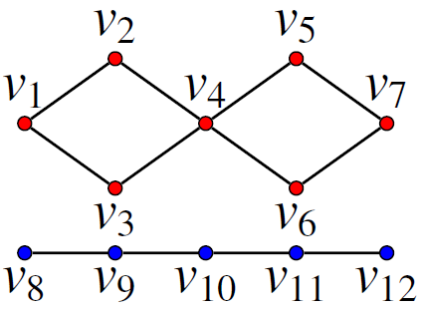
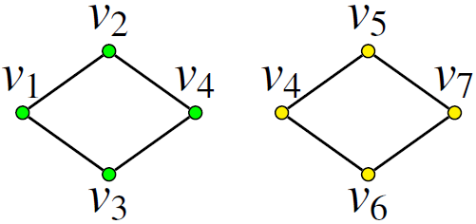
Problem Statement
Connected Component(CC): maximal connected subgraph
BiConnected Component(BCC): maximal subgraph that remains connected after removing any single vertex
Notes:
Here is the outline of this presentation.

Slide 6
Applications
Computing CCs
A key building block in processing large graphs
A preprocessing step of community detection in massive graphs
Computing BCCs
Analyze large graphs’ property (resilience to failure)
Identify articulation points of graphs
Notes:
Here is the outline of this presentation.

Slide 7
Related Works
Computing CCs in distributed environment
hash-min [ICDM’09, Kang et al. ]
single-pivot [VLDB’14, Salihoglu et al.]
S-V [VLDB’14, Yan et al.]
Computing BCCs in distributed environment
T-V [VLDB’14, Yan et al.]
Drawbacks: all these approaches have communication cost O(m$×$#superstep)
Our contribution: computing CCs and BCCs with linear communication cost while retaining the other costs
U. Kang, C. E. Tsourakakis, and C. Faloutsos. PEGASUS: A peta-scale graph mining system. In Proc. of ICDM’09, 2009.
S. Salihoglu and J. Widom. Optimizing graph algorithms on pregel-like systems. PVLDB, 2014.
D. Yan, J. Cheng, K. Xing, Y. Lu, W. Ng, and Y. Bu. Pregel algorithms for graph connectivity problems with performance guarantees. PVLDB,2014.
Notes:
Here is the outline of this presentation.

Slide 8
Outline
Introduction and Related Work
Computing Connected Component
Computing BiConnected Component
Experiment
Conclusion
Notes:
Here is the outline of this presentation.

Slide 9
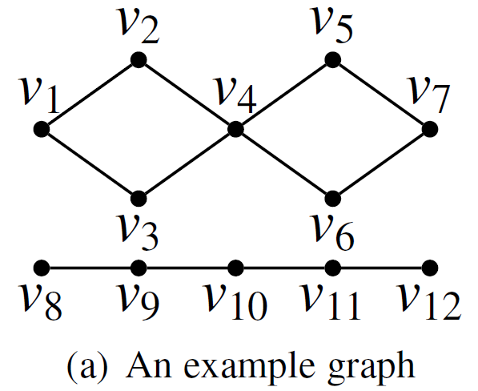
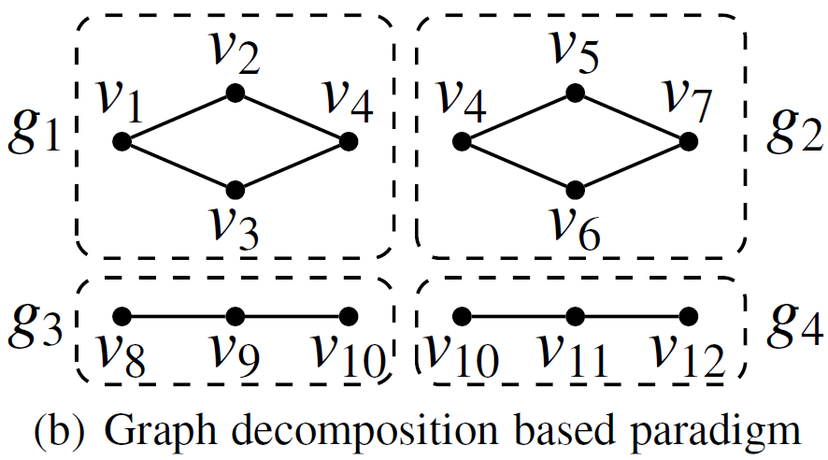
Framework
Phase 1: decompose graph G into connected subgraphs g₁, g₂,...,g_{i}
Phase 2: merge two subgraphs if they share a common vertex
Notes:
Here is the outline of this presentation.

Slide 10
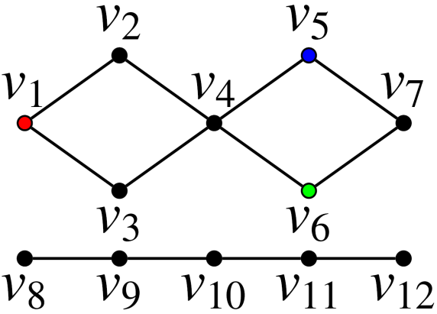
Phase 1: Graph Decomposition
Simultaneously conduct BFS from seed vertices
Challenge: how to select seeds?
Randomly select some vertices
Some CCs may never be detected
Notes:
Here is the outline of this presentation.

Slide 11
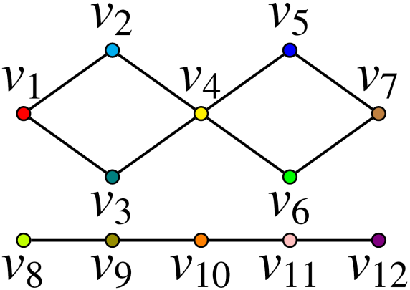
Phase 1: Graph Decomposition
Simultaneously conduct BFS from seed vertices
Challenge: how to select seeds?
Randomly select some vertices
Select all vertices
Too much work for subgraph merging
Notes:
Here is the outline of this presentation.

Slide 12
Phase 1: Graph Decomposition
Simultaneously conduct BFS from seed vertices
Seed selection: randomly sample $β^{i}−β^{i−1}$ vertices at superstep $i$
Notes:
Here is the outline of this presentation.

Slide 13
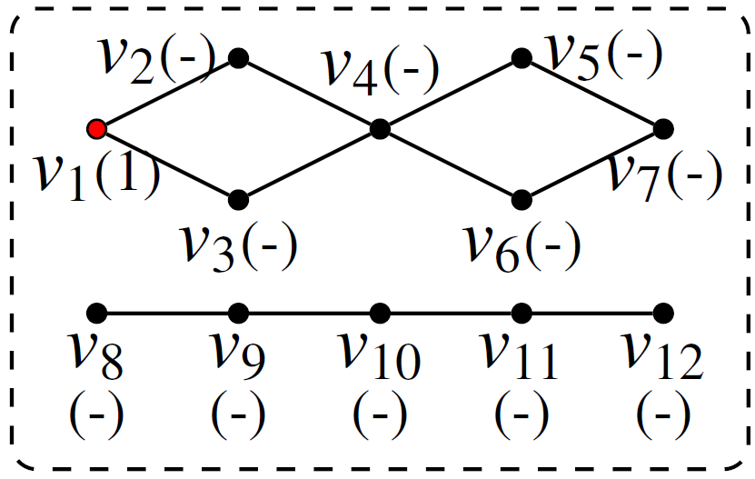
Phase 1: Graph Decomposition
Simultaneously conduct BFS from seed vertices
Seed selection: randomly sample $β^{i}−β^{i−1}$ vertices at superstep $i$
Notes:
Here is the outline of this presentation.

Slide 14
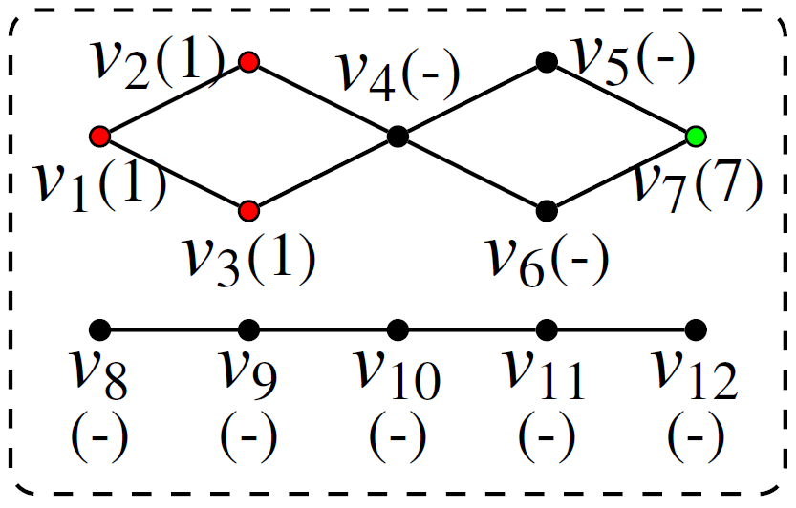
Phase 1: Graph Decomposition
Simultaneously conduct BFS from seed vertices
Seed selection: randomly sample $β^{i}−β^{i−1}$ vertices at superstep $i$
Notes:
Here is the outline of this presentation.

Slide 15
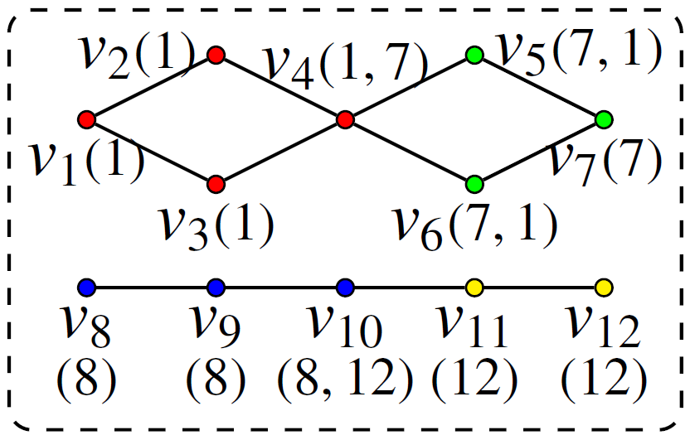
Phase 1: Graph Decomposition
Simultaneously conduct BFS from seed vertices
Seed selection: randomly sample $β^{i}−β^{i−1}$ vertices at superstep $i$
Notes:
Here is the outline of this presentation.

Slide 16
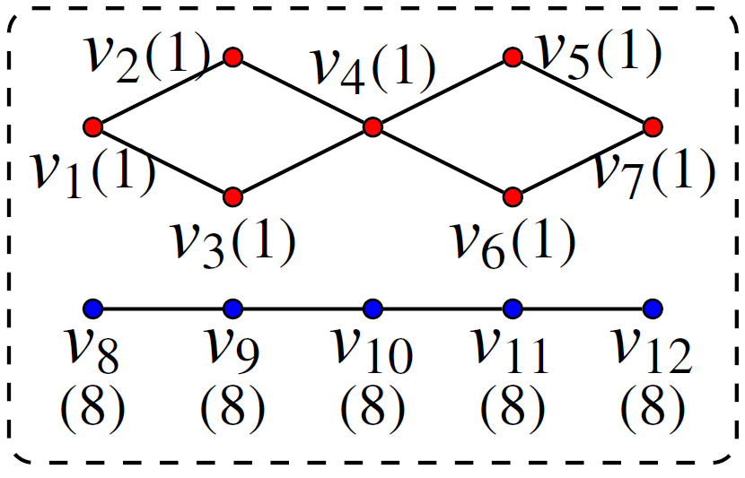
Phase 2: Subgraph Merging
Merge all colors received by a vertex.
Notes:
Here is the outline of this presentation.

Slide 17
Theoretical results
Number of supersteps: $O(\log{n})$
Total communication cost: $O(m)$
Total computation cost: $O(m)$
Notes:
Here is the outline of this presentation.

Slide 18
Outline
Introduction and Related Work
Computing Connected Component
Computing BiConnected Component
Experiment
Conclusion
Notes:
Here is the outline of this presentation.

Slide 19
Challenge
Existing work [VLDB’14, Yan et al.]
Label edges
Construct graph G’ by treating each edge as a vertex
BCCs of original graph are CCs of G’
The construction of G’ takes O(m$×$#superstep) communication cost
Our approach
Label vertices
BCCs can be inferred from vertices’ labels
Linear communication cost is achieved
Notes:
From the example here, it is obvious that an edge belongs to a unique BCC while a vertex may belong to multiple BCCs. Existing work computes BCCs by labelling edges. Au auxiliry graph G’ is constructed by treating each edge as a vertex. BCCs of original graph are CCs of G’. However, The construction of G’ takes O(m$×$#superstep) communication cost. In this paper, we proposed a new approach which labels vertices. Edge label can be inferred from vertices’ labels. By efficiently labelling vertices, Linear communication cost is achieved

Slide 20
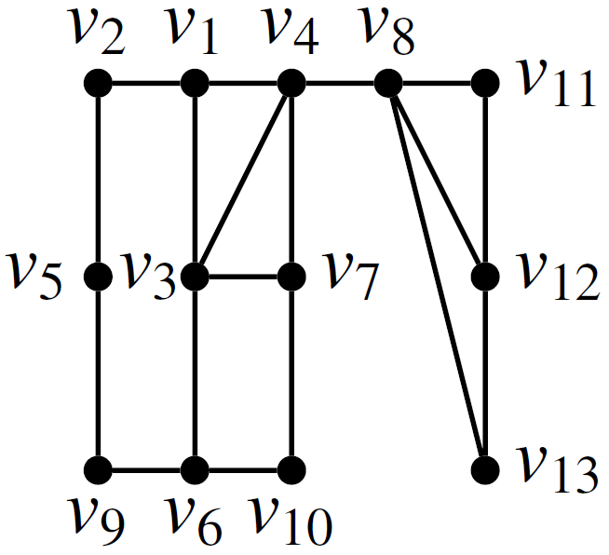
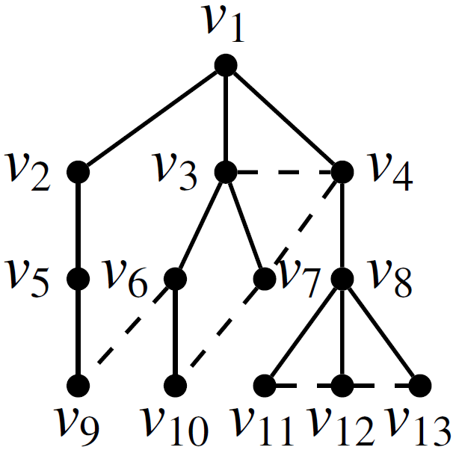
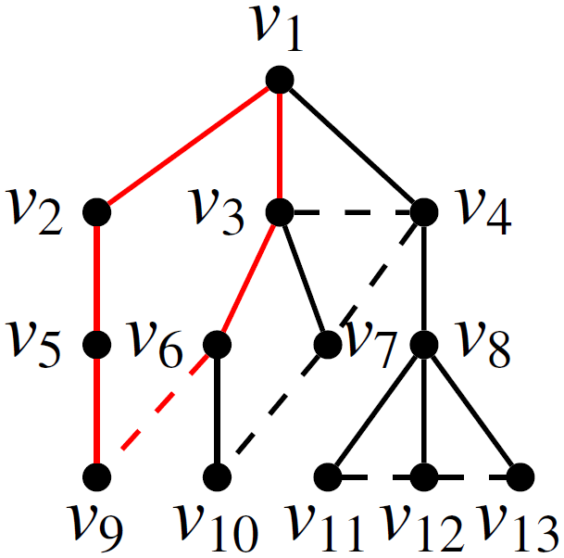
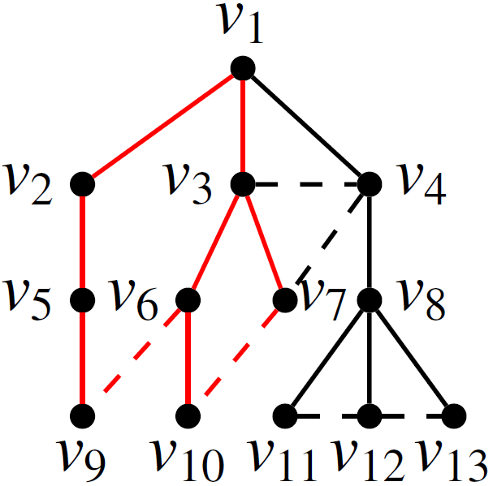
Basic Cycle
Basic cycle (based on BFS tree T):
Non-tree edge (u,v) and the path between u and v in T.
Theorem: two edges e and e’ belong to the same BCC iff
$e∈C_{0}, e^{′}∈C_{L}$ ($C_{0}$, $C_{L}$ are basic cycles)
There are basic cycles C₀,...,C_{L} such that C_{i} and C_{i+1} overlap on edges for every $0≤i<L$
Notes:
Here is the outline of this presentation.

Slide 21
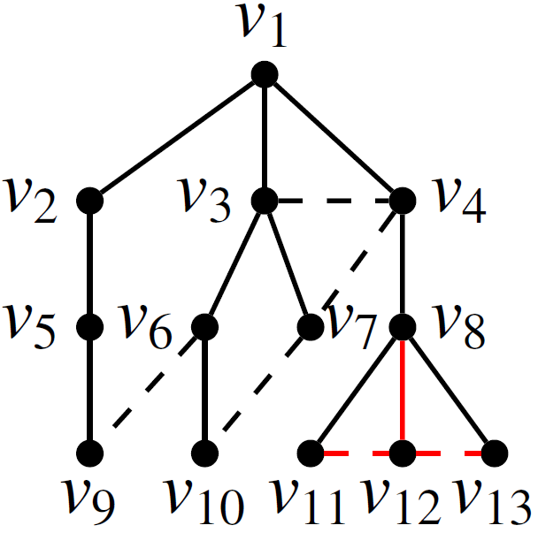
Vertex Labelling Approach
Lemma: non-tree edges associated with vertex u and tree edge $(u,p(u))$ belong to same BCC.
By efficiently labelling vertices in a bottom-up fashion, we compute BCCs with linear communication cost
p(u)
u
Notes:
All basic cycles containing non-tree edges overlap on tree edge (u, p(u))

Slide 22
Outline
Introduction and Related Work
Computing Connected Component
Computing BiConnected Component
Experiment
Conclusion
Notes:
Here is the outline of this presentation.

Slide 23
Approaches Evaluated
Regarding computing CCs, we evaluate
S-V
hash-min
single-pivot
GD-CC(our approach)
Regarding computing BCCs, we evaluate
T-V(S-V)
T-V(hash-min)
T-V(single-pivot)
GD-BCC(our approach)
Notes:
Here is the outline of this presentation.

Slide 24
Experimental Setting
25 Amazon EC2 r3.2xlarge instances with enhanced networking.
Each instance has 4 cores and 60GB RAM
Notes:
Here is the outline of this presentation.

Slide 25
Experimental Result
Evaluating CC computation algorithms
Notes:
The first set of experiment evaluates all the CC computation algorithms against four datasets. In subfigure a, we demonstrate the total running time of each algorithm against each dataset. The x-axis is the dataset while the y axis is the total running time. Our algorithm outperforms exsiting algorithms by up to 50 times. In subfigure b, the total running time is decomposed into communication time and computation time. If the communication time dominates, the entire bar represents the communication time. Otherwise, it represents the computation time. As we can see, the communication time of existing approaches dominates in most cases. For our approach, communication and computation have similar cost. Subfigure C demonstrates the communication volume of each algorithm. Our algorithm incurs much less communication due to the linear communication cost.

Slide 26
Experimental Result
Evaluating BCC computation algorithms
Notes:
The second set of experiment evaluates all the BCC computation algorithms. In subfigure a, we demonstrate the total running time of each algorithm against each dataset. As the existing algorithms run out-of-memory on large datasets, PL2 and YH, we increase the number of machines up to 50. Our algorithm consistantly outperforms exsiting algorithms as we incur much less communication cost.

Slide 27
Outline
Introduction and Related Work
Computing Connected Component
Computing BiConnected Component
Experiment
Conclusion
Notes:
Here is the outline of this presentation.

Slide 28
Conclusion
A new paradigm for computing CCs and BCCs to reduce the total data communication cost.
A graph decomposition approach for computing CCs with linear data communication cost.
A vertex labeling approach for computing BCCs with linear data communication cost.
Extensive performance studies on large graphs.
Notes:
Here is the outline of this presentation.

Slide 29
Q&A
Thank you!
Any questions?

Slide 30
Q&A
Thank you!
Any questions?

Slide 31
Vertex Labelling Approach
Non-tree edges associated with vertex u and tree edge $(u,p(u))$ belong to same BCC.
Infer edge’s label as label of vertex in lower level.
If a vertex u has same-level neighbor(s), u and its same-level neighbor(s) have same label.
If a vertex u has more than one upper-level neighbors, u and its upper-level neighbors have same label.
Notes:
All basic cycles containing non-tree edges overlap on tree edge (u, p(u))

Slide 32
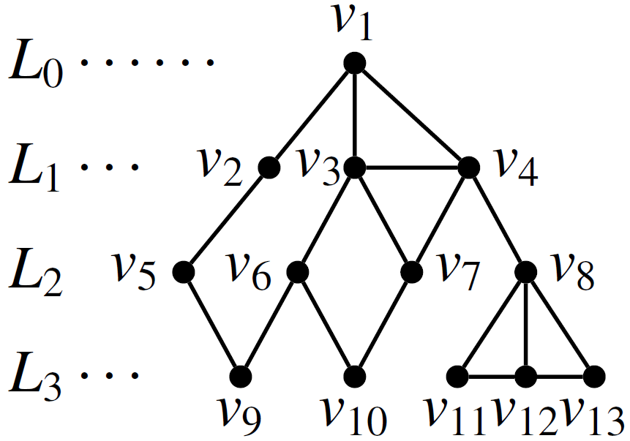
Vertex Labelling Approach
Labelling vertices in the bottom-up fashion.
Notes:
Here is the outline of this presentation.

Slide 33
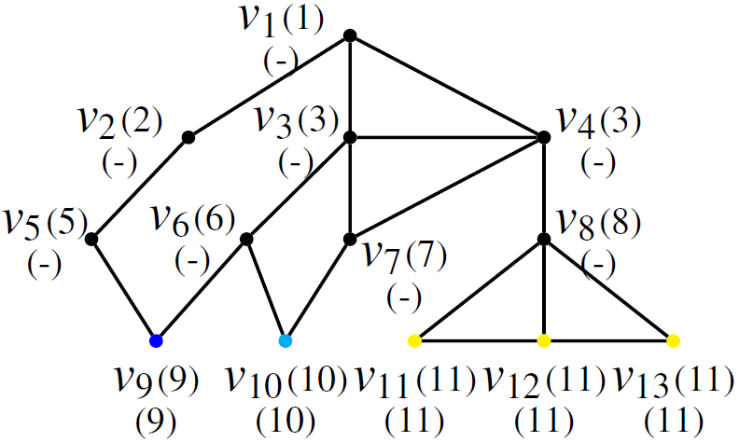
Vertex Labelling Approach
Labelling vertices in the bottom-up fashion.
Notes:
Here is the outline of this presentation.

Slide 34
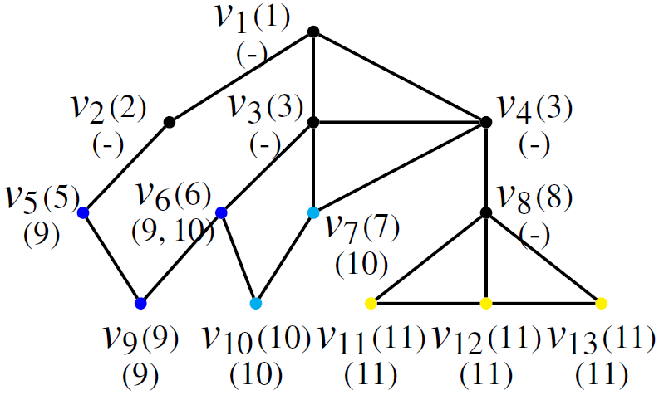
Vertex Labelling Approach
Labelling vertices in the bottom-up fashion.
Notes:
Here is the outline of this presentation.

Slide 35
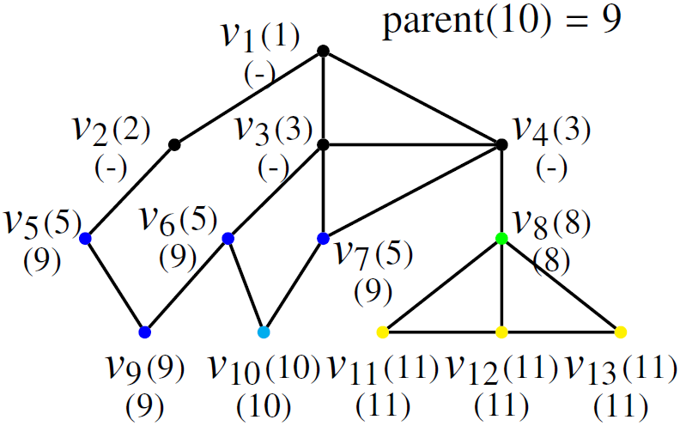
Vertex Labelling Approach
Labelling vertices in the bottom-up fashion.
Notes:
Here is the outline of this presentation.

Slide 36
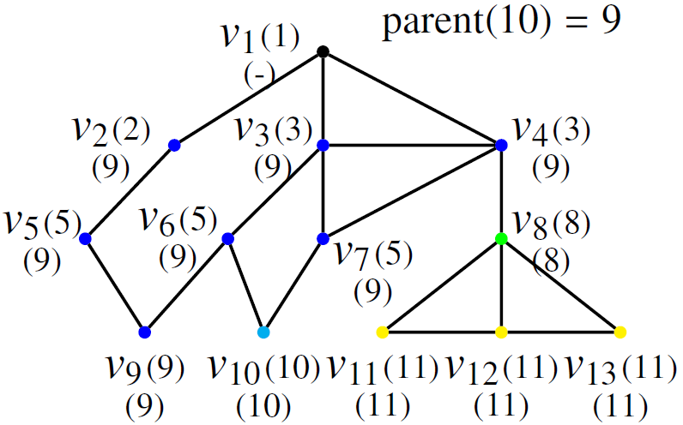
Vertex Labelling Approach
Labelling vertices in the bottom-up fashion.
Notes:
Here is the outline of this presentation.

Slide 37
Vertex Labelling Approach
Labelling vertices in the bottom-up fashion.
Notes:
Here is the outline of this presentation.

Slide 38
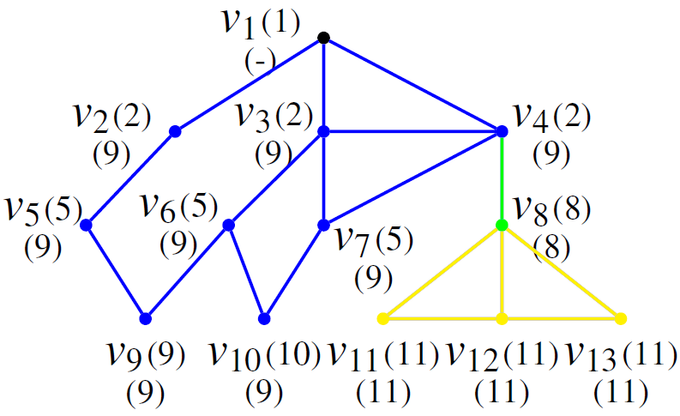
Vertex Labelling Approach
Update colors of vertices
Notes:
Here is the outline of this presentation.

Slide 39
Vertex Labelling Approach
Inferring edge label from vertices’ labels
Notes:
Here is the outline of this presentation.

Slide 40
Theoretical results
Number of Supersteps: $O(\log{n}+δ)$
Total Communication Cost: $O(m)$
Total Computation Cost: $O(m)$
Notes:
Here is the outline of this presentation.

Slide 41
Experimental Result
Notes:
Here is the outline of this presentation.

Slide 42
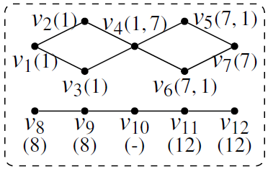
Phase1: Graph Decomposition
Simultaneously conducting BFS from seed vertices
Seed selection: randomly sample $β^{i}−β^{i−1}$ vertices at superstep $i$
Notes:
Here is the outline of this presentation.

Slide 43
Experiment
Notes:
Here is the outline of this presentation.

Slide 44
Experiment
Notes:
Here is the outline of this presentation.

Slide 45
Vertex Labelling Approach
Lemma: non-tree edges associated with vertex u and tree edge $(u,p(u))$ belong to same BCC.
By efficiently labelling vertices in a bottom-up fashion, we compute BCCs with linear communication cost
Upper BFS level
Lower BFS level
Notes:
All basic cycles containing non-tree edges overlap on tree edge (u, p(u))

