Slide 1


Selectivity Estimation on Streaming Spatio-Textual Data
Using Local Correlations
Xiaoyang Wang¹, Ying Zhang², Wenjie Zhang¹, Xuemin Lin¹,
Wei Wang¹
1. University of New South Wales, Australia
2. University of Technology, Sydney, Australia
Notes:
Hello everyone, welcome to my presentation today. My name is Xiaoyang Wang from the university of new south wales, Australia. The paper I will present today is titled Selectivity Estimation on Streaming spatio-textual data using local correlations. The paper is co-authored with Dr. Ying zhang, Dr, Wenjie Zhang, Professor Xuemin Lin and Professor Wei Wang.

Slide 2
Outline
Introduction
Preliminaries
ASP-tree based Estimation
KMV based Estimation
A²SP-tree based Estimation
Experiments
Conclusion
Notes:
Here is the outline of my presentation, First I will introduce the background and preliminaries about the problem. The I will introduce two approaches based on ASP-tree and KMV sketch. Then I will present local correlation based estimation method. Finally I will show the experiments results and conclude.

Slide 3


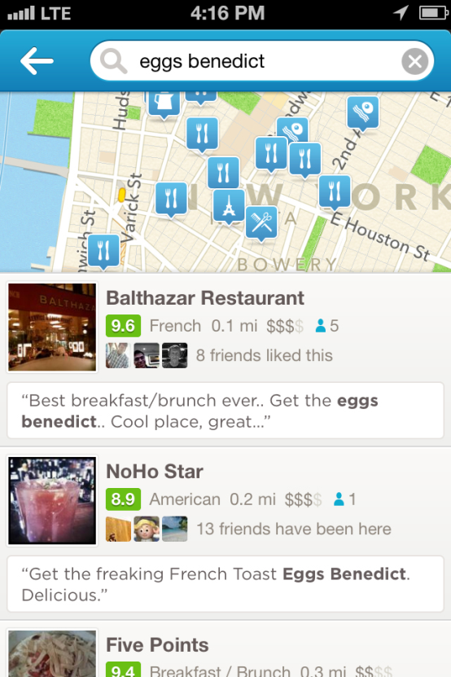
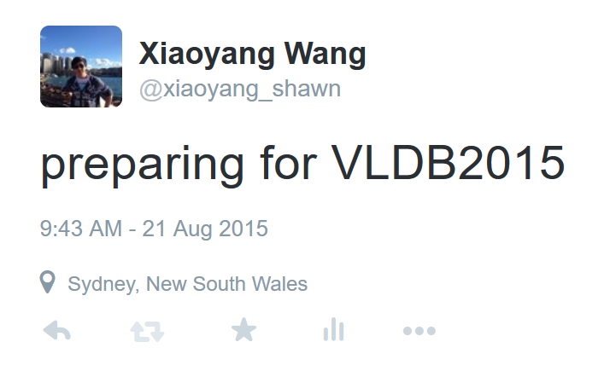
Introduction
An enormous amount of spatio-textual objects available in many applications
  Online local search
  Social network services
text
location
Notes:
As the advances location enabled devices, like smart phone, there is a large amount of spatio-textual objects in many applications. Like online local search, where people send reviews about the point of interests. In social network, like twitter, people send tweets with geo-tagged. Like this tweets I sent in sydney before I attended the conference.

Slide 4
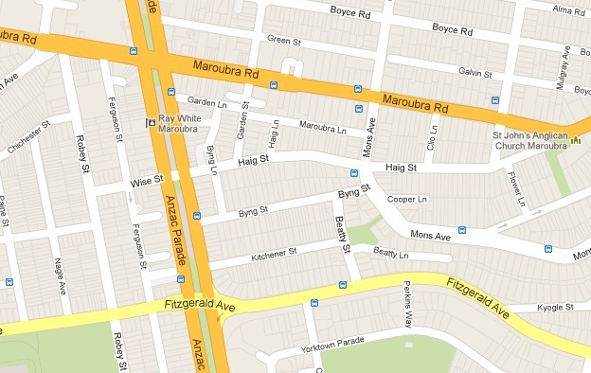

Introduction
Spatial keyword search
Apple Watch
Apple Watch
Apple Watch
Apple
Apple Watch
Watch
Notes:
Spatio-textual objects search is one of most studied problems. Given a set of spatio-textual objects, a query consists of a set keywords and a query range, it aims to find all the all the objects in the range contains the query keywords. In this example, we have a set of tweets with locations. We want to find which tweets in the region contain the keywords Apple watch. The returned results is this two tweets.

Slide 5
Introduction
Spatial keyword search
Apple Watch
Apple Watch
Apple Watch
Apple
Apple Watch
Watch
Notes:
Spatio-textual objects search is one of most studied problems. Given a set of spatio-textual objects, a query consists of a set keywords and a query range, it aims to find all the all the objects in the range contains the query keywords. In this example, we have a set of tweets with locations. We want to find which tweets in the region contain the keywords Apple watch. The returned results is this two tweets.

Slide 6
Introduction
Selectivity estimation of spatial keyword search
How many people talk about Apple Watch
Apple Watch
Apple Watch
Apple
Apple Watch
Watch
Notes:
Since the spatio-textual dataset can be very large like tweets, it will be cost to index and find all the objects. While sometimes, users do not need to the exact objects that fulfil the spatio-textual search query. They only want to know how many objects fulfil the query. For example, after Apple release apple watch. They want to know how many tweets are talking about the apple watch in some area, in order to conduct the next promotion. In the example, there are 2 tweets talking about apple watch. Selectivity estimation of spatio-textual object is to estimate the number, that is the size 2 in this example.

Slide 7
Problem Definition
Data
  A spatio-textual object stream
  Each object consists of a location and a set of keywords
Query
  Query region (q.R)
  A set of query keywords (q.T)
Task
  Estimate the number of objects that fall in query region q.R and contain the query keywords q.T by using a small summary.
Notes:
Formally, the input data is a A spatio-textual objects stream, Each object consists of a location and a set of keyword. The query consists of Query region and A set of query keywords. The task is to estimate the number of objects in q.R contain the query keyword q.T with a small summary.

Slide 8
Challenges
Massive spatio-textual objects continuously arrive at a rapid rate in many applications.
It is challenging for the summary to support both spatial and keyword constraints.
  No existing work for this problem.
Query keywords typically have correlations among them.

Slide 9

ASP-tree
Each node has a counter
Each object is only counted in one node
Maintain a threshold Θ = α $×$ n to merge or subdivide node
α = 0.5, n = 9
Θ = 4.5
r
2
a
b
e
f
g
h
1
2
2
2
c
d
e
f
g
h
Notes:
Given a query range, the number of object in the range can be estimated as the sum of counter multiply overlapping ratio. In this example, the number of objects in the red range is calculated as shown, 2 times ½ means the range covers half of the root node.

Slide 10
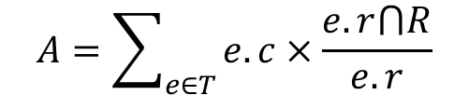


ASP-tree
Each node has a counter
Each object is only counted in one node
Maintain a threshold Θ = α $×$ n to merge or subdivide node
α = 0.5, n = 9
Θ = 4.5
r
2
a
b
e
f
g
h
1
2
2
2
$$A=\sum_{e∈T}{e.c×\frac{e.r⋂R}{e.r}}$$
c
d
e
f
$=2∗\frac{1}{2}+1+2+2+2=8$
g
h
Notes:
Given a query range, the number of object in the range can be estimated as the sum of counter multiply overlapping ratio. In this example, the number of objects in the red range is calculated as shown, 2 times ½ means the range covers half of the root node.

Slide 11


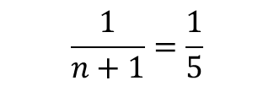
K Minimum Value (KMV)
S
a1
a2
a3
a4
0.2
0.8
0.4
0.6
$$k=2$$
S
a1
a3
a4
a2
a1
a3
0.2
0.4
0.6
0.8
0.2
0.4
$$\frac{1}{n+1}=\frac{1}{5}$$
$$A\left(S\right)=\frac{k−1}{h\left(k\right)}$$
Notes:
Extend this idea, the kmv sketch can be used to estimate set union and intersection size. Given two sets A1 and A2, we firstly generate their kmv sketch with k = 2 and 3. Then the sketch of the union of the two sets consists the k’ objects with the smallest hash value in the two set. As shown the 2 smallest hash value is the two sketch is a1 and a3. Then the union size of the sets is estimated as and the jaccard similarty betweent two sets is estimated as the jarccard in there common objects in the union sketch divide k’. Then the intersection size is estimated as jarcard multiple uion

Slide 12


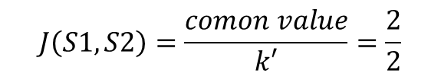
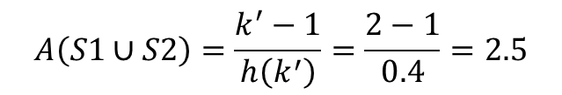


K Minimum Value (KMV)
$$k1=2$$
S1
a1
a2
a3
a4
a1
a3
0.2
0.8
0.4
0.45
0.2
0.4
$$k2=3$$
S2
a1
a3
a5
a6
a1
a3
a5
0.2
0.4
0.5
0.7
0.2
0.4
0.5
$$A\left(S1∪S2\right)=\frac{k^{′}−1}{h\left(k^{′}\right)}=\frac{2−1}{0.4}=2.5$$
$$k^{′}=min⁡(k1, k2)$$
$$J\left(S1,S2\right)=\frac{comon value}{k′}=\frac{2}{2}$$
a1
a3
$A\left(S1∩S2\right)=J(S1,S2)×A\left(S1∪S2\right)$ = 2.5
0.2
0.4
Notes:
Extend this idea, the kmv sketch can be used to estimate set union and intersection size. Given two sets A1 and A2, we firstly generate their kmv sketch with k = 2 and 3. Then the sketch of the union of the two sets consists the k’ objects with the smallest hash value in the two set. As shown the 2 smallest hash value is the two sketch is a1 and a3. Then the union size of the sets is estimated as and the jaccard similarty betweent two sets is estimated as the jarccard in there common objects in the union sketch divide k’. Then the intersection size is estimated as jarcard multiple uion

Slide 13
Bayesian network
Bayesian network to capture the correlation among keywords
T1 T2 | P(T1|T2)
1 | 8/10
0 1 | 2/10
0 | 2/5
0 0 | 3/5
T2 | P(T2)
1 | 10/15
0 | 5/15
t1
t2
Network Structure
Network Parameters
$$A\left(t1∩t2\right)=P\left(T1=1, T2=1\right)n=P\left(T1 | T2\right)P\left(T2\right)n$$
Notes:
Also some paper utilize Bayesian network to capture the correlation and calculate the selectivity. As shown Bayesian network consists a graph sturcutre showing the dependence relation among keywords, and a parameter table show the conditional prability for dependent term T1 conditiaon on T2. and independent term T2 in this example. Given this two information, we can estimtate the co-occurnce of t1 and t2 and the join distribution of t1 t2 both appeard times N, where N is the total number of objects.

Slide 14
ASP-tree based Estimation
r
1
a
t2
b
t1
t2
ASP-tree (t1)
t1,t2
t1,t2
t1,t2
t2
a
b
c
d
t2
c
d
0
3
2
2
t2
t1
t1,t2
r
1
t1,t2
t1
t2
ASP-tree (t2)
a
b
c
d
3
3
1
3
Notes:
Next I will present three approaches proposed in this paper answer the problem proposed in this paper. The first two is based on extend ASP-tree and KMV sketch. The first one ASP-tree based estimation, Given a set of spatio-textual object in the figure, each object has keyword t1 or t2 as shown. For all the object contain t1, we build its asp-tree, the same we build a asp-tree for t2. Then given a query range, we can estimate thte number of objects in the range containing t1 and t2 in the range. As shown. Then we estimate the number of object contain t1 and t2 based on independent assumption. The good is that

Slide 15

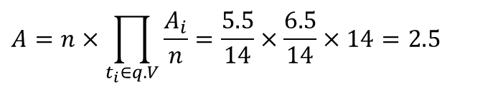

ASP-tree based Estimation
r
1
a
t2
b
t1
t2
ASP-tree (t1)
t1,t2
t1,t2
t1,t2
t2
a
b
c
d
t2
c
d
0
3
2
2
t2
t1
t1,t2
r
1
t1,t2
t1
t2
ASP-tree (t2)
$$A\left(t1\right)=1×\frac{1}{2}+3+2=5.5$$
a
b
c
d
$$A(t2)=1×\frac{1}{2}+3+3=6.4$$
3
3
1
3
Pros: good when only one query keyword
Cons: Keywords usually have correlation
$$A=n×\prod_{t_{i}∈q.V}{\frac{A_{i}}{n}}=\frac{5.5}{14}×\frac{6.5}{14}×14=2.5$$
Notes:
Next I will present three approaches proposed in this paper answer the problem proposed in this paper. The first two is based on extend ASP-tree and KMV sketch. The first one ASP-tree based estimation, Given a set of spatio-textual object in the figure, each object has keyword t1 or t2 as shown. For all the object contain t1, we build its asp-tree, the same we build a asp-tree for t2. Then given a query range, we can estimate thte number of objects in the range containing t1 and t2 in the range. As shown. Then we estimate the number of object contain t1 and t2 based on independent assumption. The good is that

Slide 16
KMV based Estimation
a
t2
b
t1
t2
t1,t2
t1,t2
t1,t2
t2
t2
c
t2
d
t1
t1,t2
t1,t2
t1
t2
Notes:
The second approach is based extending KMV sketch. We first generate hash value for each object and keep the objects with smallest based on space budget.

Slide 17
KMV based Estimation
a
b
t2
0.4
0.2
t1,t2
0.3
t1: 0.35, 0.5, 0.15
t2
t2
0.35
c
d
0.15
t1,t2
0.5
t2: 0.2, 0.3, 0.4, 0.35, 0.1, 0.15
t1
0.1
t2
Notes:
Suppose we keep 7 objects here. Where the hash value is beside each object. Then we build inverted list for each keywords, the list consist of the hash value of the objects that contain the keywords. Like t1, it is contained in 3 objects. The each keywords posting list is organized with linear quadtree for fast retrieve sketch in the query range.

Slide 18

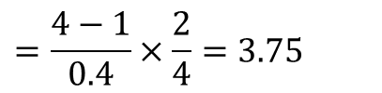
KMV based Estimation
a
b
t2
0.4
0.2
t1,t2
0.3
t1: 0.35, 0.15
t2
t2
0.35
c
d
0.15
t1,t2
0.5
t2: 0.4, 0.35, 0.1, 0.15
t1
0.1
t2
$$A=A\left(t1⋃t2\right)×J\left(t1,t2\right)$$
$$=\frac{4−1}{0.4}×\frac{2}{4}=3.75$$
Notes:
Given a query range and query keyword, we first retrieve the object sketch in the range, then we use kmv to estimate the size. The proof of correctness is presented in paper. The good is

Slide 19
KMV based Estimation
a
b
t2
0.4
0.2
t1,t2
0.3
t1: 0.35, 0.15
t2
t2
0.35
c
d
0.15
t1,t2
0.5
t2: 0.4, 0.35, 0.1, 0.15
t1
0.1
t2
$$A=A\left(t1⋃t2\right)×J\left(t1,t2\right)$$
Pros: good for multiple keyword query
Cons: single keyword query is worse than ASP-tree
big variance when survived samples size is small
$$=\frac{4−1}{0.4}×\frac{2}{4}=3.75$$
Notes:
Given a query range and query keyword, we first retrieve the object sketch in the range, then we use kmv to estimate the size. The proof of correctness is presented in paper. The good is

Slide 20
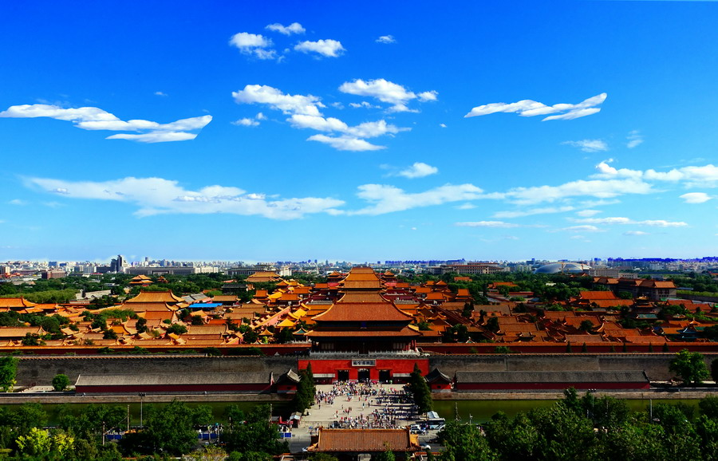
Observations
Observation 1: Many terms are highly correlated in spatio-textual objects. Moreover, correlations of these terms exhibit the “locality” property.
Observation 2: The local correlations among the terms are likely to be preserved if the search region is enlarged within the same local area.
APEC Blue
Notes:
We use two observation to improve the performance of the two appraoches. Observation 1, like APEC Blue, which are two terms highly correlated in beigjing, The second observation is , like apec blue, if in the range of china, the two keywords relation is still the same, but in the world wide the two terms may independent. Using the previous example, we in range r1, the denpdence probality is 2/3, if we enlarger the range to r2, the dependence is still the same, but if we enlarge to global, the denpdence is lost. So this motivated us to use the correlation studied in the larger region to approximate the defpendet in small region, when the small region didn’t have enough samle to do the estimation. However, to learn the correlation, we need to estimtate the single keywords and multiple keywords intersection size.

Slide 21
Observations
Observation 1: Many terms are highly correlated in spatio-textual objects. Moreover, correlations of these terms exhibit the “locality” property.
Observation 2: The local correlations among the terms are likely to be preserved if the search region is enlarged within the same local area.
a
t2
b
t1
t2
P(T1|T2, R1) = 2/3
t1,t2
t1,t2
t1,t2
t2
t2
R1
c
t2
d
t1
t1,t2
t1,t2
t1
t2
Notes:
We use two observation to improve the performance of the two appraoches. Observation 1, like APEC Blue, which are two terms highly correlated in beigjing, The second observation is , like apec blue, if in the range of china, the two keywords relation is still the same, but in the world wide the two terms may independent. Using the previous example, we in range r1, the denpdence probality is 2/3, if we enlarger the range to r2, the dependence is still the same, but if we enlarge to global, the denpdence is lost. So this motivated us to use the correlation studied in the larger region to approximate the defpendet in small region, when the small region didn’t have enough samle to do the estimation. However, to learn the correlation, we need to estimtate the single keywords and multiple keywords intersection size.

Slide 22
Observations
Observation 1: Many terms are highly correlated in spatio-textual objects. Moreover, correlations of these terms exhibit the “locality” property.
Observation 2: The local correlations among the terms are likely to be preserved if the search region is enlarged within the same local area.
R2
a
t2
b
t1
t2
P(T1|T2, R1) = 2/3
P(T1|T2, R2) = 2/3
t1,t2
t1,t2
t1,t2
t2
t2
c
t2
d
t1
t1,t2
t1,t2
t1
t2
Notes:
We use two observation to improve the performance of the two appraoches. Observation 1, like APEC Blue, which are two terms highly correlated in beigjing, The second observation is , like apec blue, if in the range of china, the two keywords relation is still the same, but in the world wide the two terms may independent. Using the previous example, we in range r1, the denpdence probality is 2/3, if we enlarger the range to r2, the dependence is still the same, but if we enlarge to global, the denpdence is lost. So this motivated us to use the correlation studied in the larger region to approximate the defpendet in small region, when the small region didn’t have enough samle to do the estimation. However, to learn the correlation, we need to estimtate the single keywords and multiple keywords intersection size.

Slide 23
Observations
Observation 1: Many terms are highly correlated in spatio-textual objects. Moreover, correlations of these terms exhibit the “locality” property.
Observation 2: The local correlations among the terms are likely to be preserved if the search region is enlarged within the same local area.
R3
a
t2
b
t1
t2
P(T1|T2, R1) = 2/3
P(T1|T2, R2) = 2/3
P(T1|T2, R3) = 5/11
t1,t2
t1,t2
t1,t2
t2
t2
c
t2
d
t1
t1,t2
t1,t2
t1
t2
Notes:
We use two observation to improve the performance of the two appraoches. Observation 1, like APEC Blue, which are two terms highly correlated in beigjing, The second observation is , like apec blue, if in the range of china, the two keywords relation is still the same, but in the world wide the two terms may independent. Using the previous example, we in range r1, the denpdence probality is 2/3, if we enlarger the range to r2, the dependence is still the same, but if we enlarge to global, the denpdence is lost. So this motivated us to use the correlation studied in the larger region to approximate the defpendet in small region, when the small region didn’t have enough samle to do the estimation. However, to learn the correlation, we need to estimtate the single keywords and multiple keywords intersection size.

Slide 24
A²SP-tree
r
1
a
b
t2
0.4
0.2
a
b
c
d
0.3
t1,t2
t2
t2
0.35
0
3
2
2
c
d
0.15
r
1
t1,t2
0.5
t1
0.1
t2
a
b
c
d
3
3
1
3
Notes:
This motivate to combine KMV and asp-tree, asp-tree is good for single keyword estimation and kmv can estimate union and intersection size. It leads to our A2SP-tree, for each keyword appeared in the kmv sketch, we build an asptree. In addition, the asptree can be used as a spatial index to organize each keyword’s kmv sketch. Based on the a2sp-tree, when the sample is not enough, we boost to an larger area to learn the bayesion network, and use the learned condition pabality in the large area to apprixmate that in the small area and then used equation for baysien network to calculate the selectivity.

Slide 25
Experiments
Algorithms
  Range counting (ASP-tree) based estimation : RC-E.
  DVs (KMV) based estimation : DVs-E.
  Local correlation based estimation : BN-E.
Dataset
Property | GN | TW | Cars
# objects | 2.2M | 11.5M | 2.25M
vocabulary size | 208K | 1.02M | 81K
avg. # keywords | 6.75 | 9.3 | 26
Notes:
In the experiment, we compare the three approaches proposed, and coduct experient on three real datasets, the parameter of dataset is shwon

Slide 26
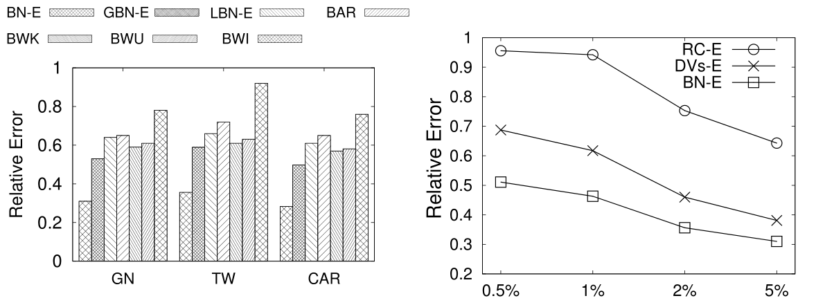
Experiments
(a) Different Burst Strategies
Notes:
To test the boosting strategy of using baysien network, we also test other boosting strategies like if we boost to the global area, if we simply scale with the region area, using the boosting jarccard, intersection size, or union size as scale factor, as we can see, the local boosting strategy has the best performance in precision, but it time consuming since we need to boost a proper area and learn the baysein network.

Slide 27
Experiments
(b) Vary Space Budget
Notes:
To test the boosting strategy of using baysien network, we also test other boosting strategies like if we boost to the global area, if we simply scale with the region area, using the boosting jarccard, intersection size, or union size as scale factor, as we can see, the local boosting strategy has the best performance in precision, but it time consuming since we need to boost a proper area and learn the baysein network.

Slide 28
Conclusion
Investigate the problem of selectivity estimation for spatial keyword search.
Propose ASP-tree and KMV based estimation.
Propose the local correlation based estimation.

Slide 29
Thanks!
Q&A
Notes:
Thanks. Any questions?

