Slide 1


Distance-Aware Influence Maximization in
Geo-social Network
Xiaoyang Wang¹, Ying Zhang¹, Wenjie Zhang², Xuemin Lin²
1. University of Technology Sydney, Australia
2 . University of New South Wales, Australia
Notes:
Hello everyone, welcome to my presentation today. My name is Xiaoyang Wang from the university of technology Sydney, Australia. The paper I will present today is titled distance-aware influence maximization in geo-social network. The paper is co-authored with Dr. Ying zhang, Dr, Wenjie Zhang, Professor Xuemin Lin.

Slide 2
Outline
Introduction
Preliminaries
Pruning Rules and Algorithm
Experiments
Conclusion
Notes:
Here is the outline of my presentation, First I will introduce the background and preliminaries about the problem. Then I will show the pruning rules and algorithm proposed in this paper. Finally I will show the experiments results and conclude.

Slide 3


Introduction
Social Networks
  Social network platforms
Notes:
With the popularity of social network platforms, many companies tend to use them to promote their products.

Slide 4

Introduction
Social Networks
  Social network platforms
  Word-of-mouth in social network
  Influence Maximization
xpad is good
xpad is good
xpad is good
xpad is good
Notes:
As a key problem in viral marketing, the influence maximization problem has been widely studied. It utilizes the word-of-mouth property to propagate the information from friends to friends. It aims to find a set of k nodes that can make the largest cascade of information, that is to let the most number of people know about the information.

Slide 5


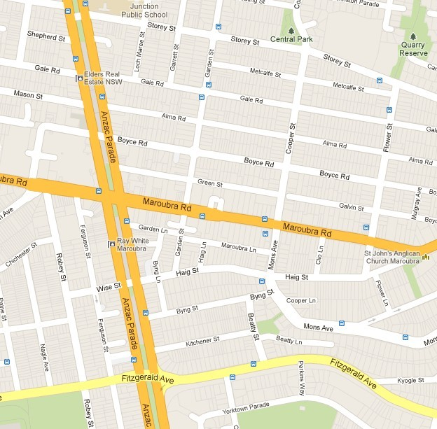

Introduction
  Geo-social Network (Foursquare, Twitter)
Notes:
As the advance of gps-enabled devices, more and more people are associated with location information. Thus, when we want to promote a local store, like a local restaurant in the figure, through the social network. It will be more effective to consider users’ location information.

Slide 6
Introduction
  Geo-social Network (Foursquare, Twitter)
  Location Aware Influence Maximization [1]
[1] G. Li, S. Chen, J. Feng, K. Tan, and W. Li. Efficient location-aware influence maximization. In SIGMOD 2014
Notes:
In the sigmod 2014 paper, the authors define the location aware influence maximization problem. Specially, it allows users to input a query region. Then it tries to find a set of k users that maximize the influence only to the users in the query region. The paper considers the location information for promotion, however it still has some limitation. When the query region is to large, it may return a results that influence many people in the outline, like the people in the circle, even if influenced, they may not come to the promoted location due to the distance reason.

Slide 7
Introduction
  Geo-social Network (Foursquare, Twitter)
  Location Aware Influence Maximization [1]
[1] G. Li, S. Chen, J. Feng, K. Tan, and W. Li. Efficient location-aware influence maximization. In SIGMOD 2014
Notes:
While if the query region is too small, only a limited number of people will be influenced. Thus both cases are not satisfied.

Slide 8
Introduction
  Geo-social Network (Foursquare, Twitter)
  Location Aware Influence Maximization [1]
10
2
0.5
10
1
10
[1] G. Li, S. Chen, J. Feng, K. Tan, and W. Li. Efficient location-aware influence maximization. In SIGMOD 2014
Notes:
So it is more natural if the user just needs to input the promoted location. Based on the location, we can assign a weight to each user in the social network, based on their distance to the promoted location. Then working on this weighted influence maximization model, it will more likely to influence the people close to the promoted location.

Slide 9
Problem Definition
Data
  Geo-social Network G = (V, E)
  Each node has a location; each edge has a probability.
  Diffusion Model (Independent Cascade Model)
xpad is good
xpad is good
0.4
xpad is good
0.5
0.3
xpad is good
0.6
0.2
Notes:
So the input of our problem is a geo-social network. Each node has a location and each edge has a weight indicating the probability that a friend influences another. The diffusion model used in this paper is independent cascade model. The diffusion process works as follows. Firstly, only the selected nodes are active, then it tries to active each inactive neighbour with the probability on the edge. The newly active nodes will have one chance to active their inactive neighbours according to the probabilities. The process stops when no more nodes can be activatied.

Slide 10
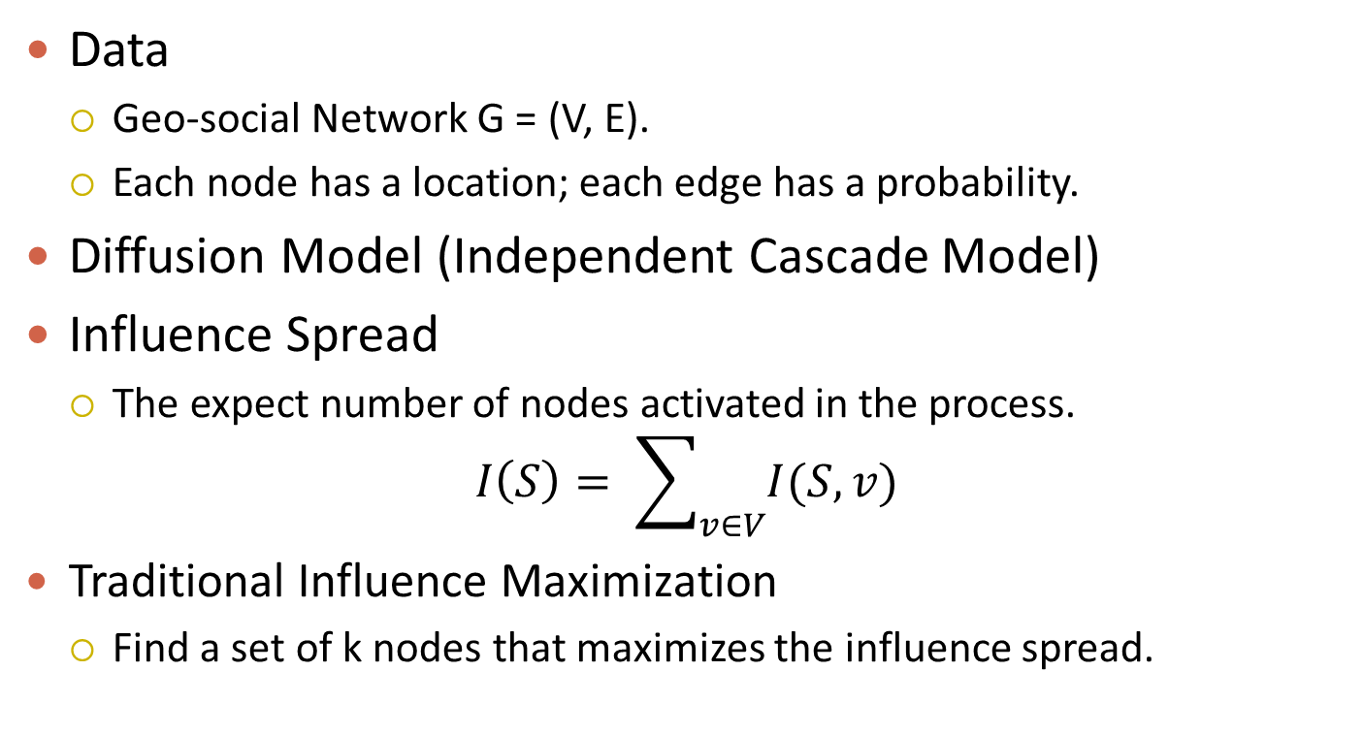
Problem Definition
Data
  Geo-social Network G = (V, E).
  Each node has a location; each edge has a probability.
  Diffusion Model (Independent Cascade Model)
  Influence Spread
  The expect number of nodes activated in the process.
  $$I\left(S\right)= \sum_{v∈V}{I(S,v)}$$
  Traditional Influence Maximization
  Find a set of k nodes that maximizes the influence spread.
Notes:
The influence spread is defined as the expect number of nodes activated in the process, which equals the sum of expected influence to each node. The traditional influence maximization problem is to find a set of k nodes which has the largest influence spread.

Slide 11
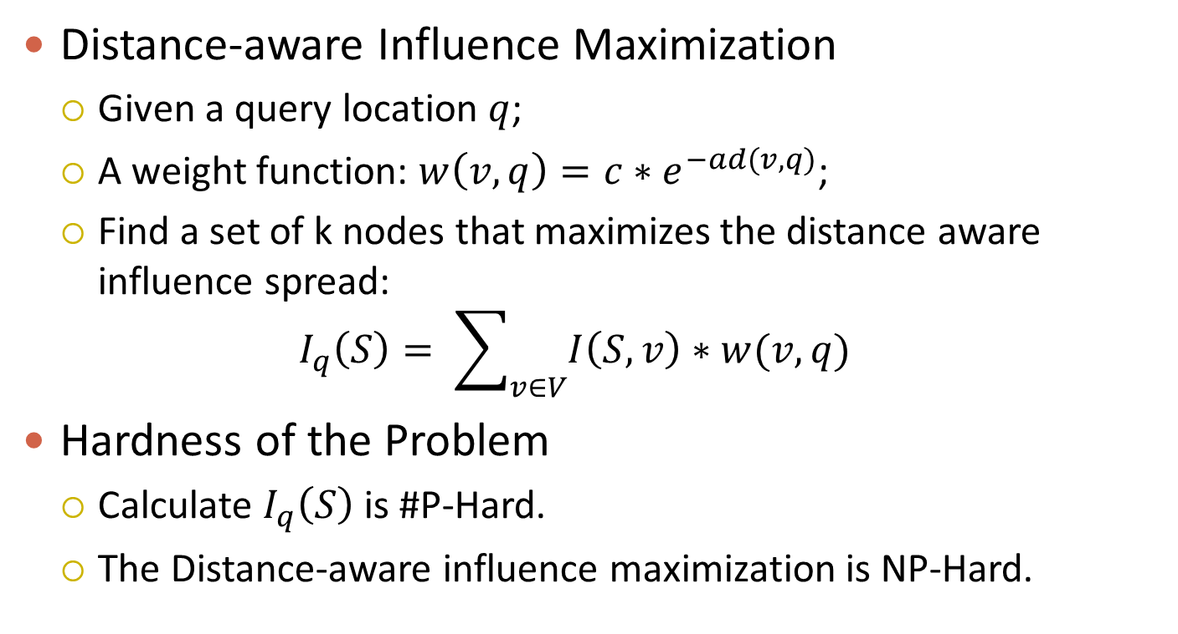
Problem Definition
  Distance-aware Influence Maximization
  Given a query location $q$;
  A weight function: ${w\left(v,q\right)=c∗e}^{−ad(v,q)}$;
  Find a set of k nodes that maximizes the distance aware influence spread:
  $$I_{q}\left(S\right)= \sum_{v∈V}{I\left(S,v\right)∗w(v,q)}$$
  Hardness of the Problem
  Calculate $I_{q}\left(S\right)$is #P-Hard.
  The Distance-aware influence maximization is NP-Hard.
Notes:
In our distance aware influence maximization problem, given a query location q, and a weight function which assigns each node a weight. The weight of a node is decided by the distance between the user and the query location. A user has a larger weight, if it is closer to the query location. Thus the distance aware influence maximization problem is to find a set of k nodes which maximize the weighted influence spread. By reduction from the traditional influence maximization problem, calculating the weighted influence spread is #P hard and the distance aware influence maximization problem is NP-hard.

Slide 12
Preliminary
MIA Model [2]
  A node can influence another node only through the maximal influence path.
2
3
1
0.5
0.8
1
4
0.5
0.5
0.5
6
5
[2] W. Chen, C. Wang, and Y. Wang. Scalable influence maximization for prevalent viral marketing in
large-scale social networks. In KDD 2010
Notes:
To facility the influence spread calculation, we use the MIA heuristic, which is proposed in the KDD 2010 paper to approximate the influence spread. Given a social network, a node can influence another node through many paths. For example, in the figure, node 1 can influence node 4 through two path. In MIA model, influence from one node to another only calculated based on the path with maximum probability. In the figure, the influence from node 1 to node 4 is calculated by the green path.

Slide 13
Preliminary
MIA Model [2]
  A node can influence another node only through the maximal influence path.
2
3
1
0.5
0.8
1
4
0.5
0.5
0.5
6
5
[2] W. Chen, C. Wang, and Y. Wang. Scalable influence maximization for prevalent viral marketing in
large-scale social networks. In KDD 2010

Slide 14

Preliminary
MIA Model [2]
  A node can influence another node only through the maximal influence path.
  The probability of the maximal influence path should be larger than a threshold t (e.g., 0.4)
2
3
2
3
1
1
0.5
0.8
0.5
0.8
1
4
1
MIOA($v1$)
4
0.5
0.5
0.5
0.5
6
5
6
[2] W. Chen, C. Wang, and Y. Wang. Scalable influence maximization for prevalent viral marketing in
large-scale social networks. In KDD 2010
Notes:
In addition, we only consider the maximal influence path with probability larger than a threshold t. like 0.4. For example, node 1 can influence node 5, but the probability of the path is 0.25 which is smaller than the threshold 0.4. Thus node 1 cannot influence node 5 in the MIA model. By assemble the nodes that node 1 can influence, we can get a tree structure denoted as MIOA(v1). We can easily calculate the influence of v1 through the tree strcuture.

Slide 15

Preliminary
MIA Model [2]
  A node can influence another node only through the maximal influence path.
  The probability of the maximal influence path should be larger than a threshold t (e.g., 0.4)
2
3
2
3
1
1
0.5
0.8
0.5
0.8
1
4
1
MIIA($v4$)
4
0.5
0.5
0.5
0.5
6
5
5
[2] W. Chen, C. Wang, and Y. Wang. Scalable influence maximization for prevalent viral marketing in
large-scale social networks. In KDD 2010
Notes:
Similarly, by assemble the nodes that can be influence node 4, we can get a tree structure MIIA to efficiently calculate the influence from other nodes to node 4. Hereafter, when we speak of influence spread, it means the influence spread calculated based on MIA model.

Slide 16
Greedy Algorithm
Hardness under MIA Model
  Under MIA model, the problem is still NP-Hard.
Notes:
However, even we use MIA model as an approximation, the problem is still NP hard.

Slide 17
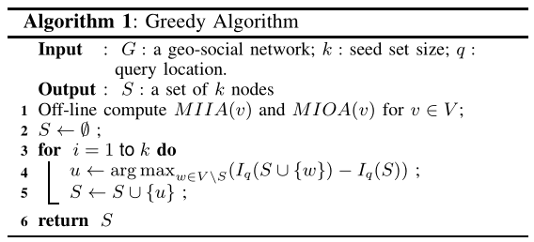
Greedy Algorithm
Hardness under MIA Model
  Under MIA model, the problem is still NP-Hard.
  Property
  Submodular and monotonic. Greedy algorithm with (1-1/e) approximation ratio.
Notes:
But the weighted influence spread function is submodular and monotonic. Thus a greedy algorithm can return a seed set with 1 – 1/e approximation ratio. That is, in each iteration, we select the node with largest marginal weighted influence spread, until we select k nodes, and return it as the result.

Slide 18
Greedy Algorithm
Hardness under MIA Model
  Under MIA model, the problem is still NP-Hard.
  Property
  Submodular and monotonic. Greedy algorithm with (1-1/e) approximation ratio.
  Problems in Baseline Greedy Algorithm
  We need to calculate the influence or marginal influence for all nodes in each round.
  To Speedup
  Avoid the calculation for less important nodes.
Notes:
The problem with the baseline greedy algorithm is that, we need to calculate the marginal influence spread for each node in each round. Since we only select k nodes, most of the other nodes are less important. To speedup the processing, it is critical to avoid the calculation for these nodes. Since there may be plenty of query issued, thus we can build some indexes for the online processing.

Slide 19
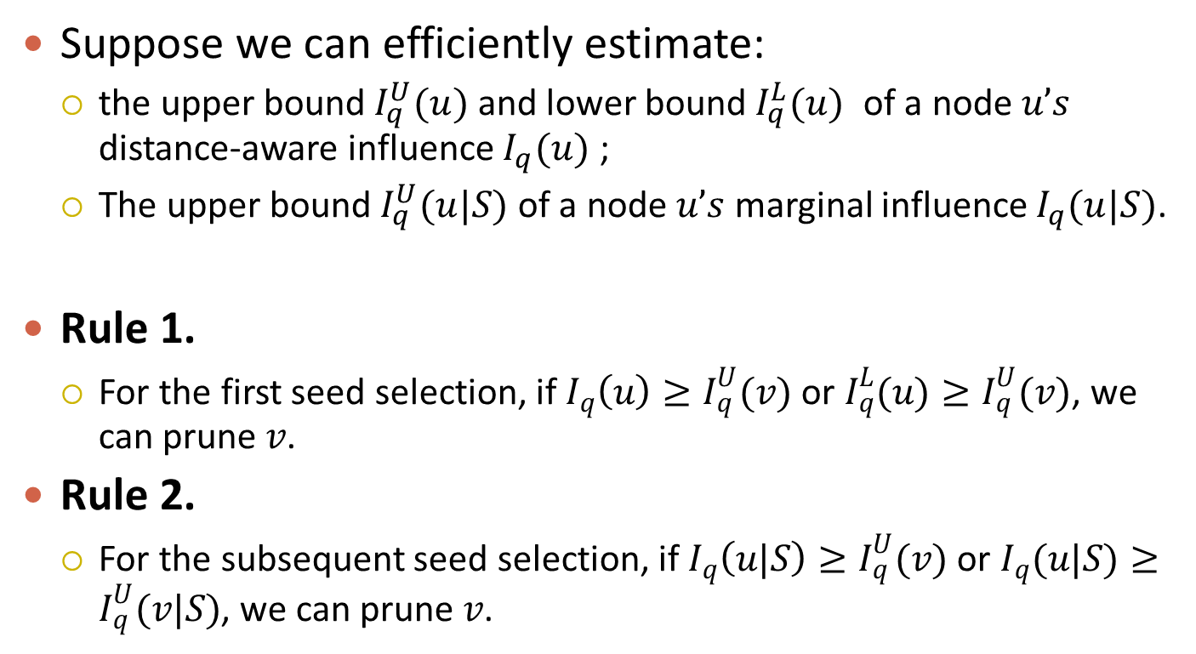
Pruning Rules
Suppose we can efficiently estimate:
  the upper bound $I_{q}^{U}(u)$ and lower bound $I_{q}^{L}(u)$ of a node $u’s$ distance-aware influence $I_{q}^{}(u)$ ;
  The upper bound $I_{q}^{U}(u|S)$ of a node $u’s$ marginal influence $I_{q}^{}(u|S)$.
Rule 1.
  For the first seed selection, if $I_{q}^{}\left(u\right)≥I_{q}^{U}(v)$ or $I_{q}^{L}(u)≥I_{q}^{U}(v)$, we can prune $v$.
Rule 2.
  For the subsequent seed selection, if $I_{q}^{}\left(u|S\right)≥I_{q}^{U}(v)$ or $I_{q}^{}(u|S)≥I_{q}^{U}(v|S)$, we can prune $v$.
Notes:
Before introducing the algorithm proposed, we first introduce some pruning rules that help to reduce the cost of calculation. Suppose we can …

Slide 20
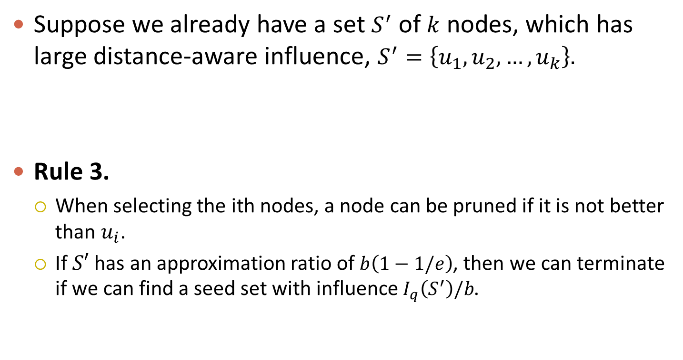
Pruning Rules
Suppose we already have a set $S^{′}$ of $k$ nodes, which has large distance-aware influence, $S^{′}=\left\{u_{1},u_{2},…, u_{k}\right\}.$
Rule 3.
  When selecting the ith nodes, a node can be pruned if it is not better than $u_{i}$.
  If $S′$ has an approximation ratio of $b\left(1−1/e\right)$, then we can terminate if we can find a seed set with influence $I_{q}\left(S^{′}\right)/b$.
Notes:
Suppose we already have a set S’ with k nodes in order with large influence. Then we can have the following rules. When selecting the ith node, it should be better ui, otherwise, we can just use ui as the seed. If $S′$ has an bounded approximation ratio, then we can terminate if we can find a seed set with influence as shown. Then the result will still have 1 -1/e approximation ratio, but we can early terminate.

Slide 21








Derive Pruning Rules
Rule 1. Upper bound and lower bound of influence.
  Anchor point --- $Lai$ = {$Iai\left(u\right) | u∈V$}.
    $$I_{q}^{U}\left(u\right)=Iai\left(u\right)∗exp(−ad(ai, q))$$
    $I_{q}^{L}\left(u\right)=Iai\left(u\right)∗exp(ad(ai, q))$
  For node with small influence, a loose bound is enough to prune it, e.g., node with 0.1 influence.
  For nodes with large influence, a loose bound will result a lot of candidates.
$$a1$$
$$a2$$
$$q$$
$$a3$$
$$a5$$
$$a4$$
$$a6$$
Notes:
Next we are talking about how to get the bounds. For rule 1, we can randomly sample some anchor points, for each anchor points, we calculate the influence for nodes assume the anchor points are the query locations. Given the query q, we select the nearest anchor point. Then we can get the upper bound and lower bound of the influence for each nodes based on the triangle inequality as shown in the equation. As shown the tightness of the bound only decided by the distance between the query and anchor point. And for all nodes the tightness is the same. For nodes with small influence, even a loose bound is enough to prune it. For example, a node with influence equals to 0.1, even the upper bound is 10 times larger, we can still easily prune it. However, for nodes with large influence, a loose bound will result a lot of candidate nodes and the pruning power is affected.

Slide 22


Derive Pruning Rules
Rule 1. Upper bound and lower bound of influence.
  Anchor point --- $Lai$ = {$Iai\left(u\right) | u∈V$}.
    $$I_{q}^{U}\left(u\right)=Iai\left(u\right)∗exp(−ad(ai, q))$$
    $I_{q}^{L}\left(u\right)=Iai\left(u\right)∗exp(ad(ai, q))$
  For node with large influence.
$$I_{q}^{U}\left(u\right)=\sum_{r∈R(u)}{I\left(u, r\right)∗c∗exp(−admin(q, r))}$$
$$I_{q}^{L}\left(u\right)=\sum_{r∈R(u)}{I\left(u, r\right)∗c∗exp(−admax(q, r))}$$
$$q$$
$$u$$
Notes:
So for nodes with large influence, we partition the nodes it can influence into grids, then we calculate the influence of the nodes to each grid. Given a query, then we can get tight bound as shown.

Slide 23

Derive Pruning Rules
Rule 1. Upper bound and lower bound of influence.
  Anchor point --- $Lai$ = {$Iai\left(u\right) | u∈V$}.
    $$I_{q}^{U}\left(u\right)=Iai\left(u\right)∗exp(−ad(ai, q))$$
    $I_{q}^{L}\left(u\right)=Iai\left(u\right)∗exp(ad(ai, q))$
  By extending the idea of anchor point, we can obtain the seed set $S′$ used in the Rule 3.
$$q$$
$$u$$
Notes:
By extending the idea of anchor point, we can obtain the seed set used in rule 3. That is we sample some pivot points and take them as the query points and calculate the seed set based on greedy algorithm. Then given the query, we can get a seed set with bounded ratio.

Slide 24

Derive Pruning Rules
Rule 2. Upper bound of marginal influence.
  For nodes with small influence.
    $$I_{q}^{U}\left(u|S, v\right)=Iq\left(u,v\right)∗\left(1 −I\left(S,v\right)\right)$$
    $$I_{q}^{U}\left(u|S\right)=\sum_{u∈MIOA(u)}{I_{q}^{U}\left(u|S, v\right)}$$
  For nodes can with large influence, the estimation cost will be large.
  We partition the MIOA of these nodes to get a coarse-grained estimation.
2
3
1
0.5
0.8
1
4
0.5
6
Notes:
To get the upper bound of marginal influence, we can estimate its marginal influence upper bound to each node it can influence and the sum them up. As show in the figure, for node 1, we can get the upper bound of its marginal influence by scan its tree structure once. However, for nodes with large influence, the cost is large and we may need to estimate its upper bound of marginal influence in each iteration. Thus, to reduce the cost, we can partition the nodes they can influence based on their distance to the root on the tree and take each partition as a unit then estimate the bound.

Slide 25







Best First Algorithm
Offline Compute the index needed for the pruning rules.
Online (k = 2).
  Estimate the $I_{q}^{U}\left(u\right)$ and $I_{q}^{L}\left(u\right)$ for $u∈V$.
  Calculate exact influence of $S′=\{v6, v7\}$.
$S$ = {}
$v1$ (10, 20)
$v6$ (15, 15)
$v2$(5, 15)
$v7$ (8, 8)
L = 15
$v3$ (5, 10)
….
Q
H
Notes:
To combine these pruning rules, we come up with the best first algorithm. That is we try to avoid the calculation based on the pruning rules. Here is an example. Offline we compute the index for pruning rules. Suppose k = 2. Online, we first estimate the upper bound and lower bound of influence for each node. And find the seed set S’ with v6 and v7. We initialize a heap H with nodes in S’. The key is the upper bound of influence or marginal influence. Since we have exactly calculate the influence for nodes in S’. The upper bound and lower bound are the same. We maintain a queue q for all the other nodes sorted based on their upper bound of influence. L records the largest lower bound in H.

Slide 26




Best First Algorithm
Offline Compute the index needed for the pruning rules.
Online (k = 2).
  Estimate the $I_{q}^{U}\left(u\right)$ and $I_{q}^{L}\left(u\right)$ for $u∈V$.
  Calculate exact influence of $S′=\{v6, v7\}$.
$S$= {}
$v2$ (5, 15)
$v1$ (10, 20)
$v3$ (5, 10)
$v6$ (15, 15)
L = 15
$v8$ (4, 5)
$v7$ (8, 8)
….
Q
H
Notes:
For the first node selection, we continue load nodes from Q to H until L larger than the top of q. It means the first node must be in H.

Slide 27

Best First Algorithm
Offline Compute the index needed for the pruning rules.
Online (k = 2).
  Estimate the $I_{q}^{U}\left(u\right)$ and $I_{q}^{L}\left(u\right)$ for $u∈V$.
  Calculate exact influence of $S′=\{v6, v7\}$.
$S$= {}
$v2$ (5, 15)
$v1$ (18, 18)
$v3$ (5, 10)
$v6$ (15, 15)
L = 18
$v8$ (4, 5)
$v7$ (8, 8)
….
Q
H
Notes:
Then we continue pop nodes from H. If we have not calculate its influence, we calculate the influence. If we have already calculated its influence, it is the first seed. Because its exact influence is larger than the influence upper bound of all the other nodes in H.

Slide 28



Best First Algorithm
Offline Compute the index needed for the pruning rules.
Online (k = 2).
  Estimate the $I_{q}^{U}\left(u\right)$ and $I_{q}^{L}\left(u\right)$ for $u∈V$.
  Calculate exact influence of $S′=\{v6, v7\}$.
$S$= {$v1$}
$v2$ (5, 15)
$v1$ (18, 18)
$v3$ (5, 10)
$v6$ (15, 15)
L = 15
$v8$ (4, 5)
$v7$ (7, 7)
….
Q
H
Notes:
For the second seed, we first calculate the exact marginal influence of v7. The we try load nodes from H if there upper bound larger than L. Otherwise, we continues pop nodes from H. If we have not estimate the upper bound of marginal influence, we estimate it and reinsert. If we have estimate the marginal influence, we calculate the exact marginal influence. Otherwise, it is the results for the second node.

Slide 29



Best First Algorithm
Offline Compute the index needed for the pruning rules.
Online (k = 2).
  Estimate the $I_{q}^{U}\left(u\right)$ and $I_{q}^{L}\left(u\right)$ for $u∈V$.
  Calculate exact influence of $S′=\{v6, v7\}$.
$S$= {$v1$}
$v2$ (5, 15)
$v6$ (~, 7)
$v3$ (5, 10)
$v7$ (7, 7)
L = 7
$v8$ (4, 5)
….
Q
H
Notes:
In the example, we estimate the marginal influence of v6 and L becomes 7.

Slide 30





Best First Algorithm
Offline Compute the index needed for the pruning rules.
Online (k = 2).
  Estimate the $I_{q}^{U}\left(u\right)$ and $I_{q}^{L}\left(u\right)$ for $u∈V$.
  Calculate exact influence of $S′=\{v6, v7\}$.
$S$= {$v1$}
$v8$ (4, 5)
$v2$ (5, 15)
$v9$ (3, 5)
$v3$ (5, 10)
L = 7
$v10$ (2, 4)
$v7$ (7, 7)
….
$v6$ (~, 7)
Q
H
Notes:
Then we load v2 and v3, because they have the potential to be the next seed.

Slide 31


Best First Algorithm
Offline Compute the index needed for the pruning rules.
Online (k = 2).
  Estimate the $I_{q}^{U}\left(u\right)$ and $I_{q}^{L}\left(u\right)$ for $u∈V$.
  Calculate exact influence of $S′=\{v6, v7\}$.
$S$= {$v1$}
$v8$ (4, 5)
$v2$ (~, 9)
$v9$ (3, 5)
$v3$ (5, 10)
L = 7
$v10$ (2, 4)
$v7$ (7, 7)
….
$v6$ (~, 7)
Q
H
Notes:
Then we continue pop node from H and verify.

Slide 32


Best First Algorithm
Offline Compute the index needed for the pruning rules.
Online (k = 2).
  Estimate the $I_{q}^{U}\left(u\right)$ and $I_{q}^{L}\left(u\right)$ for $u∈V$.
  Calculate exact influence of $S′=\{v6, v7\}$.
$S$= {$v1$}
$v8$ (4, 5)
$v3$ (~, 6)
$v9$ (3, 5)
$v2$ (~, 9)
L = 7
$v10$ (2, 4)
$v7$ (7, 7)
….
$v6$ (~, 7)
Q
H

Slide 33



Best First Algorithm
Offline Compute the index needed for the pruning rules.
Online (k = 2).
  Estimate the $I_{q}^{U}\left(u\right)$ and $I_{q}^{L}\left(u\right)$ for $u∈V$.
  Calculate exact influence of $S′=\{v6, v7\}$.
$S$= {$v1$}
$v8$ (4, 5)
$v2$ (8, 8)
$v9$ (3, 5)
$v7$ (7, 7)
L = 7
$v10$ (2, 4)
$v6$ (~, 7)
….
$v3$ (~, 6)
Q
H
Notes:
Until we pop v2 and its marginal influence is exactly calculated. We return it as the second seed.

Slide 34


Best First Algorithm
Offline Compute the index needed for the pruning rules.
Online (k = 2).
  Estimate the $I_{q}^{U}\left(u\right)$ and $I_{q}^{L}\left(u\right)$ for $u∈V$.
  Calculate exact influence of $S′=\{v6, v7\}$.
$S$ = {$v1$, $v2$}
$v8$ (4, 5)
$v2$ (8, 8)
$v9$ (3, 5)
$v7$ (7, 7)
L = 7
$v10$ (2, 4)
$v6$ (~, 7)
….
$v3$ (~, 6)
Q
H

Slide 35
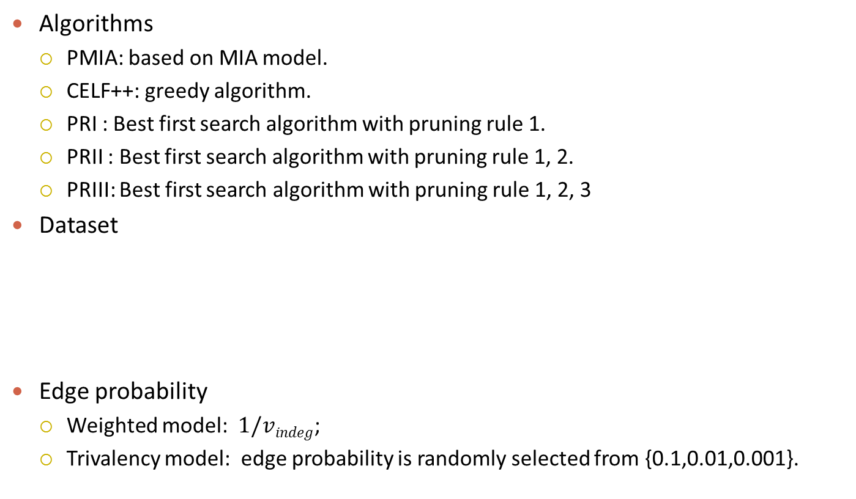
Experiments
Algorithms
  PMIA: based on MIA model.
  CELF++: greedy algorithm.
  PRI : Best first search algorithm with pruning rule 1.
  PRII : Best first search algorithm with pruning rule 1, 2.
  PRIII: Best first search algorithm with pruning rule 1, 2, 3
Dataset
  Edge probability
  Weighted model: $1/vindeg$;
  Trivalency model: edge probability is randomly selected from {0.1,0.01,0.001}.
Property | Brightkite | Gowalla | Twitter
# nodes | 58K | 197K | 554K
# edges | 428K | 1.9 million | 4.29 million
Notes:
In the experiments, we compare our algorithm with the first rule, the first two rules and with all rules with PMIA and CELF++ algorithm. We conduct the experiments on three real world geo-social networks. We use two models to generate the probability of edge. The first one is weighted model and trivalency model.

Slide 36
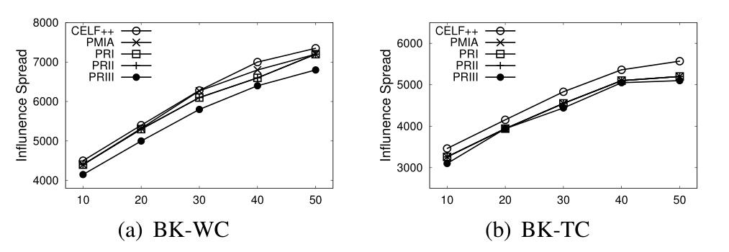
Experiments
Notes:
This two figures show the influence spread of different algorithms by varying k from 10 to 50. on the first dataset with two edge models. We can see the influence returned by the algorithms in this paper is slight smaller than the CELF++ algorithm, because we use the MIA model as an approimxation.

Slide 37
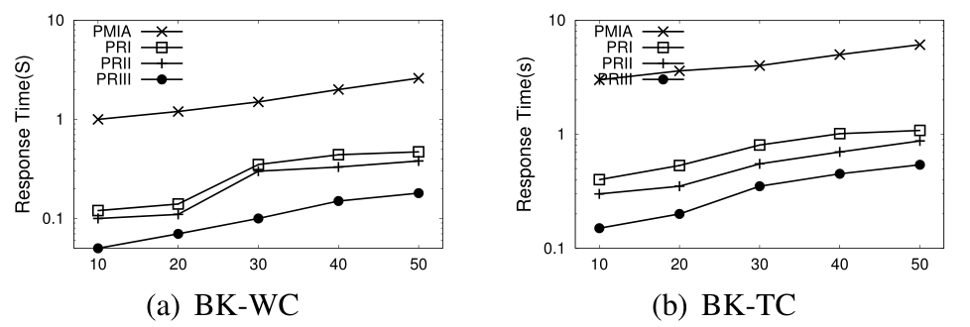
Experiments
Notes:
These two figures show the running time of proposed algorithms. As we can see, the pruning rules can truly speedup the processing.

Slide 38
Conclusion
Investigate the problem of distance aware influence maximization.
Propose three pruning rules to accelerate the nodes selection.
Propose the best first algorithm combined with the pruning rules.
Notes:
To sum up.

Slide 39
Thanks!
Q&A
Notes:
Thanks. Any questions?

