Slide 1

AP-Tree: Efficiently Support Continuous
Spatial-Keyword Queries Over Stream
Never Stand Still
Faculty of Engineering
Computer Science and Engineering
Xiang Wang^{1*}, Ying Zhang², Wenjie Zhang¹, Xuemin Lin¹, Wei Wang¹
¹The University of New South Wales, Australia
²University of Technology, Sydney, Australia
*Presenter
Notes:
Hello, everyone, the paper I am going to share with you is “XXX…”
I am Xiang Wang from UNSW/
It is a joint work with XXX….

Slide 2


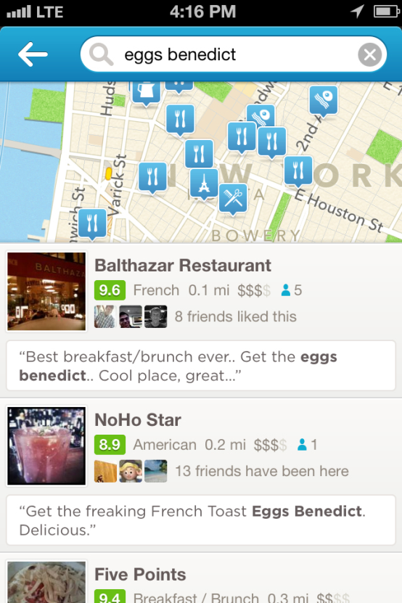

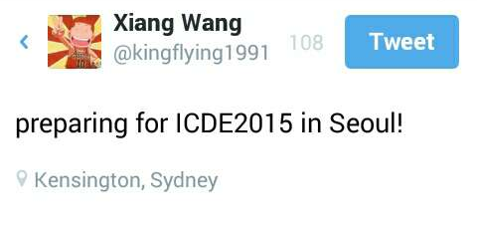
Introduction
More and more spatial-textual objects are generated in a streaming fashion
  Rapid development of Web 2.0 and GPS-enabled mobile devices
  Ensuing proliferation of social applications, e.g., Twitter, Facebook, Foursquare
  Various applications: information dissemination, location-based advertising (e.g., Groupon)
text
location

Slide 3
Introduction
User-initiated model
& Snapshot query
Spatial-keyword Query Against Static Objects
  Given a set of geo-textual objects, a spatial-keyword query aims to retrieve all the objects which satisfy its spatial and textual constraints.
Continuous Spatial-keyword Queries Against Streaming Objects
  Users register their interest as continuous spatial-keyword queries on the server.
  For each incoming geo-textual object issued by a stream publisher, deliver/push it to all the users who are interested in it immediately.
  Publish/Subscribe Framework!
Server-initiated model & Continuous query
Notes:
comment: top-k query, collective query

Slide 4








Example
nexus, surface, discount, brand-new
iPad, discount
A location-based e-coupon system
  Users interested in nearby sales register their interest in the system.
  E-coupons from nearby shopping malls are delivered to relevant users.
A
surface, iPad, brand-new, discount
Spatial constraint
Textual constraint
nexus
B
C
surface, brand-new
Notes:
1. give some examples, Groupon, google alert.
http://www.groupon.com/

Slide 5
State-of-the-arts
Spatial index
Keyword index
R^{t}-Tree (Li et al. THU, KDD 2013)
IQ-Tree (Chen et al. NTU, SIGMOD 2013)
Notes:
1. Group name acknowledgement
2. emphasize time 2013

Slide 6
R^{t}-Tree
An R-Tree is built to partition the queries based on their search ranges first.
Then in each R-Tree node, the keywords from its descendants are recorded as textual filter.
w₁,w₂,w₃,w₄,w₅,w₆
w₁,w₂,w₃,w₄,w₅,w₆
R₁
R₂
w₁,w₂,w₃,w₄,w₅,w₆
w₁,w₅,w₆
w₁,w₂,w₃,w₄
R₃
R₄
R₅
R₆
w₁,w₂,w₃,w₄
q₁
q₈
q₆
q₃
q₅
q₂
q₇
q₄
q₉
Notes:
1. R-Tree space efficient, however with poor filtering capability because of overlapping.

Slide 7
IQ-Tree
Queries are first partitioned by Quad-tree, where each query is indexed into one or multiple cells based on a cost model.
Then in each cell, a ranked inverted list is built to further partition queries, where each query is indexed into the posting list corresponding to its least frequent keyword.
w₂: q₁, q₂
w₅: q₄
q₂
q₁,q₄
q₁,q₂,q₄
q₁,q₂,q₄
4
12
0
1
2
3
8
9
10
11
q₆
q₈
q₄
q₇
q₇
Notes:
1. ranked inverted list
2. have duplicate
3. These two indexes are efficient. However, we notice that we can further improve performances based on some novel observations.

Slide 8
Observation 1
The selection of spatial partition or textual partition should depend on the spatial and keyword distributions of current query workload.
Our solution:
Employ spatial partition and keyword partition adaptively based on query distributions!
Prefer spatial partition
Prefer keyword partition

Slide 9
Observation 2
From the perspective of textual constraint, the nature of this problem is a superset containment search
  Given a set of objects and a query, each consisting of a set of keywords, find all the objects which are fully contained by the query.
  In our case, the roles of object and query are reversed.
Ordered Keyword Trie
Our solution:
Integrate a variant of ordered keyword trie into our framework for textual filtering!
Notes:
1. Traditional keyword search is essentially subset containment search

Slide 10
AP-Tree Framework
AP-Tree (i.e., Adaptive Partition Tree) is a f-ary tree structure which partitions the queries in a top-down manner.
Cost model based partition strategy
  Keyword partition: lead to a k-node
  Spatial partition: lead to a s-node
  Partition the queries into f buckets
A q-node is built to store remaining queries when termination condition reaches.
k-node
k-node
s-node
k-node
k-node
k-node
s-node
q-node
q-node
q-node
q-node
q-node
q-node
Notes:
During partition, two partition methods are employed adaptively based on current spatial and keyword distributions of queries guided by a cost model.
Cost model can decide which partition method to select at each node.

Slide 11
Keyword Partition (k-node)
f=3
[w₂,w₃,w₅]
[w₄,w₅]
[w₁,w₂,w₃,w₄,w₅]
q₁,q₂,q₃,q₄,q₅,q₆,q₇,q₈,q₉
[w₁]
[w₂,w₃]
[w₄,w₅]
q₁,q₂,q₄,q₅
q₃,q₆,q₇
q_{8,}q₉
[w₂]
[w₃]
[w₅]
[w₄]
[w₅]
q₁,q₂
q₅
q₄
q₃,q₇
q₆
Consider the keyword combinations!
Notes:
1.Much efficient than inverted list because it can explore the potential of keyword combinations.
2.We partition the keywords at each level into particular number of buckets/cuts, instead of maintaining each individual keyword. For TWEETS dataset, there are nearly 1.5 million distinct keywords.

Slide 12
Spatial Partition (s-node)
f=4
q₁,q₂,q₃,q₄,q₅,q₆,q₇,q₈,q₉
q₁,q₃,q₄,q₅
q₁,q₂,q₄,q₉
q₄
dummy node
q₁
q₁,q₄
q₃
q₄,q₅
q₁,q₂
q₂
q₉
Notes:
We do not use R-tree because there are overlaps between R-tree node.
We do not use Quad-tree because it can only partition each node into 4 cells, which does not satisfy our requirements.

Slide 13
Example of AP-Tree
q₁,q₂,q₃,q₄,q₅,q₆,q₇,q₈,q₉
[w₁]
[w₂,w₃]
[w₄,w₅]
q₁,q₂,q₄,q₅
q₃,q₆,q₇
q_{8,}q₉
[w₂]
[w₃]
[w₅]
q₁,q₂
q₅
q₄
q₆
q₇
q₃
q₈
q₉
Notes:
Now we present the overall structure using keyword partition and spatial partition at the same time.
1. Follow the filtering-and-verification framework to execute object matching.
2. next, the question is how to select proper partition method at each node

Slide 14

Object Matching At A Glance
[w₁]
[w₂,w₃]
[w₄,w₅]
w₂,w₃,w₄
[w₂]
[w₃]
[w₅]
q₁,q₂
q₅
q₄
Candidate: {q₇}
q₆
q₇
q₃
q₈
q₉
verify
Answer: {q₇}
Notes:
1. Follow the filtering-and-verification framework to execute object matching.
2. next, the question is how to select proper partition method at each node
3. If we come with k-node, we check the keyword constraint; if we come with s-node, we check the spatial constraint.

Slide 15
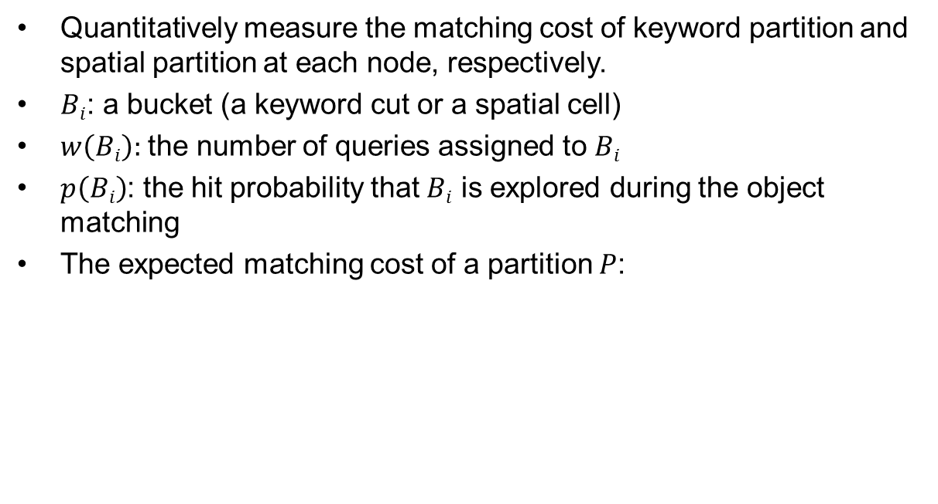
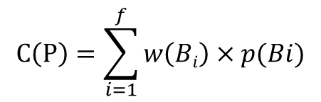
Cost Model
Quantitatively measure the matching cost of keyword partition and spatial partition at each node, respectively.
$Bi$: a bucket (a keyword cut or a spatial cell)
$w\left(Bi\right):$ the number of queries assigned to $Bi$
$p\left(Bi\right)$: the hit probability that $Bi$ is explored during the object matching
The expected matching cost of a partition $P$:
$$C\left(P\right)=\sum_{i=1}^{f}{w\left(Bi\right)×p(Bi)}$$
Notes:
1. After the previous introductions, the remaining question is how to decide which partition method to select at each node.
2. Next, we will present algorithms to minimize the matching cost of keyword partition and spatial partition respectively.
3. The function of cost model: 1. minimize the cost of keyword partition and spatial partition; 2. choose smaller one..

Slide 16
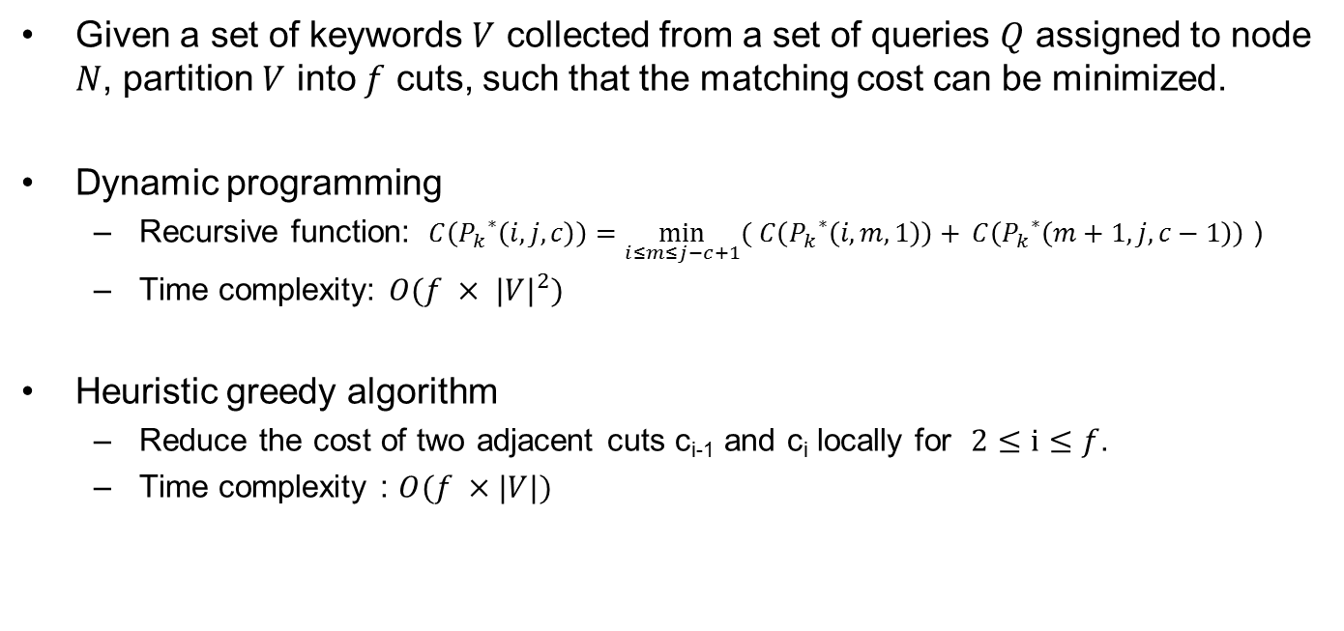
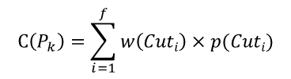

Keyword Partition Algorithm
Given a set of keywords $V$ collected from a set of queries $Q$ assigned to node $N$, partition $V$ into $f$ cuts, such that the matching cost can be minimized.
Dynamic programming
  Recursive function: $C\left({P_{k}}^{∗}\left(i,j,c\right)\right)=\min_{i≤m≤j−c+1}{( C\left({P_{k}}^{∗}\left(i,m,1\right)\right)+ }C\left({P_{k}}^{∗}\left(m+1,j,c−1\right)\right)$ )
  Time complexity: $O(f × {|V|}^{2})$
Heuristic greedy algorithm
  Reduce the cost of two adjacent cuts c_{i-1} and c_{i} locally for $2≤i≤f$.
  Time complexity : $O(f ×|V|)$
$$C\left(P_{k}\right)=\sum_{i=1}^{f}{w\left(Cuti\right)×p(Cuti)}$$
$w_{1}$ $w_{2}$ $w_{3}$ $w_{4}$ $w_{5}$ $w_{6}$ $w_{7}$ $w_{8}$ $w_{9}$ $w_{10}$ $w_{11}$ $w_{12}$
$$f=3$$
Local min
Local min
Notes:
Dynamic programming can achieve optimal solution
Greedy algorithm is efficient, while is not optimal..
Optimize the animation…!!!

Slide 17
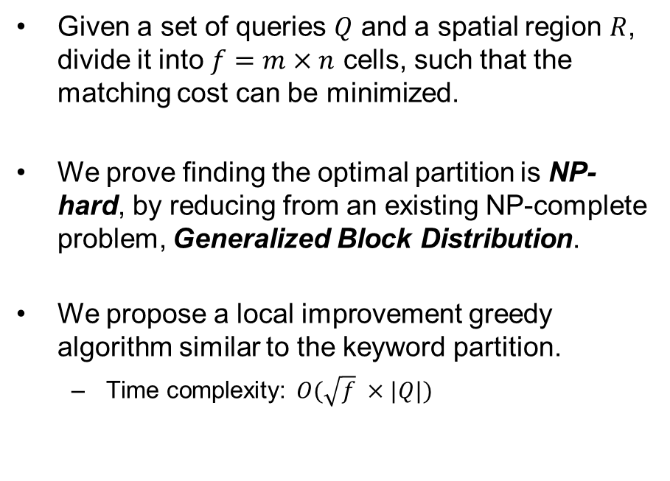
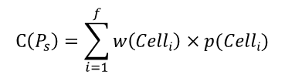

Spatial Partition Algorithm
Given a set of queries $Q$ and a spatial region $R$, divide it into $f=m×n$ cells, such that the matching cost can be minimized.
We prove finding the optimal partition is NP-hard, by reducing from an existing NP-complete problem, Generalized Block Distribution.
We propose a local improvement greedy algorithm similar to the keyword partition.
  Time complexity: $O(\sqrt{f} ×|Q|)$
$$C\left(P_{s}\right)=\sum_{i=1}^{f}{w\left(Celli\right)×p(Celli)}$$
$$f=3 ×3$$

Slide 18
Index Construction and Maintenance
Recursively partition the queries using keyword partition and spatial partition adaptively according to the cost model.
  If the cost of keyword partition is smaller, build k-node;
  Otherwise, build s-node.
  When the termination condition reaches, stop partition and assign all the remaining queries to a q-node.
Maintenance
  Employ KL-Divergence to monitor the difference between the new distribution and old distribution for each s-node and k-node, as new queries are inserted or old query are expired.
  When the KL-Divergence exceeds a threshold, re-construct sub-tree of s-node or k-node.

Slide 19
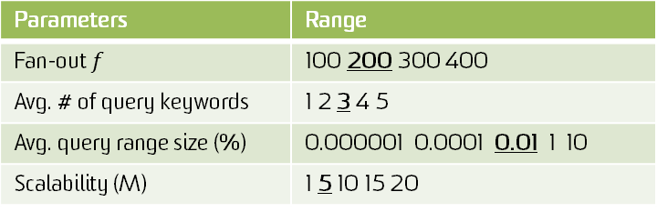
Experiments
Baselines
  R^{t}-Tree: KDD13. Spatial-first
  IQ-Tree: SIGMOD13. Spatial-first
  RQ-Tree: Keyword-first
Datasets
Parameters
Parameters | Range
Fan-out $f$ | 100 200 300 400
Avg. # of query keywords | 1 2 3 4 5
Avg. query range size (%) | 0.000001 0.0001 0.01 1 10
Scalability (M) | 1 5 10 15 20
Datasets | TWEETS | GN | CARS | AIS
# objects | 12.7 M | 2.2 M | 2.2 M | 5.7 M
Vocabulary size | 1.7 M | 208 K | 81 K | 81 K
Avg. # of object keywords | 9 | 7 | 30 | 50
Notes:
RQ-Tree is a variant of IQ-Tree

Slide 20
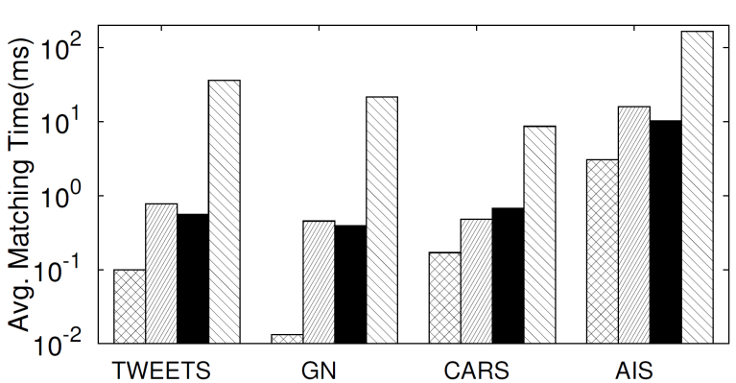
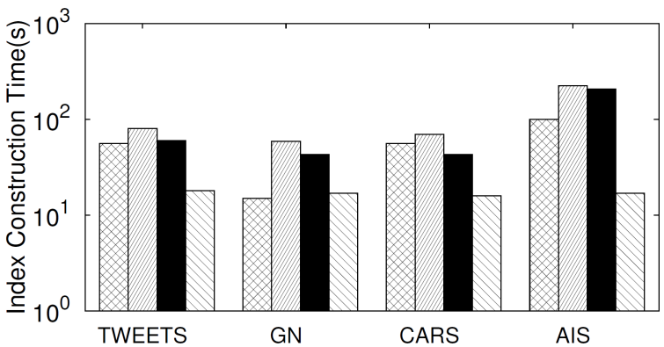
Experiments
Effect on different datasets

Slide 21
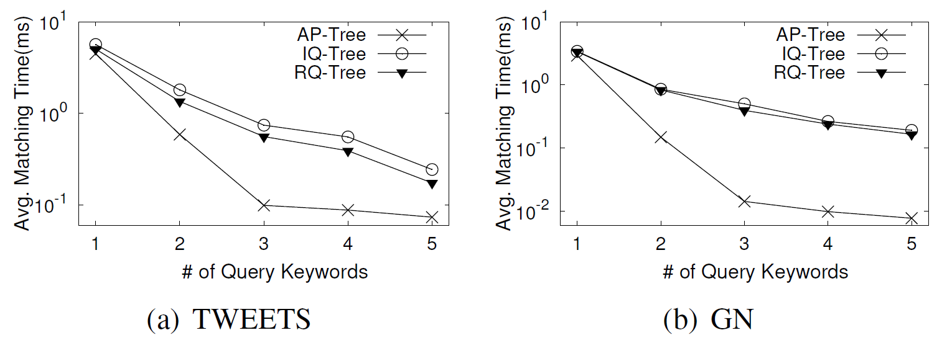
Experiments
Effect of number of query keywords
Notes:
Why follow such trend?

Slide 22
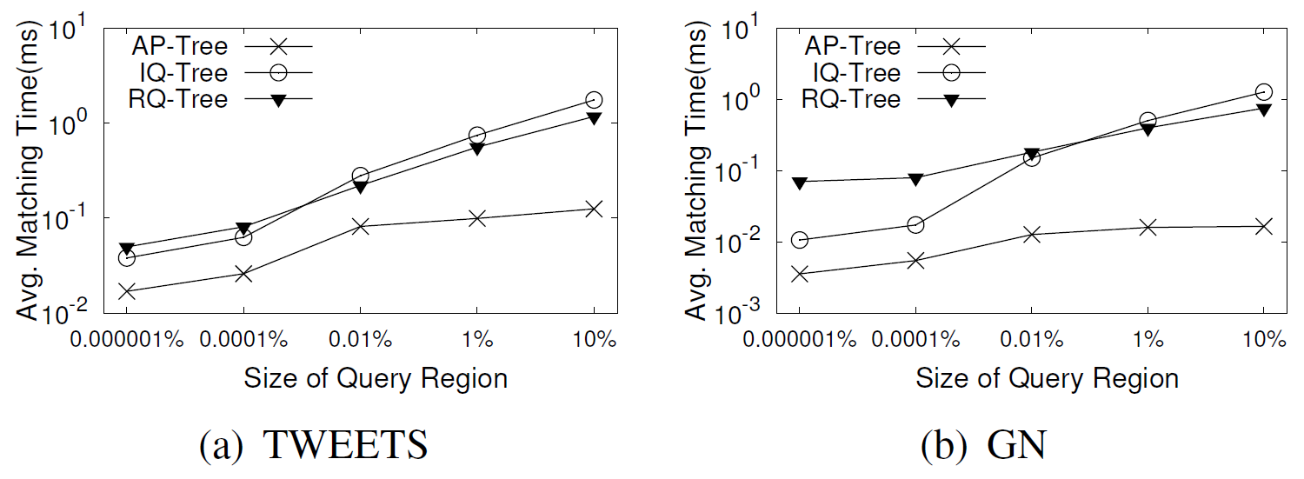
Experiments
Effect of size of query region

Slide 23
Conclusion
Propose a novel Adaptive spatial-keyword Partition indexing structure, namely AP-Tree, to efficiently organize a massive number of queries.
The construction of AP-Tree is adaptive to the spatial and keyword distributions under the guide of a cost model.
Achieve a high throughput performance improvement compared to the prior techniques.

Slide 24
Thanks!
Q&A
Notes:
add some details for possible questions?

