Slide 1
Top-k Similarity Join over Multi-valued Objects
Wenjie Zhang
Jing Xu, Xin Liang, Ying Zhang, Xuemin Lin
The University of New South Wales, Australia
Notes:
Not self name

Slide 2
Top-k Similarity Join
From two sets of objects R and S, retrieve k object pairs from R X S which are the most similar
r₄
r₁
s₁
s₃
r₂
r₃
s₂
top-2 similarity join: (r_{1,} s₃), (r_{2,} s₁)
Notes:
Given a query object q and a data set, KNN retrieves k objects from the dataset, which are the nearest to q according to some distance metrics.
In this example, the 2NN to q are objects o2 and o4, if Euclidean distance is used.

Slide 3
Top-k Similarity Join
What if objects have multiple values ?
Player A
Player B
Notes:
Let look at the most simple case: 1 d
Gymnastic no animation here: scores. q: perfect score. Select from two players based on their past performance.
Currently: handle using uncertain; list probabilistic model: show animation --- ties
Probabilistic model : 1) semantics: mutual exclusive. Co-exist in this example 2) not powerful enough to catch relative distribution difference. Moreover, KNN for what sort of purpose ---- gymnastics, select a player with a good upside, will check the best side. Upside: certain percentage, use quantile to capture it.

Slide 4
Existing Models for Multi-instances
Probabilistic Top-k Join
Probability is computed by summing up probabilities of all valid possible worlds
Join over Uncertain Data: [Cheng et al. CIKM 06]
[Kriegel et al. DASFAA 06]
Join over Uncertain Data Streams: [Lian, Chen. TKDE 11]
Notes:
Aggregate: mean, not capture relative distribution well.
Different semantics of MV and UN: mutual exclusive, another all instances occurs symtanuously

Slide 5
Probabilistic Top-k Similarity Join
q
Top-1 similarity pair from {q} X { , }
(q, ) and (q, ) have the same probability to be top-1 similarity join result
Notes:
Let look at a motivating example on the existing probabilistic KNN model.
It is easy to verify that ….

Slide 6
Probabilistic Top-k Similarity Join
q
(q, ) and (q, ) have the same probability to be top-1 similarity join result
Notes:
After we exchange the position of some of the instances ….

Slide 7
Probabilistic Top-k Similarity Join
ties
Not very sensitive to relative distribution of objects instances
Different semantics than multi-value objects !
Notes:
It is easy to notice that P KNN model tend to create ties for different instance distributions since it is …
Motivated by this, we propose to use … as quantile is a widely used tool to capture probability distributions

Slide 8
Uncertain Objects VS Multi-valued Objects
Uncertain Objects: the instances are exclusive, at most one instance can be true
Multi-valued Objects: instances exist simultaneously, all are true at the same time

Slide 9
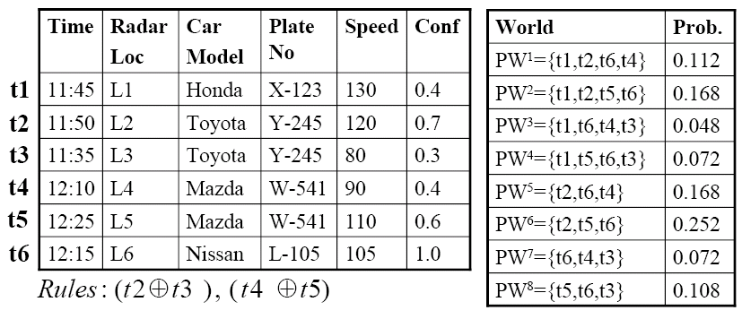
Uncertain Objects VS Multi-valued Objects
Uncertain Objects:

Slide 10
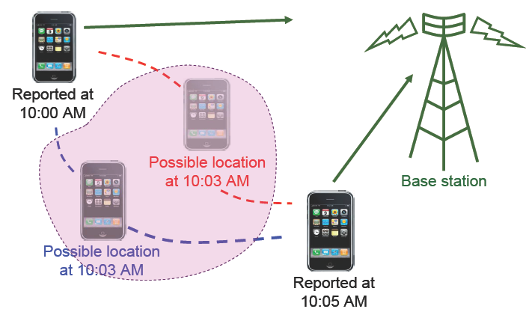
Uncertain Objects VS Multi-valued Objects
Uncertain Objects

Slide 11
Uncertain Objects VS Multi-valued Objects
Multi-valued Objects
Ranking a school in a university: with many staff members
Comparing weather of two cities: statistics from 365 days
… …

Slide 12
Aggregate Distances
Existing: mean, minimal, maximal, etc
Generalization: quantile distance
Notes:
Aggregate is the right way to reflect the semantics of multi value
Mean, min, max: can serve for different purposes. Back to the previous example, someone may want to choose the players based on their best performance. Someone may want to choose the players based on mean. Someone may want to choose player with the best worst players.
Generalize to quantile distance to provide more flexibility

Slide 13
Contributions
Formally define top-k similarity join over Multi-valued objects
Seeding-Pruning-Refinement Framework
Novel and efficient pruning techniques
Notes:
Two definitions of quantile distances

Slide 14
Preliminaries
Φ-quantile:
The first element in a sorted list with the cumulative weight not smaller than Φ, where Φ is a number in (0, 1].
Sorted elements: 3 6 7 8 8 10 13 15
Weights: .10 .15 .20 .15 .10 .05 .10. .15
Cumulative weight: 0.45
0.5-quantile
0.8-quantile
Notes:
Quantile is a very classical concept. It is defined as follows

Slide 15
Preliminaries
Multi-valued Object:
A set of weighted instances in d-dimensional space
The sum of the weights equals to 1
Notes:
A Multi-valued object studied in this paper consists of … the …

Slide 16
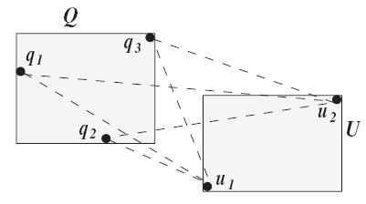
Preliminaries: Quantile Distances
Φ-quantile distance
¼
½
½
¼
½
Instance pairs: (q₂, u₁) (q₃, u₁) (q₃, u₂) (q₁, u₁) (q₂, u₂) (q₁, u₂)
Weights: 1/8 1/8 1/8 1/4 1/8 1/4
0.25-quantile
0.5-quantile
Notes:
We proposed two quantile distances in this paper. The first is quantile distance.
We sort all the possible instances increasingly. The prob of each distance is the product of probabilities of the two instances involved.
For instance, the 0.25 quantile distance is the distance between q3 and u1. the 0.5 quantile distance is the distance between q1 and u1.

Slide 17
Preliminaries: Quantile Distances
Multi-value objects U and V
Overall m=|U| * |V| instance pairs
O(m) algorithm with pruning [Zhang et al, ICDE 2010]
Notes:
Actually there is a classical algorithm to compute quantile in o(m) time. We develop new pruning rules to combine with the classical algorithm.
Bounding techniques: lower bound upper bound of quantile distance to prune

Slide 18
Preliminaries: Top-k Similarity Join
Non-index [Cheema et al, ICDE 2011]
R-tree based
Exhaustive algorithm [Corral et al, SIGMOD 2000]
Recursive algorithm [Corral et al, SIGMOD 2000]
Heap algorithm [Corral et al, SIGMOD 2000]
Priority query algorithm [Hjaltason et al, SIGMOD 1998]

Slide 19
Problem Definition

Slide 20
Framework
Seeding
Select k objects and compute quantile distance --- k seeds are selected based on mean
λ_{k}: the largest distance of the K seeded object pairs
Refinement:
Determine the final solution
Challenge: efficient pruning techniques

Slide 21
Φ-quantile Top-k Join
Global sR-tree: indexes the MBB of the two multi-value objects set, respectively.
$μ\left(U\right):the mean of U$
$σ^{2}\left(U\right):the variance of U$
Local aR-tree: indexes the instances of multi-value objects (object set)

Slide 22
Φ-quantile Top-k Join
global sR-tree of
global sR-tree of
local aR-trees for each object

Slide 23
Φ-quantile Top-k Join
Based on Heap Algorithm
Start from root pairs of two global sR-trees
Apply pruning techniques to each entry pairs

Slide 24
Φ-quantile Top-k Join
Distance based pruning rule on Global R-tree
E_{U}
from global sR-tree
≥λ_{k}
E_{V}
(E_{U}, E_{V}) could be pruned

Slide 25
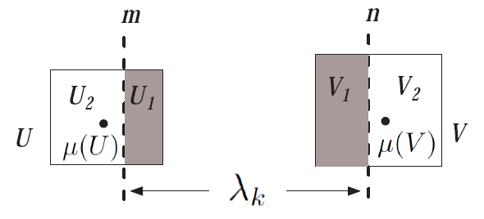
Φ-quantile Top-k Join
Statistic based pruning rule on Global sR-tree

Slide 26
Φ-quantile Top-k Join
Statistic based pruning rule on Global sR-tree

Slide 27
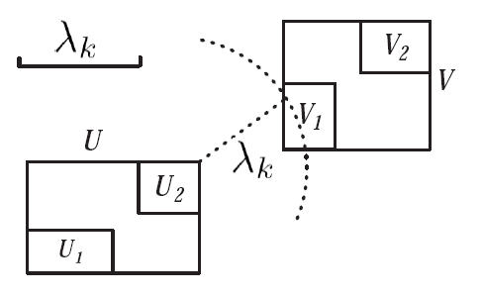
Φ-quantile Top-k Join
Weight based pruning rule on local aR-tree

Slide 28
Φ-quantile Top-k Join
Pruning on the Local R-tree of U and V
Trim the local R-tree of both U and V by λ_{k} level by level. Discard entries in V with minimal distance to U larger than λ_{k}, similarly for U.
Denote the total weight of remaining entries as P_{U} and P_{V}, respectively, if P_{U} * P_{V} ≤ Φ, then (U, V)can be pruned.

Slide 29
Φ-quantile KNN
Overall processing: for each pair of entries
1. Pruning on Global sR-tree based on distance
2. Pruning on Global sR-tree based on statistics
3. Pruning on Local R-tree based on weight
If not pruned, insert to heap, till the heap is empty
Notes:
Apply the cheapest pruning rule first

Slide 30
Experiment
Real Dataset
NBA player statistics
339, 721 records of 1,313 players
3 dimension
Synthetic Dataset
Size: 5k to 15k (5k)
Instances: 100 to 800 (200)
Dimension: 2 to 5 (3)
K: 5 to 25 (10)

Slide 31
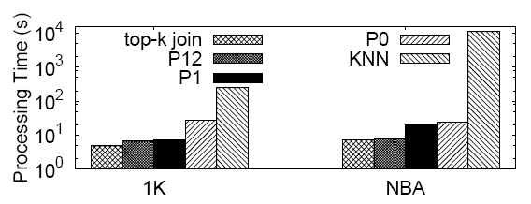
Overall Performance
KNN refers to naively apply KNN processing over multi-valued objects techniques in [Zhang et al, ICDE 2010]
Notes:
Not EDBT: main memory based. Unfair to compare with EDBT 06 work because that is a disk-based algorithm.

Slide 32
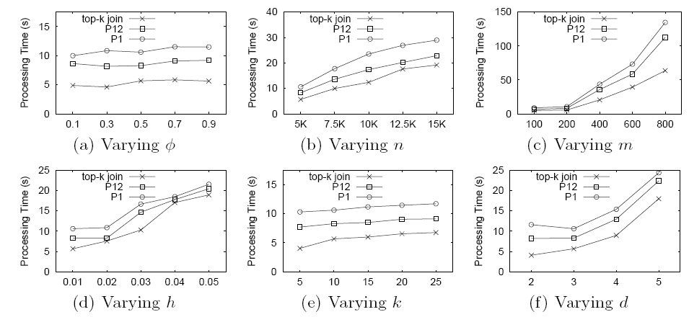
Different Settings

Slide 33
I/O Costs

Slide 34
Conclusions
Top-k Similarity Join over multi-valued objects
Novel and efficient pruning techniques
Notes:
Novel pruning

Slide 35
Future Work
Fundamental spatial queries over multi-valued objects
KNN [Zhang et al, ICDE 2010]
Top-k Similarity Join [This paper]
Skyline
Range query, range aggregate query

Slide 36
Thanks

