Slide 1
Quantile-Based KNN over Multi-Valued Objects
Wenjie Zhang
Xuemin Lin, Muhammad Aamir Cheema, Ying Zhang, Wei Wang
The University of New South Wales, Australia
Notes:
Not self name

Slide 2
KNN Query
Find k objects closest to query q
o₄
o₁
q
o₂
o₃
2-NN of q: o₂ and o₄
Notes:
Given a query object q and a data set, KNN retrieves k objects from the dataset, which are the nearest to q according to some distance metrics.
In this example, the 2NN to q are objects o2 and o4, if Euclidean distance is used.

Slide 3
KNN Query
Find k objects closest to query q
What if objects have multiple values ?
Player A
Player B
q
Notes:
Let look at the most simple case: 1 d
Gymnastic no animation here: scores. q: perfect score. Select from two players based on their past performance.
Currently: handle using uncertain; list probabilistic model: show animation --- ties
Probabilistic model : 1) semantics: mutual exclusive. Co-exist in this example 2) not powerful enough to catch relative distribution difference. Moreover, KNN for what sort of purpose ---- gymnastics, select a player with a good upside, will check the best side. Upside: certain percentage, use quantile to capture it.

Slide 4
Existing Models for Multi-instances
Probabilistic KNN Models
Probability is computed by summing up probabilities of all valid possible worlds
Probable top-k NN: [Bekales, Soliman, Ilyas. VLDB 08]
Probabilistic verifiers: [Cheng, Chen, Mokebel, Chow. ICDE 08]
Notes:
Aggregate: mean, not capture relative distribution well.
Different semantics of MV and UN: mutual exclusive, another all instances occurs symtanuously

Slide 5
Probabilistic KNN Model
q
and have the same probability to be NN of q
Notes:
Let look at a motivating example on the existing probabilistic KNN model.
It is easy to verify that ….

Slide 6
Probabilistic KNN Model
q
and have the same probability to be NN of q
Notes:
After we exchange the position of some of the instances ….

Slide 7
Probabilistic KNN Model
q
and have the same probability to be NN of q
Notes:
We keep exchanging the positions of the instances, … also …

Slide 8
Probabilistic KNN Model
ties
Not very sensitive to relative distribution of objects instances
Different semantics than multi-value objects !
Notes:
It is easy to notice that P KNN model tend to create ties for different instance distributions since it is …
Motivated by this, we propose to use … as quantile is a widely used tool to capture probability distributions

Slide 9
Aggregate Distances
Existing: mean, minimal, maximal, etc
Generalization: quantile distance
Notes:
Aggregate is the right way to reflect the semantics of multi value
Mean, min, max: can serve for different purposes. Back to the previous example, someone may want to choose the players based on their best performance. Someone may want to choose the players based on mean. Someone may want to choose player with the best worst players.
Generalize to quantile distance to provide more flexibility

Slide 10
Applications
GIS
Location based service
Radio Frequency Identify Device
…
Notes:
Multi-valued objects have a wide range of applications including GIS, LBS and RFID
Multi-valued objects naturally exist; evaluate KNN based on group, may regard each group as a multivalued object

Slide 11
Contributions
Distance between two multi-value objects
Quantile distance
Quantile group-base distance
KNN processing
Linear time algorithm for quantile distance
Pruning Techniques on object & instance level
Notes:
Two definitions of quantile distances

Slide 12
Preliminaries
Φ-quantile:
The first element in a sorted list with the cumulative weight not smaller than Φ, where Φ is a number in (0, 1].
Sorted elements: 3 6 7 8 8 10 13 15
Weights: .10 .15 .20 .15 .10 .05 .10. .15
Cumulative weight: 0.45
0.5-quantile
0.8-quantile
Notes:
Quantile is a very classical concept. It is defined as follows

Slide 13
Preliminaries
Multi-valued Object:
A set of weighted instances in d-dimensional space
The sum of the weights equals to 1
Notes:
A Multi-valued object studied in this paper consists of … the …

Slide 14
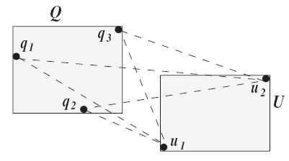
Quantile Distances
Φ-quantile distance
¼
½
½
¼
½
Instance pairs: (q₂, u₁) (q₃, u₁) (q₃, u₂) (q₁, u₁) (q₂, u₂) (q₁, u₂)
Weights: 1/8 1/8 1/8 1/4 1/8 1/4
0.25-quantile
0.5-quantile
Notes:
We proposed two quantile distances in this paper. The first is quantile distance.
We sort all the possible instances increasingly. The prob of each distance is the product of probabilities of the two instances involved.
For instance, the 0.25 quantile distance is the distance between q3 and u1. the 0.5 quantile distance is the distance between q1 and u1.

Slide 15
Quantile Distances
Φ-quantile group-base distance
Candidate group: a subset S’ of elements set Q x U such that the total weights of elements in is not smaller than Φ.
The minimal total weighted distance among all candidate groups, namely with the minimal
Notes:
Intuitively, a phi quantile group base distance is to find a phi portion of the whole population with the smallest total weighted distance. This means it is the best phi portion of the whole population.
Then candidate group, the minimal …

Slide 16
Quantile Distances
Φ-quantile group-base distance
Φ = 0.5
Instance pairs: (q₂, u₁) (q₃, u₁) (q₃, u₂) (q₁, u₁) (q₂, u₂) (q₁, u₂)
Weights: 1/8 1/8 1/8 1/4 1/8 1/4

Slide 17
Problem Definition
Given a set of multi-valued objects, a multi-valued query object and Φ in (0, 1], retrieve K objects with smallest Φ-quantile distance and Φ-quantile group-base distance to the query object.

Slide 18
Framework
Seeding
Select k objects and compute quantile distance --- k seeds are selected based on mean
Challenge: efficient computation of quantile distances
Refinement:
Determine the final solution
Challenge: efficient pruning techniques

Slide 19
Φ-quantile Distance
Multi-value objects U and V
Overall m=|U| * |V| instance pairs
Existing: Disk-based Quantile computation: O(mlogm) with pruning
--- Yiu et al EDBT 06
Our contribution: O(m) algorithm with pruning
Basic Idea: index instances by R-tree; prune entry pairs at higher levels using bounding techniques
Notes:
Actually there is a classical algorithm to compute quantile in o(m) time. We develop new pruning rules to combine with the classical algorithm.
Bounding techniques: lower bound upper bound of quantile distance to prune

Slide 20
Φ-quantile Distance
U₂
0.5
0.5
Φ=0.6
U₁
V₁ 0.4
0.6
Φ=0.6 – 0.2
V₂
lower bound
(U₁, V₁) 0.2
(U₁, V₂) 0.3
(U₂, V₂) 0.3
(U₂, V₁) 0.2
upper bound
Notes:
Do this level by level

Slide 21
Φ-quantile KNN
λ_{k}: the largest distance of the K seeded objects
Global R-tree: indexes the MBB of the multi-value objects set
Local R-tree: indexes the instances of multi-value objects (query, object set)

Slide 22
Φ-quantile KNN
Distance based pruning rule on Global R-tree
E
from global R-tree
≥λ_{k}
Q

Slide 23
Φ-quantile KNN
Weight based pruning rule on Global R-tree Entry E:
Let Ω denote the set of entries with minimal distance ≤ λ_{k}, if the total weight of entries in Ω is ≤ Φ, then every object in E could be pruned.
from global R-tree
E
Q
Q₂
minimal distance: mindist(Q₂, E) ≤ λ_{k}
weight(Q2) ≤Φ
Q₁

Slide 24
Φ-quantile KNN
Pruning on the Local R-tree of Q and U
Trim the local R-tree of both Q and U by λ_{k} level by level. Discard entries in Q with minimal distance to U larger than λ_{k}, similarly for U.
Denote the total weight of remaining entries as P_{Q} and P_{U}, respectively, if P_{Q} * P_{U} ≤ Φ, then U can be pruned.

Slide 25
Φ-quantile KNN
Pruning on the Local R-tree of Q and U
U
U₂
Q
U₁
Q₂
minimal distance: mindist(Q₁, U) ≥ λ_{k}
minimal distance: mindist(Q, U₂) ≥ λ_{k}
Q₁
weight(Q₂) * weight(U₁) ≤Φ
Notes:
regarding the pair, Q and U, Q1 and U2 will not further considered.

Slide 26
Φ-quantile KNN
Overall processing
1. Pruning on Global R-tree based on distance
2. Pruning on Global R-tree based on weights
3. Pruning on Local R-tree
Φ-quantile distance computation
Notes:
Apply the cheapest pruning rule first

Slide 27
Φ-quantile Group-base Distance
From |Q| * |U| instance pairs, select a set of pairs such that
the sum of weights is ≥ Φ
the weighted distance is minimized
Reduced to Knapsack problem. NP-hard
Notes:
Knapsack problem is a special case of quantile group base distance

Slide 28
Φ-quantile Group-base Distance
Approximate algorithm with ratio 2 and time complexity O(m log m), where m is the total number of instance pairs.
sorted distance: 1
weight: 0.28
2
0.12
3
0.48
4
0.12
possible solution: 1.72 (1, 0.28), (3, 0.48)
possible solution: 1 (1, 0.28), (2, 0.12), (4, 0.12)
Notes:
Existing

Slide 29
Φ-quantile Group-base KNN
Prune a set of objects on Global R-tree based on distance
E
L
Q
Φ * L ≥ λ_{k}

Slide 30
Φ-quantile Group-base KNN
Prune a set of objects on Global R-tree based on weights
Traverse the local R-tree of Q
Sort entry pairs according to lower bound distance at each level of Q

Slide 31
Q
E
Global R-tree
Q₂
Q₃
Q₁
Q₄
Φ = 0.5
0.5-quantile
(1, 0.28)
(2, 0.12)
(3, 0.48)
(4, 0.12)
d1= 1 * 0.28 + 2 * 0.12
d2= 3 * (Φ – 0.28 – 0.12)
If d1 + d2 ≥ λ_{k}, then E could be removed.

Slide 32
Φ-quantile Group-base KNN
Overall Processing
1. Distance based pruning on Global R-tree
2. Weight based pruning on Global R-tree
Φ-quantile Group-base distance calculation
Notes:
Seems impossible to find pruning rules on the instance level. This could be a future work.

Slide 33
Experiment
Real Dataset
NBA player statistics
339, 721 records of 1,313 players
3 dimension
Synthetic Dataset
Size: 10, 000 to 50, 000
Instances: 400 to 2, 000
Dimension: 2 to 5
MBB length, spatial distribution, instance distribution, weight distribution …

Slide 34
Φ-quantile Distance Computation
Notes:
Not EDBT: main memory based. Unfair to compare with EDBT 06 work because that is a disk-based algorithm.

Slide 35
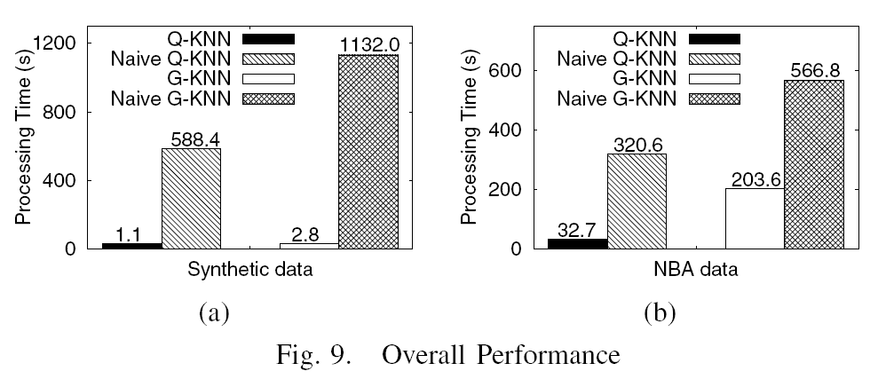
Overall Performance
Naive algorithms refer to techniques without pruning rules

Slide 36
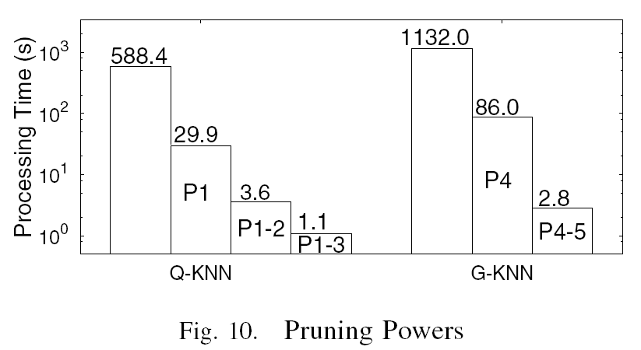
Pruning Powers

Slide 37
Accuracy
Notes:
More accurate than theoretical guarantee

Slide 38
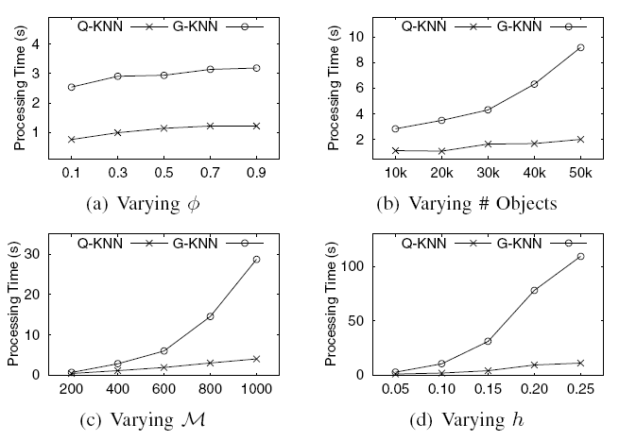
Varying Parameters

Slide 39
Conclusions
Distance between two multi-value objects based on quantile
A linear algorithm for quantile distance computation with pruning
Efficient KNN processing techniques
Notes:
Novel pruning

Slide 40
Thanks

