Slide 1
Diversified Top-K Clique Search
Computer Science and Engineering
Long Yuan¹ , Lu Qin^{2,1} , Xuemin Lin^{1,3} , Lijun Chang¹ , Wenjie Zhang¹
¹ The University of New South Wales, Australia
² University of Technology, Sydney, Australia
³ East China Normal University, China
Notes:
Hello, everyone. The title of our paper is “Diversified Top-K Clique Search”, and this is a joint work with Dr. Lu Qin, Prof. Xuemin Lin, Dr. Lijun Chang, and Dr. Wenjie Zhang.

Slide 2
Outline
Diversified Top-K Clique Search
Our Approach
Experimental Study
Future Work
Notes:
This is the outline of today’s talk. Diversified Top-K clique Search, Our Approach, Experimental Study and Future Work.

Slide 3
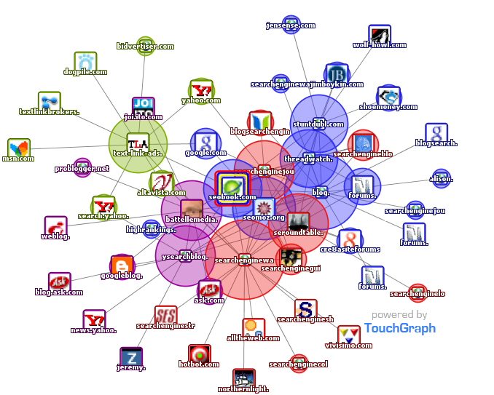
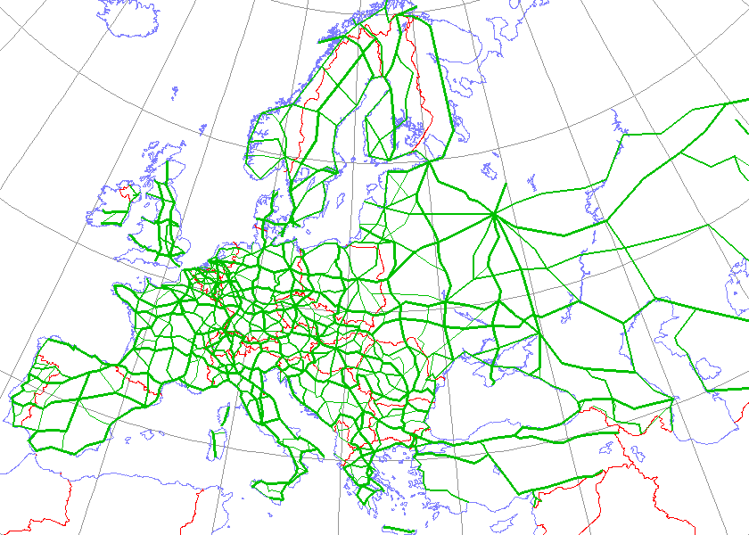
Graph Everywhere!
Social Network
Facebook, Twitter
Web Graph
Google, Yahoo
Road Network
The Internet of
Things
Notes:
In many applications, we can be model the problem as a graph. For example, Web Graph such as Google and Yahoo, Road Network, Social Network, and the Internet of Things. And in this big data age, the size of graphs is becoming larger and larger. In this paper, we study the clique problem in the paper.

Slide 4
Clique and Maximal Clique
Given a graph G, a clique is a set of nodes such that for any pair of them have an edge
A clique is called maximal clique if there exist no other bigger cliques that contain it
v₁
v₆
v₈
v₀
v₄
v₅
v₉
v₂
v₃
v₇
v₁₀
Notes:
In many applications, we need to compute maximal cliques. Then what is a clique. Clique is a set of nodes and each pair of them has an edge, maximal clique means we can not extend an existing clique to obtain a bigger one. Here is an example

Slide 5
Traditional models for Maximal Clique
Maximal Clique Enumeration:
Enumerate all the maximal cliques in the graph
Exponential number of maximal cliques
Large redundant and useless information
Top-K Maximal Clique:
Return top-k maximal cliques with largest size
Still contain large redundancy and hold little information as a whole.
Notes:
The traditional methods to compute maximal cliques can be divided into 2 categories. Maximal clique enumeration enumerates all the maximal cliques in the graph. The problem of it is it will produce exponential number of maximal cliques and there are large redundant and useless information. Top-k Maximal Cliques returns top-k maximal cliques with largest size. The problem of it is the returned result still contain large redundancy and hold little information as a whole.

Slide 6
Diversified Top-K Clique
v₆
v₈
v₁
v₀
v₄
v₅
v₉
v₁₀
v₇
v₂
v₃
Notes:
The problem of traditional computing models for maximal cliques is clearly illustrated in this example. We can see, the returned result has lots of overlaps. However, if we take diversity into consideration, we can see, we still return 2 cliques but the returned result can cover all the nodes in the graph.

Slide 7
Diversified Top-K Clique Search
Diversified Top-K Clique:
Given: a graph G and an integer k,
Maximize $|C_{1}∪C_{2}…C_{k}|$
s.t ${ C}_{i} (1≤i≤k)$ is a maximal clique
NP-hard Problem
Advantage:
Consider both size and diversity, provide a better query result for users.
Notes:
Motivated by this, we study diversified top-k clique search in this paper. Diversified top-k clique search returns k maximal cliques that the number of covered nodes is maximized. Diversified Top-k Clique search problem is a np-hard problem even when k = 1. The advantage of this model is that we consider both size and diversity and it can provide a better query result for users.

Slide 8
Application
Motif Discovery (X. Zheng et al., JPP’11)
CEGs are represented as maximal cliques and motif discovery requires to obtain large CEGs with low overlaps.
Anomaly Detection (N. Berry et al., AOTP’04)
Cliques are used as signals of rare events and the problem is to find a set of large cliques with low overlaps
Community Search (C. Lee et al., SNMA’10 )
Diversified top-k cliques can sever as the seeds for community search
Notes:
Diversified Top-k Clique search can be used in lots of applications, such as motif discovery in molecular biology, anomaly detection in terrorist network and community search in social network

Slide 9
Baseline Solutions
EnumAll
Phase 1: Enumerate all the maximal cliques in the graph(D.
Eppstein et al., SEA’11)
Phase 2: Greedily select k cliques from all the maximal cliques
that cover most nodes in the graph
Problem
Clique enumeration is a costly operation
Keeping all maximal cliques in memory is infeasible
The number of cliques is exponential to the number of nodes
Hard to handle large graph
Problem
It still outputs exponential number of maximal cliques without a bound
EnumSub(sample-based enumeration)
Phase 1: Sample a subset of the maximal cliques in the graph(J.
Wang et al., KDD’13)
Phase 2: Greedily select k cliques from the sampling that cover
most nodes in the graph
Notes:
In literature, there are two baseline solutions for this problem. This first one is Enumall. it enumerates all the maximal cliques in the graph and then The problem are , To solve this problem, the second baseline solution sample a subset of the maximal clique in the graph first and then . However, it still outputs exponential number of maximal cliques without a bound. So both baseline solutions cannot handle large graphs.

Slide 10
Challenge
Retain the result quality, while avoid:
generating all maximal cliques, and
keeping all generated maximal cliques in memory
Notes:
So, the challenge to solve diversified top-k clique search problem is: we want to retain the quality of the result, which avoid generating all maximal cliques in the graph and keeping all generated maximal cliques in memory. In order to solve the challenge in diversified top-k clique search, we propose an new algorithm to solve this problem.

Slide 11
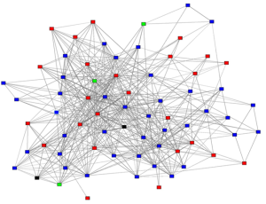
Our Approach: extending online k coverage problem
Main Idea
1. online model storing k maximal cliques in memory
2. update top-k candidate set when enumerate cliques
replace small existing cliques with big new cliques
which
how
Input Graph
Top-K Candidate Set
Notes:
The main idea of our approach is that we extend the online k coverage problem. In our approach, we adopt an online model and store k maximal cliques in memory. Then, we update the top-k candidate set when we enumerate cliques. Intuitively, we update small cliques with big cliques. In this way, what we need to store in memory is just k maximal cliques while the baseline solutions need to keep all the generated maximal cliques in the memory. Then we wonder which one needs to be replaced and how to replace it.

Slide 12
Replacement Strategy
C₂
B
C₃
A
A
C
C₁
which one to be replaced
private set
C_{min}: clique with smallest private set
what is the replacement condition
$|C|>|B|+ α ∙\left(|A|+|B|\right)/k$
$α$ is a parameter ($0< α ≤1$)
Notes:
I will answer these two questions with this example. Assume that we already have two maximal cliques C1 and C2 in top-k candidate. For the first question which one to be replaced. First, I will give a definition of private set. The private set of a maximal clique is the set of nodes that covered privately by the maximal clique. In this example, B is the private set of C2. And the maximal clique that needs to be replaced, we call it Cmin, is the clique with the smallest private set. For the second question, what is the replacement condition, we use this formula as our replacement condition. Here C is private set of C3 in the new candidate set. \alpha is a parameter and k is the topk. So this condition says, if the private set of C3 is greater than the private set of C2 plus the average size of maximal cliques in topk candidate set with an \alpha scale, then we replace c2 with c3. Why do we use these formula? As I said before, we extend the online k coverage problem so here we use the replacement condition for the online k coverage problem. However, we introduce a parameter \alpha here to improve the flexibility of our algorithm. And the experiment results illustrate that we can improve the quality of returned result after introducing \alpha.

Slide 13
Advantages of Our Approach
Guaranteed result quality
Achieve a guaranteed approximation ratio of 0.25, and much better in practice.
Low memory consumption
Instead of all maximal cliques, just K most promising candidates are kept in memory
Efficiency and Scalability ?
Notes:
The advantages of our approach are 1: guaranteed result quality, our approach can achieve a guaranteed approximation ratio of 0.25, and much better in practice. 2. low memory consumption. The remaining problem is how about the efficiency and scalability?

Slide 14
Cost Analysis
A naïve implementation of our approach:
for each generated maximal clique C
update top-k candidate set by C with replacement condition
The time complexity is :
$O( |𝒜|∗k∗\left|Cmax\right|$ $+$ $Tenum(G)$ $)$
number of maximal cliques
size of maximum clique
time for maintaining top-k candidate set
time for enumerating maximal cliques
PNP-Index
Pruning Rules
Notes:
A naïve implementation of our approach is enumerate all the cliques and update the candidates for each C. and the time complexity is . It contains two parts: the first part is the time consumed for candidate maintenance and the second part is the time spent for enumerate all the maximal clique in the input graph. Here we have two questions: the first one is for this part, how to reduce the time used and in this paper, we devise an PNP-Index to answer this question and the second one is how to avoid generating unpromising maximal cliques during enumeration. The answer we give in this paper is that we propose three pruning rules for this problem. For the time limit, I will present PNP-Index in detail and briefly introduce pruning rules.

Slide 15
PNP-Index
C₂
v₁₁
v₆
v₃
v₁₂
v₇
C₁
v₄
v₉
v₁
v₅
v₁₀
v₂
v₈
C₃
 | v₁ | v₂ | v₃ | v₄ | v₅ | v₆ | v₇ | v₈ | v₉ | v₁₀ | v₁₁ | v₁₂ | |priv(C)|
c₁ | $$\overline{1}$$ | $$\overline{1}$$ | $$1$$ | $$1$$ | $$1$$ |  |  |  |  |  |  |  | $$2$$
c₂ |  |  | $$1$$ | $$1$$ | $$1$$ | $$\overline{1}$$ | $$1$$ |  |  |  |  |  | $$1∗$$
c₃ |  |  |  |  | $$1$$ |  | $$1$$ | $$\overline{1}$$ | $$\overline{1}$$ | $$\overline{1}$$ |  |  | $$3$$
|rcov(v)| | $$1$$ | $$1$$ | $$2$$ | $$2$$ | $$3$$ | $$1$$ | $$2$$ | $$1$$ | $$1$$ | $$1$$ |  |  | |cov|:$10$
Notes:
Here we take this graph as an example to show our PNP-Index, assume that we want to compute top-3 clique and already have three cliques c1 c2 c3 in D, in pnp-index each row represents a maximal clique and each column represents a node in g. priv(c) is in the last column and |cov| is in the right bottom cell. The corresponding cell is marked 1 bar is v\in priv(c) and 1 otherwise. Cim is marked with a star.

Slide 16
PNP-Index
Step 1: Check the replacement condition
v₁₁
C₄
C₂
$$3$$
v₆
$$>1+0.5 ×10÷3=2.67$$
v₃
v₁₂
v₇
$$α$$
C₁
v₄
v₉
v₁
replace C₂ with C₄
v₅
v₁₀
v₂
v₈
C₃
 | v₁ | v₂ | v₃ | v₄ | v₅ | v₆ | v₇ | v₈ | v₉ | v₁₀ | v₁₁ | v₁₂ | |priv(C)|
c₁ | $$\overline{1}$$ | $$\overline{1}$$ | $$1$$ | $$1$$ | $$1$$ |  |  |  |  |  |  |  | $$2$$
c₂ |  |  | $$1$$ | $$1$$ | $$1$$ | $$\overline{1}$$ | $$1$$ |  |  |  |  |  | $$1∗$$
c₃ |  |  |  |  | $$1$$ |  | $$1$$ | $$\overline{1}$$ | $$\overline{1}$$ | $$\overline{1}$$ |  |  | $$3$$
|rcov(v)| | $$1$$ | $$1$$ | $$2$$ | $$2$$ | $$3$$ | $$1$$ | $$2$$ | $$1$$ | $$1$$ | $$1$$ |  |  | |cov|:$10$
c₄ |  |  |  |  |  | $$1$$ | $$1$$ |  | $$1$$ |  | $$1$$ | $$1$$
Notes:
When C4 computes, the first step is to compute priv(C, D’). It consists of two parts: the first part is rcov(v) = 0 and the second part is |rcov(v) = 1| & v \in Cmin. In this example, priv(C, D’) is 3 which is greater than 2.67. thus we need to replace c2 with c4

Slide 17
PNP-Index
Step 2: Delete C₂
C₂
v₁₁
v₆
v₃
v₁₂
v₇
C₁
v₄
v₉
v₁
v₅
v₁₀
v₂
v₈
C₃
 | v₁ | v₂ | v₃ | v₄ | v₅ | v₆ | v₇ | v₈ | v₉ | v₁₀ | v₁₁ | v₁₂ | |priv(C)|
c₁ | $$\overline{1}$$ | $$\overline{1}$$ | $$\overline{1}$$ | $$\overline{1}$$ | $$1$$ |  |  |  |  |  |  |  | $$4$$
c₃ |  |  |  |  | $$1$$ |  | $$\overline{1}$$ | $$\overline{1}$$ | $$\overline{1}$$ | $$\overline{1}$$ |  |  | $$4$$
|rcov(v)| | $$1$$ | $$1$$ | $$1$$ | $$1$$ | $$2$$ |  | $$1$$ | $$1$$ | $$1$$ | $$1$$ |  |  | |cov|:$9$
Notes:
We delete c2 from D first and then update rcov(v), if rcov decrease from 1 to 0, thus cov needs to decrease by 1. if rcov decrease from 2 to 1, then priv is updated by increase 1

Slide 18
PNP-Index
Step 3: Insert C₄
v₁₁
C₄
v₆
v₃
v₁₂
v₇
C₁
v₄
v₉
v₁
v₅
v₁₀
v₂
v₈
C₃
 | v₁ | v₂ | v₃ | v₄ | v₅ | v₆ | v₇ | v₈ | v₉ | v₁₀ | v₁₁ | v₁₂ | |priv(C)|
c₁ | $$\overline{1}$$ | $$\overline{1}$$ | $$\overline{1}$$ | $$\overline{1}$$ | $$1$$ |  |  |  |  |  |  |  | $$4$$
c₄ |  |  |  |  |  | $$\overline{1}$$ | $$1$$ |  | $$1$$ |  | $$\overline{1}$$ | $$\overline{1}$$ | $$3$$
c₃ |  |  |  |  | $$1$$ |  | $$1$$ | $$\overline{1}$$ | $$1$$ | $$\overline{1}$$ |  |  | $$2∗$$
|rcov(v)| | $$1$$ | $$1$$ | $$1$$ | $$1$$ | $$2$$ | $$1$$ | $$2$$ | $$1$$ | $$2$$ | 1 | 1 | 1 | |cov|:$12$
Notes:
We insert c4 into D first and then update rcov(v), if rcov increase from 0 to 1, thus cov needs to increase by 1. if rcov increase from 1 to 2, then priv is updated by decreasing 1

Slide 19
PNP-Index
An naïve implementation for candidate set maintenance needs $O(|𝒜|∗k∗|C_{max}|)$
With the help of PNP-Index, our algorithm can only take $O(\sum_{c ∈𝒜}{|C|})$ time
Notes:
With the help of PNP-Index, the time complex of our algorithm can be reduced to $O(\sum_{c ∈𝒜}{|C|})$

Slide 20
Pruning Rules
Global Pruning: based on k-core and graph coloring
Local Pruning: check the current coverage of the neighbourhood
Initial Candidate Computation: increase the power of the above pruning processes
Notes:
We also explore three pruning strategies to further improve the performance of our algorithm. Global pruning use a size upper bound for a vertex based on k-core and graph coloring to prune the useless maximal clique as the size the maximal clique should not to be too small according to the replace strategy. Local pruning prune unpromising maximal cliques by checking the current coverage of the neighbourhood as the number of nodes covered by the top-k candidate set in the new maximal cliques should not be too large according to the replacement strategy. Initial candidate computation can increase the power of the above pruning processes.

Slide 21
Experiment
Dataset
Dataset | Type | |V(G)| | |E(G)| | Avg Deg
Google | Web | 875,713 | 5,105,039 | 11.66
Skitter | Physical | 1,696,415 | 11,095,298 | 13.08
Youtube | Social | 3,223,589 | 12,223,774 | 7.58
Pokec | Social | 1,632,803 | 30,622,564 | 37.51
Wiki | Reference | 2,936,413 | 104,673,033 | 71.29
UK-2002 | Web | 18,520,486 | 298,113,762 | 32.19
Notes:
We conduct experiments on six public graphs with different types and properties. The first four are small graph while the last two are big graph. The largest graph has nearly 0.3 billion edges. As far as I know, our approach is the first algorithm that can handle such a large graph.

Slide 22
Experiment
Algorithms
EnumAll : Baseline solution 1
EnumSub: Baseline solution 2
EnumK: Our algorithm without pruning rules
Local: EnumK + local pruning
Global: Local + global pruning
EnumKOpt: Global + InitK
Replace EnumK by:
SOPS: Candidate maintenance using the method in (B. Saha et al. SDM’09)
GOPS: Candidate maintenance using the method in (Hu. Yu et al. SDM’13)
SIEVE: Candidate maintenance using the method in (A. Badanidiyuru et al. KDD’14)
Notes:
we compare these nine algorithms in experiment part, and EnumKOpt is our algorithm

Slide 23
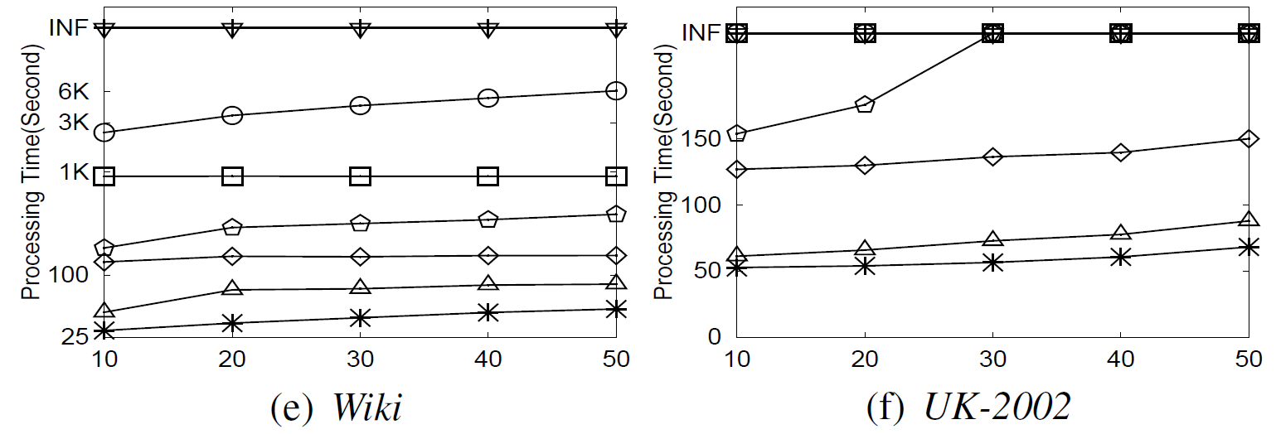
Experiment-Efficiency
Vary k (top-$k$ value) and report total processing time
Vary k
Notes:
The first set of experiments is to verify the efficiency of our algorithm. For the clearness of the presentation, I just show the result on two big graphs. The results on small graphs have similar trends. This is the processing time for 8 algorithms on 2 datasets when we vary k. We can see, our algorithm can finish the query with least time

Slide 24
Experiment-Effectiveness
Vary k(top-$k$ value) and report covered nodes
Vary k
Notes:
The second set of algorithm is to verify the effectiveness of our algorithm. These figures show the number of nodes covered by the returned k cliques. For big graph, our algorithm can obtain the most nodes compared with the other algorithms.

Slide 25
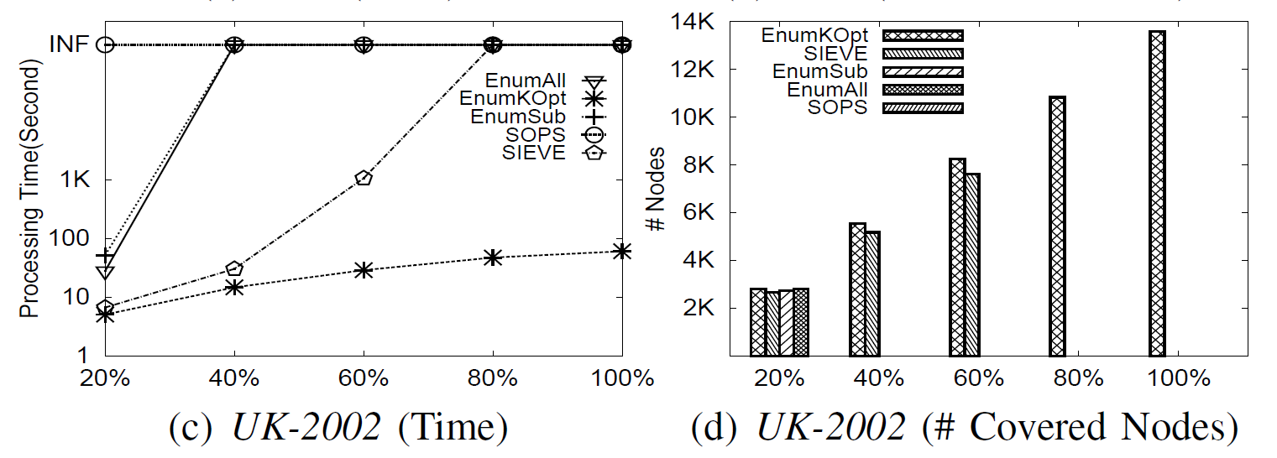
Experiment-Scalability
Generate subgraphs with 20%, 40%, 60%, 80%, 100% of nodes of two big data sets, report processing time and covered nodes
Vary |V|
Notes:
This figures show the scalability of algorithm. We generate subgraph with 20%, 40%, 60%, 80%, and 100% nodes of Wiki and UK-2002 and we can see our approach has the best scalability

Slide 26
Experiment-$α$
Vary $α$, report processing time and covered nodes
Vary $α$
Notes:
This set of algorithm is to verify the effectiveness of \alpha. We report processing time and covered nodes when we vary \alpha. And we can seen the quality of the returned result is improved after the introduction of \alpha.

Slide 27
Future work
Disk-Based Approach
already submitted to VLDBJ
Distributed-Based Approach

Slide 28
Thank you!
Questions?

