Slide 1
Influence based Cost Optimization on User Preference
Computer Science and Engineering
Jianye Yang¹ , Ying Zhang² , Wenjie Zhang¹ , Xuemin Lin¹
¹ The University of New South Wales, Australia
² University of Technology, Sydney, Australia
Notes:
Hello, everyone. The title of our paper is “Influence based cost optimization on user preference”, and this is a joint work with Dr. Ying Zhang, Dr. Wenjie Zhang, and Prof. Xuemin Lin

Slide 2
Outline
Influence based Cost Optimization
Existing Work
Our Proposals
Experimental Studies
Conclusion

Slide 3
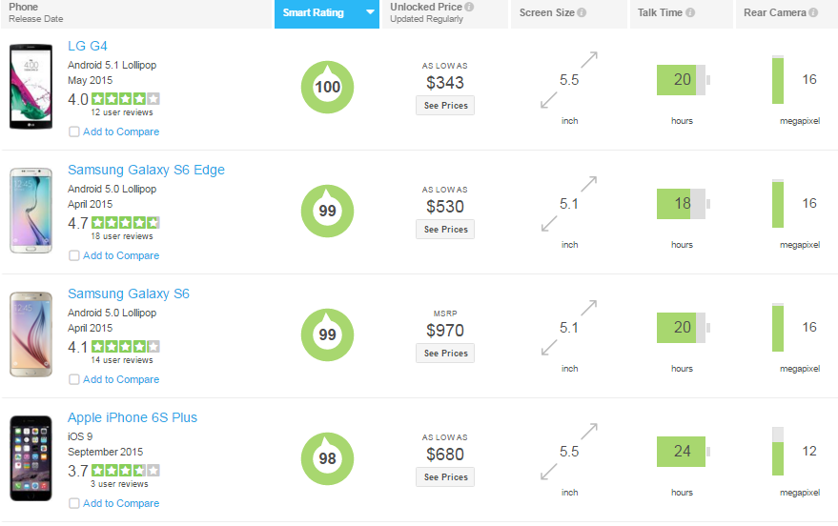
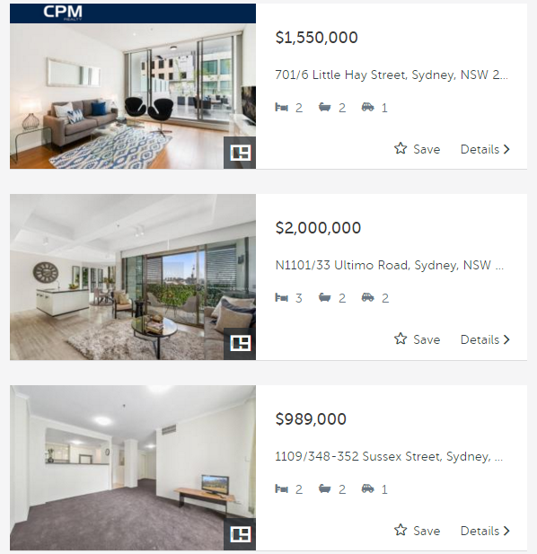
Multi-Criteria Decision Is Everywhere

Slide 4
User Preference over Multi-criteria
How to express preference on smart phones?
customer1
customer2
Additive Linear Function:
$$w\left(p\right)=w∙p=\sum_{i=1}^{d}{w\left[i\right]p[i]}$$
customer3
Without loss of generality,
the smaller the better.
A customer chooses the smart phone with best utility.
customer4

Slide 5
Influence based Cost Optimization
Goal 1 (Influence):
Attract at least k out of n customers
How to design a new smart phone?
Goal 2 (Cost):
Minimized manufacturing cost
Manufacturing Cost Function
Monotonic & Convex: $f(p_{1})≥f(p_{2})$ if $p_{1}≺p_{2}$
e.g., $f\left(p\right)=\sum_{i=1}^{d}{\frac{1}{p[i]}}$
Marketer

Slide 6
Influence based Cost Optimization
Problem Statement (k-critical point retrieval)
Given a set $P$ of tuples, a set $W$ of user preferences, a cost function $f$, and a number $k (1≤k≤\left|W\right|)$, we aim to identify the most cost-effective point in $ℛ^{d}$ to attract (i.e., top-1 tuple) at least $k$ users.

Slide 7
Existing Work
Existing work
[Gao et al. VLDB2015] develop a novel algorithm to find the cost optimal point to attract a specific group of k users by applying quadratic programming method.
Issue 1:
It is cost-prohibitive to enumerate $\left({n \atop k}\right)$ possible groups
Issue 2:
We aim to support the general monotonic and convex cost functions

Slide 8
Preliminaries
Product tuples
ID | attr1 | attr2
$$p_{1 }$$ | 0.5 | 3.0
$$p_{2 }$$ | 1.5 | 1.5
$$p_{3 }$$ | 3.0 | 0.5
attr2
$$p_{1 }$$
$$p_{2 }$$
$$p_{3 }$$
$$o$$
attr1

Slide 9
Preliminaries
Product tuples
ID | attr1 | attr2
$$p_{1 }$$ | 0.5 | 3.0
$$p_{2 }$$ | 1.5 | 1.5
$$p_{3 }$$ | 3.0 | 0.5
attr2
$$p_{1 }$$
User preferences
ID | attr1 | attr2 | Top-1
$$w_{1 }$$ | 0.8 | 0.2
$$p_{2 }$$
$$p_{3 }$$
$$o$$
attr1

Slide 10
Preliminaries
Property 1:
Rank of point $p$ = # of points on or below the hyperplane which is perpendicular to the preference vector
Product tuples
ID | attr1 | attr2
$$p_{1 }$$ | 0.5 | 3.0
$$p_{2 }$$ | 1.5 | 1.5
$$p_{3 }$$ | 3.0 | 0.5
attr2
Preference hyperplane $H_{1}$
$$p_{1 }$$
User preferences
ID | attr1 | attr2 | Top-1
$$w_{1 }$$ | 0.8 | 0.2 | $$p_{1 }$$
$$p_{2 }$$
$$q$$
$$p_{3 }$$
A new product $q$must be on or below $H_{1}$ if one aims to make it attract $w_{1}$
$$w_{1 }$$
$$o$$
attr1

Slide 11
Preliminaries
Property 1:
Rank of point $p$ = # of points on or below the hyperplane which is perpendicular to the preference vector
Product tuples
ID | attr1 | attr2
$$p_{1 }$$ | 0.5 | 3.0
$$p_{2 }$$ | 1.5 | 1.5
$$p_{3 }$$ | 3.0 | 0.5
attr2
$$p_{1 }$$
User preferences
ID | attr1 | attr2 | Top-1
$$w_{1 }$$ | 0.8 | 0.2 | $$p_{1 }$$
$$w_{2 }$$ | 0.7 | 0.3 | $$p_{1 }$$
$$w_{3 }$$ | 0.5 | 0.5 | $$p_{2 }$$
$$w_{4 }$$ | 0.3 | 0.7 | $$p_{3 }$$
$$w_{5 }$$ | 0.2 | 0.8 | $$p_{3 }$$
$$H_{4}$$
$$p_{2 }$$
$$H_{5}$$
$$p_{3 }$$
$$o$$
$$H_{1}$$
$$H_{2}$$
$$H_{3}$$
attr1

Slide 12
Preliminaries
Property 2:
Influence of point $p$ = # of hyperplanes which are above or contain $p$
Product tuples
ID | attr1 | attr2
$$p_{1 }$$ | 0.5 | 3.0
$$p_{2 }$$ | 1.5 | 1.5
$$p_{3 }$$ | 3.0 | 0.5
Search space when $k=3$
attr2
$$p_{1 }$$
User preferences
ID | attr1 | attr2 | Top-1
$$w_{1 }$$ | 0.8 | 0.2 | $$p_{1 }$$
$$w_{2 }$$ | 0.7 | 0.3 | $$p_{1 }$$
$$w_{3 }$$ | 0.5 | 0.5 | $$p_{2 }$$
$$w_{4 }$$ | 0.3 | 0.7 | $$p_{3 }$$
$$w_{5 }$$ | 0.2 | 0.8 | $$p_{3 }$$
$$H_{4}$$
$$p_{2 }$$
$$H_{5}$$
$$p_{3 }$$
$$o$$
$$H_{1}$$
$$H_{2}$$
$$H_{3}$$
attr1
Notes:
After finding all the preference hyperplanes for the rest of users, we can easily derive the search space for a given k. For example, when k=3, the search space is the shaded area because there are at least 3 hyperplanes above the points in this area.

Slide 13
Reduce Search Space
Theorem 1:
Given a number $k$ with $1≤k≤n$, the $k$-critical point $q$ can only be one of the intersection points or tangent points on ${lev}_{k}(ℋ)$’s faces.
attr2
attr2
The 3-level, ${lev}_{3}(ℋ)$
$$H_{4}$$
$$H_{4}$$
$$H_{5}$$
$$H_{5}$$
$$o$$
$$o$$
$$H_{1}$$
$$H_{2}$$
$$H_{3}$$
attr1
$$H_{1}$$
$$H_{2}$$
$$H_{3}$$
attr1
Notes:
However, there are infinite number of points in the search space. Therefore, we need to reduce the search space. How? Following the monotonicity of cost function, we know that the optimal point must be on this red bold curve, which is called k-level. However, there are still infinite number of points on this k-level. Fortunately, we only need to care about a finite number of points on it based on Theorem 1, which are the intersection points and tangent points on its faces.

Slide 14
Framework Overview
Naive Solutions
Traverse based method (2D)
Randomized incremental method
Our Proposals
Anchor-pair region based traverse method (2D)
Space partition based method
Exact approach
Sampling approach

Slide 15
Naive Solutions
Traverse based Method (d=2) [Cheema et al. EDBT2014]
Main idea: The $k$-level is constructed by traveling along the adjacent faces on ${lev}_{k}(ℋ)$. We make a turn at each intersection point.
attr2
Drawback 1:
One cannot make use of the minimum cost for the candidate points seen so far because of fixed traveling order
$$H_{4}$$
$$H_{5}$$
Drawback 2:
Time complexity: $O(n^{2}k^{1/3})$
$$o$$
$$H_{1}$$
$$H_{2}$$
$$H_{3}$$
attr1
Notes:
Based on the theorem, we can immediately devise a naive solution. That is, we first construct the k-level of the hyperplanes, and then consider the intersection points and tangent points on it one by one to find the optimal solution. There are a whole lot of algorithms in the computational geometry community to compute the k-level, which can be roughly divided into two categories. The first is for 2-dimensional space, and the other is for general dimension.

Slide 16
Naive Solutions
Randomized Incremental Method ($d≥2$) [Mulmuley et al. DCG1991]
Main idea: The $k$-level is constructed incrementally by adding in hyperplanes one by one in a random order.
attr2
$$H_{4}$$
$$o$$
$$H_{1}$$
$$H_{2}$$
attr1

Slide 17
Naive Solutions
Randomized Incremental Method ($d≥2$) [Mulmuley et al. DCG1991]
Main idea: The $k$-level is constructed incrementally by adding in hyperplanes one by one in a random order.
attr2
$$H_{4}$$
$$H_{5}$$
$$o$$
$$H_{1}$$
$$H_{2}$$
attr1

Slide 18
Naive Solutions
Randomized Incremental Method ($d≥2$) [Mulmuley et al. DCG1991]
Main idea: The $k$-level is constructed incrementally by adding in hyperplanes one by one in a random order.
attr2
Drawback：
The performance is very sensitive to $n$ even in low dimensional space due to high expected time complexity $O(n^{\left\lfloor d/2\right\rfloor }k^{\left\lceil d/2\right\rceil })$
$$H_{4}$$
$$H_{5}$$
$$o$$
$$H_{1}$$
$$H_{2}$$
$$H_{3}$$
attr1

Slide 19
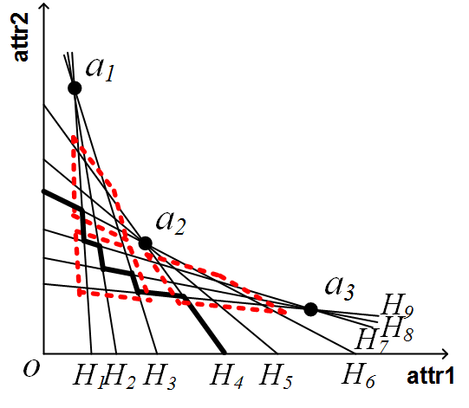
Our Proposals
Traverse based Method (d=2)
Main idea: The solution space is partitioned into regions, some of which can be pruned during the computation. Meanwhile, we can also quickly identify candidate points for each survived region without knowledge of the previous turning point.
Notes:
We develop novel and efficient algorithms for both categories.

Slide 20
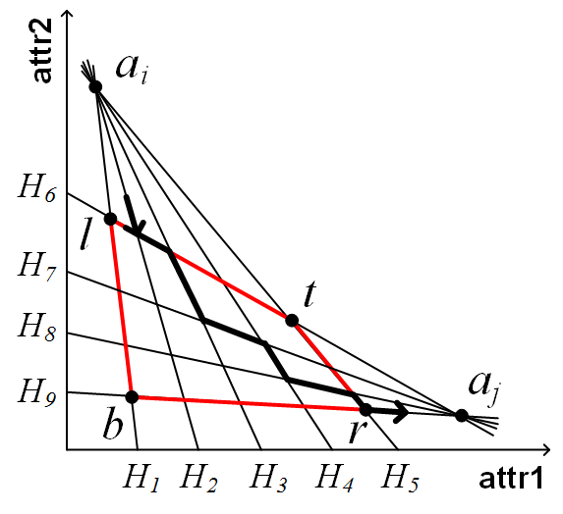
Anchor-pair Region
Influence-based Pruning:
$I^{+}\left(R\right)=\sum_{i≤s≤j}{\left|ℋ_{a_{s}}\right|}$, $I^{−}(R)=\sum_{i<s<j}{\left|ℋ_{a_{s}}\right|+2}$
Cost-based Pruning:
$f^{+}\left(R\right)$ relies only on three points $l$, $b$and $r$;
$f^{−}\left(R\right)$ is derived based on $l$, $b$, $r$ as well as two possible tangent points on $\overline{lt}$ and $\overline{tr}$
Anchor-pair Region $R_{i,j}$
Traverse the Anchor-pair Region:
Find the entrance line, $O(1)$ time
Traverse, $O(n_{i}+n_{j})$ time

Slide 21
Algorithm: TraverseBased
Phase 1 (Anchor-pair Region Collection)
We ensure that only $3m$ out of the $\frac{m^{2}}{2}$ regions are touched
Phase 2 (Traverse Survived Regions)
We can traverse a region in $O(n_{i}+n_{j})$ time
Theorem 2:
The combinatorial complexity of ${lev}_{k}(ℋ)$ is bounded by $2n$
Theorem 3:
The time complexity of Algorithm-TraverseBased is $O(n)$
Notes:
We have an important finding that the combinatorial compleixty … Based on that, we claim that the time complexity …

Slide 22
Our proposals: Space Partition base Method
Space Partition based Method
Main idea: The solution space is partitioned into hypercubes such that the number of preference hyperplanes involved in each partition (e.g., hypercube) is significantly reduced.
attr2
$$H_{4}$$
$$H_{5}$$
$$o$$
$$H_{1}$$
$$H_{2}$$
$$H_{3}$$
attr1
Notes:
For the general dimension, we apply a space partition based method. After partitioning, the number of hyperplanes in each partition is significantly reduced.

Slide 23
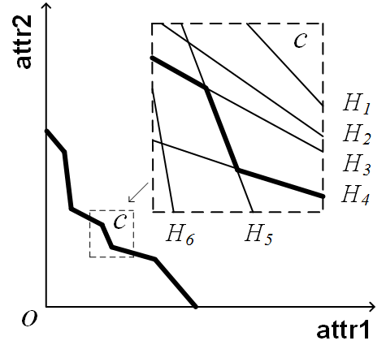
Space Partition Based Pruning Techniques
Pruning a Partition:
$I^{+}\left(c\right)=I\left(c_{l}\right)$, $I^{−}\left(c\right)=I\left(c_{h}\right)$,$f^{+}\left(c\right)=f\left(c_{l}\right)$, $f^{−}\left(c\right)=f\left(c_{h}\right)$
Exploiting Local Dominance:
1. Dominance Pruning Rule (lower bound)
2. Dominance Pruning Rule (upper bound)
Notes:
As we’ve done before, we can make use of the influence bounds and cost bounds as well to prune a partition during the computation. Here, cl and ch are the lower left corner and upper right corner of a partition respectively. For a survived partition, we can make use of the local dominance relationship to further reduce the number of hyperplanes in it. Basically, the lower bound pruning rule is to remove the hyperplanes that are strictly below k-level, while the upper bound rule is for those strictly above k-level.

Slide 24
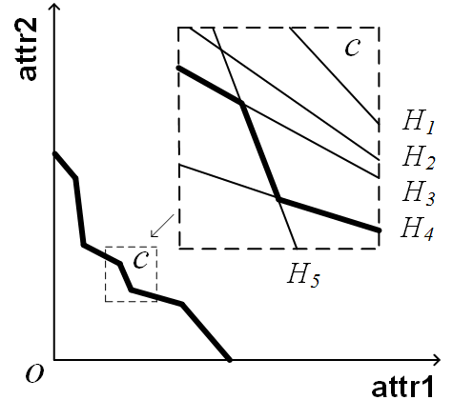
Space Partition Based Pruning Techniques
Pruning a Partition:
$I^{+}\left(c\right)=I\left(c_{l}\right)$, $I^{−}\left(c\right)=I\left(c_{h}\right)$,$f^{+}\left(c\right)=f\left(c_{l}\right)$, $f^{−}\left(c\right)=f\left(c_{h}\right)$
Exploiting Local Dominance:
1. Dominance Pruning Rule (lower bound)
2. Dominance Pruning Rule (upper bound)

Slide 25
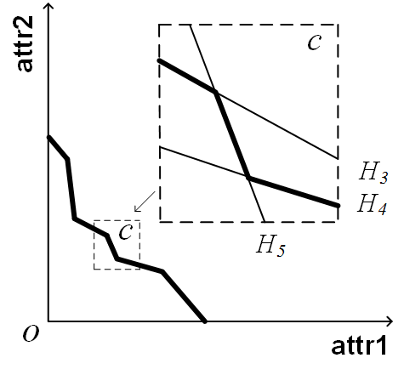
Space Partition Based Pruning Techniques
Pruning a Partition:
$I^{+}\left(c\right)=I\left(c_{l}\right)$, $I^{−}\left(c\right)=I\left(c_{h}\right)$,$f^{+}\left(c\right)=f\left(c_{l}\right)$, $f^{−}\left(c\right)=f\left(c_{h}\right)$
Exploiting Local Dominance:
1. Dominance Pruning Rule (lower bound)
2. Dominance Pruning Rule (upper bound)

Slide 26
Algorithm: PartitionBased-Exact
Pruning a Partition:
$I^{+}\left(c\right)=I\left(c_{l}\right)$, $I^{−}\left(c\right)=I\left(c_{h}\right)$,$f^{+}\left(c\right)=f\left(c_{l}\right)$, $f^{−}\left(c\right)=f\left(c_{h}\right)$
Exploiting Local Dominance:
1. Dominance Pruning Rule (lower bound)
2. Dominance Pruning Rule (upper bound)
Finding Candidate Solution:
Applying the Randomized Incremental Method to find the candidate solution in $c$
Problem
$n_{c}$ might be still considerably large
Notes:
After that, the randomized incremental method is applied to find the candidate solution in c. However, even after the local dominance pruning, nc might be still considerably large, especially when the dimensionality d is relatively large, such 4 or 5. To further boost the performance, we devise a novel sampling based approach.

Slide 27
Our Proposal: PartitionBased-Sampling
Sampling based Method
Main idea: We might get candidate solutions by sampling hyperplanes and maintaining the half-space intersection of them.
Time Complexity:
$O(n_{r}{(ρn_{c})}^{\left\lfloor d/2+1\right\rfloor })$, where $ρ=1/{k_{s}}$, ${k_{s}=n}_{c}−k_{c}$, and $n_{r}$ is the number of sampling rounds
Theoretical Result:
Sampling $n_{r}=8{k_{s}}^{d}\ln{\frac{1}{δ}}$ rounds, we can identify the optimal solution with probability $1−δ$
Notes:
Following theorem 1, we know that the optimal point is determined by at most d hyperplanes. If we randomly sample some hyperplanes and maintain the half-space intersection of them, we might get candidate solutions on the intersection. For instance, in figure b, we sampled h1, h4, and h5. The half-space intersection is the shaded area. We find the optimal solution on the intersection p* which is also the optimal solution of our original problem. We call this case an optimal sampling. In other cases, the optimal point of the half-space intersection is not optimal but valid because it is below k-level. We call this case a valid sampling. Contrarily, we may get a invalid sampling, such as figure c, because the optimal point is above k-level. Our sampling method bears two decent properties. First, it is very efficient since we only need to maintain the half-space intersection of the sampled hyperplanes in each round. Second, we got quite a chance to obtain a valid solution even thought we might miss the optimal solution in most cases.

Slide 28
Experimental: Datasets
Tuple Dataset
Dataset | size | dim
COLOR (C) | 68,036 | 2, 3, 4, 5
HOUSE (H) | 127,925
Preference Dataset
Dataset | Cardinality
Uniform (UN) | 10K, 0.2M, 0.4M, 0.6M, 0.8M, 1M
Clustered (CL)

Slide 29
Experimental: Algorithms
Algorithms
Algorithm | Description
TRAVERSE (NP) | Naive Traverse based method (2D)
TRAVERSE | Anchor-pair region based Traverse method (2D)
PARTITION | The space partition based exact method
EXACT | Denote TRAVERSE (PARTITION) when $d=2$ ($d≥3$)
SAMPLING | The space partition based sampling method

Slide 30
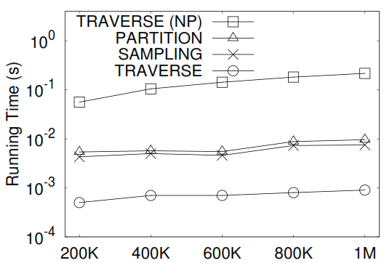
Experimental: Efficiency
Comparing methods ($2d$)

Slide 31
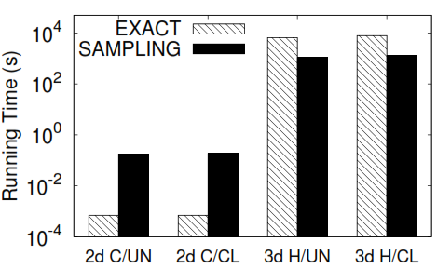
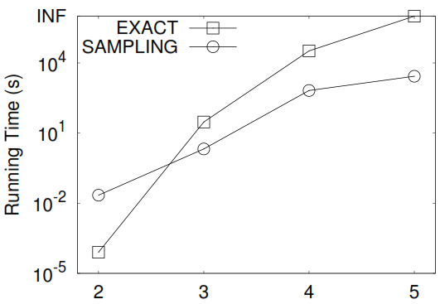
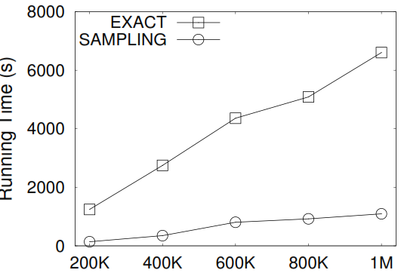
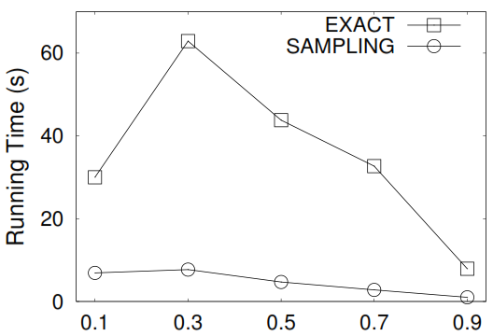
Experimental: Efficiency
Running time vs datasets
Running time vs $d$
Running time vs $\left|W\right|$
Running time vs $k$

Slide 32
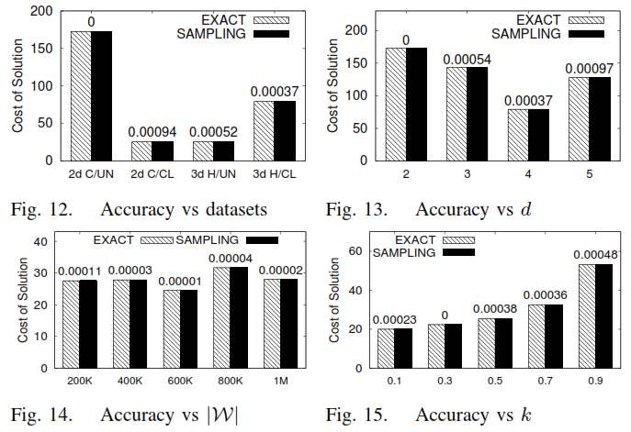
Experimental: Accuracy
Varying $\left|W\right|$
Varying $d$

Slide 33
Conclusion
We propose a k-critical point retrieval query, which finds in a d-dimensional real space an optimal point, such that it can attract at least k out of n customers and the manufacturing cost is minimized.
We develop efficient algorithms to answer the k-critical point retrieval problem.
We conduct extensive experiments to demonstrate the effectiveness and efficiency of our techniques.

Slide 34
Thank you!
Questions?

