Slide 1
Towards Efficient SimRank Computation over Large Networks
Weiren Yu^{1,2}, Xuemin Lin¹, Wenjie Zhang¹
¹ University of New South Wales
² NICTA, Australia

Slide 2
Outline
SimRank overview
Existing computing method
Our approaches
Partial Sums Sharing
Exponential SimRank
Empirical evaluations
Conclusions

Slide 3
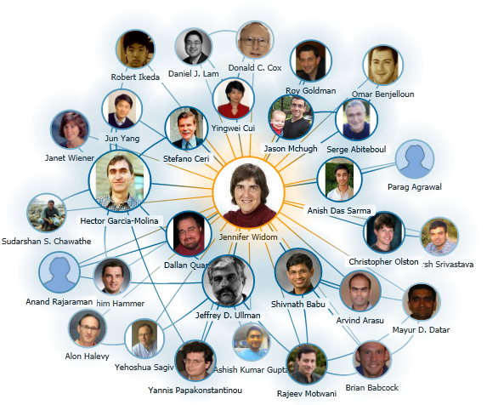
SimRank Overview
Similarity Computation plays a vital role in our lives.
Recommender
System
Citation Graph
Collaboration Network

Slide 4
SimRank Overview
SimRank
An appealing link-based similarity measure (KDD ’02)
Basic philosophy
Two vertices are similar if they are referenced by similar vertices.
Two Forms
Original form (KDD ’02)
Matrix form (EDBT ’10)
damping factor
similarity btw. nodes a and b
in-neighbor set of node b

Slide 5
Existing Computing Methods
State-of-the-art Method (VLDB J. ’10)
Partial Sum Memoization
Two Limitations
High computation time: O(Kdn²)
Low convergence rate:
memoize
reuse

Slide 6
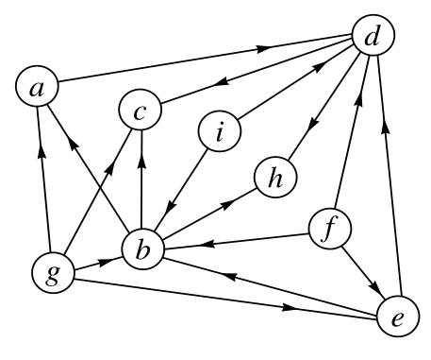
Naïve vs. VLDB J.’10
Example: Compute s(a,b), s(a,d)
b
g
b
g
g
e
e
f
f
i
i
a
Naïve
Duplicate
Computations
Notes:
Pictorially, we need to sum up 8 red squares together to compute s(a,b)
Likewise, to compute s(a,d), we need to sum up 8 blue squares.
Since I(d) and I(b) has 3 vertices in common. Thus, the summation over this region may have duplicate redundancy.
To remove such duplicate computations,

Slide 7
Naïve vs. VLDB J.’10
Example: Compute s(a,b), s(a,d)
b
g
g
e
f
i
Partial Sum
Memoization
Partial Sums Memoization (VLDB J.’10)
a
reuse

Slide 8
VLDB J.’10 Limitations
Example: Compute s(a,b), s(a,d), s(c,b), s(c,d)
b
g
b
g
d
g
g
e
e
f
f
i
i
a
Partial Sums
Duplicate
Redundancy
a

Slide 9
Motivation
Prior Work (VLDB J. ’10)
High time complexity: O(Kdn²)
Duplicate computation among partial sums memoization
Slow (geometric) convergence rate
Require K = ⌈log_{C}ϵ⌉ iterations to guarantee accuracy ϵ
Our Contributions
Propose an adaptive clustering strategy to reduce the time from O(Kdn²) to O(Kd’n²), where d’≤ d.
Introduce a new notion of SimRank to accelerate convergence from geometric to exponential rate.

Slide 10
Eliminating Partial Sums Redundancy
Main idea
share common sub-summations among partial sums
Example
fine-grained partial sums
NP-hard to find “best” partition for
Existing Approach
(3 additions)
Our Approach
(only 2 additions)
Partition
Duplicate Computation !!

Slide 11
Heuristic for Finding Partitions
Find: partitions for each in-neighbor set Minimize: the total cost of all partial sums
Main Idea
Calculate transition cost btw. in-neighbor sets
Construct a weighted digraph s.t.
Find a MST of to minimize the total transition cost

Slide 12
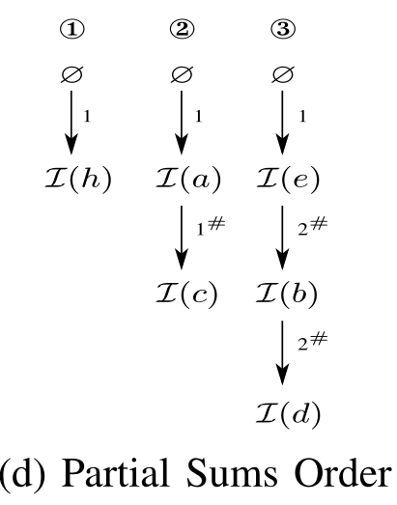
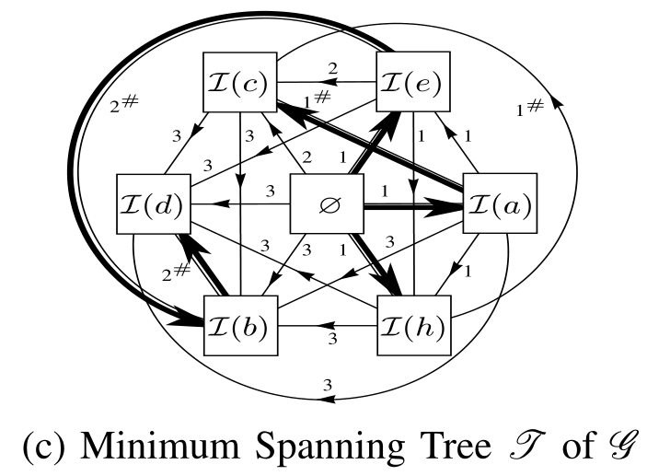
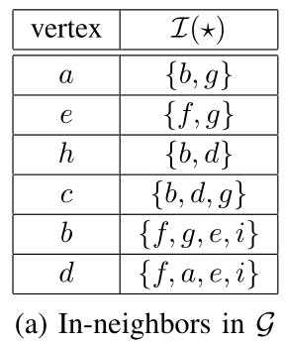
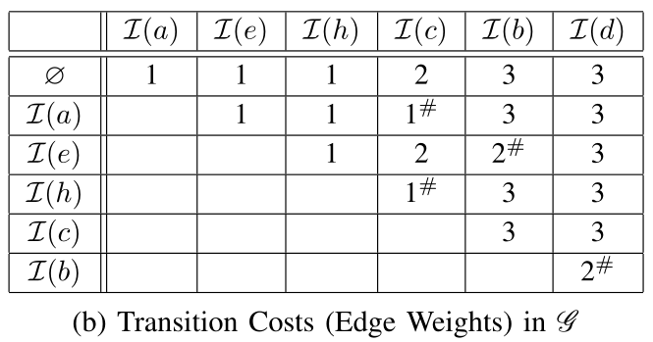
Example
(4)
(1)
(3)
(2)

Slide 13
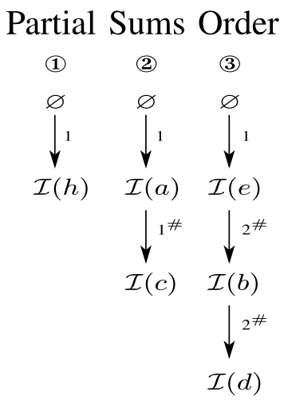
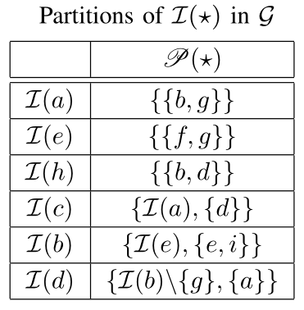
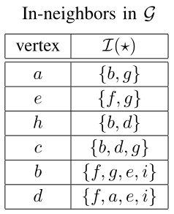
Example
(1)
d
+
+
b
+
(2)
g
-
f
+
i
+
e
+
a
+

Slide 14
Outer Partial Sums Sharing
(Inner) partial sums sharing
Outer partial sums sharing

Slide 15
Exponential SimRank
Existing Approach (VLDB J. ’10)
For , to guarantee the accuracy , there are
Our Approach
For , , we need only 7 iterations.
Geometric Rate
Exponential Rate

Slide 16
Exponential SimRank
Geometric Sum
Key Observation
The effect of C^{i} is to reduce the contribution of long paths relative to short ones
Main Idea
Accelerate convergence by replacing the geometric sum of SimRank with the exponential sum.
.
Differential Equation
Initial Condition
Normalized Factor
Exponential Sum

Slide 17
SimRank Differential Equation
Recursive form for Differential SimRank
Conventional computing method
Euler iteration: Set ,
Disadvantage: Hard to determine the value of h.
Our approach

Slide 18
SimRank Differential Equation
Accuracy Guarantee
#-Iterations
Use Lambert W function
Use Log function (for )
Example ( , )

Slide 19
Comparison
Geometric vs. Exponential SimRank
Closed form
Series form
Iterative form
Accuracy
(Geometric) SimRank
Exponential SimRank

Slide 20
Experimental Settings
Datasets
Real graph: BERKSTAN, PATENT, DBLP (D02, D05, D08, D11)
Synthetic data: SYN100K (via GTGraph generator)
Compared Algorithms
OIP-DSR: Differential SimRank + Partial Sums Sharing
OIP-SR: Conventional SimRank + Partial Sums Sharing
psum-SR [VLDB J. ’10]: Without Partial Sums Sharing
mtx-SR [EDBT ’10]: Matrix-based SimRank via SVD
Evaluations
Efficiency: CPU time, memory space, convergence rate
Effectiveness: relative order preservation of OIP-DSR

Slide 21
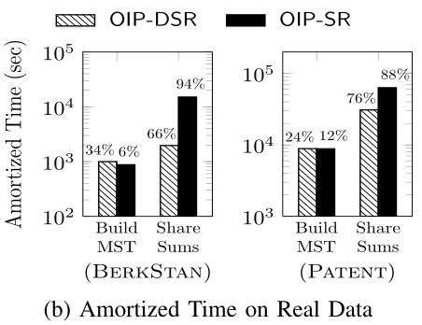
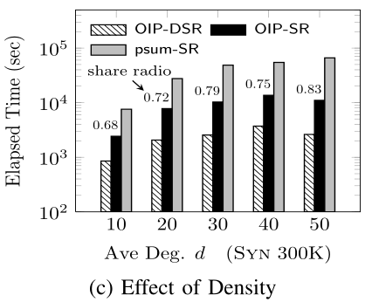
Time Efficiency

Slide 22
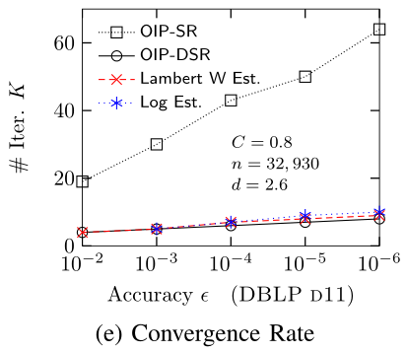
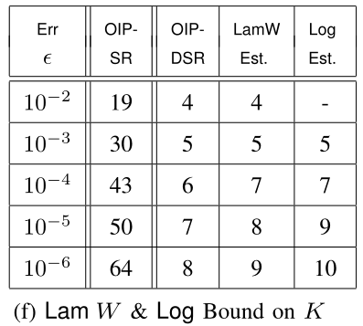
Space & Convergence Rate

Slide 23
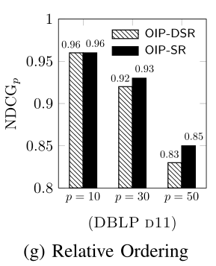
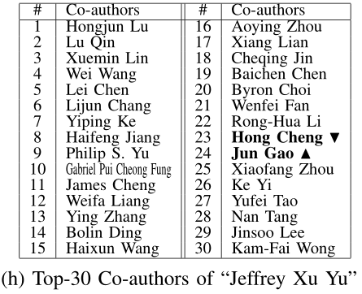
Relative Order Preservation

Slide 24
Conclusions
Two efficient methods are proposed to speed up the computation of SimRank on large graphs.
A novel clustering approach to eliminate duplicate computations among the partial summations.
A differential SimRank model for achieving an exponential convergence rate.
Empirical evaluations to show the superiority of our methods by one order of magnitude.

Slide 25
Thank you!
Q/A

