Slide 1
Finding Top k Most Influential Spatial Facilities over Uncertain Objects
School of Computer Science and Engineering
Liming Zhan Ying Zhang Wenjie Zhang Xuemin Lin
The University of New South Wales, Australia

Slide 2
Outline
Motivation
Problem Definition
Our Approach
Experiments
Conclusion

Slide 3
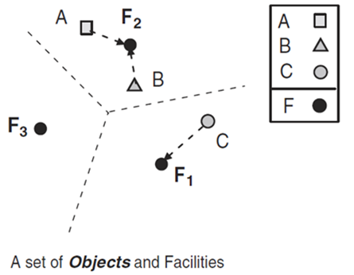
Motivation example: NN, RNN, Influential Sites
I(F₁)=1
I(F₂)=2
I(F₃)=0
I(F): influence score of F, which is the number of objects influenced by F, namely, treat F as the NN.

Slide 4
Motivation
Warehouse Management Systems
  RFID tags are attached to the items, whose locations can be obtained by RFID readers
  Find top k popular dispatching points.
Location Based Service (LBS)
  Mobile to identify users’ location
  Find the top k supermarkets which influence the largest number of users.

Slide 5
Influence Sites
Influence sets based on reverse nearest neighbor queries [SIGMOD 2000, Korn et al.]
On computing top-t most influential spatial sites (TkIS) [VLDB 2005, Xia et al.]

Slide 6
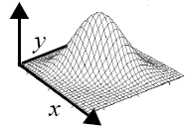
Uncertainty exists
Uncertainty
  RFID Reader: noisy
  Location of mobile users: imprecise
Uncertain objects
  Continuous: PDF
  Discrete: multiple instances

Slide 7
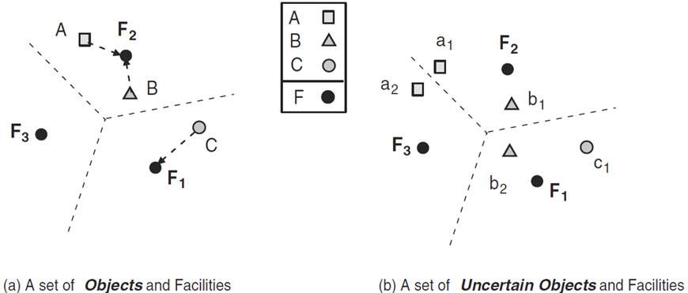
Motivating example

Slide 8
Challenge
Uncertain model
  Instances from an uncertain object may be influenced by several facilities – How to model the query.
Efficiency of the algorithm
  More complicated than that of traditional objects

Slide 9
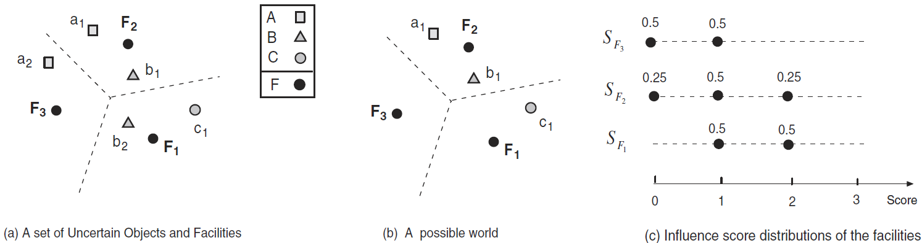
Example
[TKDE 2011, Zheng et al.]

Slide 10
Problem Statement
Given a set of uncertain objects O and a set of facilities F, find the k facilities with the highest expected influence scores.

Slide 11
Naïve method
  For each instance of an object, find the nearest facility f and increase the influential score of f by the probability of the instance.
  Return k facilities with highest scores.

Slide 12
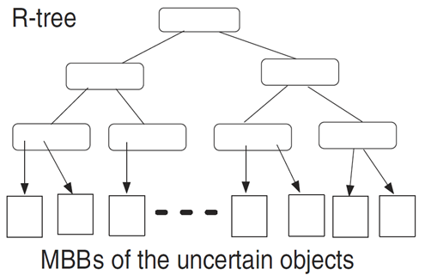
Data Structure: Global R-tree
  Global R-tree indexes the MBBs of all uncertain objects.
  MBB of an object is the minimum bounding box containing all its instances.
  Each leaf is a MBB of an object in the global R-tree.

Slide 13
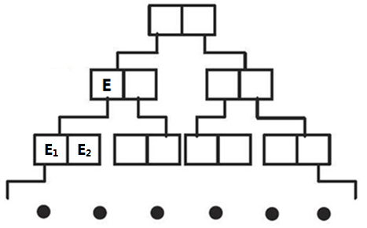
Data Structure: Local aR-tree (Aggregate R-tree)
  For each uncertain object, a local aR-tree is built to organize its multiple instance.
  For every intermediate entry E in the local aR-tree, the probability of E is the sum of probability of the instances considering E as an ancestor.
P(E)=P(E₁)+P(E₂)

Slide 14
Framework
Filtering
  Obtain tight lower and upper bounds for each facility and prune unpromising facilities.
  Process on global index - no object loaded.
Refinement
  For each candidate facility, compute influence score based on local aR-tree.

Slide 15
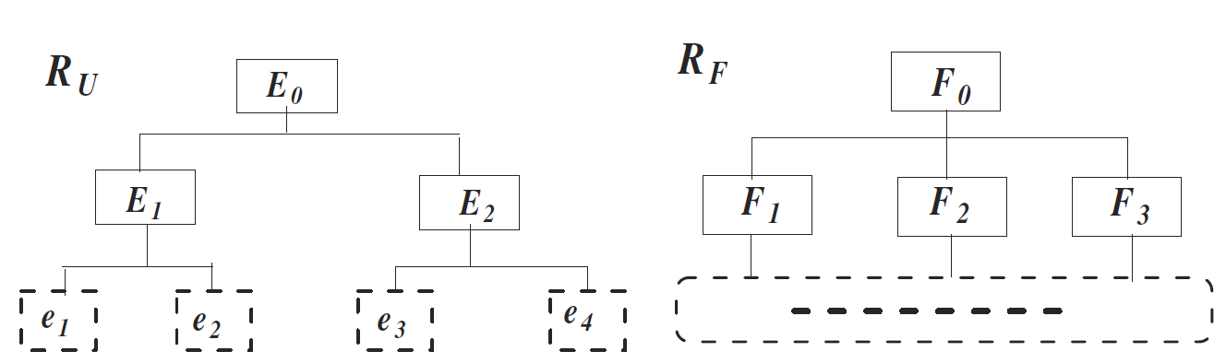
Filtering: Level by level
R_{U}: Objects R-tree
R_{F}: Facility R-tree
⋈
⋈
⋈

Slide 16
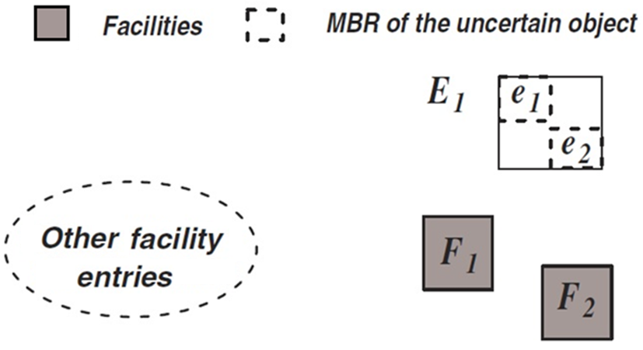
Filtering: upper bound of facility score
min distance
max distance
maxdist(F₁,E₁)< mindist(F_{i},E₁)
maxdist(F₂,E₁)< mindist(F_{i},E₁)
I⁺(F₁), I⁺(F₂) ← number of objects in E₁

Slide 17
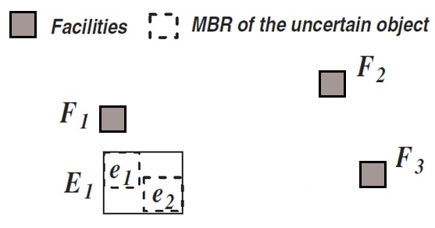
Filtering: lower bound of facility score
max distance
min distance
maxdist(F₁,E₁)< mindist(F₂,E₁)
maxdist(F₁,E₁)< mindist(F₃,E₁)
I⁻(F₁) ← number of objects in E₁

Slide 18
Filtering: get candidate
Sort facilities by lower bound in descending order
For top-K query
  Compare the lower bound of the K^{th} facility with the upper bound of the following facilities
Get candidate facilities dataset

Slide 19
Refinement
For each candidate facility, traverse all the possible influenced objects aR-tree to get the exact score.
Get the top k facilities with the highest influence scores.

Slide 20
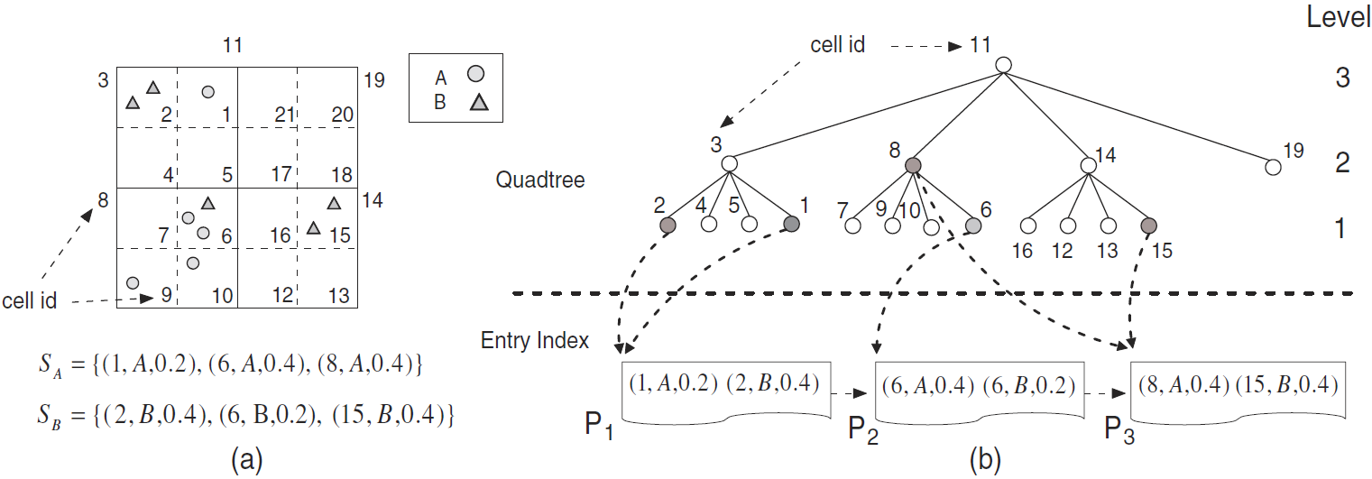
U-Quadtree as global index
EDBT 2012, Zhang et al.

Slide 21
Improvement by U-Quadtree
Filtering
  U-Quadtree build summaries of objects based on Quadtree, so we can get tighter upper and lower bounds to prune more objects.
Refinement
  Use the leaf cell of U-Quadtree to intersect the entries of aRtree to reduce the search space.

Slide 22
Experiments
Algorithms:
  Naïve: The naïve implementation
  RTKIS: The technique based on R-tree
  UQuadTKIS: The technique based on U-Quadtree
  UTKIS: The technique presented in [TKDE 2011, Zheng et al.]
Environment:
  PC with Intel Xeon 2.40GHz dual CPU
  4GB memory
  Debian Linux
  Disk page size is 4096 bytes

Slide 23
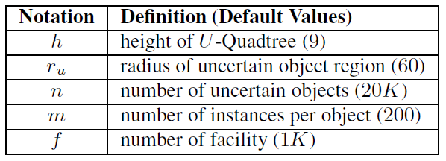
Experiments (Cont.)
Real datasets
  Center distribution: CA (62k), US (200k), R-tree-portal(21K)
  Normalized to [0,10000]
Parameters

Slide 24
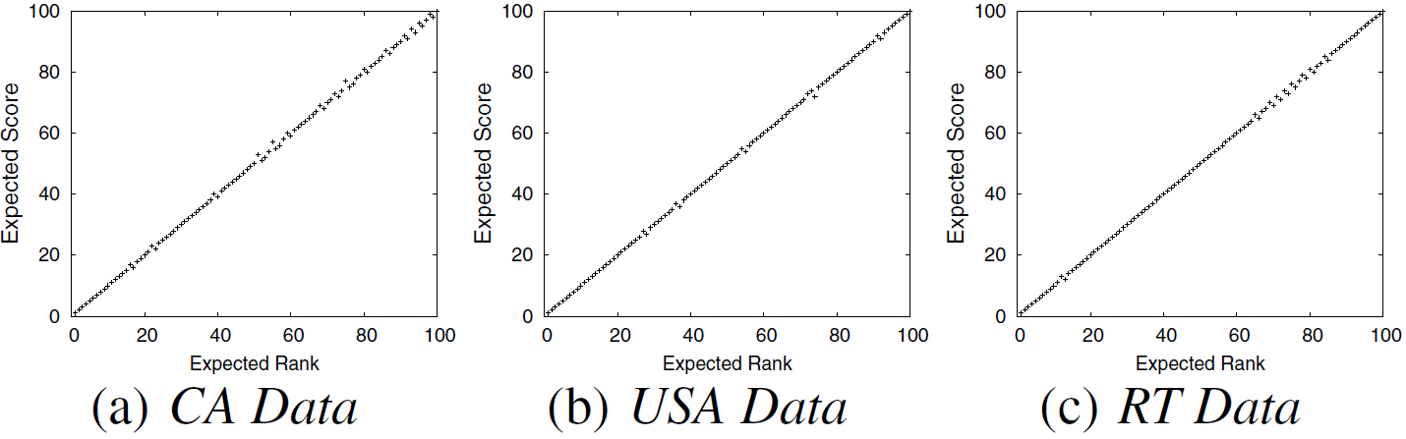
Experiments (Cont.)
Expected Score VS Expected Rank – Result Comparison

Slide 25
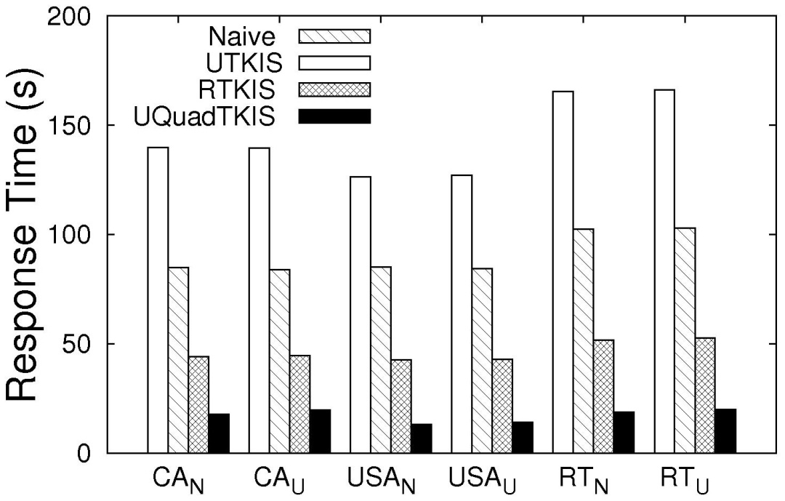
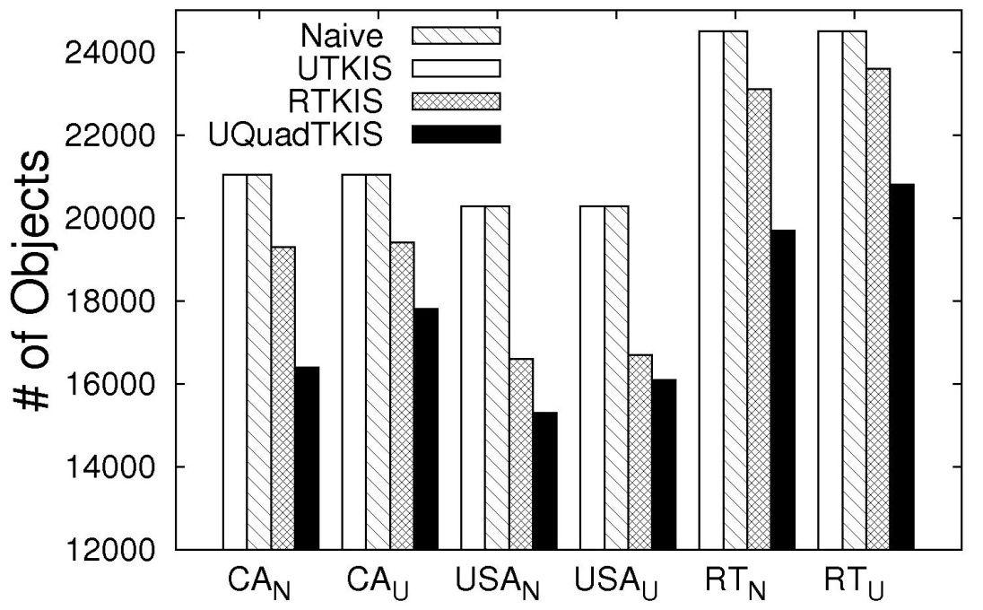
Experiments (Cont.)
Impact of Data Distribution

Slide 26
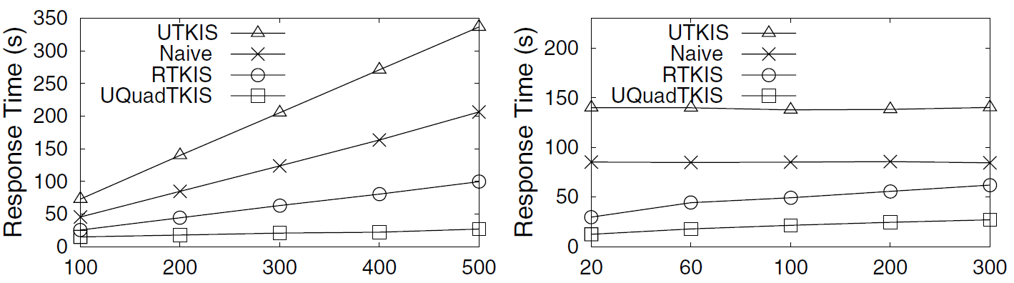
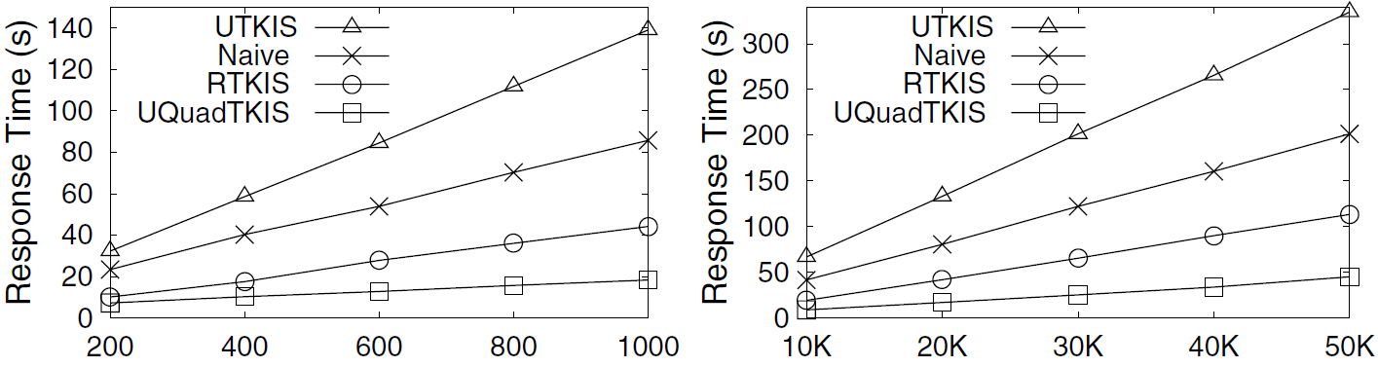
Experiments (Cont.)
Varying m
Varying r_{u}
Varying #facilities
Varying #objects

Slide 27
Conclusion
  We propose a new model to evaluate the influences of the facilities over a set of uncertain objects.
  Efficient R-tree and U-Quadtree based algorithms are presented following the filtering and refinement paradigm.
  Novel pruning techniques are proposed to significantly improve the performance of the algorithms by reducing the number of uncertain objects and facilities in the computation.
  Comprehensive experiments demonstrate the effectiveness and efficiency of our techniques.

Slide 28
Thank you!
Questions?

