Slide 1
Efficient Computing of Radius-Bounded-k-Cores
Kai Wang†, Xin Cao†, Xuemin Lin†, Wenjie Zhang†, Lu Qin‡
†University of New South Wales, ‡University of Technology Sydney

Slide 2
Outline
Motivation
Problem definition
Solutions
Experiments
Conclusion

Slide 3
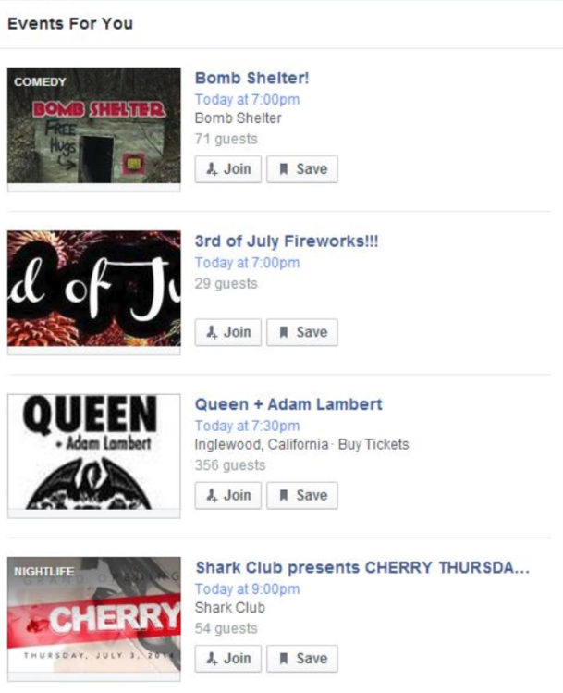
Motivation
Geo-social networks:
Community retrieval over geo-social networks:
Notes:
Geosocial Network is a type of social networking in which uses geographic information to enable additional social dynamics. Geolocation techniques can allow social networks to connect and coordinate users with local people or events that match their interests. For example, Events-For-You is a part of Facebook, which can recommend events to users based on their personal locations and social relationships. Nevertheless, the current technology cannot provide a service of EventsFor-You based on users’ arbitrary requests.

Slide 4
Motivation
Geo-social networks → Spatial graphs
Paul
Social networks → Graphs
Community retrieval over social networks
→ Cohesive subgraph mining over spatial graphs
Jim
Adam
Roy
Ken
Leo
Bob
Bill
Taylor
Lee
Mark
Frank
John
Notes:
The vertices represent the social network users and the edges represent their relationships in geo-social networks. Each vertex v ∈ V (G) has a location (v.x, v.y) which denotes the position of v along x- and y-axis in a two-dimensional space In geo-social networks, a user often associated with location information(spatial graphs). It is important to find groups of people who are physically close to each other.

Slide 5
Community retrieval
Spatial databases
- Spatial keyword query[6], locality search[7], …
Non-spatial graphs
- Models: k-core[1], k-truss[4], clique[5], …
Spatial graphs
- Spatial-aware-community search[2], (k, r)-core[3], …
[1] S. B. Seidman. Network structure and minimum degree. Social networks, 5(3):269–287, 1983.
[2] F. Zhang, Y. Zhang, L. Qin, W. Zhang, and X. Lin, “When engagement meets similarity: efficient (k, r)-core computation on social networks,” PVLDB, 2017.
[3] Y. Fang, R. Cheng, X. Li, S. Luo, and J. Hu, “Effective community search over large spatial graphs,” PVLDB, 2017.
[4] J. Cohen, “Trusses: Cohesive subgraphs for social network analysis,” NSATR, vol. 16, 2008. [5] R. D. Luce and A. D. Perry, “A method of matrix analysis of group structure,” Psychometrika, vol. 14, no. 2, pp. 95–116, 1949 [6]T. Guo, X. Cao, and G. Cong, “Efficient algorithms for answering the m-closest keywords query,” in SIGMOD. [7] Q. Qu, S. Liu, B. Yang, and C. S. Jensen, “Efficient top-k spatial locality search for co-located spatial web objects,” in Mobile Data Management (MDM), 2014
Notes:
Categorized the existing studies into three categories.
In spatial databases, several works studied the group objects retrieval problem based on users’ spatial locations . Prior works studied various models such as k-core [4], ktruss [5], and clique [6] to retrieve communities based on users’ social connections.
some works studied the community retrieval problem considering both the spatial and social features.

Slide 6
k-core
Given a graph G, the k-core of G is a maximal subgraph where each node has at least k neighbors.
v₇
v₄
v₆
3-core
v₂
v₃
v₅
v₁
v₈
Applications:
community detection, user engagement, event detection, ……

Slide 7
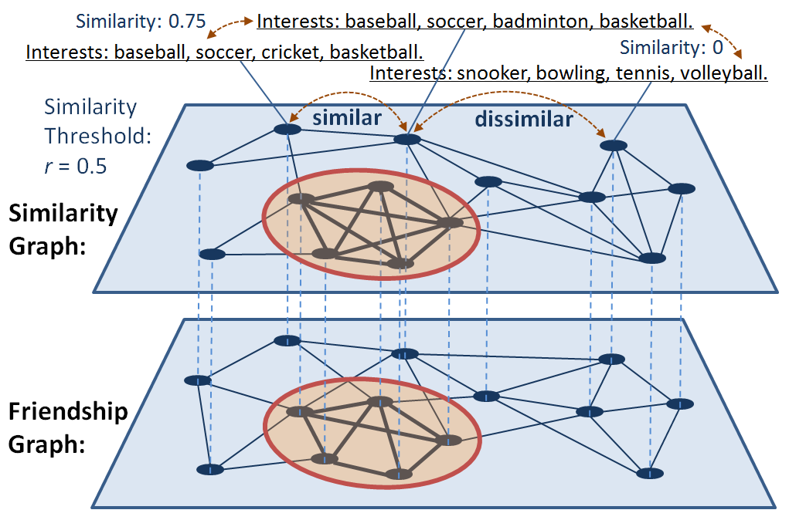
(k, r)-core
-- Social cohesiveness: Find maximal k-cores and the maximum k-core.
-- Structure cohesiveness: Constraint pairwise similarity between each pair of vertices.
-- an NP-hard problem.
Notes:
[2] solving the community detection problem mainly focused on analyzing and understanding the complexity networks rather than online community search. Fang et al. [3] proposed both exact and approximate algorithms to find a community covered by the smallest circle for a given query vertex. In their work, the radius of circle is not given by users and only one community covered by the smallest circle is returned to users, and thus it cannot provide more options for users as done by our work

Slide 8
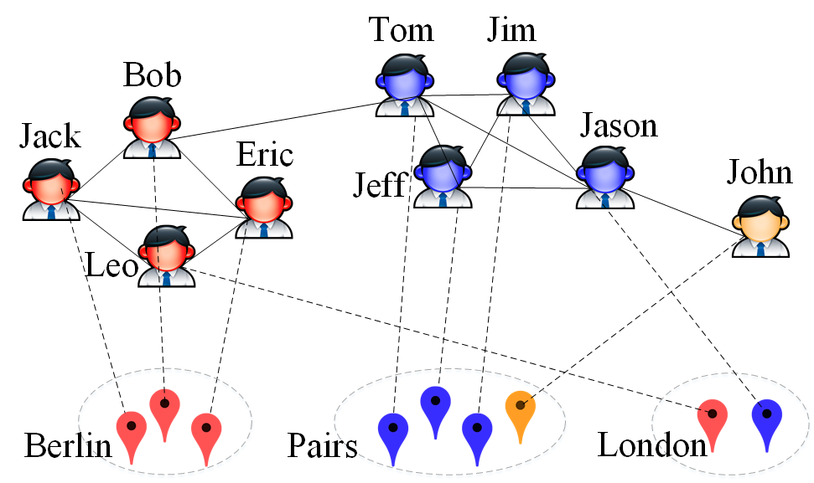
Spatial-aware-community search
-- Find the k-core containing the query vertex covered by the smallest circle.
-- Only able to provide users one selection.
-- Our techniques can be applied to this problem and achieve a speed-up around twice.
Notes:
[2] solving the community detection problem mainly focused on analyzing and understanding the complexity networks rather than online community search. Fang et al. [3] proposed both exact and approximate algorithms to find a community covered by the smallest circle for a given query vertex. In their work, the radius of circle is not given by users and only one community covered by the smallest circle is returned to users, and thus it cannot provide more options for users as done by our work

Slide 9
Motivation
Paul
Radius-Bounded k-Core Search
Event recommendation,
Location-aware marketing,
...
Jim
Adam
Roy
Ken
Leo
Bob
Bill
Taylor
Lee
Mark
Frank
John
Notes:
Now, the motivation of our radius-bounded k-core search is also retrieval communities for a query user. For instance, in the following example, given a query user Leo, we will find the groups in red and in blue colors.

Slide 10
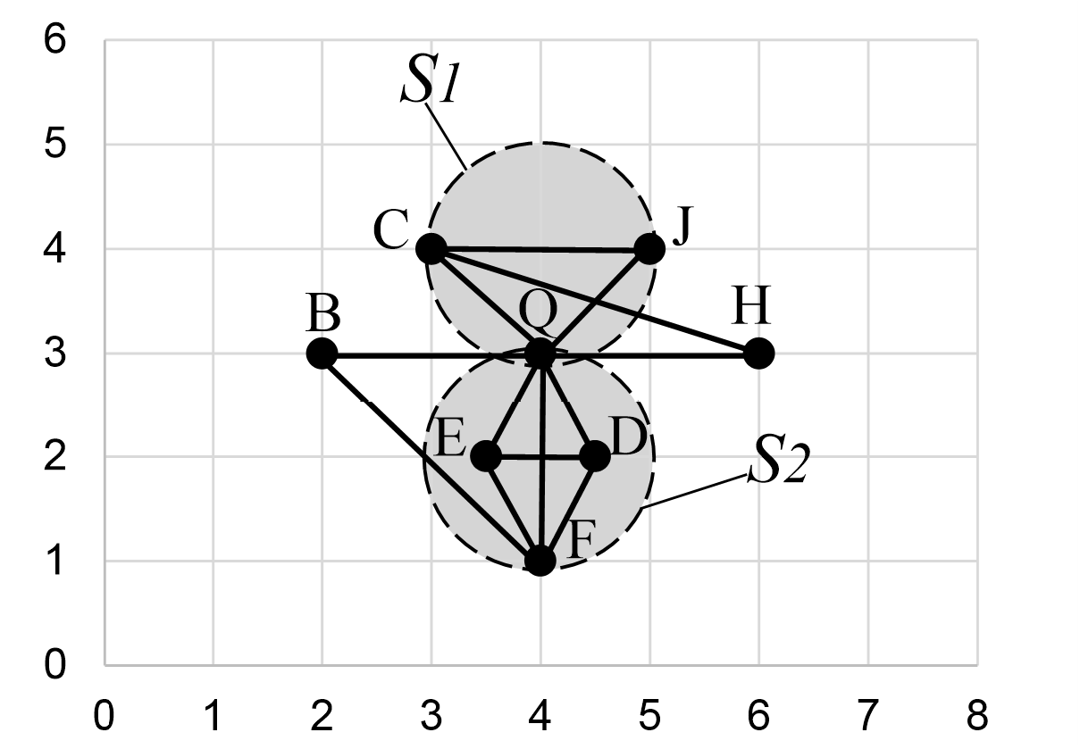
Problem Definition
Given a graph G(V, E), a vertex q ∈ V (G), k and r, G_{q} is a Radius-Bounded-k-Core (RB-k-Core), if it satisfies:
Connectivity constraint. G_{q} is connected and it contains q.
Structure constraint. k-core (It can be replaced by k-truss, k-clique,…).
Spatial constraint. All vertices in G_{q} fall into a circle with radius r.
Maximality constraint. No other RB-k-Core G’_{q} ⊇ G_{q.}
q = Q, k = 2 and r = 1

Slide 11
Challenges
The position of the radius-bounded circle of a RB-k-core is unknown.
It is time-consuming to verify all the candidate subgraphs individually.
Notes:
1) The location of the radius-bounded circle of a RBk-core is unknown. Therefore, it is a challenge to efficiently enumerate such circles. 2) During the process of finding RB-k-cores, it is time-consuming to construct and verify the candidate subgraphs individually. Therefore, it is important to reuse intermediate computation results and explore possible cost sharing which is challenging.

Slide 12
Solutions
Two steps framework:
Step 1: Generate candidate circles.
Step 2: Compute the maximum k-core in each candidate circle.
Solution 1: Triple-vertex-based algorithm (TriV, Baseline)
Solution 2: Binary-vertex-based algorithm (BinV)
Solution 3: Rotating-circle-based algorithm (RotC)

Slide 13
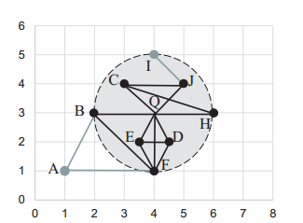
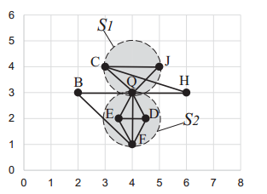
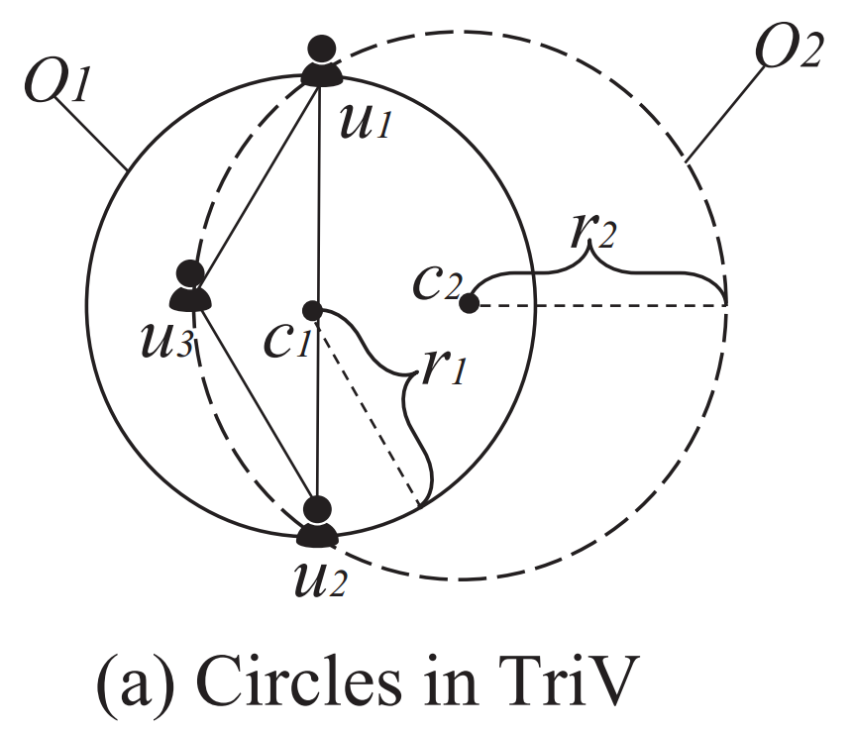
Triple-vertex-based algorithm
Motivation: A circle should have two or three vertices lying on its boundary.
q = Q, k = 2 and r = 1
Select candidate vertices.
Enumerate all candidate triple-vertex- and binary-vertex-combinations as boundary vertices.
Check the subgraph enclosed by the circles.
Time Complexity
O(n³ · m + n² · m),
n=|V|, m=|E|
Can we only enumerate all triple-vertex-combinations?
Notes:
We can safely remove vertex A because d(A, Q) > 2r = 2 and vertex I because I is not in the 2-core of G. Then we can obtain the candidate geo-social subgraph.
we can find two RB-k-cores G(S1) and G(S2), where S1 = {Q, C, J} and S2 = {Q, D, E, F }.

Slide 14
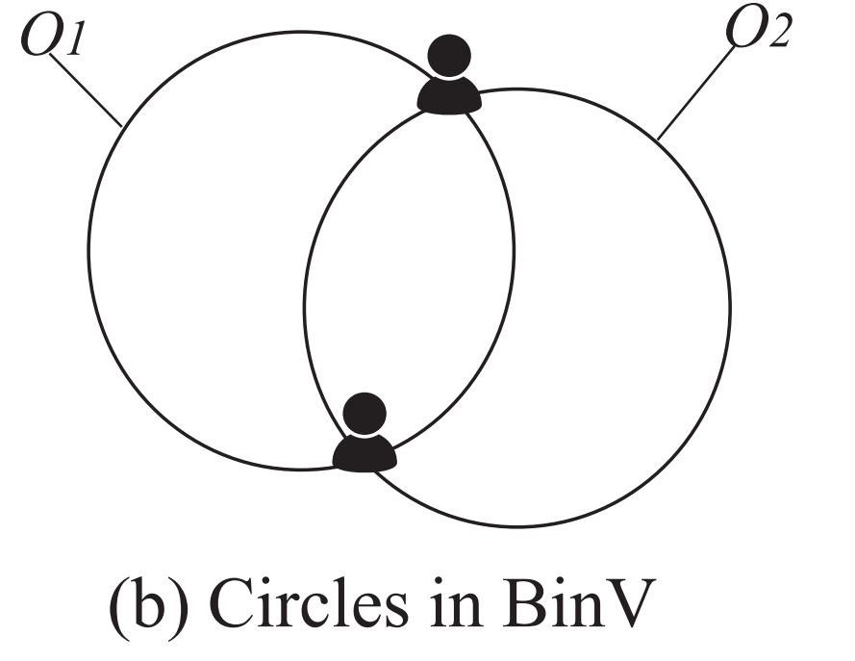
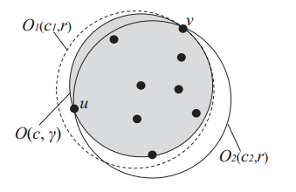
Binary-vertex-based algorithm
In TriV, we need to verify O(n³ +n²) candidate subgraphs.
Observation: For each RB-k-core, it should be enclosed in at least one circle with radius r.
Enumerate all candidate triple-vertex-combinations and binary-vertex-combinations as boundary vertices.
Time complexity O(n² · (n + m)).
Notes:
(1) If γ = r, by Lemma 1, there should exist at least two vertices on the boundary of O(c, γ), and thus Lemma 3 holds. (2) If γ < r, we take Figure 4 as an example to explain the proof process. We can choose any vertex v which lies on the boundary of O(c, γ), and draw a circle O1(c1, r) which internally tangents with O(c, γ) at vertex v. Apparently, O1(c1, r) can enclose all the vertices of V (Gr k) (enclosed in O(c, γ)). Then we can always rotate O1(c1, r) anticlockwise and stop at the position (i.e., O2(c2, r)) when O1(c1, r) first meets a vertex u in O(c, γ). Because during this process all vertices of V (Gr k) are always in the intersection of two circles, O2(c2, r), a binary-vertexbounded circle which takes u and v as the boundary vertices, encloses all vertices of V (Gr k), and thus Lemma 3 holds.

Slide 15
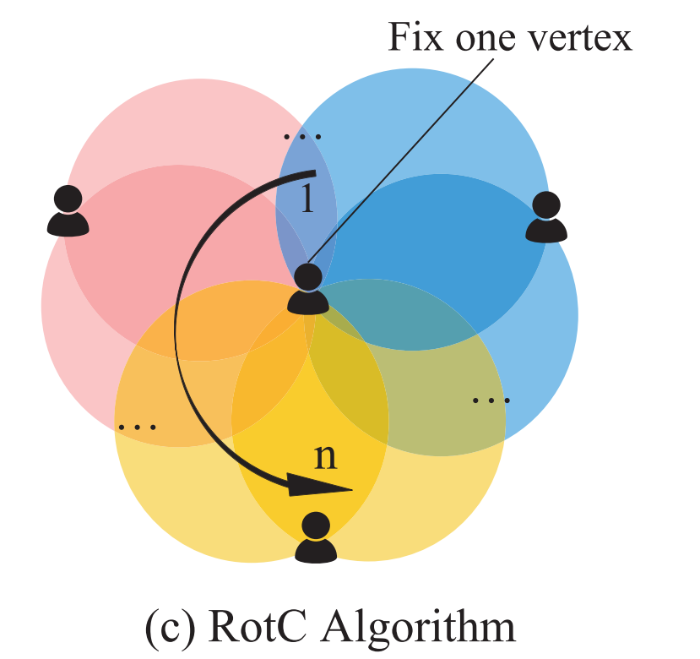
Rotating-circle-based algorithm
Observation: The candidate subgraphs in BinV is constructed and verified individually.
O3
Improve the BinV algorithm by exploring possible cost sharing.
Q
O4
O2
E
D
O1
O5
Main Steps:
Choose a fix vertex (F)
Sort candidate circles
Verify candidate graphs incrementally
F
The time complexity of RotC is O(n² · (log n + m’)), where m’ << m.
Notes:
we consider putting these binary-vertex-bounded circles into a polar coordinate system using F as the fix vertex(pole), and sorting these binary-vertex-bounded circles according to their centers’ polar angles. a list of sorted circles L = {O1, O2, O3, O4, O5}. Specifically, in Figure 5(c), O2 and O3 are two adjacent binary-vertex-bounded circles. We can observe that for these two induced subgraphs G(X2) and G(X3) where their binary-vertex-bounded circles adjacent to each other, V (G(X2)) is only one vertex (vertex q) difference from V (G(X3)). Based on this observation, we devise a novel algorithm which shares the construction and verification cost for these candidate subgraphs.

Slide 16
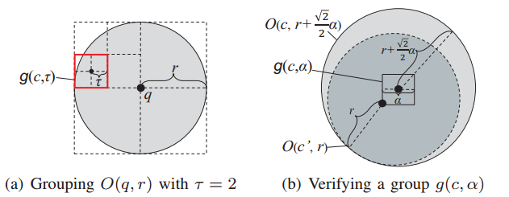
Optimization techniques
Grouping-based Pre-Process Pruning.
-- All the centers of MCCs of RB-k-cores are in the circle O(q, r).
-- The circle O(q, r) can be partitioned into groups.
In-Process Pruning.
-- Overall Checking of a fix vertex. -- Circle Filtering.
Notes:
Reviewing the process of the RotC algorithm, we choose a vertex v from V (Gk) as the fix vertex and generate a candidate vertex set S ={u ∈ V (Gk) | d(u, v) ≤ 2r}.
Firstly, we can prune all the circles which exclude the query vertex q. We divide the circles into two groups, the entering circles and leaving circles, respectively. For each entering circle, we record the vertex it brings in and for each leaving circle, we record the vertex it moves out. It is obvious that the number of vertices in V(Oenter) monotonously increase with the index of Oenter in Lenter.

Slide 17
Experiments
Notes:
We use four real datasets in our experiments including Brightkite, Gowalla, Flickr, and Foursquare. In the four datasets, we consider each user associated with a geo-location coordinate (latitude and longitude) as a vertex and the friendship between two users is represented by an edge. Helmert transformation [13] is adopted to transform geo-location coordinates of vertices to Cartesian coordinates.

Slide 18
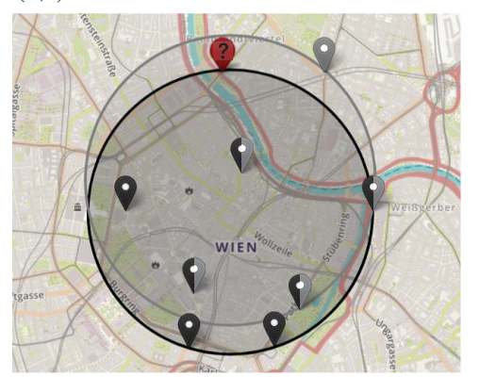
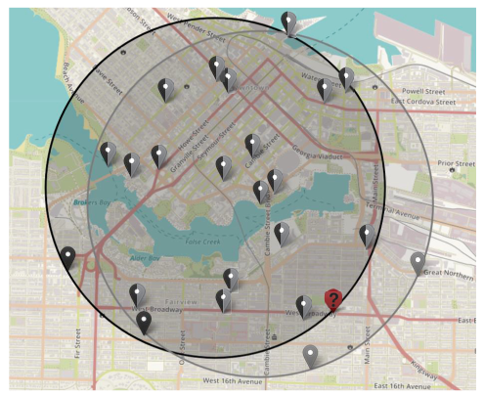
Effectiveness
Case study on Gowalla
Case study on Flickr
Notes:
We mark the vertices and the MCC of these two RB-k-cores in black color and grey color, respectively. We can see that, the social constraint and the spatial constraint both contribute to the construction of these two RB-k-cores. For example, if the social constraint is ignored, the black vertices enclosed by the grey circle will be included in the grey RB-k-core. On the other hand, all the vertices in Figure 7 will be united into one community if the radius constraint is not being considered. Using the same q and k, the SAC search (i.e., a similar model in [3]) will provide the communities with black color as shown in Figure 7 and Figure 8. The radius of the black circles are 0.74km and 1.67km in Figure 7 and Figure 8,respectively. Comparing with the SAC search, in Figure 7, our RB-k-core search can give users more options by slightly increasing the minimum radius (i.e., from 0.74km to 0.76km) for the same q and k. In Figure 8, the RB-k-core search is able to provide users more than one selection for the same q, k, and minimum r.

Slide 19
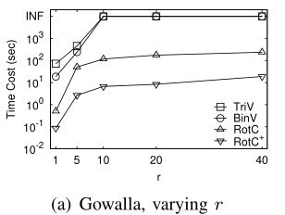
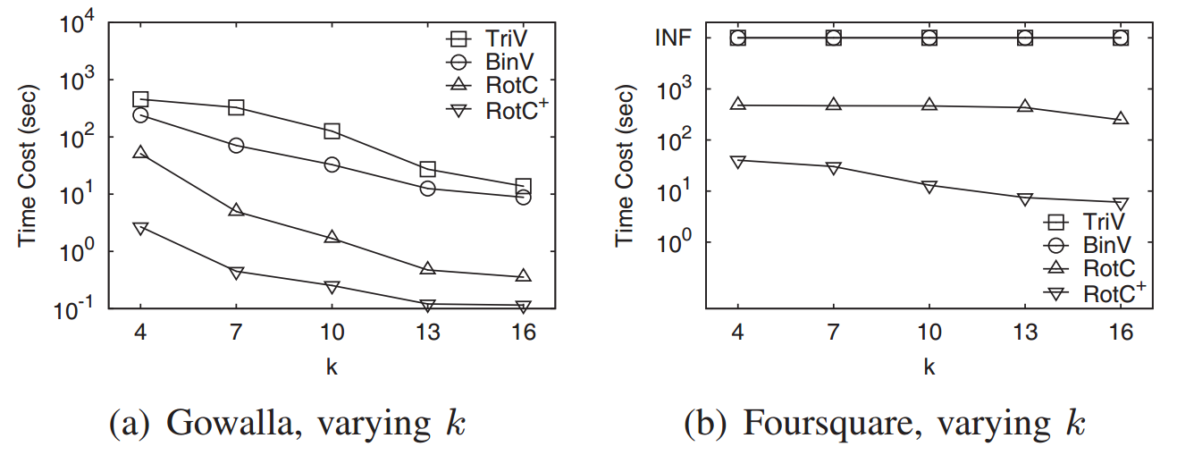
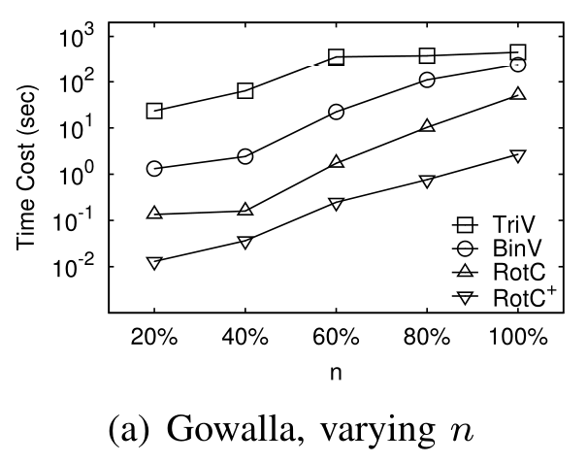
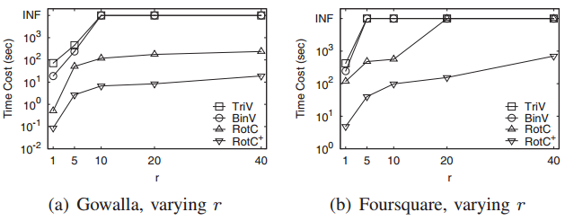
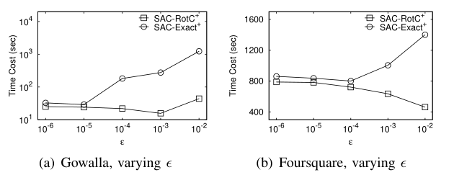
Efficiency
(c)
Extend to solve SAC search problem
(d)
(e)
Notes:
As expected, RotC and RotC+ significantly outperform TriV and BinV on both datasets because of using the rotating circle technique. For example, on both datasets, RotC is about one order of magnitude faster than TriV and BinV and RotC+ is at least two orders of magnitude faster than TriV and BinV. we compare its performance with the state-ofthe-art exact algorithm SAC-Exact+ proposed in [3]. Comparing the minimal time cost of the two algorithms on both datasets in our experiments, we can conclude that SAC-RotC+ can achieve a speed-up around twice.

Slide 20
Conclusion
Propose RB-k-core model and a novel paradigm to compute RB-k-cores.
Propose several optimization techniques.
Extend our algorithms to solve the SAC search problem.
Conduct extensive experiments on real and synthetic datasets.

Slide 21
Thank You! Q&A
End

