Slide 1
Efficiently Reinforcing Social Networks
over User Engagement and Tie Strength
${Fan Zhang}^{1}$, ${Ying Zhang}^{2}$, ${Lu Qin}^{2}$, ${Wenjie Zhang}^{1}$, ${Xuemin Lin}^{1}$
Computer Science and Engineering
$1$University of New South Wales, 2 University of Technology Sydney

Slide 2
The Collapse of Friendster
Founded in 2002.
Popular at early 21st century with over 115 million users.
Suspended in 2015 for lack of user engagement.
D. Garcia, P. Mavrodiev, and F. Schweitzer. Social resilience in online communities: the autopsy of friendster. In COSN, pages 39–50, 2013.
K. Seki and M. Nakamura. The collapse of the friendster network started from the center of the core. In ASONAM, pages 477–484, 2016.

Slide 3
Prevent Network Unraveling
K. Bhawalkar, J. Kleinberg, K. Lewi, T. Roughgarden, and A. Sharma. Preventing unraveling in social networks: the anchored k-core problem. SIAM Journal on Discrete Mathematics, 29(3):1452–1475, 2015.
The engagement of a user is influenced by the number of her engaged friends.
k-Core: a maximal subgraph where each vertex has at least k neighbors.
S. B. Seidman. Network structure and minimum degree. Social networks, 5(3):269–287, 1983.
“promiscuous subgraphs”,
“seedbeds, within which cohesive subsets can precipitate out”.

Slide 4
The Model of k-Truss
J. Cohen. Trusses: Cohesive subgraphs for social network analysis. National Security Agency Technical Report, page 16, 2008.
The strength of a tie can be estimated by the number of triangles containing it.
Edge Support: the support of an edge in S is the number of triangles which contains the edge in S.
k-Truss: a maximal subgraph where each edge has a support of at least k-2 in k-truss.
M. Wang, C. Wang, J. X. Yu, and J. Zhang, Community detection in social networks: An in-depth benchmarking study with a procedure-oriented framework. PVLDB, 8(10):998–1009, 2015.
High quality on some community metrics.
High accuracy on approximating ground-truth communities.
The most efficient one among all the evaluated algorithms.

Slide 5
The Computation of k-Truss
Compute the (k-1)-core.
Compute the support of each edge.
Recursively delete each edge with support of less than k-2.
Delete the isolated vertices.
$4$-truss
$$v_{2}$$
$$k=4$$
$$2$$
$$v_{5}$$
$$v_{10}$$
$$2$$
$$2$$
$$2$$
$$1$$
$$v_{8}$$
$$v_{1}$$
$$v_{3}$$
$$2$$
$$v_{6}$$
$$2$$
$$v_{11}$$
$$1$$
$$2$$
$$2$$
$$v_{9}$$
$$2$$
$$v_{7}$$
$$v_{4}$$
$$2$$
$$v_{12}$$

Slide 6
Anchored k-Truss Problem
k-Truss: a maximal subgraph where each edge has a support of at least k-2 in k-truss.
Anchor: a node which always exists in k-truss. An incident edge is retained in k-truss if it has a support of at least 1 in k-truss.
Anchored k-Truss: the k-truss of a graph with some anchors.
Follower: a node v is a follower of an anchor u, if v is not in k-truss but belongs to anchored k-truss by anchoring u.
Anchored k-Truss Problem: find b anchors which has the largest number of followers, i.e., the largest anchored k-truss.
NP-hard when k $≥$ 4.

Slide 7
Anchored k-Truss Problem
Find b anchors which has the largest anchored k-truss.
$anchored 4$-truss by ${ v}_{1}$
$$k=4$$
$4$-truss
$$v_{2}$$
$$2$$
$$v_{5}$$
$$v_{10}$$
$$2$$
$$2$$
$$2$$
$$1$$
$$1$$
$$v_{8}$$
$$v_{1}$$
$$v_{6}$$
$$1$$
$$2$$
$$v_{3}$$
$$2$$
$$1$$
$$v_{11}$$
$$1$$
$$2$$
$$2$$
$$v_{9}$$
$$2$$
$$v_{7}$$
$$0$$
$$v_{4}$$
$$2$$
$$v_{12}$$

Slide 8
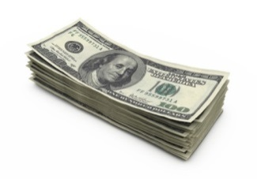
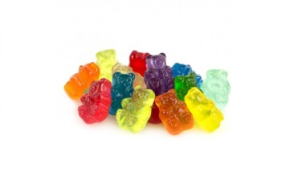
Anchored k-Truss Problem
The best anchor is ${ v}_{1}.$
$$k=4$$
$anchored 4$-truss by ${ v}_{1}$
$4$-truss
$$v_{2}$$
$$2$$
$$v_{5}$$
$$v_{10}$$
$$2$$
$$2$$
$$2$$
$$1$$
$$1$$
$$v_{8}$$
$$v_{1}$$
$$v_{6}$$
$$1$$
$$2$$
$$v_{3}$$
$$2$$
$$1$$
$$v_{11}$$
$$1$$
$$2$$
$$2$$
$$v_{9}$$
$$2$$
$$v_{7}$$
$$0$$
$$v_{4}$$
$$2$$
$$v_{12}$$

Slide 9
A Greedy Heuristic (AKT)
Find 1 best anchor which has the largest number of followers in each iteration.
Optimization objectives：
Obj-$1$. Prune unpromising candidate anchor vertices.
Obj-2. Speed up anchored k-truss computation for one anchor.

Slide 10
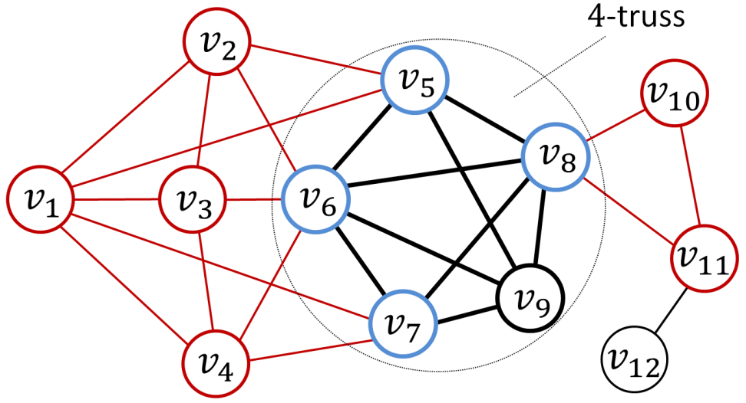
Theorems for Anchoring One Node
k-Hull: the subgraph induced by k-truss / (k+1)-truss.
k-Hull+: k-hull + the endpoints of each edge in k-hull.
Theorem 1: if v is a follower of u, v $∈$ (k-1)-hull or v = u.
Theorem 2: if u has at least 1 follower besides itself, we have
u $∈$ (k-1)-hull+ or
u is not in (k-1)-truss and u forms a triangle with an edge in (k-1)-hull.
Obj-2.
Obj-1.
$$k=4$$
3-hull:
3-hull+:

Slide 11
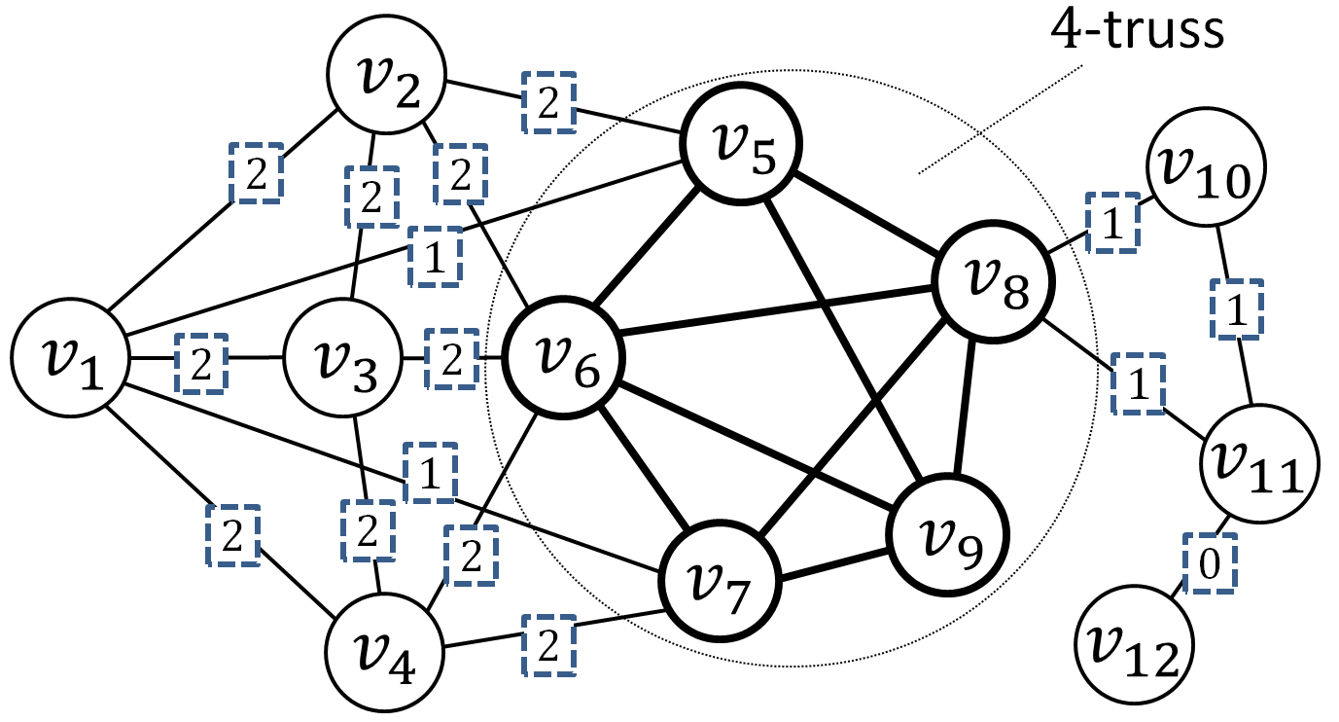
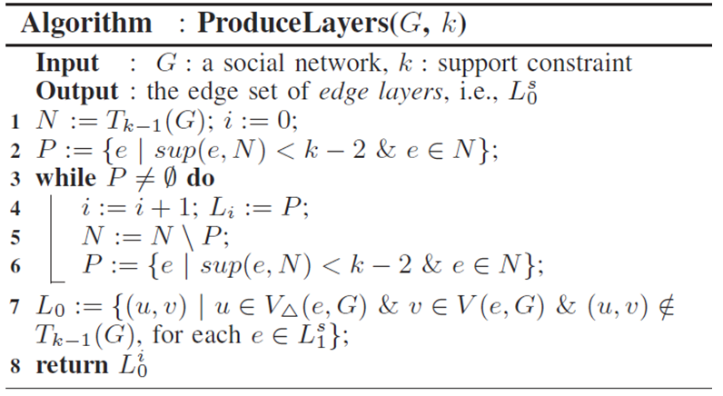
The Edge Layers
A structure based on (k-1)-hull+ and (the vertices which are not in (k-1)-truss and each forms a triangle with an edge in (k-1)-hull).
Significantly improve Obj-2.
$$x$$
: support value
$$k=4$$
$$x$$
: layer number

Slide 12
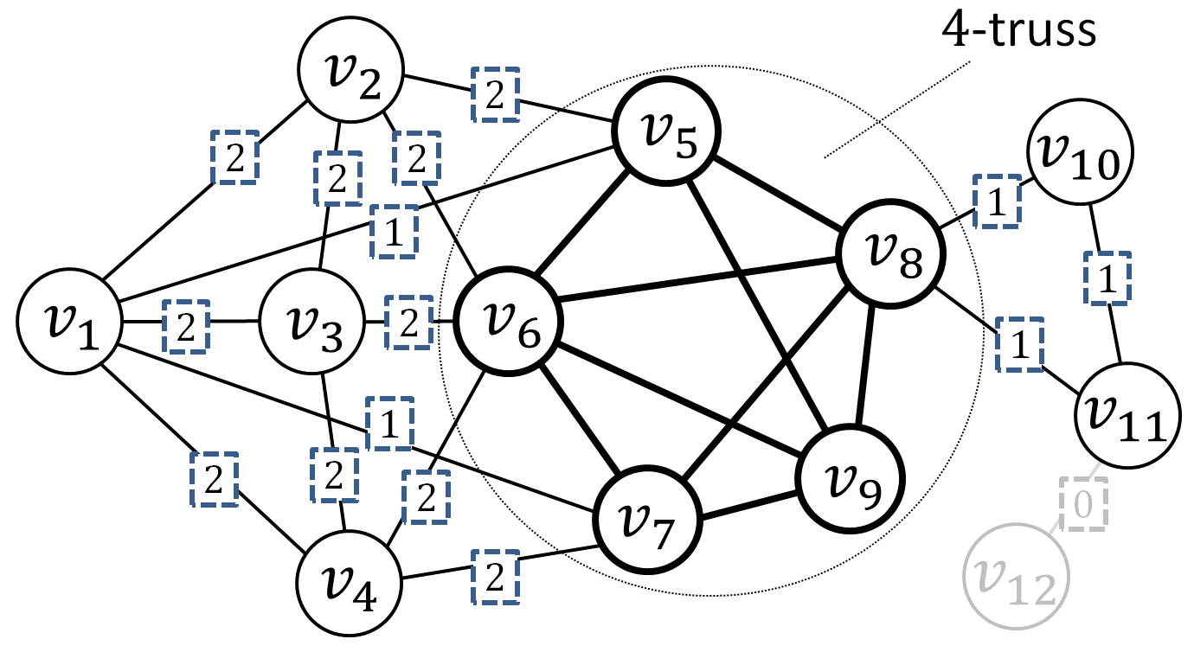
The Edge Layers
A structure based on (k-1)-hull+ and (the vertices which are not in (k-1)-truss and each forms a triangle with an edge in (k-1)-hull).
Significantly improve Obj-2.
$$x$$
: support value
$$k=4$$
$$x$$
: layer number

Slide 13
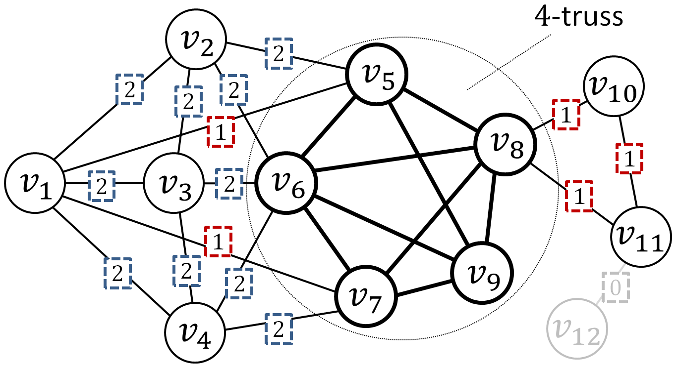
The Edge Layers
A structure based on (k-1)-hull+ and (the vertices which are not in (k-1)-truss and each forms a triangle with an edge in (k-1)-hull).
Significantly improve Obj-2.
$$x$$
: support value
$$k=4$$
$$x$$
: layer number

Slide 14
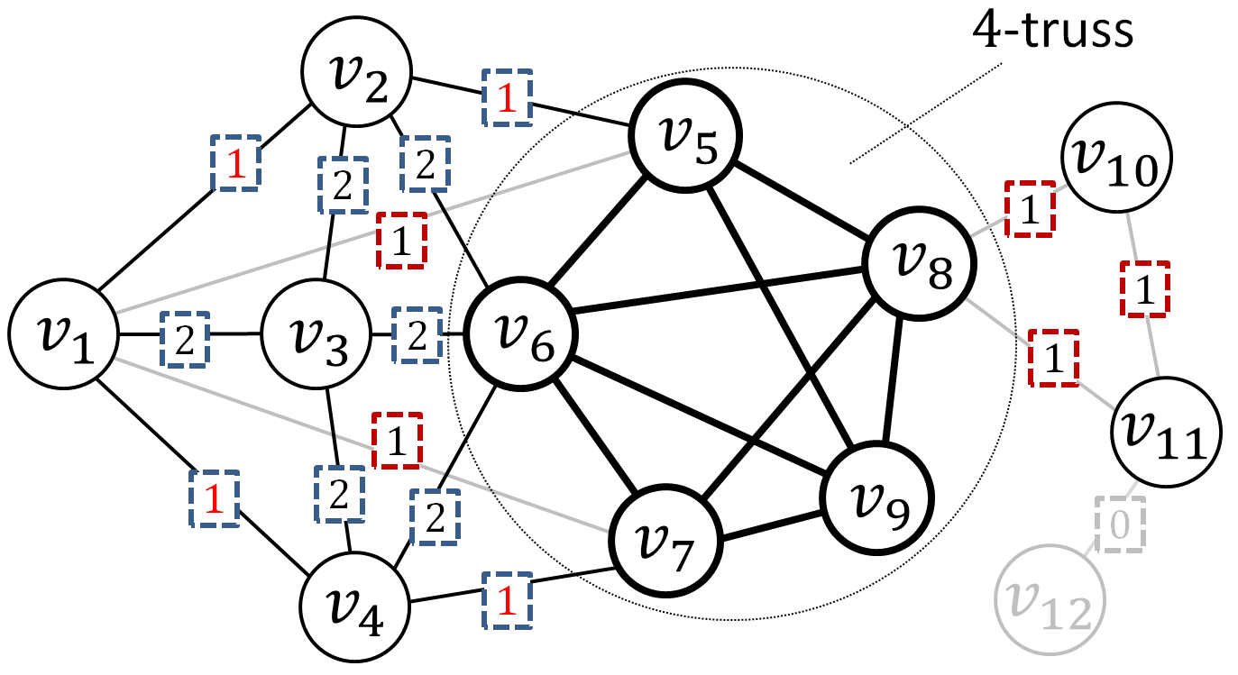
The Edge Layers
A structure based on (k-1)-hull+ and (the vertices which are not in (k-1)-truss and each forms a triangle with an edge in (k-1)-hull).
Significantly improve Obj-2.
$$x$$
: support value
$$k=4$$
$$x$$
: layer number

Slide 15
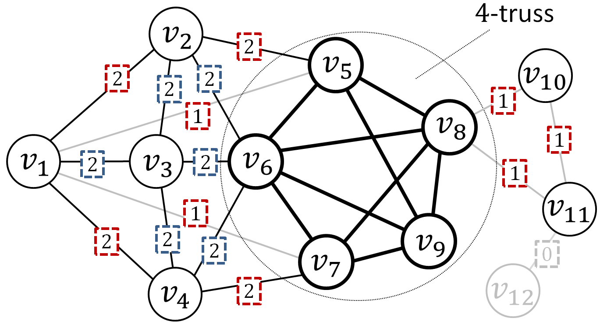
The Edge Layers
A structure based on (k-1)-hull+ and (the vertices which are not in (k-1)-truss and each forms a triangle with an edge in (k-1)-hull).
Significantly improve Obj-2.
$$x$$
: support value
$$k=4$$
$$x$$
: layer number

Slide 16
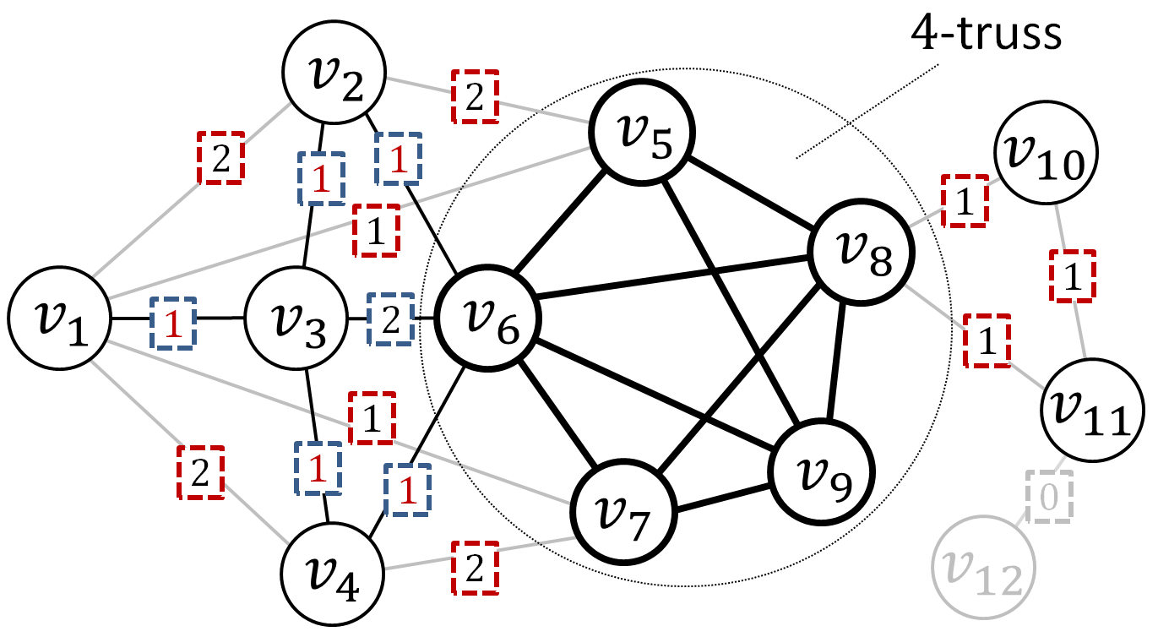
The Edge Layers
A structure based on (k-1)-hull+ and (the vertices which are not in (k-1)-truss and each forms a triangle with an edge in (k-1)-hull).
Significantly improve Obj-2.
$$x$$
: support value
$$k=4$$
$$x$$
: layer number

Slide 17
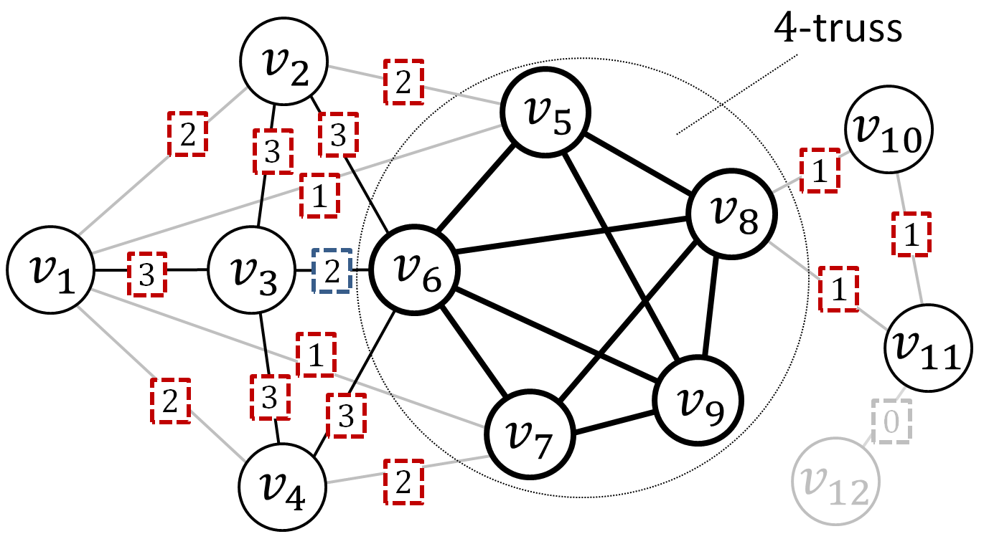
The Edge Layers
A structure based on (k-1)-hull+ and (the vertices which are not in (k-1)-truss and each forms a triangle with an edge in (k-1)-hull).
Significantly improve Obj-2.
$$x$$
: support value
$$k=4$$
$$x$$
: layer number

Slide 18
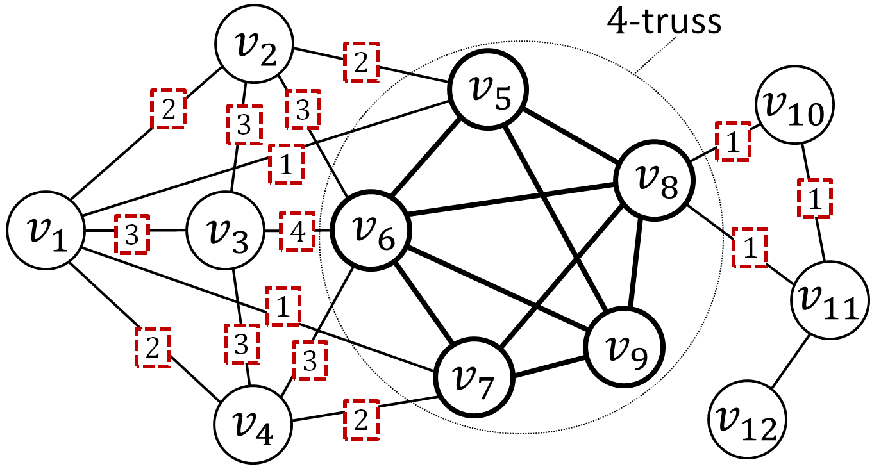
The Edge Layers
A structure based on (k-1)-hull+ and (the vertices which are not in (k-1)-truss and each forms a triangle with an edge in (k-1)-hull).
Significantly improve Obj-2.
Vertex Set U
$$x$$
: support value
$$k=4$$
$$x$$
: layer number (ln)
U (k-1)-hull+

Slide 19
Triangle Hold Path in Edge Layers (L)
Once a vertex is anchored, its incident edges in L become candidate edges.
Strong Triangle Hold from $e_{1}$ to $e_{2}$ in a triangle {$e_{1}$, $e_{2}$, $e_{3}$} in L, if
ln($e_{1}$) < ln($e_{2}$) and ln($e_{1}$) < ln($e_{3}$).
triangle held: $e_{1}$ became a candidate edge $e_{2}$ becomes a candidate edge.
Weak Triangle Hold from $e_{1}$ to $e_{2}$ in a triangle {$e_{1}$, $e_{2}$, $e_{3}$} in L, if
ln($e_{1}$) < ln($e_{2}$) and ln($e_{1}$) = ln($e_{3}$) .
triangle held: $e_{1}$ and $e_{3}$ both became candidate edges $e_{2}$ becomes a candidate edge
Strong triangle hold
from ($v_{1}$, $v_{2}$) to ($v_{1}$, $v_{3}$)
Weak triangle hold
from ($v_{2}$, $v_{3}$) to ($v_{3}$, $v_{6}$)

Slide 20
Triangle Hold Path in Edge Layers (L)
Triangle Hold Path: from u to v if there is an incident edge $e_{1}$ of u, an incident edge $e_{2}$ of v, and an edge set E such that each edge in E $∪$ {$e_{1}$, $e_{2}$, $e_{3}$} is triangle held by at least one edge in E $∪$ {$e_{1}$, $e_{2}$, $e_{3}$}.
Theorem 3: if v is a follower of u, there is a triangle hold path from u to v.
Anchor $v_{2}$
Only $v_{1}$ and $v_{3}$ can be followers of $v_{2}$

Slide 21
Triangle Hold Path in Edge Layers (L)
Triangle Hold Path: from u to v if there is an incident edge $e_{1}$ of u, an incident edge $e_{2}$ of v, and an edge set E such that each edge in E $∪$ {$e_{1}$, $e_{2}$, $e_{3}$} is triangle held by at least one edge in E $∪$ {$e_{1}$, $e_{2}$, $e_{3}$}.
Theorem 3: if v is a follower of u, there is a triangle hold path from u to v.
Obj-2.
Anchor $v_{2}$
Only $v_{1}$ and $v_{3}$ can be followers of $v_{2}$

Slide 22
More Theorems for Anchored k-Truss
Theorem 4: in the anchored k-truss computation by L, an edge cannot become a candidate edge if it support upper bound is insufficient.
Theorem 5: if v is a follower of u, anchoring v cannot have more followers than anchoring u.
Obj-2.
Anchor $v_{2}$, ($v_{1}$, $v_{3}$) and ($v_{3}$, $v_{6}$) cannot become candidate edges.
Obj-1.
$v_{2}$ cannot have more followers than $v_{1}$.

Slide 23
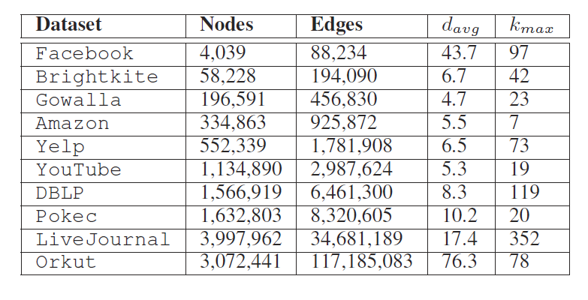
Experimental Setting
Datasets:
Environments:
Intel Xeon 2.3GHz CPU and Linux System.
All algorithms are implemented by C++.

Slide 24
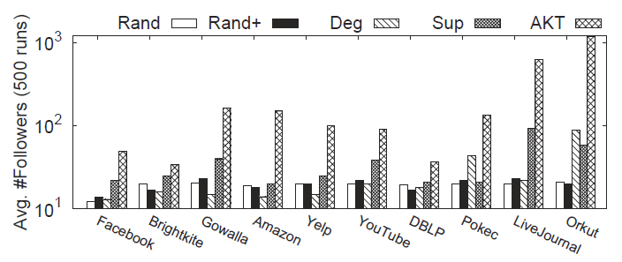
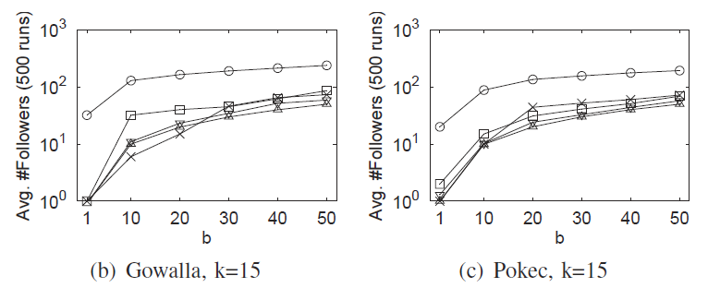
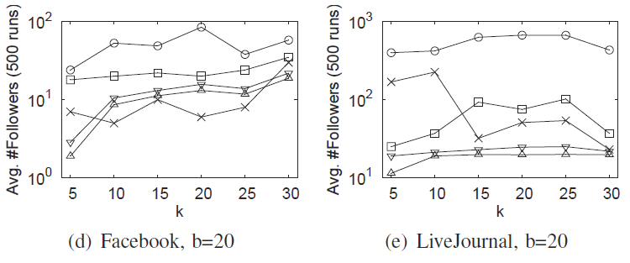
Number of Followers
$$k=15$$
$$b =20$$

Slide 25
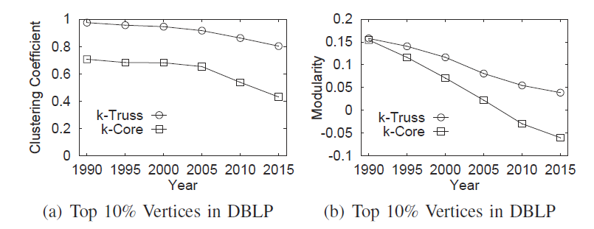
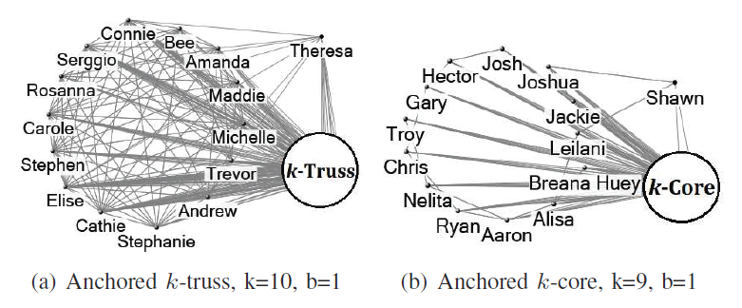
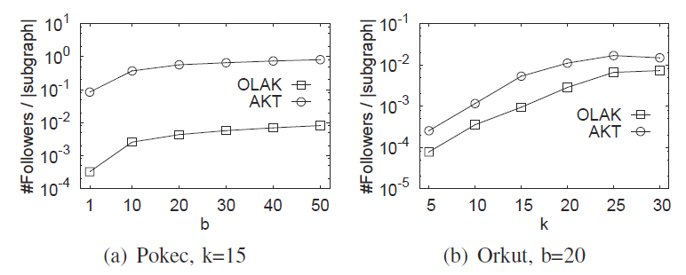
Comparing Core and Truss
Notes:
Yelp, https://www.yelp.com/; Yelp Dataset Challenge, https://www.yelp.com.au/dataset_challenge.
Two authors are identified by OLAK as the best anchors and there are 26 followers.
We find that although the two anchored authors have not co-authored any papers, they belong to the same community.
Not surprisingly, all their followers are also from the same community, and there are already considerably large number of co-authored papers among them
In this case study, each node is a author and each edge represents there are at least 3 co-authored papers.

Slide 26
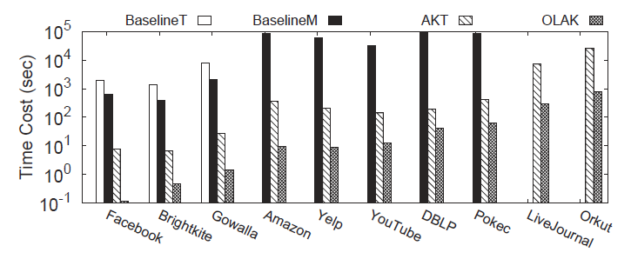
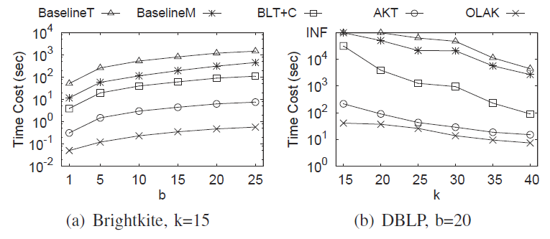
Efficiency
$$k=15$$
$$b =20$$

Slide 27
Conclusion
We propose the anchored k-truss problem and prove its NP-hardness.
We propose the edge layer structure which unravels the support relationship among the vertices and edges in k-truss computation.
An efficient heuristic algorithm is designed based on the edge layer structure, which significantly prunes unpromising candidates and speed up the follower computation.
We conduct extensive experiments to demonstrate the effectiveness of the model and the efficiency of the algorithm.

Slide 28
THANK YOU
Q&A

Slide 29
Prevent Network Unraveling
Kshipra Bhawalkar, Jon Kleinberg, Kevin Lewi, Tim Roughgarden, and Aneesh Sharma. "Preventing unraveling in social networks: the anchored k-core problem." SIAM Journal on Discrete Mathematics 29, no. 3 (2015): 1452-1475.
The engagement of a user is influenced by the number of her friends.
k-Core: a maximal subgraph where each node has at least k neighbors.
Anchor: a node which always exists in k-core.
Anchored k-Core: the k-core of a graph with some anchors.
Anchored k-Core Problem: find b anchors which has the largest anchored k-core.

Slide 30
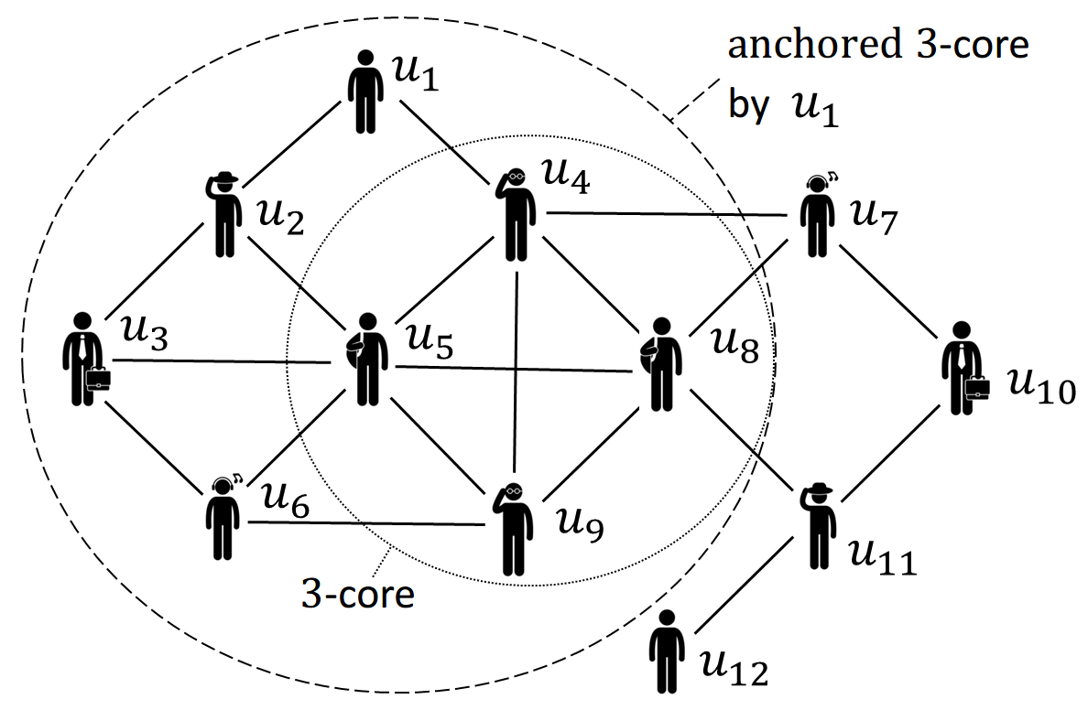
Anchored k-Core Problem
find b anchors which has the largest anchored k-core.
k = 3
The first efficient algorithm:
F. Zhang, W. Zhang, Y. Zhang, L. Qin, and X. Lin. OLAK: an efficient algorithm to prevent unraveling in social networks. PVLDB, 10(6):649–660, 2017.

