Slide 1
TT-Join: Efficient Set Containment Join
Computer Science and Engineering
Jianye Yang¹ , Wenjie Zhang¹ , Shiyu Yang¹ , Ying Zhang² , Xuemin Lin¹
¹ The University of New South Wales, Australia
² University of Technology, Sydney, Australia
Notes:
Hello, everyone. The title of our paper is “”, and this is a joint work with Dr. Ying Zhang, Dr. Wenjie Zhang, and Prof. Xuemin Lin

Slide 2
Outline
Set Containment Join
Existing Solutions
Our Approach
Experimental Studies
Conclusion

Slide 3
Set Containment Join
Job Advertisements
Job Seekers
Job ID | Required Skills
$$r_{1}$$ | $$\left\{e_{1}, e_{2},e_{3}\right\}$$
$$r_{2}$$ | $$\left\{e_{1}, e_{2},e_{4}\right\}$$
$$r_{3}$$ | $$\left\{e_{1}, e_{3},e_{4}\right\}$$
$$r_{4}$$ | $$\left\{e_{2}, e_{5} \right\}$$
People ID | Acquired Skills
$$s_{1}$$ | $$\left\{e_{1}, e_{2},e_{3},e_{5}\right\}$$
$$s_{2}$$ | $$\left\{e_{1}, e_{2},e_{4}\right\}$$
$$s_{3}$$ | $$\left\{e_{1}, e_{3},e_{6}\right\}$$
$$s_{4}$$ | $$\left\{e_{2}, {e_{4},e}_{5} \right\}$$
Who is qualified for each position?
Human Resource

Slide 4
Set Containment Join
Problem Statement (Set Containment Join)
Given two collections $ℛ$ and 𝒮 of records, the set containment join between $ℛ$ and 𝒮, denoted by $ℛ⋈_{⊆}\text{𝒮}$, is to find all pairs $\left(r,s\right)$, such that $r∈ℛ$, $s∈\text{𝒮}$, and $r⊆s$. That is $𝓡⋈_{⊆}\text{𝒮}\text{=}\left\{\left(r,s\right)|r∈𝓡\text{, }s∈\text{𝒮}\text{, }\text{and} r⊆s\right\}$.

Slide 5
Existing Solutions
Existing solutions
Based on the computing paradigms, we classify them into two categories, namely intersection-oriented methods and union-oriented methods.

Slide 6
Existing Solutions: intersection-oriented
Key Idea
Build inverted index on $\text{𝒮}$, and then apply the intersection operator for each $r∈𝓡$ to calculate $ℛ⋈_{⊆}\text{𝒮}$.
(e.g., [SIGMOD 2013], [DASFAA 2005], [ICDE 2015], [KAIS 2015], [SSDBM 2016])

Slide 7
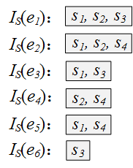
Existing Solutions: intersection-oriented
Job ID | Required Skills
$$r_{1}$$ | $$\left\{e_{1}, e_{2},e_{3}\right\}$$
$$r_{2}$$ | $$\left\{e_{1}, e_{2},e_{4}\right\}$$
$$r_{3}$$ | $$\left\{e_{1}, e_{3},e_{4}\right\}$$
$$r_{4}$$ | $$\left\{e_{2}, e_{5} \right\}$$
People ID | Acquired Skills
$$s_{1}$$ | $$\left\{e_{1}, e_{2},e_{3},e_{5}\right\}$$
$$s_{2}$$ | $$\left\{e_{1}, e_{2},e_{4}\right\}$$
$$s_{3}$$ | $$\left\{e_{1}, e_{3},e_{6}\right\}$$
$$s_{4}$$ | $$\left\{e_{2}, {e_{4},e}_{5} \right\}$$
$r_{1}$: $I_{S}(e_{1})∩I_{S}(e_{2})$ $∩ I_{S}\left(e_{3}\right)=\left\{s_{1}\right\}$
Result pair of $r_{1}$: $\left\{\left(r_{1},s_{1}\right)\right\}$
Result pair of $r_{2}$: $\left\{\left(r_{2},s_{2}\right)\right\}$
Result pair of $r_{3}$: $∅$
Result pair of $r_{4}$: $\left\{\left(r_{4},s_{1}\right),\left(r_{4},s_{4}\right)\right\}$

Slide 8
Existing Solutions: union-oriented
Key Idea
Build inverted index for record signatures on $𝓡$, generate candidate records for each $s∈\text{𝒮}$, and then verify candidate pairs to calculate $ℛ⋈_{⊆}\text{𝒮}$.
(e.g., [VLDB 1997], [VLDB 2000], [EDBT 2002], [TODS 2003], [ICDE 2015])

Slide 9
Existing Solutions: union-oriented
Job ID | Required Skills
$$r_{1}$$ | $$\left\{e_{1}, e_{2},e_{3}\right\}$$
$$r_{2}$$ | $$\left\{e_{1}, e_{2},e_{4}\right\}$$
$$r_{3}$$ | $$\left\{e_{1}, e_{3},e_{4}\right\}$$
$$r_{4}$$ | $$\left\{e_{2}, e_{5} \right\}$$
People ID | Acquired Skills
$$s_{1}$$ | $$\left\{e_{1}, e_{2},e_{3},e_{5}\right\}$$
$$s_{2}$$ | $$\left\{e_{1}, e_{2},e_{4}\right\}$$
$$s_{3}$$ | $$\left\{e_{1}, e_{3},e_{6}\right\}$$
$$s_{4}$$ | $$\left\{e_{2}, {e_{4},e}_{5} \right\}$$
Example: Bitmap signature with $b=4$
To set a bit$: i mod b$for $e_{i}$
Job ID | Signature
$$r_{1}$$ | $$0111$$
$$r_{2}$$ | $$1110$$
$$r_{3}$$ | $$1101$$
$$r_{4}$$ | $$0110$$
People ID | Signature
$$s_{1}$$ | $$0111$$
$$s_{2}$$ | $$1110$$
$$s_{3}$$ | $$0111$$
$$s_{4}$$ | $$1110$$
Notes:
One algorithm is to use bitmap signature. First, we hash each record into a bitmap signature with a fixed length, where we set a bit by applying the mod operator. It is easy to show that the signature is a good pruning method to filter non-result pairs. That is, given a record pair r and s, if the signature of r is not included by that of s, then r cannot be a subset of s. On the other hand, the bitmap inclusion test can be efficiently done with some basic bitwise operator. Therefore, we can avoid many set comparisons by utilizing the time-saving bitwise operator.

Slide 10
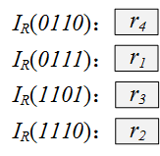
Existing Solutions: union-oriented
Job ID | Skills | Signature
$$r_{1}$$ | $$\left\{e_{1}, e_{2},e_{3}\right\}$$ | $$0111$$
$$r_{2}$$ | $$\left\{e_{1}, e_{2},e_{4}\right\}$$ | $$1110$$
$$r_{3}$$ | $$\left\{e_{1}, e_{3},e_{4}\right\}$$ | $$1101$$
$$r_{4}$$ | $$\left\{e_{2}, e_{5} \right\}$$ | $$0110$$
People ID | Skills | Signature
$$s_{1}$$ | $$\left\{e_{1}, e_{2},e_{3},e_{5}\right\}$$ | $$0111$$
$$s_{2}$$ | $$\left\{e_{1}, e_{2},e_{4}\right\}$$ | $$1110$$
$$s_{3}$$ | $$\left\{e_{1}, e_{3},e_{6}\right\}$$ | $$0111$$
$$s_{4}$$ | $$\left\{e_{2}, {e_{4},e}_{5} \right\}$$ | $$1110$$
Build inverted index
Generate candidates
Step 1: Enumerate all subsets of the signature
Step 2: Take the union of corresponding inverted lists
$s_{1}$: $I_{R}(0001)∪I_{R}(0010)$ $∪⋯∪ I_{R}\left(0111\right)=\left\{r_{1},r_{4}\right\}$
Verify candidates
Result pair of $s_{1}$: $\left\{\left(r_{1},s_{1}\right),\left(r_{4},s_{1}\right)\right\}$

Slide 11
Existing Solutions: union-oriented
Job ID | Skills | Signature
$$r_{1}$$ | $$\left\{e_{1}, e_{2},e_{3}\right\}$$ | $$0111$$
$$r_{2}$$ | $$\left\{e_{1}, e_{2},e_{4}\right\}$$ | $$1110$$
$$r_{3}$$ | $$\left\{e_{1}, e_{3},e_{4}\right\}$$ | $$1101$$
$$r_{4}$$ | $$\left\{e_{2}, e_{5} \right\}$$ | $$0110$$
People ID | Skills | Signature
$$s_{1}$$ | $$\left\{e_{1}, e_{2},e_{3},e_{5}\right\}$$ | $$0111$$
$$s_{2}$$ | $$\left\{e_{1}, e_{2},e_{4}\right\}$$ | $$1110$$
$$s_{3}$$ | $$\left\{e_{1}, e_{3},e_{6}\right\}$$ | $$0111$$
$$s_{4}$$ | $$\left\{e_{2}, {e_{4},e}_{5} \right\}$$ | $$1110$$
Build inverted index
Generate candidates
$s_{3}$: $I_{R}(0001)∪I_{R}(0010)$ $∪⋯∪ I_{R}\left(0111\right)=\left\{r_{1},r_{4}\right\}$
Verify candidates
Result pair of $s_{3}$: $∅$
Issues:
Large amount of subsets & False positives

Slide 12
Existing Solutions: properties
 | Advantage | Limit
Intersection-Oriented | Verification free | Large size of inverted lists
Union-Oriented | Small size of inverted list | 1. Need to enumerate all subsets 2. Need to verify all candidate pairs

Slide 13
Our Approach: Overview
Motivation
Design a new union-oriented such that (i) more effective signatures are employed; (ii) we need not verify all candidate pairs.
IS-Join
Exploit data distribution and use the least frequent element as the signature of the record.
TT-Join
Same index size as IS-Join;
Same pruning power as $k$IS-Join;
Naturally validate a large number of candidates.
$k$IS-Join
To enhance the pruning power, use the $k$ least frequent elements as the signature of the record.

Slide 14
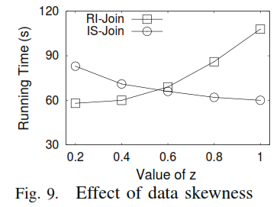
Our Approach: IS-Join
Observation
Many real-life data are skewed, i.e., some elements appear more frequently than others.
$$C_{RI}={(nm)}^{2}×\sum_{e∈ℰ}{{P\left(e\right)}^{2}}$$
$$C_{IS}={(nm)}^{2}×\sum_{e∈ℰ}{{P\left(e\right)}^{2}×{F\left(e\right)}^{m−1}}+C_{vef}$$

Slide 15
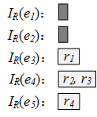
Our Approach: IS-Join
Job ID | Skills | Signature
$$r_{1}$$ | $$\left\{e_{1}, e_{2},e_{3}\right\}$$ | $$e_{3}$$
$$r_{2}$$ | $$\left\{e_{1}, e_{2},e_{4}\right\}$$ | $$e_{4}$$
$$r_{3}$$ | $$\left\{e_{1}, e_{3},e_{4}\right\}$$ | $$e_{4}$$
$$r_{4}$$ | $$\left\{e_{2}, e_{5} \right\}$$ | $$e_{5}$$
People ID | Skills | Signature
$$s_{1}$$ | $$\left\{e_{1}, e_{2},e_{3},e_{5}\right\}$$ | $$\left\{e_{1}, e_{2},e_{3},e_{5}\right\}$$
$$s_{2}$$ | $$\left\{e_{1}, e_{2},e_{4}\right\}$$ | $$\left\{e_{1}, e_{2},e_{4}\right\}$$
$$s_{3}$$ | $$\left\{e_{1}, e_{3},e_{6}\right\}$$ | $$\left\{e_{1}, e_{3},e_{6}\right\}$$
$$s_{4}$$ | $$\left\{e_{2}, {e_{4},e}_{5} \right\}$$ | $$\left\{e_{2}, {e_{4},e}_{5} \right\}$$
Build inverted index
Generate candidates
$s_{1}$: $I_{R}(e_{1})∪I_{R}(e_{2})$ $∪I_{R}(e_{3})∪ I_{R}\left(e_{5}\right)=\left\{r_{1},r_{4}\right\}$
Verify candidates
Result pair of $s_{1}$: $\left\{\left(r_{1},s_{1}\right),\left(r_{4},s_{1}\right)\right\}$

Slide 16
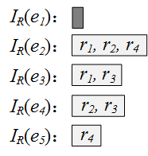
Our Approach: $k$IS-Join ($k=2$)
Job ID | Skills | Signature
$$r_{1}$$ | $$\left\{e_{1}, e_{2},e_{3}\right\}$$ | $$e_{2},e_{3}$$
$$r_{2}$$ | $$\left\{e_{1}, e_{2},e_{4}\right\}$$ | $$e_{2},e_{4}$$
$$r_{3}$$ | $$\left\{e_{1}, e_{3},e_{4}\right\}$$ | $$e_{3},e_{4}$$
$$r_{4}$$ | $$\left\{e_{2}, e_{5} \right\}$$ | $$e_{2}, e_{5}$$
People ID | Skills | Signature
$$s_{1}$$ | $$\left\{e_{1}, e_{2},e_{3},e_{5}\right\}$$ | $$\left\{e_{1}, e_{2},e_{3},e_{5}\right\}$$
$$s_{2}$$ | $$\left\{e_{1}, e_{2},e_{4}\right\}$$ | $$\left\{e_{1}, e_{2},e_{4}\right\}$$
$$s_{3}$$ | $$\left\{e_{1}, e_{3},e_{6}\right\}$$ | $$\left\{e_{1}, e_{3},e_{6}\right\}$$
$$s_{4}$$ | $$\left\{e_{2}, {e_{4},e}_{5} \right\}$$ | $$\left\{e_{2}, {e_{4},e}_{5} \right\}$$
Build inverted index
Generate candidates
$s_{2}$: $I_{R}(e_{1})∪I_{R}(e_{2})$ $∪I_{R}\left(e_{4}\right)=\left\{r_{1}:1,r_{2}:2,r_{3}:1,r_{4}:1\right\}$

Slide 17
Our Approach: $k$IS-Join ($k=2$)
Job ID | Skills | Signature
$$r_{1}$$ | $$\left\{e_{1}, e_{2},e_{3}\right\}$$ | $$e_{2},e_{3}$$
$$r_{2}$$ | $$\left\{e_{1}, e_{2},e_{4}\right\}$$ | $$e_{2},e_{4}$$
$$r_{3}$$ | $$\left\{e_{1}, e_{3},e_{4}\right\}$$ | $$e_{3},e_{4}$$
$$r_{4}$$ | $$\left\{e_{2}, e_{5} \right\}$$ | $$e_{2}, e_{5}$$
People ID | Skills | Signature
$$s_{1}$$ | $$\left\{e_{1}, e_{2},e_{3},e_{5}\right\}$$ | $$\left\{e_{1}, e_{2},e_{3},e_{5}\right\}$$
$$s_{2}$$ | $$\left\{e_{1}, e_{2},e_{4}\right\}$$ | $$\left\{e_{1}, e_{2},e_{4}\right\}$$
$$s_{3}$$ | $$\left\{e_{1}, e_{3},e_{6}\right\}$$ | $$\left\{e_{1}, e_{3},e_{6}\right\}$$
$$s_{4}$$ | $$\left\{e_{2}, {e_{4},e}_{5} \right\}$$ | $$\left\{e_{2}, {e_{4},e}_{5} \right\}$$
Build inverted index
Generate candidates
$s_{2}$: $I_{R}(e_{1})∪I_{R}(e_{2})$ $∪I_{R}\left(e_{4}\right)=\left\{r_{1}:1,r_{2}:2,r_{3}:1,r_{4}:1\right\}$
Verify candidates $\left\{\left(r_{2},s_{2}\right)\right\}$
Result pair of $s_{2}$: $\left\{\left(r_{2},s_{2}\right)\right\}$
Issue:
Pruning cost increases when k increases

Slide 18
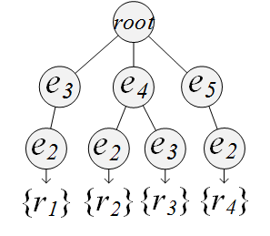
Our Approach: TT-Join ($k=2$)
$k$-length least frequent prefix
Given a record $x=\left\{e_{1}, ⋯,e_{n}\right\}$, we define $\left\{e_{n}, ⋯,e_{n−k+1}\right\}$ as its $k$-length least frequent prefix, denoted by ${LFP}_{k}\left(x\right)$.
Job ID | Skills | $${LFP}_{k}\left(x\right)$$
$$r_{1}$$ | $$\left\{e_{1}, e_{2},e_{3}\right\}$$ | $$\left\{e_{3},e_{2}\right\}$$
$$r_{2}$$ | $$\left\{e_{1}, e_{2},e_{4}\right\}$$ | $$\left\{e_{4},e_{2}\right\}$$
$$r_{3}$$ | $$\left\{e_{1}, e_{3},e_{4}\right\}$$ | $$\left\{e_{4},e_{3}\right\}$$
$$r_{4}$$ | $$\left\{e_{2}, e_{5} \right\}$$ | $$\left\{e_{5},e_{2}\right\}$$
$k$-length least frequent prefix tree on ℛ

Slide 19
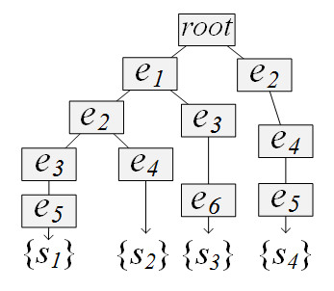
Our Approach: TT-Join ($k=2$)
Main Idea
Traverse $T_{𝒮}$ following a depth-first strategy. On each node, we switch to traverse $T_{\text{ℛ}}$ by matching corresponding elements. Verification is executed when reaching a leaf node of $T_{\text{ℛ}}$.
$kLFP$-tree on ℛ
prefix tree on 𝒮

Slide 20
Our Approach: TT-Join ($k=2$)
$kLFP$-tree on ℛ
prefix tree on 𝒮

Slide 21
Our Approach: TT-Join ($k=2$)
$$w_{1}$$
$kLFP$-tree on ℛ
prefix tree on 𝒮

Slide 22
Our Approach: TT-Join ($k=2$)
No matching
$$w_{1}$$
$kLFP$-tree on ℛ
prefix tree on 𝒮

Slide 23
Our Approach: TT-Join ($k=2$)
No matching
$$w_{2}$$
$kLFP$-tree on ℛ
prefix tree on 𝒮

Slide 24
Our Approach: TT-Join ($k=2$)
$$v_{1}$$
Find matching
$$w_{3}$$
$kLFP$-tree on ℛ
prefix tree on 𝒮

Slide 25
Our Approach: TT-Join ($k=2$)
$$v_{1}$$
Switch to $T_{\text{ℛ}}$
$$w_{3}$$
$$v_{2}$$
$kLFP$-tree on ℛ
prefix tree on 𝒮

Slide 26
Our Approach: TT-Join ($k=2$)
$$v_{1}$$
Check if exists in prefix
$$w_{3}$$
$$v_{2}$$
$kLFP$-tree on ℛ
prefix tree on 𝒮

Slide 27
Our Approach: TT-Join ($k=2$)
$$w_{2}$$
$$v_{1}$$
Dose exist in prefix
$$w_{3}$$
$$v_{2}$$
$kLFP$-tree on ℛ
prefix tree on 𝒮

Slide 28
Our Approach: TT-Join ($k=2$)
Verify $r_{1}$ and $w_{3}.set=\left\{e_{1}, e_{2},e_{3}\right\}$
$$w_{3}$$
$kLFP$-tree on ℛ
prefix tree on 𝒮

Slide 29
Our Approach: TT-Join ($k=2$)
Generate result for $w_{3}$: $\left\{r_{1}\right\}$
$$w_{3}$$
Result: $\left\{r_{1}\right\}$
$kLFP$-tree on ℛ
prefix tree on 𝒮

Slide 30
Our Approach: TT-Join ($k=2$)
Pass result to child nodes
$kLFP$-tree on ℛ
Result: $\left\{r_{1}\right\}$
prefix tree on 𝒮

Slide 31
Our Approach: TT-Join ($k=2$)
Generate result pairs $\left\{\left(r_{1},s_{1}\right) \right\}$
$kLFP$-tree on ℛ
Result: $\left\{r_{1}\right\}$
prefix tree on 𝒮

Slide 32
Our Approach: Cost Comparison
$$C_{IS}={(nm)}^{2}×\sum_{e∈ℰ}{{P\left(e\right)}^{2}×{F\left(e\right)}^{m−1}}+C_{vef}$$
IS-Join:
$$C_{kIS}={(nm)}^{2}×\sum_{e∈ℰ}{{P\left(e\right)}^{2}×{F\left(e\right)}^{m−i}}+C_{vef}$$
$k$IS-Join:
$$C_{TT}={(nm)}^{2}×\sum_{e∈ℰ}{{P\left(e\right)}^{2}×{F\left(e\right)}^{m−1}}+C_{check}+C_{vef}$$
TT-Join:

Slide 33
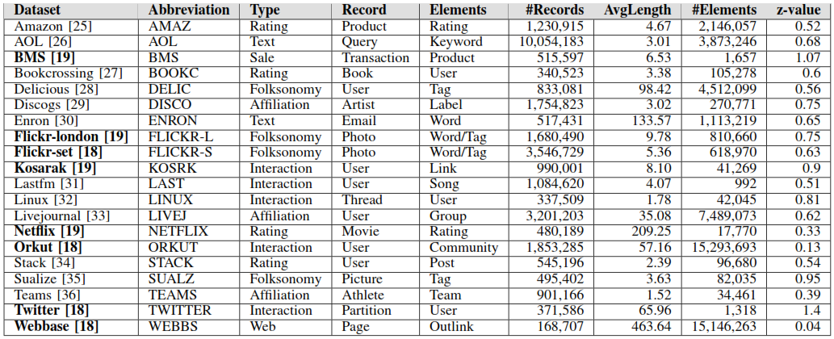
Experimental: Datasets

Slide 34
Experimental: Algorithms
Algorithm | Description
TT-Join | Our approach (k=4 under all settings)
LIMIT | Intersection-oriented [KAIS 2015]
PIEJoin | Intersection-oriented [SSDBM 2016]
PRETTI+ | Intersection-oriented [ICDE 2015]
PTSJ | Union-oriented [ICDE 2015]
DivideSkip | Adapted algorithm [ICDE 2008]
Adapt | Adapted algorithm [SIGMOD 2012]
FreqSet | Adapted algorithm [SIGMOD 2010]

Slide 35
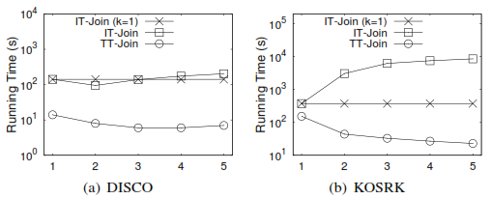
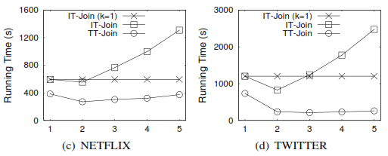
Experimental: Performance Tuning
Effect of $k$ on running time

Slide 36
Experimental: Comparison with Existing Algorithms

Slide 37
Conclusion
We classify the existing solutions into two categories and show the advantages and limits of the methods in each category.
We propose a new union-oriented method, namely TT-Join.
Our comprehensive experiments on 20 real-life datasets demonstrate that our TT-Join significantly outperforms the state-of-the-art algorithms on most of the datasets, and can achieve up to two orders of magnitude speedup.

Slide 38
Thank you!
Questions?

