Slide 1
Global Reinforcement of Social Networks: The
Anchored Coreness Problem
Qingyuan Linghu, Fan Zhang, Xuemin Lin, Wenjie Zhang, Ying Zhang
Guangzhou University
University of New South Wales
University of Technology Sydney

Slide 2
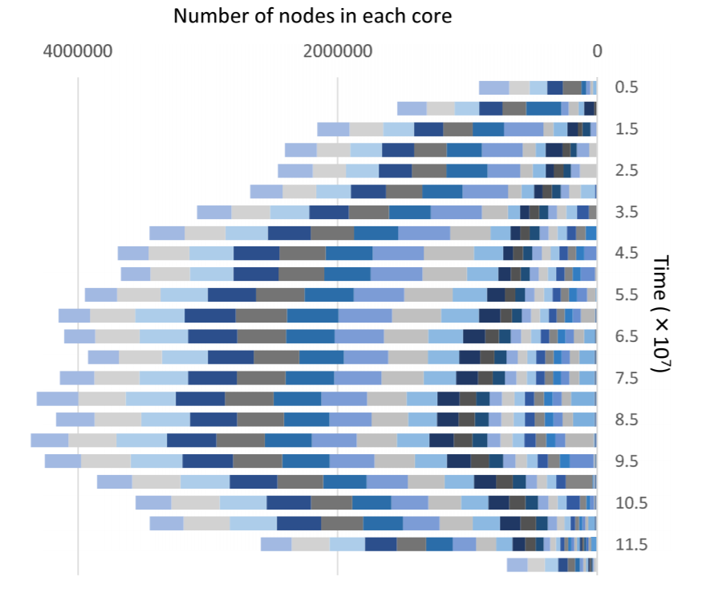
Network Stability
The Collapse of Friendster[1][2]
Founded in 2002, getting popular with over 115 million users.
Suspended in 2015 for lack of user engagement.
[1] D. Garcia, P. Mavrodiev, and F. Schweitzer. Social resilience in online communities: the autopsy of friendster. In COSN, pages 39–50, 2013.
[2] K. Seki and M. Nakamura. The collapse of the friendster network started from the center of the core. In ASONAM, pages 477–484, 2016.

Slide 3
Network Reinforcement
Coreness: “best practice” for capturing user engagement
Previous work’s analysis: [1]
Experiments verification: Gowalla dataset
[1] Fragkiskos D. Malliaros and Michalis Vazirgiannis. 2013. To stay or not to stay: modeling engagement dynamics in social graphs. In CIKM. 469–478.

Slide 4
k-Core Decomposition
k-core: Given a graph G, the k-core of G is a maximal subgraph where each node has at least k neighbors in the subgraph (i.e., a degree of k).
Coreness of a node v: the largest value of k such that there is a k-core containing v.
$$u_{12}$$
4
2
3
$$u_{4}$$
1-core
$$u_{6}$$
4
$$u_{13}$$
$$u_{11}$$
4
$$u_{8}$$
2
3
$$u_{3}$$
$$u_{9}$$
$$u_{10}$$
4
4-core
4
2
3-core
$$u_{2}$$
1
$$u_{5}$$
$$u_{7}$$
2
$$u_{1}$$
3
2-core

Slide 5
Anchored k-core: Local Reinforcement
Anchor a vertex: degree is considered as positive infinity (never leaves)
Anchor b vertices to maximize the size of k-core (fixed input k)
3
$$u_{12}$$
4
2
Input
Anchor
Followers
Coreness
3
$$u_{4}$$
k = 3
b = 1
$$u_{6}$$
4
$$u_{13}$$
$$u_{11}$$
4
$$u_{8}$$
2
$$u_{1}$$
3
3
$$u_{3}$$
$$u_{9}$$
$$u_{10}$$
4
$u_{2}$, $u_{3}$, $u_{4}$
2
4
$$u_{5}$$
$$u_{2}$$
1
$$u_{7}$$
2
$$u_{1}$$
2 → 3
3
3

Slide 6
Anchored k-core: Local Reinforcement
Anchor a vertex: degree is considered as positive infinity (never leaves)
Anchor b vertices to maximize the size of k-core (fixed input k))
$$u_{12}$$
4
2
4
Input
Anchor
Followers
Coreness
3
$$u_{4}$$
k = 3
b = 1
k = 4
b = 1
$$u_{6}$$
4
4
$$u_{13}$$
$$u_{11}$$
4
$$u_{8}$$
2
$$u_{1}$$
$$u_{5}$$
3
$$u_{3}$$
$$u_{9}$$
$$u_{10}$$
4
$u_{2}$, $u_{3}$, $u_{4}$
$u_{6}$, $u_{7}$, $u_{8}$
2
4
$$u_{5}$$
$$u_{2}$$
1
$$u_{7}$$
2
$$u_{1}$$
2 → 3
3 → 4
3
4

Slide 7
Shortcomings of Anchored k-core
It is very hard to determine the best input value of k for the Anchored k-core problem.
The Anchored k-core problem can only benefit a partial set of vertices (mostly those originally having coreness k-1).
Valid vertices for anchoring are from a small set of vertices, and the anchoring of other vertices cannot enlarge the size of k-core.

Slide 8
Anchored Coreness: Global Reinforcement
Anchored coreness: aiming to maximize the total increment of core-ness from all vertices (without regarding to a fixed k)
3
$$u_{12}$$
4
2
3
$$u_{4}$$
Input
Anchor
Followers
Coreness
4
b = 1
$$u_{6}$$
$$u_{13}$$
$$u_{11}$$
4
$$u_{8}$$
2
3
$$u_{2}$$
3
4
$$u_{3}$$
$$u_{9}$$
$$u_{10}$$
4
$$u_{3}\text{, }u_{4}$$
$$u_{7}\text{, }u_{8}$$
2
4
$$u_{5}$$
$$u_{2}$$
1
$$u_{7}$$
2
$$u_{1}$$
$$\text{2 }\text{→ 3}$$
$$\text{3 }\text{→ 4}$$
3
4

Slide 9
Problem Hardness
Theorem 1. Given a graph G, the anchored coreness problem is NP-hard.
Theorem 2. For any $ε>0$, the anchored coreness problem cannot be approximated in polynomial time within a ratio of $(1−\frac{1}{e}+ε)$, unless P = NP.
Theorem 3. The function $g(⋅)$ of coreness gain is not submodular.
Greedy Anchored Coreness (GAC)

Slide 10
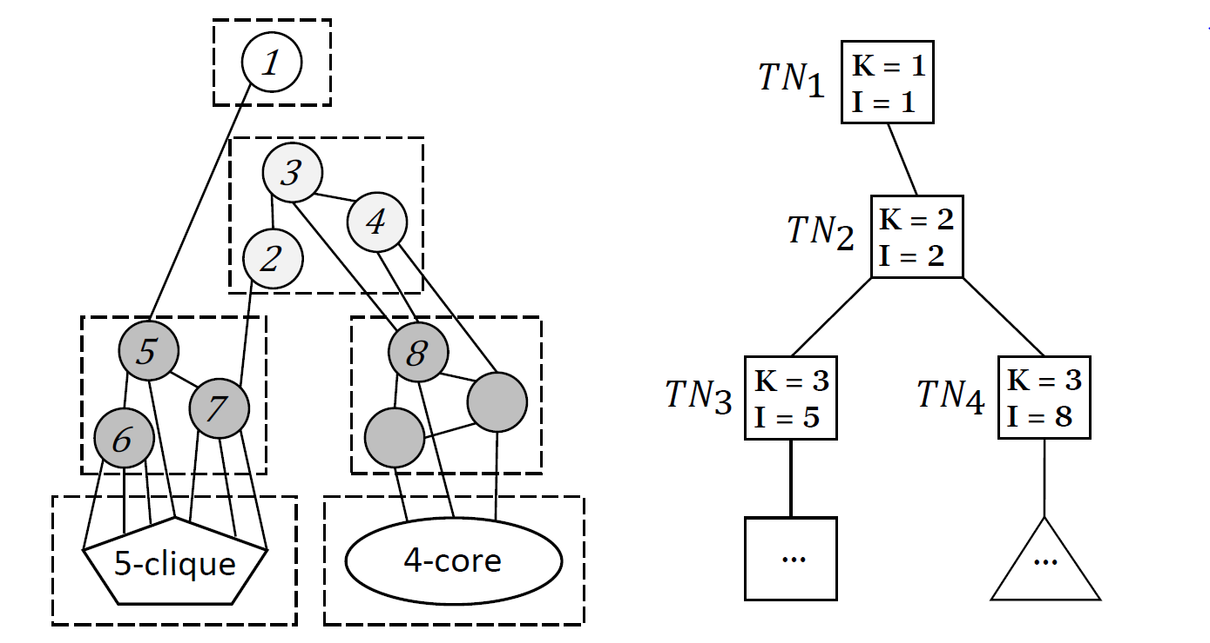
Tree Structure
Partition the graph w.r.t. coreness and connectivity of vertices
k-core component: Given a graph G and the k-core of G, S is a k-core component if S is a connected component of the k-core.

Slide 11
Intermediate Result Reusing
Anchor | $$1$$
Followers | $$5, 6, 7$$
Anchor | $$2$$
Followers | $$3, 4$$ | $$7$$
After anchoring 1
Anchor | $$2$$
Followers | $$3, 4$$

Slide 12
Finding Followers & Upper Bound Pruning
Inspired by Core Maintenance[1] and Anchored k-core[2]
Find Followers: instead of doing core decomposition, it can more efficiently compute the followers of each vertex
Upper Bound: easy and fast to compute, so that can prune many vertices without actually computing their followers
[1] Yikai Zhang, Jeffrey Xu Yu, Ying Zhang, and Lu Qin. 2017. Fast Order-Based Approach for Core Maintenance. ICDE 2017.
[2] Fan Zhang, Wenjie Zhang, Ying Zhang, Lu Qin, and Xuemin Lin. 2017. OLAK: An Efficient Algorithm to Prevent Unraveling in Social Networks. PVLDB 10, 6 (2017), 649–660.

Slide 13
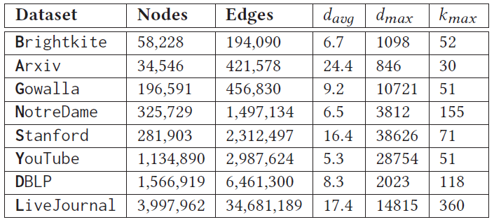
Experimental Setting
Datasets:
Environments:
Intel Xeon 2.3GHz CPU and Redhat Linux System.
All algorithms are implemented in C++.

Slide 14
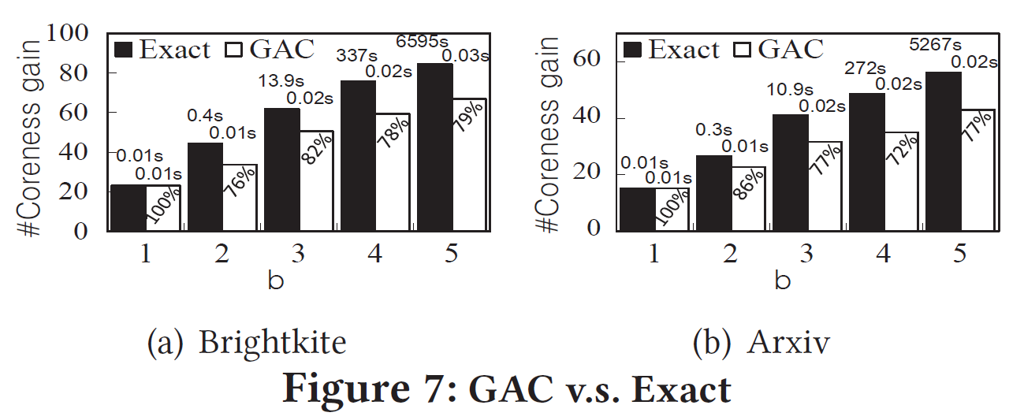
Experiment: Effectiveness
Coreness gain: the sum of followers from all iterations.
Computing time is much less without sacrificing much coreness gain.

Slide 15
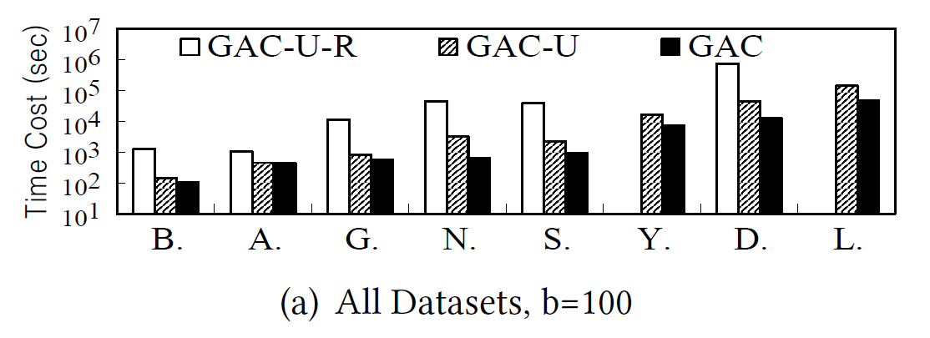
Experiment: Efficiency
GAC: The optimal Greedy algorithm of Anchored Coreness
GAC-U: Without equipping Upper bound
GAC-U-R: Without equipping Upper bound and Reusing mechanism
The optimal algorithm achieves 2 orders of magnitude faster than the baseline algorithm.

Slide 16
Thanks for listening!
Q & A

