Slide 1
Efficient String Similarity Search: A Cross Pivotal Based Approach
Computer Science and Engineering
Fei Bi¹ , Lijun Chang¹ , Wenjie Zhang¹ , Xuemin Lin^{1,2}
¹ The University of New South Wales, Australia
² East China Normal University, China

Slide 2
Outline
Background
Our Approach
Experimental Study
Notes:
This is the outline of today’s talk. Background of our work, our approach, our two proposed advanced filters, experimental study.

Slide 3
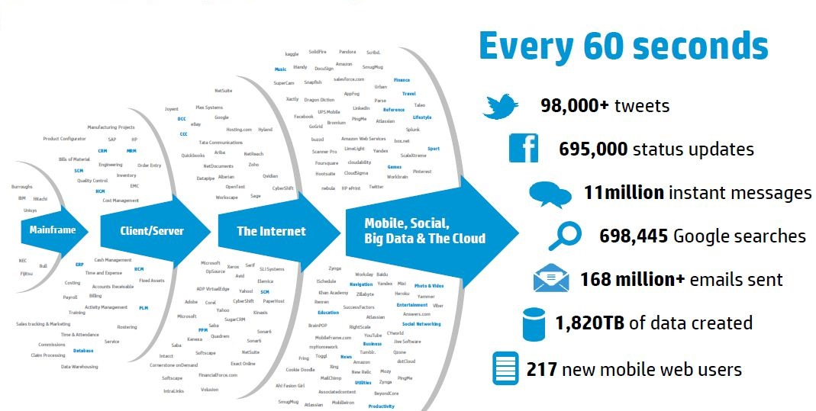
Strings Everywhere!
Notes:
Nowadays, everyone is talking about the big-data era, but how big the data is really is? This is a survey conducted by HP, and it shows that in every 60 seconds, this huge amount of data is created. It is very easy to see that a large proportion of the data is string!. So we definitely fast algorithms to process the string data. In this paper, we study the string similarity search problem.

Slide 4
String Similarity Search
Why do we need similarity search?
  Data in the real world could be dirty. (incomplete, noisy and inconsistent)
  Try to understand the relation among data sets.
Applications of string similarity search
  Duplicate detection (i.e. TurnItIn).
  Spelling check or auto typing correction (i.e. Microsoft Words).
  Sequence alignment comparison in bioinformatics.

Slide 5
Similarity Measurement
Edit distance
  Minimum number of edit operation required to transform one string into the other.
  Three types of edit operation:
  insertion, deletion, and substitution.
Example
  s = “datamining” and r = “datemnings”
  To transform s into r:
1. Substitute ‘a’ with ‘e’
2. Delete ‘i’
3. Insert ‘s’ after ‘g’

Slide 6

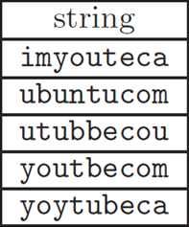
Problem Definition
String Similarity Search
Query string
r = “yotubecom” and τ = 2
ed(s, r) <= 2
Output “youtbecom” as a result
string dataset S

Slide 7

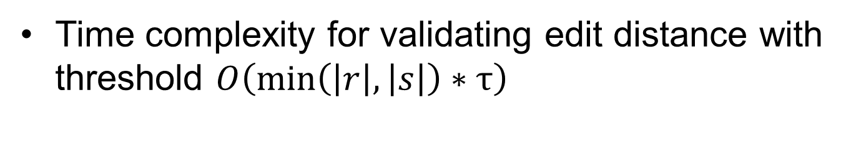
Challenge
Time complexity for validating edit distance with threshold $O\left(\min\left(\left|r\right|, \left|s\right|\right)∗τ\right)$
Navïe Method
  Time complexity for each query
      $$O\left(\left|S\right|∗\min\left(\left|r\right|, \left|s\right|\right)∗τ\right)$$

Slide 8
Filter-and-Verification Framework
Query string r
Dataset S
Signatures
Index built on signatures
Filter
Query Index
Candidates
Validation
Verification
Results

Slide 9
Signature: Q-Gram
Q-gram is first proposed as a signature scheme by Gravano in 2001.
Q-gram: A sequence of q characters of the original string.
  Example for q=3
    vacation : vac, aca, cat, ati, tio, ion.
    Similar strings have many common q-grams.

Slide 10
Related work: Pivotal Prefix
Pivotal q-gram set: a set of t + 1 disjoint q-grams selected from qt + 1 prefix of the q-gram set.
  Sort all q-grams by global ordering, such as idf
  q(r) : The sorted q-gram set of query string r
  Pre(r)
  Piv(r)
  |Piv(r)|= τ+1 and the q-grams in Piv(r) are disjoint

Slide 11
Related work: Pivotal Prefix
  Pre(r)
  last(r)
  Piv(s)
  last(s)
  Piv(r)
  Pre(s)
  Pivotal Prefix Filter:
  If last(r) < last(s) and piv(r) ∩ pre(s) = ϕ, ED(r,s) > τ
  If last(s) < last(r) and piv(s) ∩ pre(r) = ϕ, ED(r,s) > τ

Slide 12
Our Approach
  Cross Pivotal based pruning technique
  Min-Order based pivotal set selection method
  Two advanced filters:
      Position Match Filter
      Pivotal Substitution Filter

Slide 13
Advantages of Our Approach
High pruning power
  Three pruning strategies are guaranteed to achieve least candidates among existing algorithms
More effective method for pivotal set selection with reduced complexity
Low memory consumption

Slide 14
Cross Pivotal Filter
  lpr: the position of the last pivotal q-gram
q(r):
  Piv(r) = τ+1 disjoint q-grams
q(s):
If s and r are similar, then Piv(r) ∩ q(s) ≠ ϕ.
If s and r are similar,
then Piv(r) ∩ Pre_{lpr + (q-1)} _{τ}(s) ≠ ϕ and Piv(s) ∩ Pre_{lps + (q-1)} _{τ}(r) ≠ ϕ
If s and r are similar, then Piv(r) ∩ Pre_{lpr + (q-1)} _{τ}(s) ≠ ϕ.
If r and s are similar, then Piv(s) ∩ Pre_{lps + (q-1)} _{τ}(r) ≠ ϕ.
Cross Pivotal Filter:
Given any two strings s and r, if Piv(r) ∩ Pre_{lpr + (q-1)} _{τ}(s) = ϕ
or Piv(s) ∩ Pre_{lps + (q-1)} _{τ}(r) = ϕ, then s and r cannot be similar.

Slide 15
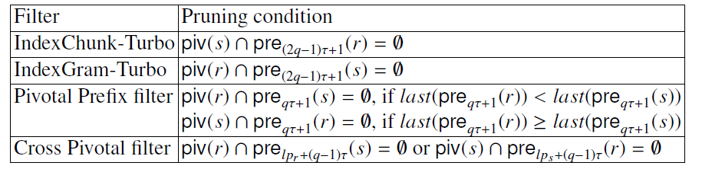
Comparison of pruning power
Our proposed cross pivotal filter possesses the strongest pruning power, compared to
IndexChunk-Turbo [Qin TODS13], IndexGram-Turbo [Qin TODS13], and
Pivotal Preifx [Deng SIGMOD 13]

Slide 16
Cross Pivotal Filter
Suppose that we have two strings s and r:
s = datamining
r = datacleaning
q(s) = {am, mi, da, ni, ng, ta, at, in, in}
q(r) = {ac, cl, an, le, da, ea, ni, ng, ta, at, in}
We select piv(s) ={am, da, ni} and piv(r) = {ac, an, le};
so we have :
lp_{s} = 4 and the prefix length is lp_{s} + (q-1)t = 6;
lp_{r} = 4 and the prefix length is lp_{r} + (q-1)t = 6.
pre(s) = {am, mi, da, ni, ng, ta}
pre(r) = {ac, cl, an, le, da, ea }
Cross pivotal filter:
piv(s) ∩ pre(r) = {da} and piv(r) ∩ pre(s) = ϕ

Slide 17
Overflow of our approach
Build two indexes for pivotal and (2q-1)τ+1 prefix respectively
Data string set S
Offline
Query string r
Query the (2q-1)τ+1 prefix index with pivotal
Query the pivotal index with (2q-1)τ+1 prefix
Intersect to refine candidates
Advanced filters
Verification

Slide 18
MinOrder Based Pivotal Selection
Objective
  Minimize lpr and lps to gain more pruning power
  Goal
    Minimize the maximum order of the selected pivotal q-gram set
  Advantages:
    Effective: reduce the filtering cost
    Efficient: DP method with O(qt²), as opposed to O(q²t³) in previous works.
  lpr

Slide 19

Single Match Candidate:
  Suppose there are five data strings {s₁, s₂, s₃, s₄, s₅} and the pivotal set of query string r is piv(r) = {g₁, g₂, g₃}.
  Using piv(r) to the query the inverted index of prefix,
  g₁ retrieves s₁, s₃, s₅
  g₂ retrieves s₂, s₃, s₅
  g₃ retrieves s₂, s₅
  s₁ is retrieved by one and only one pivotal q-gram g₁, so s₁ is a single match candidate.

Slide 20
Single Match Candidates
50% - 95% of candidates are single match candidates.
Very Unlikely to be the results.
Two filters based on single match candidates:
  Pivotal Substitution Filter
  Position Match Filter

Slide 21
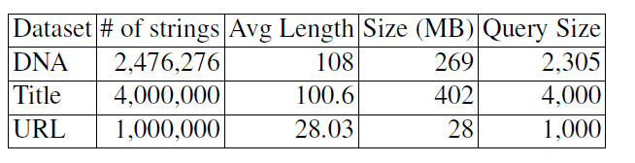
Experimental study
Dataset
Performance Evaluation
  Candidate number
  Processing time
Algorithms:
  CrossPivotalSearch
  Pivotal Prefix
  IndexGramTurbo
  IndexChunkTurbo

Slide 22
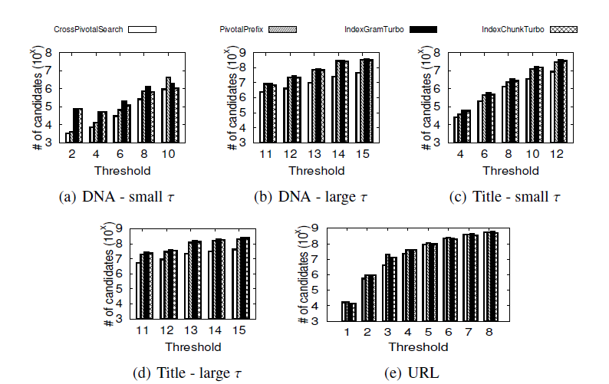
Experiment-Candidate Number

Slide 23
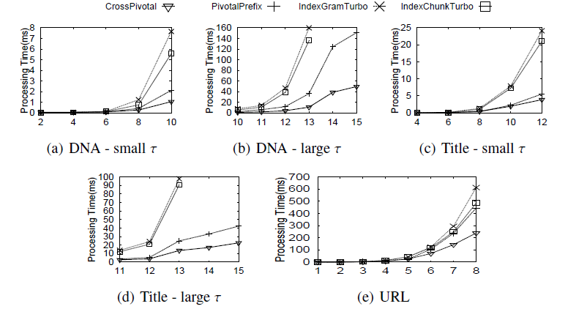
Experiment-Processing Time

Slide 24
Evaluation of Proposed Advanced Filters
CrossPivotalSearch:
      Cross Pivotal filter + two advanced filters + verification
CrossPivotalBasic:
      Cross Pivotal filter + verification

Slide 25
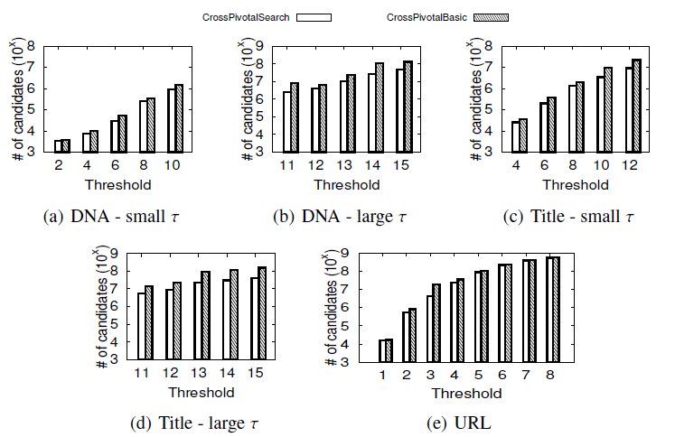
Experiment – Candidate Number

Slide 26
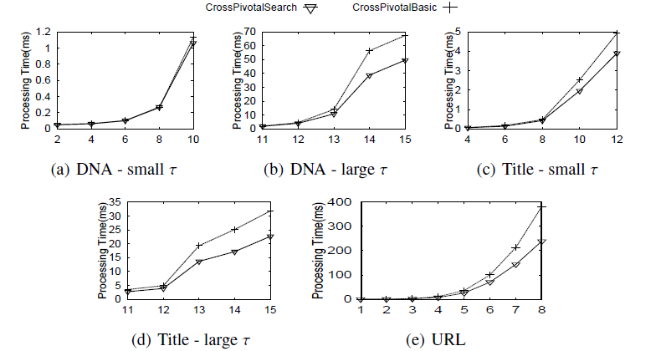
Experiment – Processing Time

Slide 27

Thank you!
Questions?

Slide 28
Pivotal Substitution Filter
Our cross pivotal filter’s pruning condition is
Piv(s) ∩ Pre_{lps + (q-1)} _{τ}(r) = ϕ or Piv(r) ∩ Pre_{lpr + (q-1)} _{τ}(s) = ϕ
To further increase the pruning power, a naïve way is using more pivotal sets of the query string r to query the Pre_{lpr + (q-1)} _{τ}(s) .
Piv(s) ∩ Pre_{lps + (q-1)} _{τ}(r) = ϕ or Piv(r) ∩ Pre_{lpr + (q-1)} _{τ}(s) = ϕ
or Piv₁(r) ∩ Pre_{lpr1 + (q-1)} _{τ}(s) = ϕ
or Piv₂(r) ∩ Pre_{lpr2 + (q-1)} _{τ}(s) = ϕ
…….
Unfortunately, the filtering cost here is actually very high.
So we need to find a balance between the pruning power and the filtering cost.

Slide 29


Pivotal Substitution Filter
  Example: piv(r) = {g₁, g₂, g₃}.
  We can select another q-gram in g₄ as the pivotal substitution of g₁.
  Then, we actually have another pivotal set {g₄, g₂, g₃}.
  Example: s₁ is a single match candidate retrieved by g₁ in piv(r).
  However, g₁’s pivotal substitution g₄ is not in q(s₁). So s₁ is pruned.

Slide 30

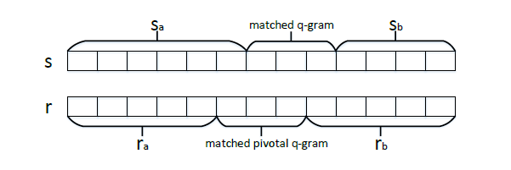
Position Match Filter
i - 1
t + 1 - i

