Slide 1




Scaling Up k-Clique Densest Subgraph Detection
Speaker: Yizhang He
Yizhang He, Kai Wang*, Wenjie Zhang, Xuemin Lin, Ying Zhang
Notes:
My name is Yizhang He.
I am a PhD student at the University of New South Wales.
The paper I am presenting today is titled:
Other co-authors are from UNSW, Shanghai JiaoTong University, and University of Technology Sydney.

Slide 2



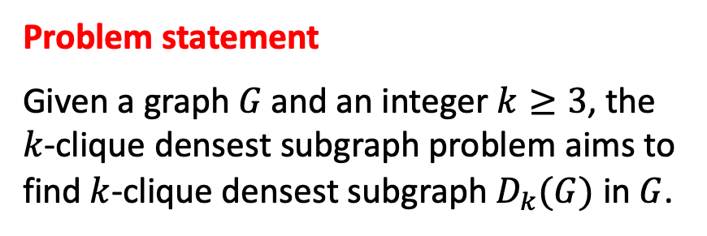





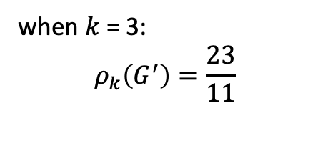






Introduction
$k$-clique: a complete subgraph with $k$ vertices.
$${v_{3}}_{ }$$
$${v_{9}}_{ }$$
$${v_{2}}_{ }$$
$${v_{4}}_{ }$$
$${v_{8}}_{ }$$
$${v_{10}}_{ }$$
$k$-clique density: the 𝑘-clique density of $G^{′}$ is the average number of 𝑘-cliques per vertex in $G^{′}.$
$$ρ_{k}\left(G^{′}\right)=\frac{\left|C_{k}\left(G^{′}\right)\right|}{|V(G^{′})|}$$
$${v_{1}}_{ }$$
$${v_{7}}_{ }$$
$${v_{5}}_{ }$$
$${v_{12}}_{ }$$
$${v_{11}}_{ }$$
$${v_{6}}_{ }$$
5-clique
Problem statement
Given a graph 𝐺 and an integer $k≥3$, the $k$-clique densest subgraph problem aims to find $k$-clique densest subgraph $D_{k}(G)$ in $G$.
when $k$ = 3:
$$ρ_{k}\left(G^{′}\right)=\frac{23}{11}$$
Notes:
In this paper, we study the k-clique densest subgraph problem
A k-clique is a complete subgraph with k vertices.
For example, this is a 5-clique.
Given a subgraph, its k-clique density is the number of kcliques divided by the number of vertices.
For example,
when k =3, this shaded subgraph has a k-clique density of 23/11.
In this paper, we aim to find the subgraph that maximize the k-clique density.

Slide 3
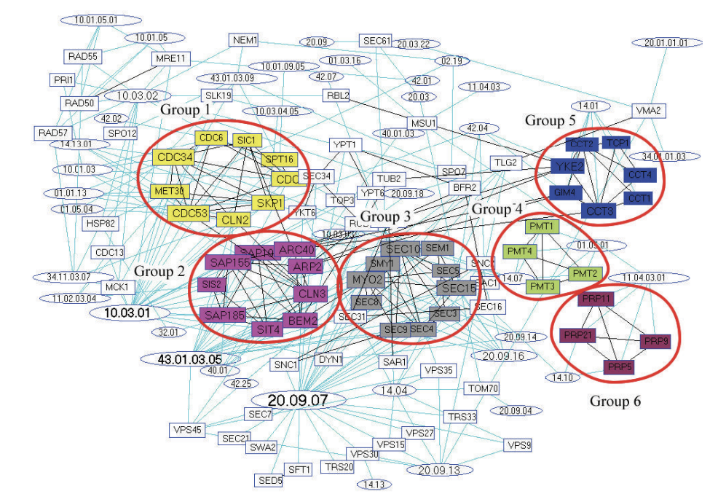
Applications
DNA motif discovery
Spam link detection
New protein characterization
A protein-interaction network
Cui, Guangyu, et al. "An algorithm for finding functional modules and protein complexes in protein-protein interaction networks." Journal of Biomedicine and Biotechnology 2008 (2008).
Notes:
The k-clique densest subgraph problem has many applications.
DNA motif discovery
Spam link detection
New protein characterization
For example, in this Protein-Interaction network, there are 6 near-cliques. Within near-clique, the proteins have very similar functionalities, which helps us classify new proteins.

Slide 4
Related Works
Edge densest subgraph and its variants
Uriel Feige, Michael Seltser, et al. 1997. On the densest k-subgraph problem. Citeseer.
Chenhao Ma, Reynold Cheng, Laks VS Lakshmanan, and Xiaolin Han. 2022. Finding locally densest subgraphs: a convex programming approach. Proceedings of the VLDB Endowment 15, 11 (2022), 2719–2732.
Nate Veldt, Austin R Benson, and Jon Kleinberg. 2021. The generalized mean densest subgraph problem. In Proceedings of the 27th ACM SIGKDD Conference on Knowledge Discovery & Data Mining. 1604–1614.
Maximilien Danisch, T-H Hubert Chan, and Mauro Sozio. 2017. Large scale density-friendly graph decomposition via convex programming. In Proceedings of the 26th International Conference on World Wide Web. 233–242.
k-clique densest subgraph
Michael Mitzenmacher, Jakub Pachocki, Richard Peng, Charalampos Tsourakakis, and Shen Chen Xu. 2015. Scalable large near-clique detection in large-scale networks via sampling. In Proceedings of the 21th ACM SIGKDD International Conference on Knowledge Discovery and Data Mining. 815–824.
Charalampos Tsourakakis. 2015. The k-clique densest subgraph problem. In Proceedings of the 24th international conference on world wide web. 1122–1132.
Yixiang Fang, Kaiqiang Yu, Reynold Cheng, Laks V. S. Lakshmanan, and Xuemin Lin. 2019. Efficient Algorithms for Densest Subgraph Discovery. Proceedings VLDB Endow. 12, 11 (2019), 1719–1732.
Bintao Sun, Maximilien Danisch, TH Chan, and Mauro Sozio. 2020. KClist++: A simple algorithm for finding k-clique densest subgraphs in large graphs. Proceedings of the VLDB Endowment (PVLDB) (2020).
Notes:
The k-clique densest subgraph problem has been extensively studied.
In this paper, we aim to improve the two existing works highlighted in red.
The first is based on a cohesive subgraph model and the second is based on convex-programming.

Slide 5
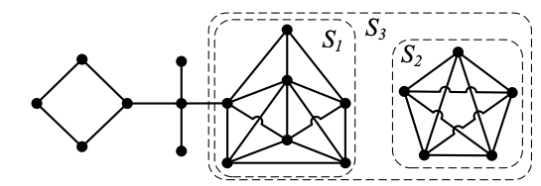
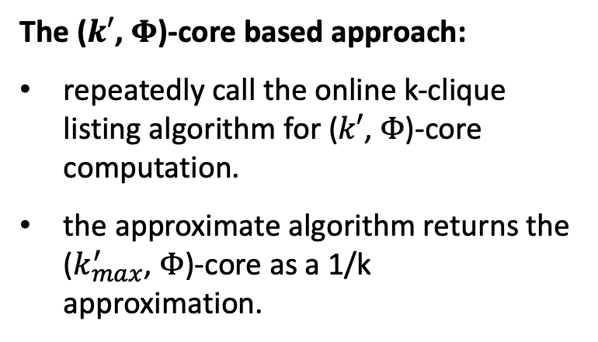
Existing solutions: limitations
The ($k′$, $Φ$)-core based approach:
repeatedly call the online k-clique listing algorithm for ($k′$, $Φ$)-core computation.
the approximate algorithm returns the ($k_{max}^{′}$, $Φ$)-core as a 1/k approximation.
Yixiang Fang, Kaiqiang Yu, Reynold Cheng, Laks V. S. Lakshmanan, and Xuemin Lin. 2019. Efficient Algorithms for Densest Subgraph Discovery. Proceedings VLDB Endow. 12, 11 (2019), 1719–1732.
The convex programming-based approach (a variant of the Franke-Wolf algorithm):
computes the 𝑘-cliques from scratch in each iteration
visits all 𝑘-cliques, some of which are irrelevant to the optimal solution.
Bintao Sun, Maximilien Danisch, TH Chan, and Mauro Sozio. 2020. KClist++: A simple algorithm for finding k-clique densest subgraphs in large graphs. Proceedings of the VLDB Endowment (PVLDB) (2020).
Notes:
The first work uses the k-phi core to reduce the search scope for the k-clique densest subgraph problem.
A (k, phi core) is the maximal subgraph such that each vertex is contained by at least k’ k-cliques.
The kmax-psi core is returned as a 1/k approximation.
The second work formulates the problem as a convex program and proposes a variant of the Franke-Wolf algorithm to find near-optimal solutions.
Both approaches rely on computing all the k-cliques repeatedly.
In this work, we address this issue by using an index to compactly store the k-cliques.
Then, we propose optimizations and adopt sampling-based strategies for further speedup.

Slide 6
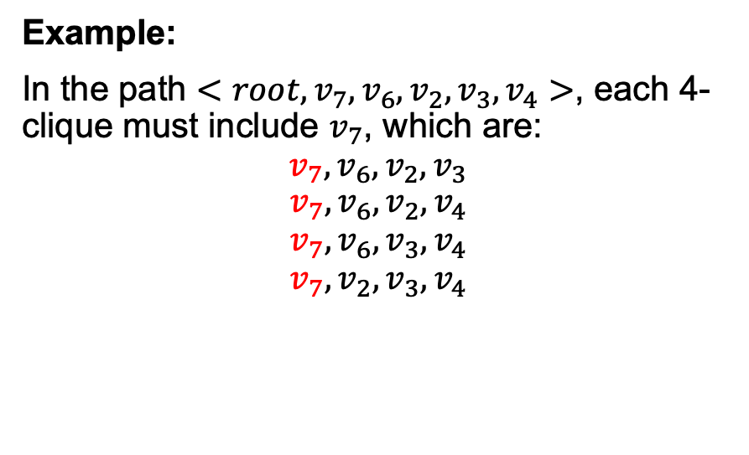
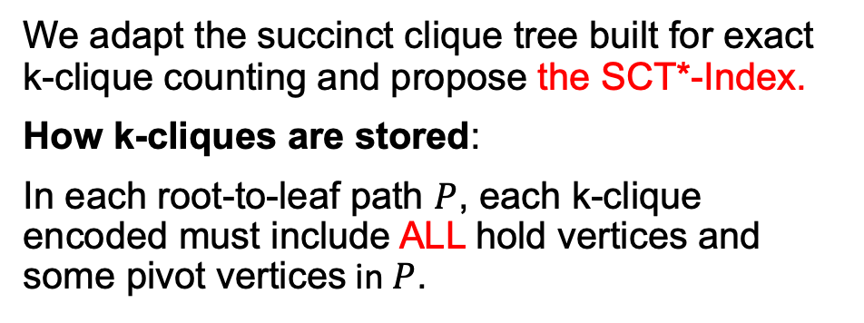
Our Approach: SCT∗-Index
We adapt the succinct clique tree built for exact k-clique counting and propose the SCT*-Index.
How k-cliques are stored:
In each root-to-leaf path $P$, each k-clique encoded must include ALL hold vertices and some pivot vertices in $P$.
The SCT*-Index built for the graph in slide 3.
Example:
In the path $<root, v_{7},v_{6}, v_{2}, v_{3}, v_{4}>$, each 4-clique must include $v_{7}$, which are:
$$v_{7}, v_{6}, v_{2}, v_{3}$$
$$v_{7}, v_{6}, v_{2}, v_{4}$$
$$v_{7}, v_{6}, v_{3}, v_{4}$$
$$v_{7}, v_{2}, v_{3}, v_{4}$$
a hold vertex
a pivot vertex
Shweta Jain and C Seshadhri. 2020. The power of pivoting for exact clique counting. In Proceedings of the 13th International Conference on Web Search and Data Mining. 268–276.
Notes:
In the literature, the succinct clique tree is proposed for exact k-clique counting, where each k-clique has a unique encoding.
In each root-to-leaf path, there are two types of vertices, the hold vertices and the pivot vertices.
Each k-clique represented must contain all hold vertices and some pivot vertices on the path.
For example:
In this path, each 4-clique must contain the vertex v7.
We make two adjustments to the succinct clique tree and propose the SCT-Index:
store the maximum depth of each sub-tree, to avoid visiting paths not leading to k-cliques.
adopt degeneracy-based and out-degree-based pruning to allow the index to be built partially, which supports k-clique listing when k exceeds a threshold.

Slide 7






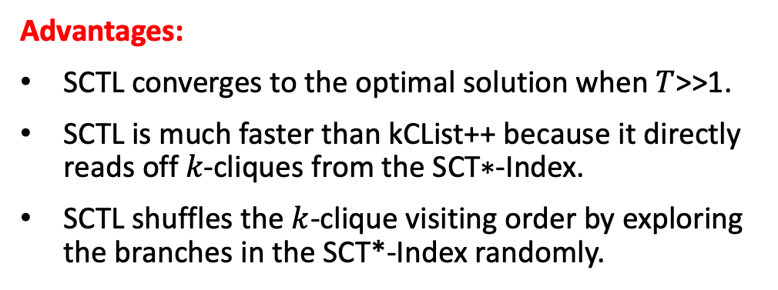





Our Approach: The SCTL algorithm
$$r\left(v_{1}\right)=2$$
Main steps:
SCTL recursively traverses the SCT∗-Index in a depth-first manner and visits each k-clique
For each 𝑘-clique, SCTL finds the vertex with the smallest weight and increases it by 1.
$${v_{1}}_{ }$$
$${v_{5}}_{ }$$
$$r\left(v_{2}\right)=2$$
$$r\left(v_{5}\right)=3$$
$${v_{2}}_{ }$$
$${v_{4}}_{ }$$
$${v_{3}}_{ }$$
Advantages:
SCTL converges to the optimal solution when $T$>>1.
SCTL is much faster than kCList++ because it directly reads off 𝑘-cliques from the SCT∗-Index.
SCTL shuffles the $k$-clique visiting order by exploring the branches in the SCT*-Index randomly.
$$r\left(v_{4}\right)=1$$
$$r\left(v_{3}\right)=5$$
The vertex with the smallest weight in this 5-clique
$$r\left(v_{4}\right)←r\left(v_{4}\right)+1=2$$
Notes:
Based on the SCT*-Index, we propose a SCTL algorithm to obtain a near-optimal approximate solution.
This algorithm maintains the weight of the vertices as it scans the k-cliques for many iterations.
For each visited k-clique, it finds the vertex with the smallest weight and increase it by one.
For example, in this 5-clique, xxx has the smallest weight.
In the end, it collects the vertices with the highest weights to form an approximate solution.

Slide 8
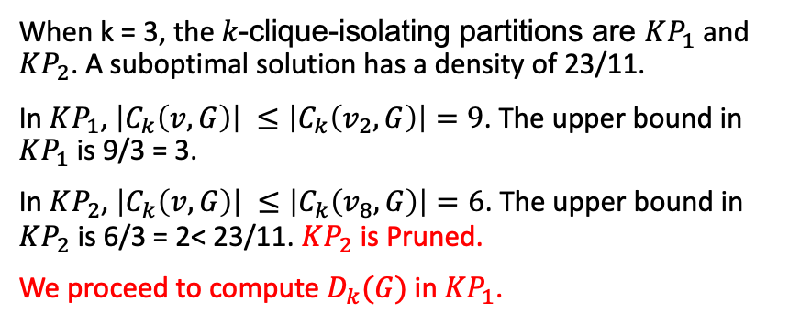
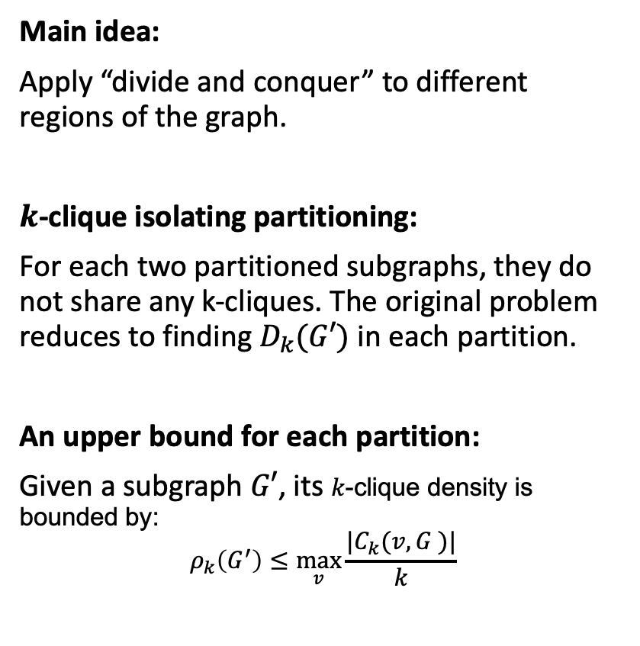
Optimizations: Clique-connectivity-based reduction
Main idea:
Apply “divide and conquer” to different regions of the graph.
$k$-clique isolating partitioning:
For each two partitioned subgraphs, they do not share any k-cliques. The original problem reduces to finding $D_{k}(G′)$ in each partition.
An upper bound for each partition:
Given a subgraph $G′$, its 𝑘-clique density is bounded by:
$$ρ_{k}\left(G^{′}\right)≤\max_{v}{\frac{|C_{k}(v, G )|}{k}}$$
When k = 3, the 𝑘-clique-isolating partitions are $KP_{1}$ and $KP_{2}$. A suboptimal solution has a density of 23/11.
In $KP_{1}$, $\left|C_{k}\left(v, G\right)\right| ≤\left|C_{k}\left(v_{2}, G\right)\right|=9$. The upper bound in $KP_{1}$ is 9/3 = 3.
In $KP_{2}$, $\left|C_{k}\left(v, G\right)\right| ≤\left|C_{k}\left(v_{8}, G\right)\right|=6$. The upper bound in $KP_{2}$ is 6/3 = 2< 23/11. $KP_{2}$ is Pruned.
We proceed to compute $D_{k}(G)$ in $KP_{1}$.
Notes:
To further speed up the SCTL algorithm, we propose graph reduction techniques to reduce the search scope.
Intuitively, we apply “divide-and-conquer” to different partitions of the graph that do not share any k-cliques.
These partitions are called k-clique isolating partitions.
For each partition, an upper bound for the k-clique density can be derived, based on the maximum per-vertex k-clique count.
For example, in KP1, the maximum per-vertex k-clique count is 9, which leads to an upper bound of 3.
In KP2, the upper bound is computed to be 2, which is less than a suboptimal k-clique density 23/11.
Thus, we discard KP2 and focus on KP1 to continue our search.

Slide 9
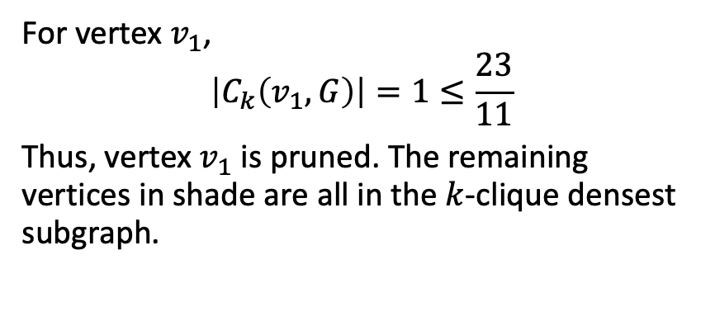
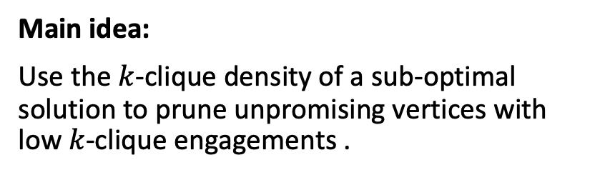
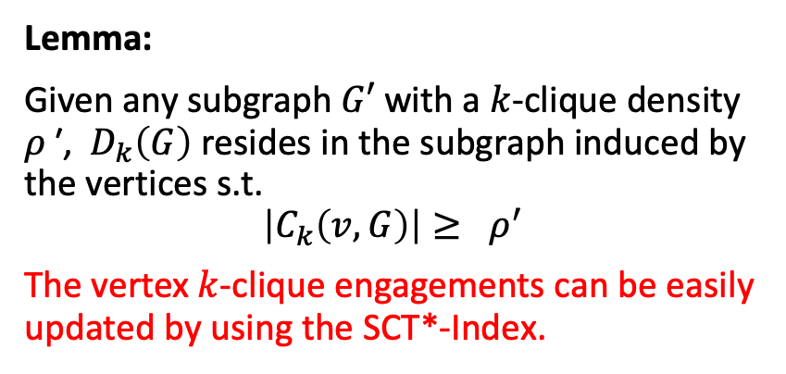
Optimizations: Clique-engagement-based reduction
Main idea:
Use the $k$-clique density of a sub-optimal solution to prune unpromising vertices with low $k$-clique engagements .
Lemma:
Given any subgraph $G′$ with a $k$-clique density 𝜌 ′, $D_{k}\left(G\right)$ resides in the subgraph induced by the vertices s.t.
$$\left|C_{k}\left(v, G\right)\right|≥ ρ^{′}$$
The vertex $k$-clique engagements can be easily updated by using the SCT*-Index.
For vertex $v_{1}$,
$$\left|C_{k}\left(v_{1}, G\right)\right|=1≤\frac{23}{11}$$
Thus, vertex $v_{1}$ is pruned. The remaining vertices in shade are all in the $k$-clique densest subgraph.
Notes:
We also derive a lemma to prune the unpromising vertices that are contained by very few k-cliques.
This is called clique-engagement-based graph reduction.
We discover that given a suboptimal solution with density rho’, the optimal solution must be contained by the subgraph induced by the vertices with k-clique count larger than rho’.
Continuing our discussion from last slide, we focus on KP1 when k = 3.
Given a sub-optimal solution with density 23/11, the vertex 1 should be pruned because it is only contained by one k-clique, which is less than 23/11.

Slide 10






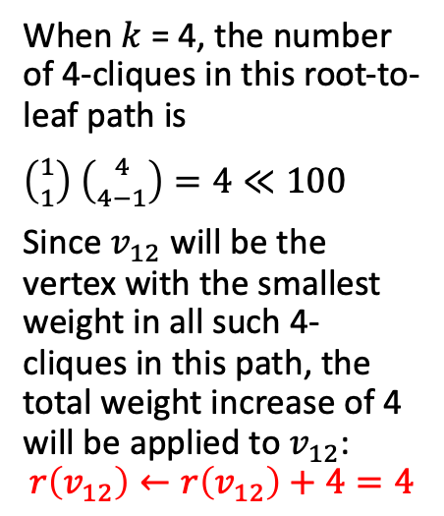





Optimizations: Batch processing k-cliques
$$root$$
Main idea:
Distribute the weight increase (= the
number of 𝑘-cliques in a root-to-leaf path) to the vertices in batch.
An extreme example:
Given a root-to-leaf path P, when one vertex has a very small weight, it is likely to undertake all the weight increase.
Note:
There are many more cases where batch updates are possible. We recursively break down the original problem into these cases.
When $k$ = 4, the number of 4-cliques in this root-to-leaf path is
$\left({1 \atop 1}\right)$ $\left({4 \atop 4−1}\right)=4≪100$
Since $v_{12}$ will be the vertex with the smallest weight in all such 4-cliques in this path, the total weight increase of 4 will be applied to $v_{12}$:
$$r\left(v_{12}\right)←r\left(v_{12}\right)+4=4$$
$${v_{12}}_{ }$$
$$r\left(v_{12}\right)=0$$
5
$${v_{11}}_{ }$$
$$r\left(v_{11}\right)=100$$
5
$${v_{8}}_{ }$$
5
$$r\left(v_{1}\right)=100$$
$${v_{9}}_{ }$$
$$r\left(v_{9}\right)=100$$
5
$${v_{10}}_{ }$$
5
$$r\left(v_{10}\right)=100$$
A root-to-leaf path in the SCT*-Index
Notes:
Since a root-to-leaf path P in the SCT∗-Index organizes multiple 𝑘-cliques, a natural question arises: “can we distribute the weight increase (i.e., the
number of 𝑘-cliques in P) to the vertices in P in batch”?
The answer is positive.
We illustrate via an extreme example:
When one vertex has a very small weight, it is likely to undertake all the weight increase.
For instance, in this root-to-leaf path, when k = 4, there are four k-cliques represented in this path.
Since v12 is the hold vertex, it must participate in all 4 kcliques.
Since its vertex weight is significantly less than the other vertices, the total weight increase of 4 will be applied to v12.
There are many more cases where batch updates are possible.

Slide 11

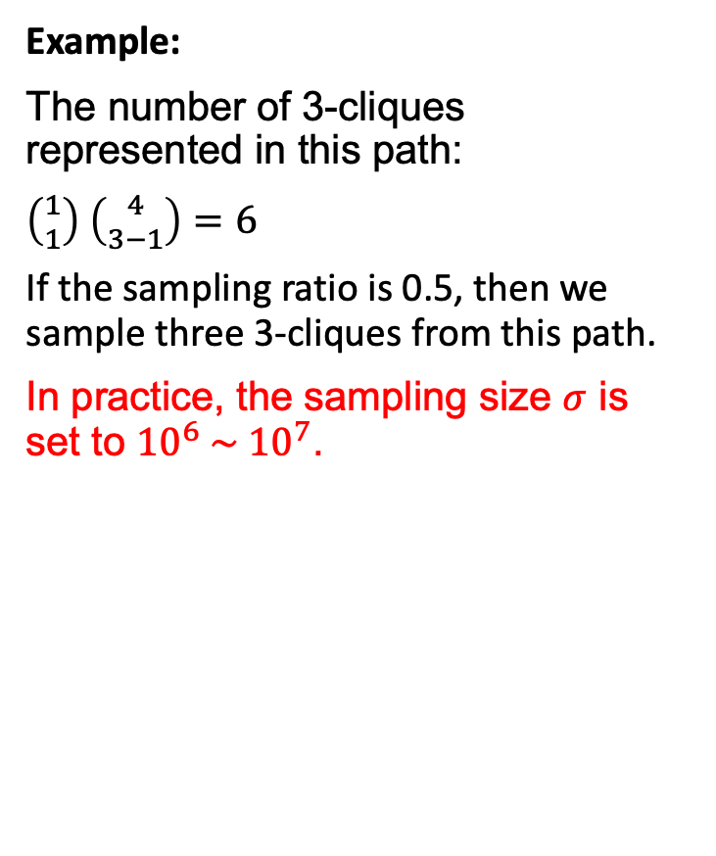

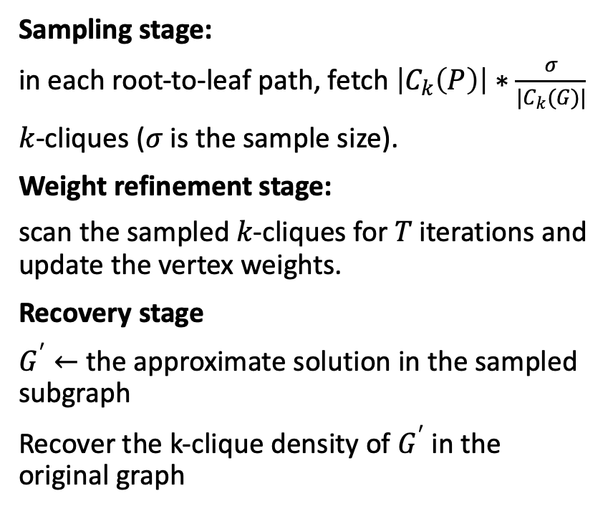



The sampling-based approximate algorithm
Sampling stage:
in each root-to-leaf path, fetch $\left|C_{k}\left(P\right)\right|∗\frac{σ}{|C_{k}(G)|}$
$k$-cliques ($σ$ is the sample size).
Weight refinement stage:
scan the sampled 𝑘-cliques for 𝑇 iterations and update the vertex weights.
Recovery stage
$G^{′}←$ the approximate solution in the sampled subgraph
Recover the k-clique density of $G^{′}$ in the original graph
$$root$$
Example:
The number of 3-cliques represented in this path:
$\left({1 \atop 1}\right)$ $\left({4 \atop 3−1}\right)=6$
If the sampling ratio is 0.5, then we sample three 3-cliques from this path.
In practice, the sampling size $σ$ is set to ${{10}^{6} \sim 10}^{7}$.
If $G^{′}$ contains $v_{12}$, $v_{11}, and v_{8}$, then the number of k-cliques in this path is:
$\left({1 \atop 1}\right)$ $\left({2 \atop 3−1}\right)=1$
$${v_{12}}_{ }$$
5
$${v_{11}}_{ }$$
5
$${v_{8}}_{ }$$
5
$${v_{9}}_{ }$$
5
$${v_{10}}_{ }$$
5
A root-to-leaf path in the SCT*-Index
Notes:
We also adopt sampling to improve the scalability of our algorithms.
The advantage of our sampling-based algorithm is that it never relies on enumerating all k-cliques in any stage, with the help of the proposed index.

Slide 12
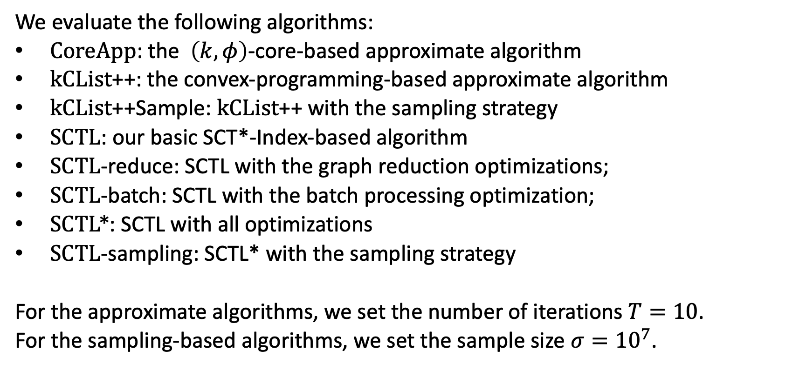
Experiments
We evaluate the following algorithms:
$CoreApp$: the $\left(k, φ\right)$-core-based approximate algorithm
kCList++: the convex-programming-based approximate algorithm
kCList++Sample: kCList++ with the sampling strategy
SCTL: our basic SCT*-Index-based algorithm
SCTL-reduce: SCTL with the graph reduction optimizations;
SCTL-batch: SCTL with the batch processing optimization;
SCTL*: SCTL with all optimizations
SCTL-sampling: SCTL* with the sampling strategy
For the approximate algorithms, we set the number of iterations $T=10$.
For the sampling-based algorithms, we set the sample size $σ={10}^{7}$.
Notes:
In the remainder of this presentation, we show some experimental results.
We compare our proposed algorithms with methods in the two existing works.
For convex-programming-based algorithms, then number of iterations is set to be 10.
For sampling algorithms, the sample size is set to be 10^7.

Slide 13
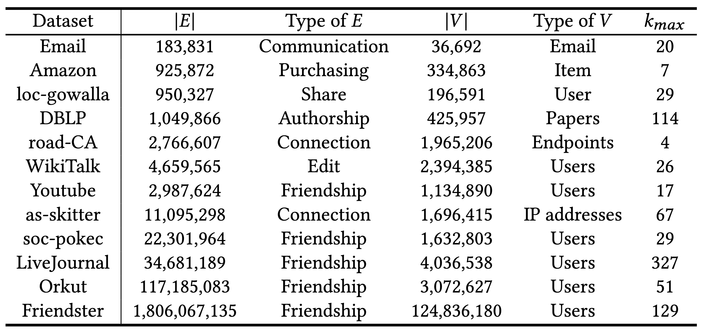
Experimental Settings: Datasets
Notes:
We use 12 real-world datasets in the experiments.
The largest dataset has almost 2 billion edges, with the size of the maximum clique to be 129.

Slide 14
Effect of 𝑘 on the running time
Email
Youtube
soc-Pokec
WikiTallk
SCTL and SCTL∗ significantly outperform KCL on different 𝑘 values.
SCTL∗ achieves a speedup of 733X and 135X compared to KCL on Wikitalk (𝑘 = 19) and Email (𝑘 = 23).
Notes:
Here we compare SCT-index-based algorothms and the existing convex-programming based approach on 4 datasets.
We can see that xxx significantly outperform xxx in terms of efficiency.
Also, SCTL∗ with all optimizations outperforms SCTL by up to one order of magnitude (soc-Pokec, 𝑘 = 5).

Slide 15
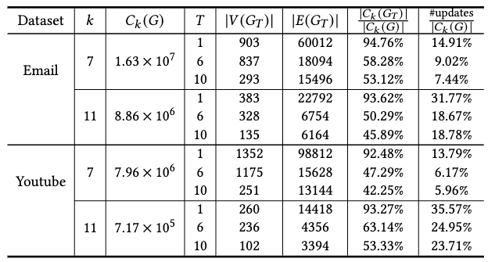
Effectiveness of the proposed optimizations
Email
Youtube
The graph reduction technique generally has more pruning power on small 𝑘 values.
The batch processing technique is usually more effective on medium 𝑘 values.
The SCTL∗ algorithm with both optimizations yields the largest speedup ratios in most settings.
Notes:
Here we incrementally add the graph reduction and batch processing optimization to the SCTL algorithm.
We conclude that
The graph reduction technique generally has more pruning power on small 𝑘 values.
The batch processing technique is usually more effective on medium 𝑘 values.
The SCTL∗ algorithm with both optimizations yields the largest speedup ratios in most settings.

Slide 16
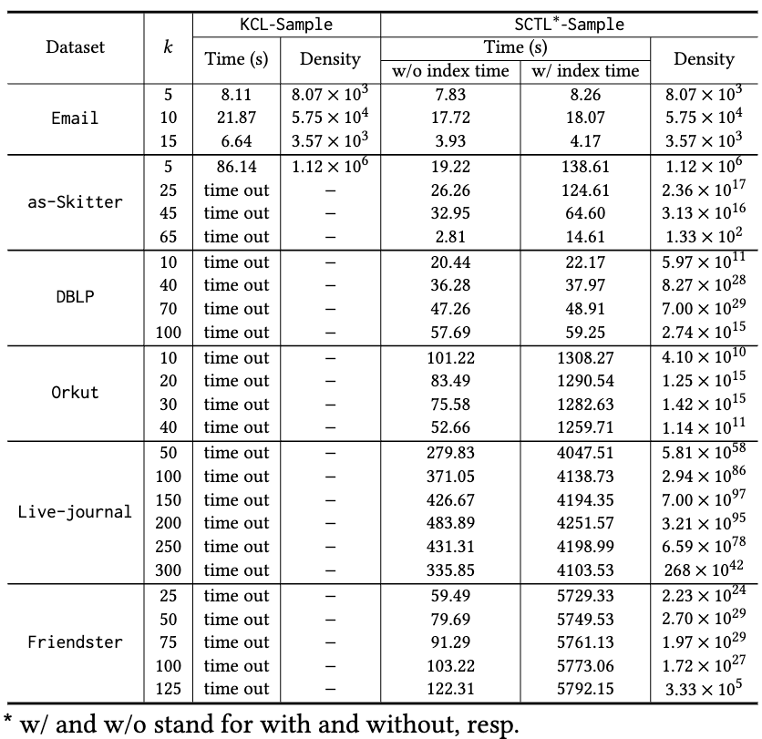
Comparison between KCL-Sample and SCTL∗-Sample
We compare KCL-Sample and
SCTL∗-Sample on 6 datasets as 𝑘 varies.
The optimal solutions are
only available on Email and DBLP, and SCTL∗-Sample can find them quickly.
SCTL∗-Sample provides reasonable approximate solutions for all 𝑘 on graphs at billion-scale.
Notes:
We compare KCL-Sample and SCTL∗-Sample on 6 datasets as 𝑘 varies.
KCL-sampling is the state-of-the-art convex-progamming-based approach with sampling.
Note that The optimal solutions are only available on Email and DBLP, and SCTL∗-Sample can find them quickly.
This is because the 𝑘-clique densest subgraph on the sampled subgraph and that of the original graph highly overlap
SCTL∗-Sample provides reasonable approximate solutions for all 𝑘 on the billion-scale graph, Friendster.

Slide 17
Conclusion
By adapting the succinct clique tree, we propose the SCT∗-Index to compactly organize the 𝑘-cliques.
The SCTL algorithm converges to the optimal solution more efficiently by utilizing the SCT*-Index.
We propose novel graph reduction optimizations and a batch processing technique to push the efficiency boundary.
We propose a sampling-based algorithm that provides reasonable approximations for billion-scale graphs, which facilitates the exact algorithm.
Extensive experiments on 12 real-world graphs validate both the efficiency and effectiveness of the proposed techniques.
Notes:
In conclusion, we propose a novel index to compactly stored the k-cliques.
Based on this index, we propose efficient approximate algorithms that achieve near-optimal solutions. The sampling-based algorithm can provide reasonable approximation on billion-scale graphs.
We evaluate the effectiveness and efficiency of these algorithms on 12 real-world graphs. .

Slide 18
Thank you!
Notes:
This concludes my presentation. Thank you for your attension.

