Slide 1



Neural Subgraph Counting With Wasserstein Estimator
Hanchen Wang^{1,2}, Rong Hu¹, Ying Zhang¹, Lu Qin¹, Wei Wang³, Wenjie Zhang²
¹ The University of Technology Sydney, ² The University of New South Wales,
³ The Hong Kong University of Science and Technology (Guangzhou)
SIGMOD 2022

Slide 2
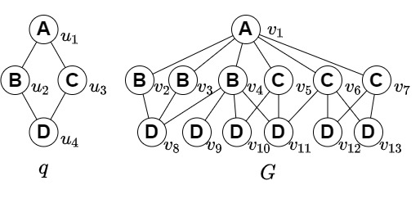

Background
Subgraph Counting
Subgraph Counting: Given a query graph $q$ and a data graph $G$, the problem is to count the number of subgraphs in the data graph that match the query graph by subgraph isomorphism.
Subgraph isomorphisms

Slide 3
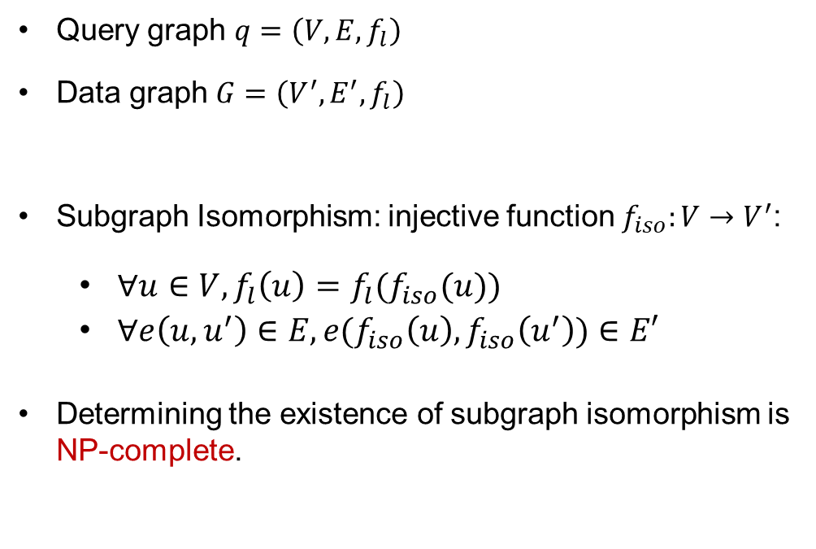
Background
Subgraph Isomorphism
Query graph $q=\left(V,E,f_{l}\right)$
Data graph $G=\left(V^{′},E^{′},f_{l}\right)$
Subgraph Isomorphism: injective function $f_{iso}:V→V^{′}$:
  $∀u∈V,f_{l}\left(u\right)=f_{l}(f_{iso}(u))$
  $∀e\left(u, u^{′}\right)∈E, e(f_{iso}\left(u\right),f_{iso}\left(u^{′}\right))∈E′$
Determining the existence of subgraph isomorphism is NP-complete.

Slide 4
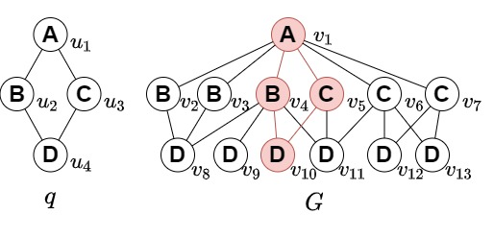

Background
Subgraph Counting
Subgraph Counting: Given a query graph $q$ and a data graph $G$, the problem is to count the number of subgraphs in the data graph that match the query graph by subgraph isomorphism.
Subgraph isomorphisms
$\left(u_{1}, u_{2}, u_{3}, u_{4}\right)→\left(v_{1}, v_{4}, v_{5}, v_{10}\right)$

Slide 5
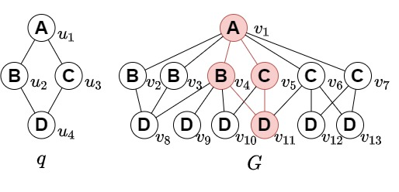
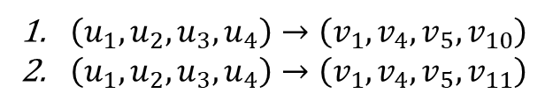
Background
Subgraph Counting
Subgraph Counting: Given a query graph $q$ and a data graph $G$, the problem is to count the number of subgraphs in the data graph that match the query graph by subgraph isomorphism.
Subgraph isomorphisms
$\left(u_{1}, u_{2}, u_{3}, u_{4}\right)→\left(v_{1}, v_{4}, v_{5}, v_{10}\right)$
$\left(u_{1}, u_{2}, u_{3}, u_{4}\right)→\left(v_{1}, v_{4}, v_{5}, v_{11}\right)$

Slide 6
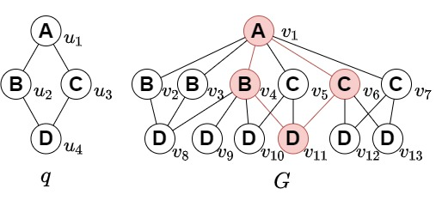
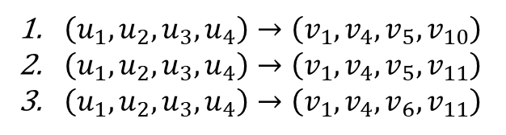
Background
Subgraph Counting
Subgraph Counting: Given a query graph $q$ and a data graph $G$, the problem is to count the number of subgraphs in the data graph that match the query graph by subgraph isomorphism.
Subgraph isomorphisms
$\left(u_{1}, u_{2}, u_{3}, u_{4}\right)→\left(v_{1}, v_{4}, v_{5}, v_{10}\right)$
$\left(u_{1}, u_{2}, u_{3}, u_{4}\right)→\left(v_{1}, v_{4}, v_{5}, v_{11}\right)$
$\left(u_{1}, u_{2}, u_{3}, u_{4}\right)→\left(v_{1}, v_{4}, v_{6}, v_{11}\right)$

Slide 7
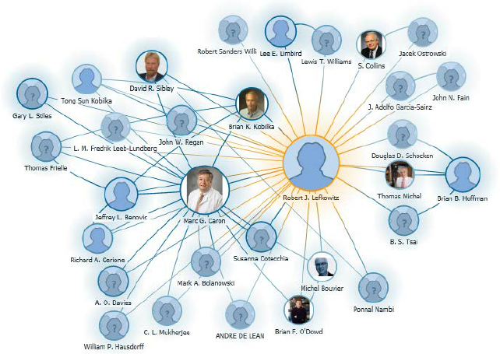
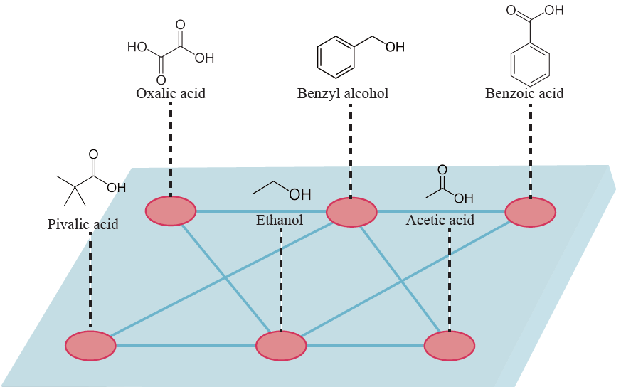
Background
Applications
Analysis on Social Networks:
Find co-authorships, communication detection.
Analysis on Biological Networks:
On brain, regulation, protein and molecule graphs.
Summarize the structural patterns for the biological graphs.
Query Optimization for Subgraph Matching Queries:
Cardinality estimation for multi-way join.

Slide 8
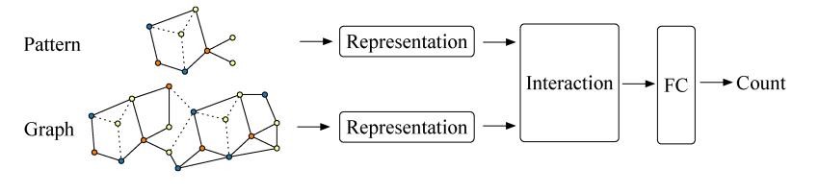
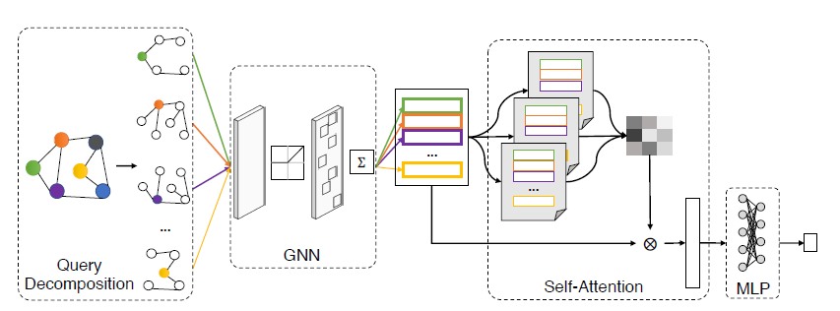
Background
Learning-based Methods:
Neural Subgraph Isomorphism Counting
A Learned Sketch for Subgraph Counting
Existing methods
Algorithmic Methods:
Enumeration-based methods:
Computational complexity.
Sampling-based methods:
Sampling failure.
Summary-based methods:
Independent assumption.
*Until Sept. 2021

Slide 9
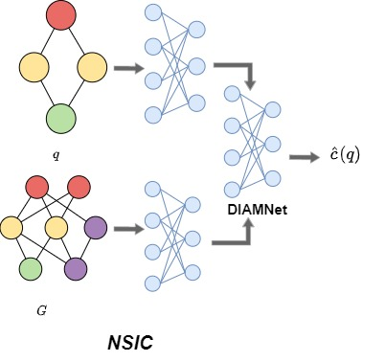
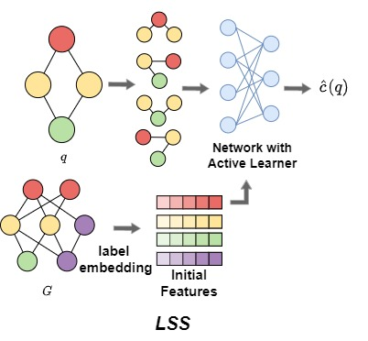
Background
Learning-based methods
Efficiency and scalability issue.
Hard to distinguish different query graphs.
Not fully use data graph information
Limited robustness.
*Until Sept. 2021

Slide 10
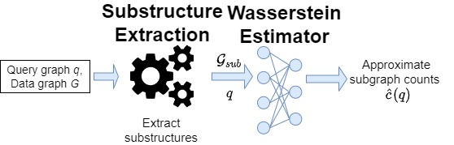
Overview
Neural Subgraph Counting method: NeurSC

Slide 11
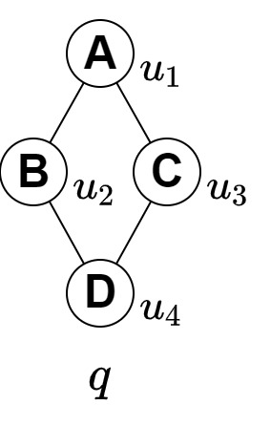
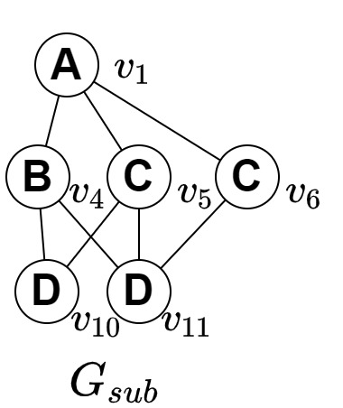
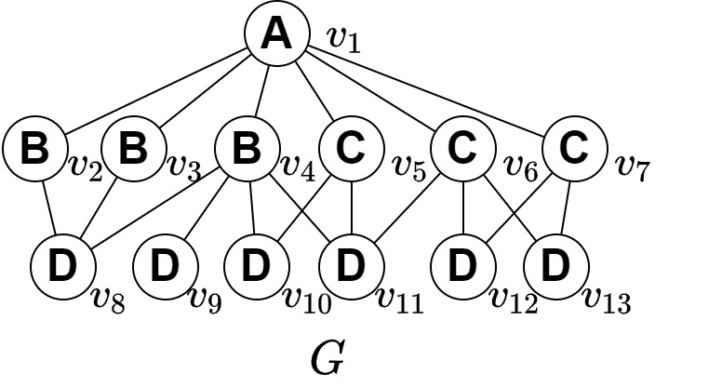
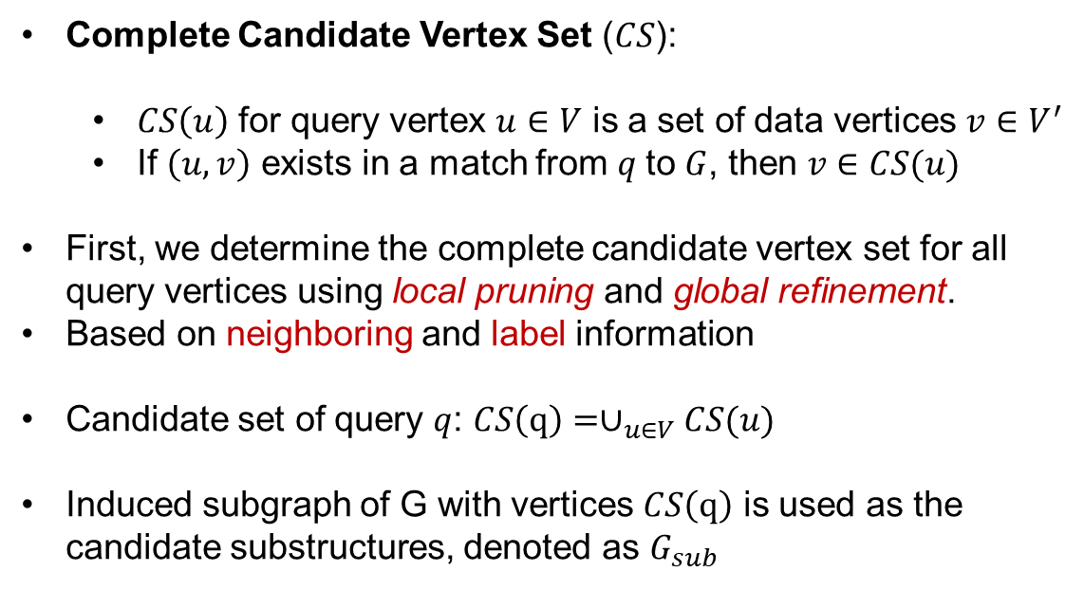
NeurSC
Substructure Extraction
Complete Candidate Vertex Set ($CS$):
  $CS\left(u\right)$ for query vertex $u∈V$ is a set of data vertices $v∈V^{′}$
  If $\left(u, v\right)$ exists in a match from $q$to $G$, then $v∈CS(u)$
First, we determine the complete candidate vertex set for all query vertices using local pruning and global refinement.
Based on neighboring and label information
Candidate set of query $q$: $CS\left(q\right)=∪_{u∈V}CS(u)$
Induced subgraph of G with vertices $CS\left(q\right)$ is used as the candidate substructures, denoted as $G_{sub}$

Slide 12
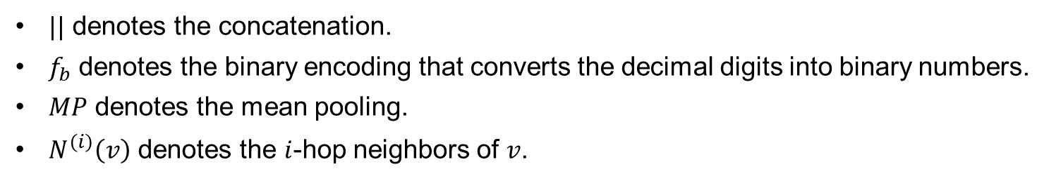
NeurSC
Feature Initialization
$$x_{v}=f_{b}\left(\deg_{v}\right)||f_{b}\left(f_{l}\left(v\right)\right)||_{i=1}^{k}MP_{∀v^{′}∈N^{\left(i\right)}\left(v\right)}f_{b}\left(\deg_{v^{′}}\right)||f_{b}\left(f_{l}\left(v′\right)\right)$$
Degree information
Label information
Neighbor information
$||$ denotes the concatenation.
$f_{b}$ denotes the binary encoding that converts the decimal digits into binary numbers.
$MP$ denotes the mean pooling.
$N^{\left(i\right)}\left(v\right)$ denotes the $i$-hop neighbors of $v$.

Slide 13
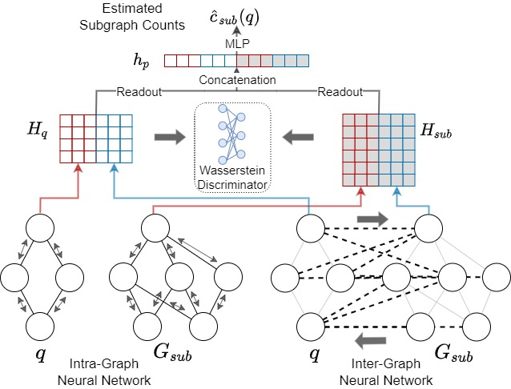
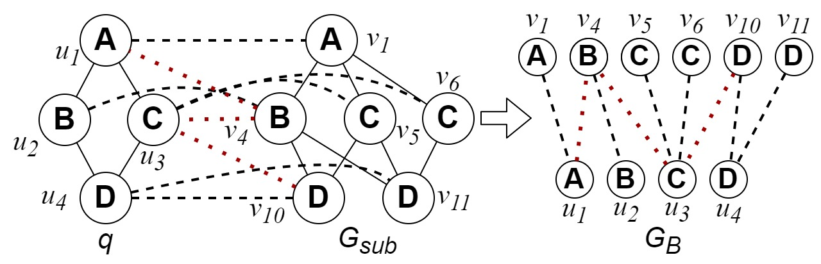
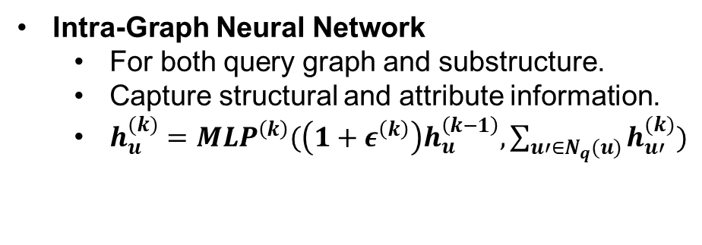
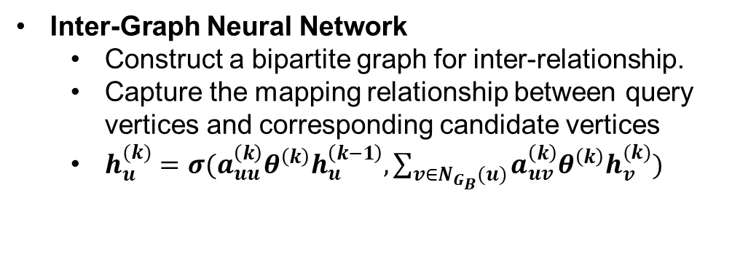
NeurSC
Wasserstein Estimator
Intra-Graph Neural Network
  For both query graph and substructure.
  Capture structural and attribute information.
  $h_{u}^{(k)}={MLP}^{\left(k\right)}(\left(1+ε^{\left(k\right)}\right)h_{u}^{\left(k−1\right)}, \sum_{u′∈N_{q}(u)}{h_{u′}^{(k)}})$
Inter-Graph Neural Network
  Construct a bipartite graph for inter-relationship.
  Capture the mapping relationship between query vertices and corresponding candidate vertices
  $h_{u}^{(k)}=σ(a_{uu}^{\left(k\right)}θ^{\left(k\right)}h_{u}^{\left(k−1\right)}, \sum_{v∈N_{G_{B}}(u)}{a_{uv}^{\left(k\right)}{θ^{\left(k\right)}h}_{v}^{(k)}})$

Slide 14
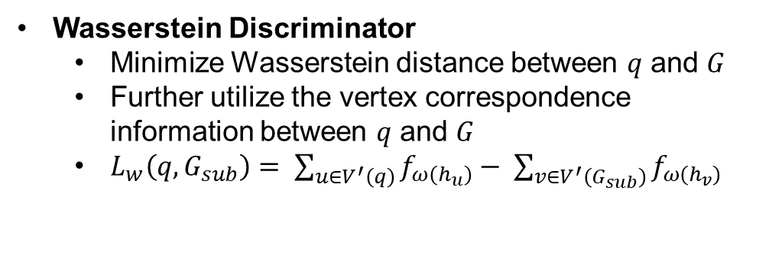
NeurSC
Wasserstein Estimator
Readout
  Sum Pooling
  Concatenation of intra- and inter-graph representations.
Prediction
  Multi-layer perceptron.
Wasserstein Discriminator
  Minimize Wasserstein distance between $q$ and $G$
  Further utilize the vertex correspondence information between $q$ and $G$
  $L_{w}\left(q, G_{sub}\right)= \sum_{u∈V^{′}\left(q\right)}{f_{ω\left(h_{u}\right)}}− \sum_{v∈V^{′}\left(G_{sub}\right)}{f_{ω\left(h_{v}\right)}}$
Expressive Power
  WEst is as powerful as 1-Weisfeiler-Lehman test.

Slide 15
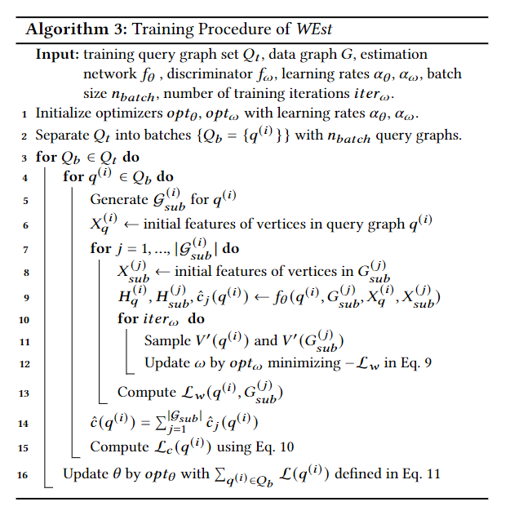
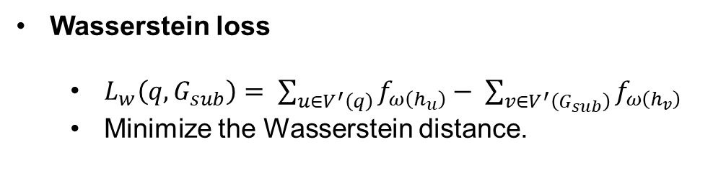
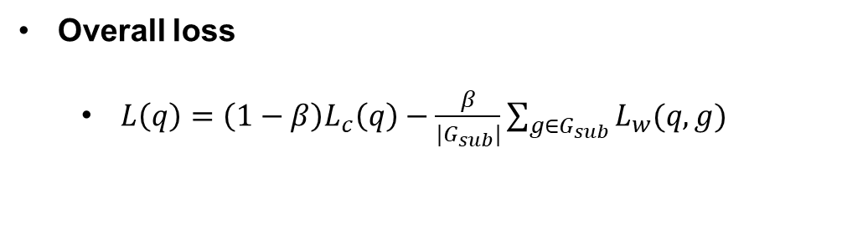
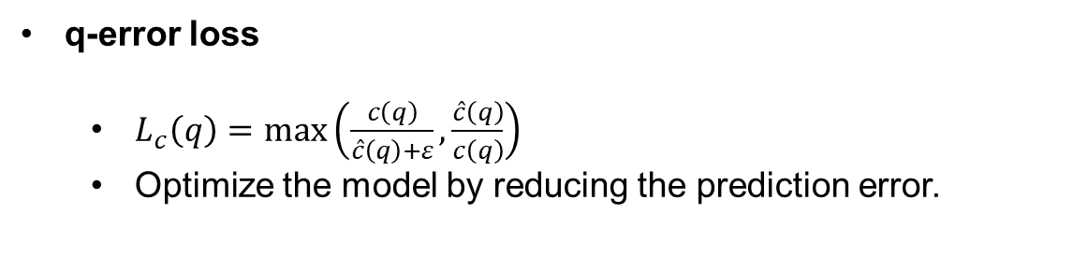
NeurSC
Learning objective and training procedure
q-error loss
  $L_{c}\left(q\right)=\max\left(\frac{c\left(q\right)}{\hat{c}\left(q\right)+ε}, \frac{\hat{c}\left(q\right)}{c\left(q\right)}\right)$
  Optimize the model by reducing the prediction error.
Wasserstein loss
  $L_{w}\left(q, G_{sub}\right)= \sum_{u∈V^{′}\left(q\right)}{f_{ω\left(h_{u}\right)}}− \sum_{v∈V^{′}\left(G_{sub}\right)}{f_{ω\left(h_{v}\right)}}$
  Minimize the Wasserstein distance.
Overall loss
  $L\left(q\right)=\left(1−β\right)L_{c}\left(q\right)−\frac{β}{|G_{sub}|}\sum_{g∈G_{sub}}{L_{w}(q,g)}$

Slide 16
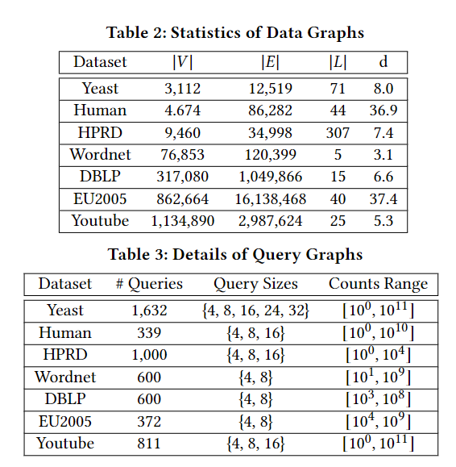
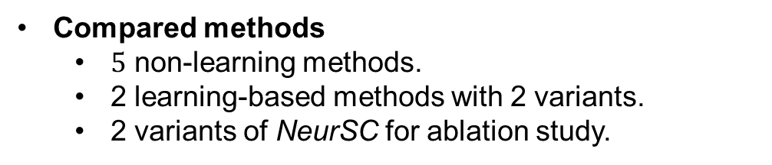
Experiments
Experimental Setup
Dataset
  7 data graphs + 5 query sets.
Compared methods
  $5$ non-learning methods.
  2 learning-based methods with 2 variants.
  2 variants of NeurSC for ablation study.
Parameter settings
  Initial dimension: 64
  Hidden and output dimension 128
  Intra- and Inter-GNN have 2 layers.
  Prediction network is a 4-layer MLP.
Implementation
  Substructure extraction: C++
  WEst: Python + Pytorch Geometric

Slide 17
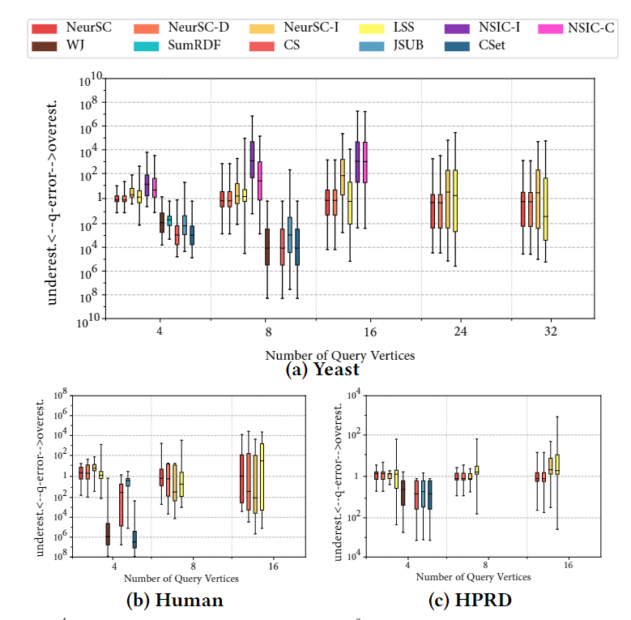
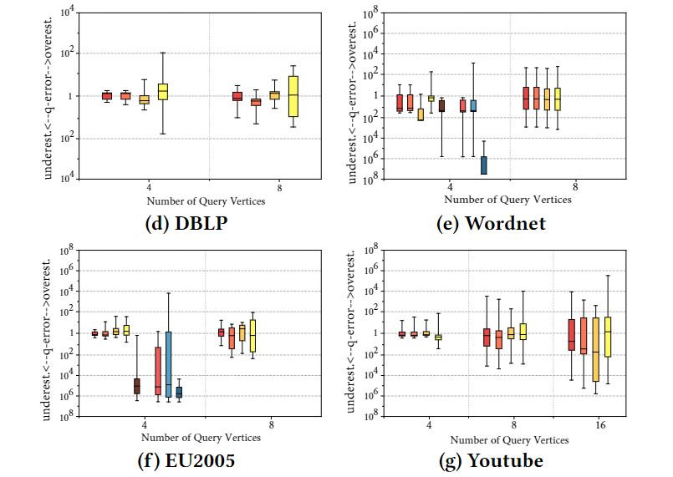
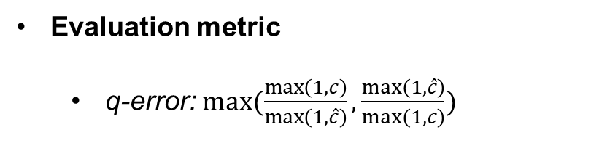
Experiments
Accuracy Evaluation
Evaluation metric
  q-error: $max⁡(\frac{\max\left(1,c\right)}{\max\left(1,\hat{c}\right)},\frac{\max\left(1,\hat{c}\right)}{\max\left(1, c\right)})$

Slide 18
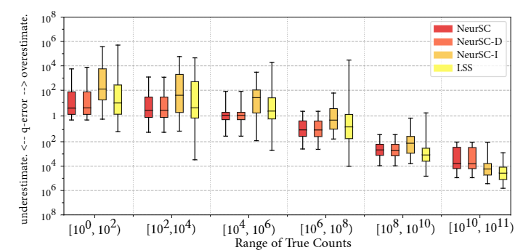
Experiments
q-error varying ground-truth counts on Yeast

Slide 19
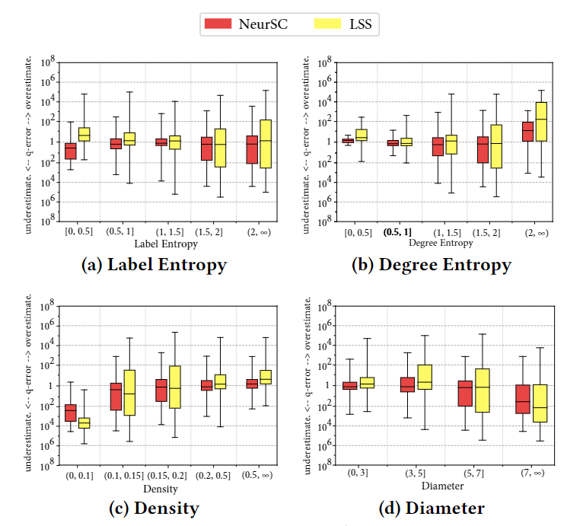
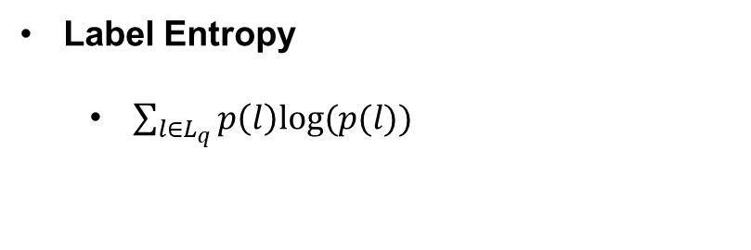
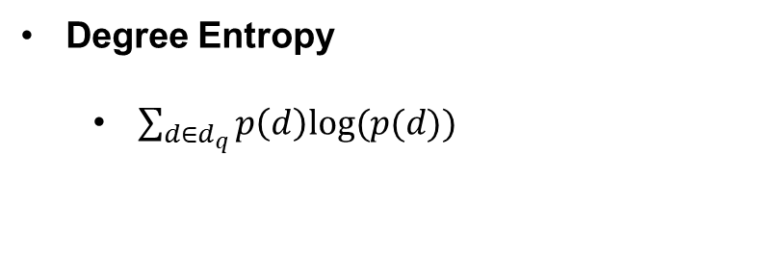
Experiments
q-error varying query characteristics on Yeast
Label Entropy
  $\sum_{l∈L_{q}}{p\left(l\right)log⁡(p(l))}$
Degree Entropy
  $\sum_{d∈d_{q}}{p\left(d\right)log⁡(p(d))}$

Slide 20
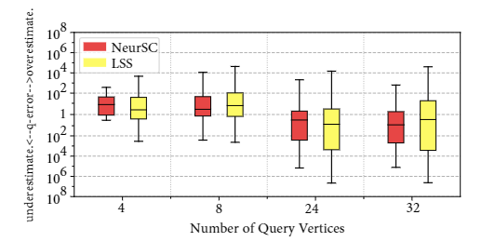
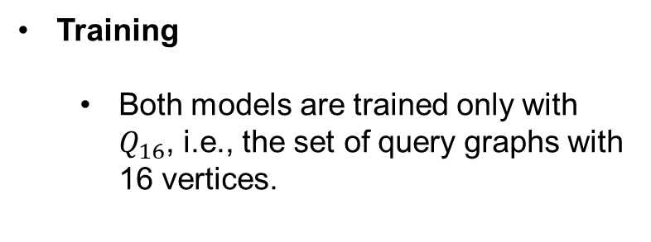
Experiments
Robustness evaluation on Yeast
Training
  Both models are trained only with $Q_{16}$, i.e., the set of query graphs with 16 vertices.
Test
  The trained models are then evaluated on the other query sets with 4, 8, 24, 32 vertices.

Slide 21
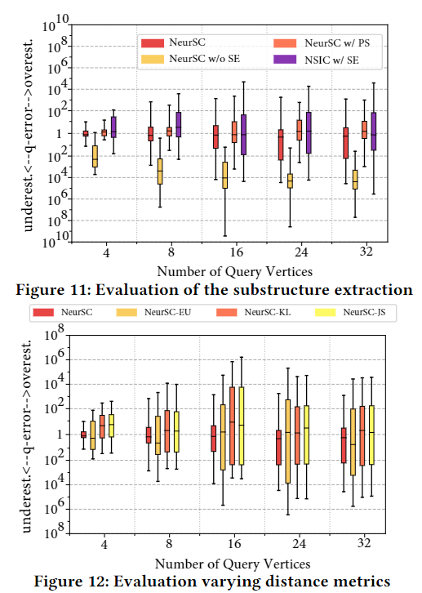
Experiments
Ablation Study
Evaluation with/without substructure extraction module.
  NeurSC
  NeurSC with ‘perfect’ substructure
  NeurSC with out substructure extraction
  NSIC with substructure extraction
Evaluation varying distance metrics.
  NeurSC with Wasserstein distance
  NeurSC with Euclidean distance
  NeurSC with KL divergence
  NeurSC with JS divergence

Slide 22
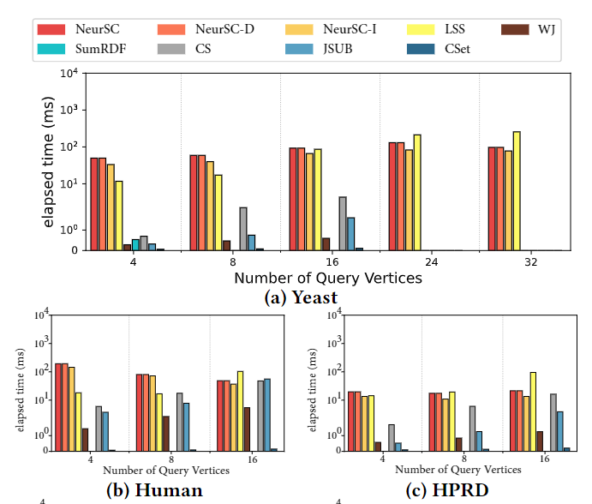
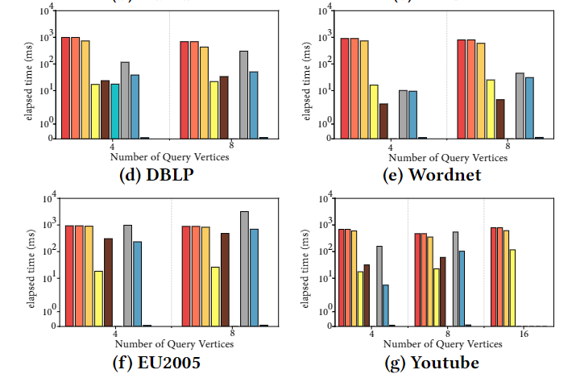
Experiments
Query Time Comparison

Slide 23
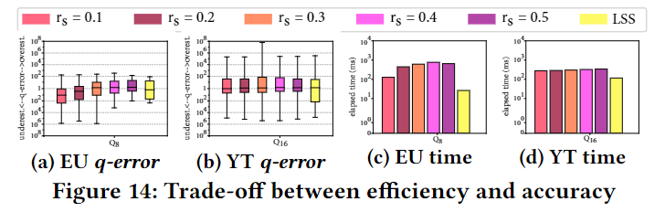
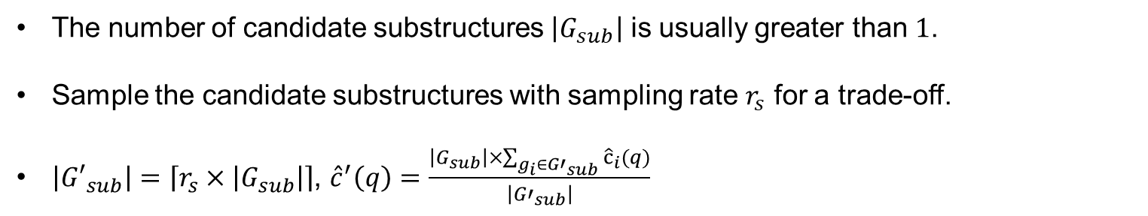
Experiments
Trade-off between accuracy and efficiency
The number of candidate substructures $\left|G_{sub}\right|$ is usually greater than $1$.
Sample the candidate substructures with sampling rate $r_{s}$ for a trade-off.
$\left|{G′}_{sub}\right|=\left\lceil r_{s}×\left|G_{sub}\right|\right\rceil$, ${\hat{c}}^{′}\left(q\right)=\frac{\left|G_{sub}\right|×\sum_{g_{i}∈{G′}_{sub}}{{\hat{c}}_{i}(q)}}{\left|{G′}_{sub}\right|}$

Slide 24
Thank you!
Hanchen Wang, University of Technology Sydney.
hanchen.wang@uts.edu.au

