Slide 1
Towards Real-Time Counting Shortest Cycles on Dynamic Graphs: A Hub Labeling Approach
Qingshuai Feng, You Peng, Wenjie Zhang, Ying Zhang, Xuemin Lin

Slide 2
Shortest Cycle Counting
Middle-man accounts
In transaction networks:
Node → Account
Edge → Transaction
Shortest cycle through a node → Money laundering
More such cycles through an account
→ Higher risk of engaging in illegal activities
Normal
accounts
$$M1$$
Agent accounts
$$N1$$
$$A1$$
$$Mn$$
$$C3$$
Non-criminal account
$$N2$$
$$C1$$
$$C2$$
Criminal accounts
$$A2$$
$$Mn’$$
$$N3$$
$$M1’$$
E-commerce networks: detect fraudulent transactions
P2P file-sharing networks: detect hop hosts and optimize networks
……

Slide 3
Problem Definition
Shortest Cycle Counting of $v7$, $SCCnt(v7)$, is: 3
$v7, v10, v1, v4, v7$
$v7, v10, v1, v5, v7$
$v7, v10, v2, v4, v7$
Networks changes (insertion and deletion of vertices and edges) from time to time…
Problem:
How to efficiently count the shortest cycles through a given node on a dynamic graph?
$$v3$$
$$v1$$
$$v10$$
$$v6$$
$$v5$$
$$v4$$
$$v2$$
$$v9$$
$$v7$$
$$v8$$

Slide 4
Background
Counting patterns
Enumerating Patterns
2-Hop Labeling (Hub Labeling)
Index-based approach, real-time query evaluation
Label of vertex $v{,L}_{in}(v)$ and $L_{out}\left(v\right) :\{…,{(h,sd(h,v),θ}_{h,v}),…\}$
$H=\{h|\underset{h∈L_{out}(s)∩L_{in}(t)}{arg min}{\{sd\left(s,h\right)+sd(h,t)\}}\}$
$SPCnt\left(s,t\right)=\sum_{h∈H}{θ(s,h)∙θ(h,t)}$
Canonical labels
Non-canonical labels

Slide 5
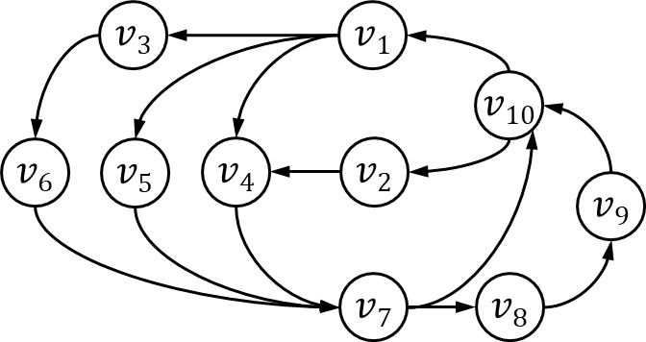
Hub Labeling for Shortest Path Counting^{[1]}
$$v_{1}≺v_{7}≺v_{4}≺v_{10}≺v_{2}≺v_{3}≺v_{5}≺v_{6}≺v_{8}≺v_{9}$$
v | L_{in} | L_{out}
v₁ | (v₁, 0, 1) | (v₁, 0, 1)
v₂ | (v₁, 6, 2) (v₇, 2, 1) (v₁₀, 1, 1) (v₂, 0, 1) | (v₁, 6, 1) (v₇, 2, 1) (v₄, 1, 1) (v₂, 0, 1)
v₃ | (v₁, 1, 1) (v₃, 0, 1) | (v₁, 6, 1) (v₇, 2, 1) (v₃, 0, 1)
v₄ | (v₁, 1, 1) (v₇, 3, 1) (v₄, 0, 1) | (v₁, 5, 1) (v₇, 1, 1) (v₄, 0, 1)
v₅ | (v₁, 1, 1) (v₅, 0, 1) | (v₁, 5, 1) (v₇, 1, 1) (v₅, 0, 1)
v₆ | (v₁, 2, 1) (v₃, 1, 1) (v₆, 0, 1) | (v₁, 5, 1) (v₇, 1, 1) (v₆, 0, 1)
v₇ | (v₁, 2, 2) (v₇, 0, 1) | (v₁, 2, 1) (v₇, 0, 1)
v₈ | (v₁, 3, 2) (v₇, 1, 1) (v₈, 0, 1) | (v₁, 3, 1) (v₇, 5, 1) (v₄, 4, 1) (v₁₀, 2, 1) (v₈, 0, 1)
v₉ | (v₁, 4, 2) (v₇, 2, 1) (v₈, 1, 1) (v₉, 0, 1) | (v₁, 2, 1) (v₇, 4, 1) (v₄, 3, 1) (v₁₀, 1, 1) (v₉, 0, 1)
v₁₀ | (v₁, 5, 2) (v₇, 1, 1) (v₁₀, 0, 1) | (v₁, 1, 1) (v₇, 3, 1) (v₄, 2, 1) (v₁₀, 0, 1)
$(v1, 2, 2)$in $Lin(v7)$ is canonical label
$$v1→v_{7}:$$
$$v1 →v_{4} →v_{7}$$
$$v1 →v_{5} →v_{7}$$
$(v7, 3, 1)$in $Lin(v4)$ is non-canonical label
$$v7→v_{4}:$$
$$v7 →v_{10} →v_{2}→v_{4}$$
$$v7 →v_{10} →v_{1}→v_{4}$$
$SPCnt(v7, v4):$using $Lout(v7)$and $Lin(v4)$
Through $v1$, $sd=2+1=3$, $counting=1∗1=1$
Through $v7$, $sd=0+3=3$, $counting=1∗1=1$
$SPCnt(v7, v4)=1+1=2$ with shortest path length$=3$
[1] Zhang, Y. and Yu, J.X., 2020, June. Hub labeling for shortest path counting. In Proceedings of the 2020 ACM SIGMOD International Conference on Management of Data (pp. 1813-1828).

Slide 6
Maintenance for 2-Hop Labeling
Insertion Update
Find affected hubs
Conduct partial BFS from affected hubs
Traverse and update labels until distance doesn’t change
Deletion Update
Find affected hubs
Remove potential out-of-date labels
Conduct partial index construction to recover labels

Slide 7
Motivation
Real world applications
Money laundering detection
Fake transaction detection
File sharing network optimization
Real-time query evaluation
2-hop labeling: microseconds per query on billion scale graphs
Update algorithm for 2-hop labeling counting index on dynamic graphs

Slide 8
Counting Short Cycles with SPC-Index
In original graph
Query between $v$ and all its in/out-neighbors
$SCCnt(v7):$
There are 2 out-neighbors $(v8, v10)$and 3 in-neighbors $(v4, v5, v6)$
$sd(v8, v7)=5$ and $SPCnt(v8, v7)=3$
$sd(v10, v7)=3$and $SPCnt(v8, v7)=3$
$SCCnt(v7)=3$with shortest cycle length$=3+1=4$
$$Query time of SCCnt(v) ∝ min⁡(|nbrin(v)|, |nbrout(v)|)$$
where $|nbrin(v)|$ ($|nbrout(v)|$) is the number of in-neighbors (out-neighbors) of $v$

Slide 9
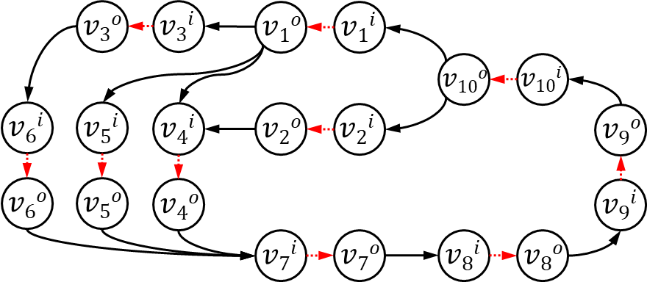
Bipartite Conversion
Each $v$ is split into $vi$ and $vo$ and $vi≺vo$
All in-edges of $v$ connect to $vi$; All out-edges of $v$ connect to $vo$
Add edge $(v^{i},v^{o})$
$SCCnt(v)$= the number of shortest paths from $vo$ to $vi$
Only one query evaluation is required to calculate $SCCnt(v)$

Slide 10
Bipartite Hub Labeling
Couple-Vertex Skipping
Vertex $v$ receiving hub, skip $vo$, directly add $d$ by 1
E.g., vertex $v1i$ and $v1o$
Vertex $v$ as hub, only use $vi$ as hub, ignore $vo$
E.g., vertex $hi$ and $ho$
For each couple vertices $vi$ and $vo$, only store one copy of label
$(v^{i}, d, c)$may exist in $Lout(v^{o})$
$(h^{i}, 1, 1)$
$(h^{i}, d+1, c)$
$(h^{i}, d+3, c)$
$$hi$$
$$ho$$
$$v1i$$
$$v1o$$
$$v2i$$
$$v2o$$
$(h^{i}, 0, 1)$
$(h^{i}, d, c)$
$(h^{i}, d+2, c)$

Slide 11
Counting Shortest Cycle (CSC) index
CSC Index
Query evaluation
$SCCnt(v7):$
Through $v_{1}^{i}$, $sd=4+3=7, counting=2∗1=2$
Through $v_{7}^{i}$, $sd=0+7=7, counting=1∗1=1$
$SCCnt\left(v7\right)=2+1=3$with shortest cycle length $= (7+1)÷2 = 4$
Index Time: $O({nω}^{2}\log^{2}n+(s_{f}+s_{b})∙nωlogn)$
Index Size: $O(nωlogn)$
For a graph with treewidth $ω$, average out-degree $s_{f}$ and average in-degree $s_{b}$
$v_{1}^{i}≺v_{1}^{o}≺v_{7}^{i}$ $≺v_{7}^{o}$ $≺v_{4}^{i}⋯$
$$L_{in}(v_{7}^{i})$$ | $(v_{1}^{i}, 4, 2)$ $(v_{7}^{i}, 0, 1)$
$$L_{out}(v_{7}^{o})$$ | $(v_{1}^{i}, 3, 1)$ $(v_{7}^{i}, 7, 1)$ $(v_{7}^{o}, 0, 1)$

Slide 12
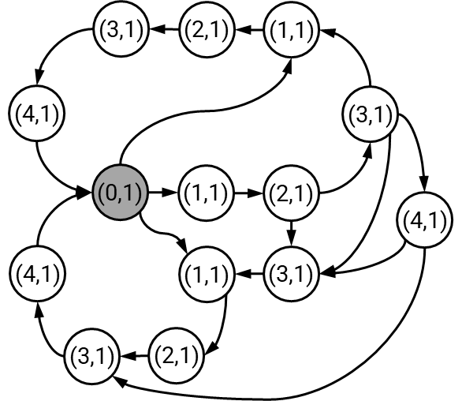
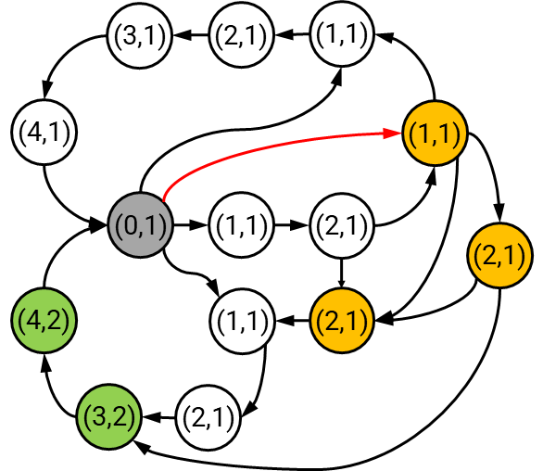
Insertion Update
Edge Insertion $(a, b)$
The shortest distance between any pair of vertices does not grow with the addition of a new edge.
The affected hubs associated with $a$ as $hubA = \{hA|(hA, d, c) ∈L_{in}(a)\}$and the affected hubs related to $b$ as $hubB = \{hB|(hB, d, c) ∈L_{out} (b)\}$
Insert edge $(a, b)$
$$b$$
$$b$$
For each $(hA, d, c) ∈L_{in}(a)$, conduct BFS using hub $hA$ from $b$ with $d+1$ and $c$
When meeting a vertex $v (≻h_{A})$:
$DBFS>Dquery$, prune
$DBFS=Dquery$, accumulate counting
$DBFS<Dquery$, update with new $d$ and $c$
$$a$$
$$a$$

Slide 13
Insertion Update
Update while preserving the minimality property
When $dh1$ decreases, $(w, d_{w}, c_{w})$in $Lout(v)$ is out-of-date
Inverted index of $w$, $inv_in(w)$and $inv_out(w),$contains the vertices which have $w$ as hub
Use inverted index to locate vertices like $v$ and remove out-of-date labels
Time complexity: $O(kω2 log2n)$
where k is the number of vertices visited during the BFS for updating
$$h$$
$$h≺w≺v$$
$$L_{out}\left(v\right):\{\left(h,d_{h2}, c_{h2}\right), \left(w,d_{w},c_{w}\right)…\}$$
$$v$$
$$a$$
$$b$$
$$w$$
$$L_{in}\left(w\right):\{\left(h,d_{h1}, c_{h1}\right)…\}$$

Slide 14
Deletion Update
Edge Deletion $(a, b)$
Find affected hubs
$hubA=\left\{v \right| sd(v, a)+1=sd(v, b)\}$
$hubB=\left\{u \right| sd(b, u)+1=sd(a, u)\}$
Remove potential out-of-date labels
If $v∈hubA∧u∈hubB$, delete $(v, d, c)$ from $Lin(u)$ or delete $(u, d, c)$from $Lout(v)$ if they exist
BFS from affected hubs to recover labels
Start at each vertex $v$ in $hubA$ and inserting $(v, d, c)$into $Lin(u)$ if $u∈hubB$
Vice versa to add out-label entries from vertices in $hubB$ in reverse direction

Slide 15
Experiments
BFS: Breath First Search
HP-SPC: traverse the in/out-neighbors of the query node and use SPC index
CSC: the proposed algorithm for shortest cycle counting
INCCNT: update algorithm for CSC index
Graph | Notation | n | m
p2p-Gnutella04 | G04 | 10,879 | 39,994
p2p-Gnutella30 | G30 | 36,682 | 88,328
email-EuAll | EME | 265,214 | 420,045
web-NotreDame | WBN | 325,729 | 1,497,134
wiki-Talk | WKT | 2,394,385 | 5,021,410
web-BerkStan | WBB | 685,231 | 7,600,595
Hudong-Related | HDR | 2,452,715 | 18,854,882
Wiki_link_War | WAR | 2,093,450 | 38,631,915
Wiki_link_SR | WSR | 3,175,009 | 139,586,199

Slide 16
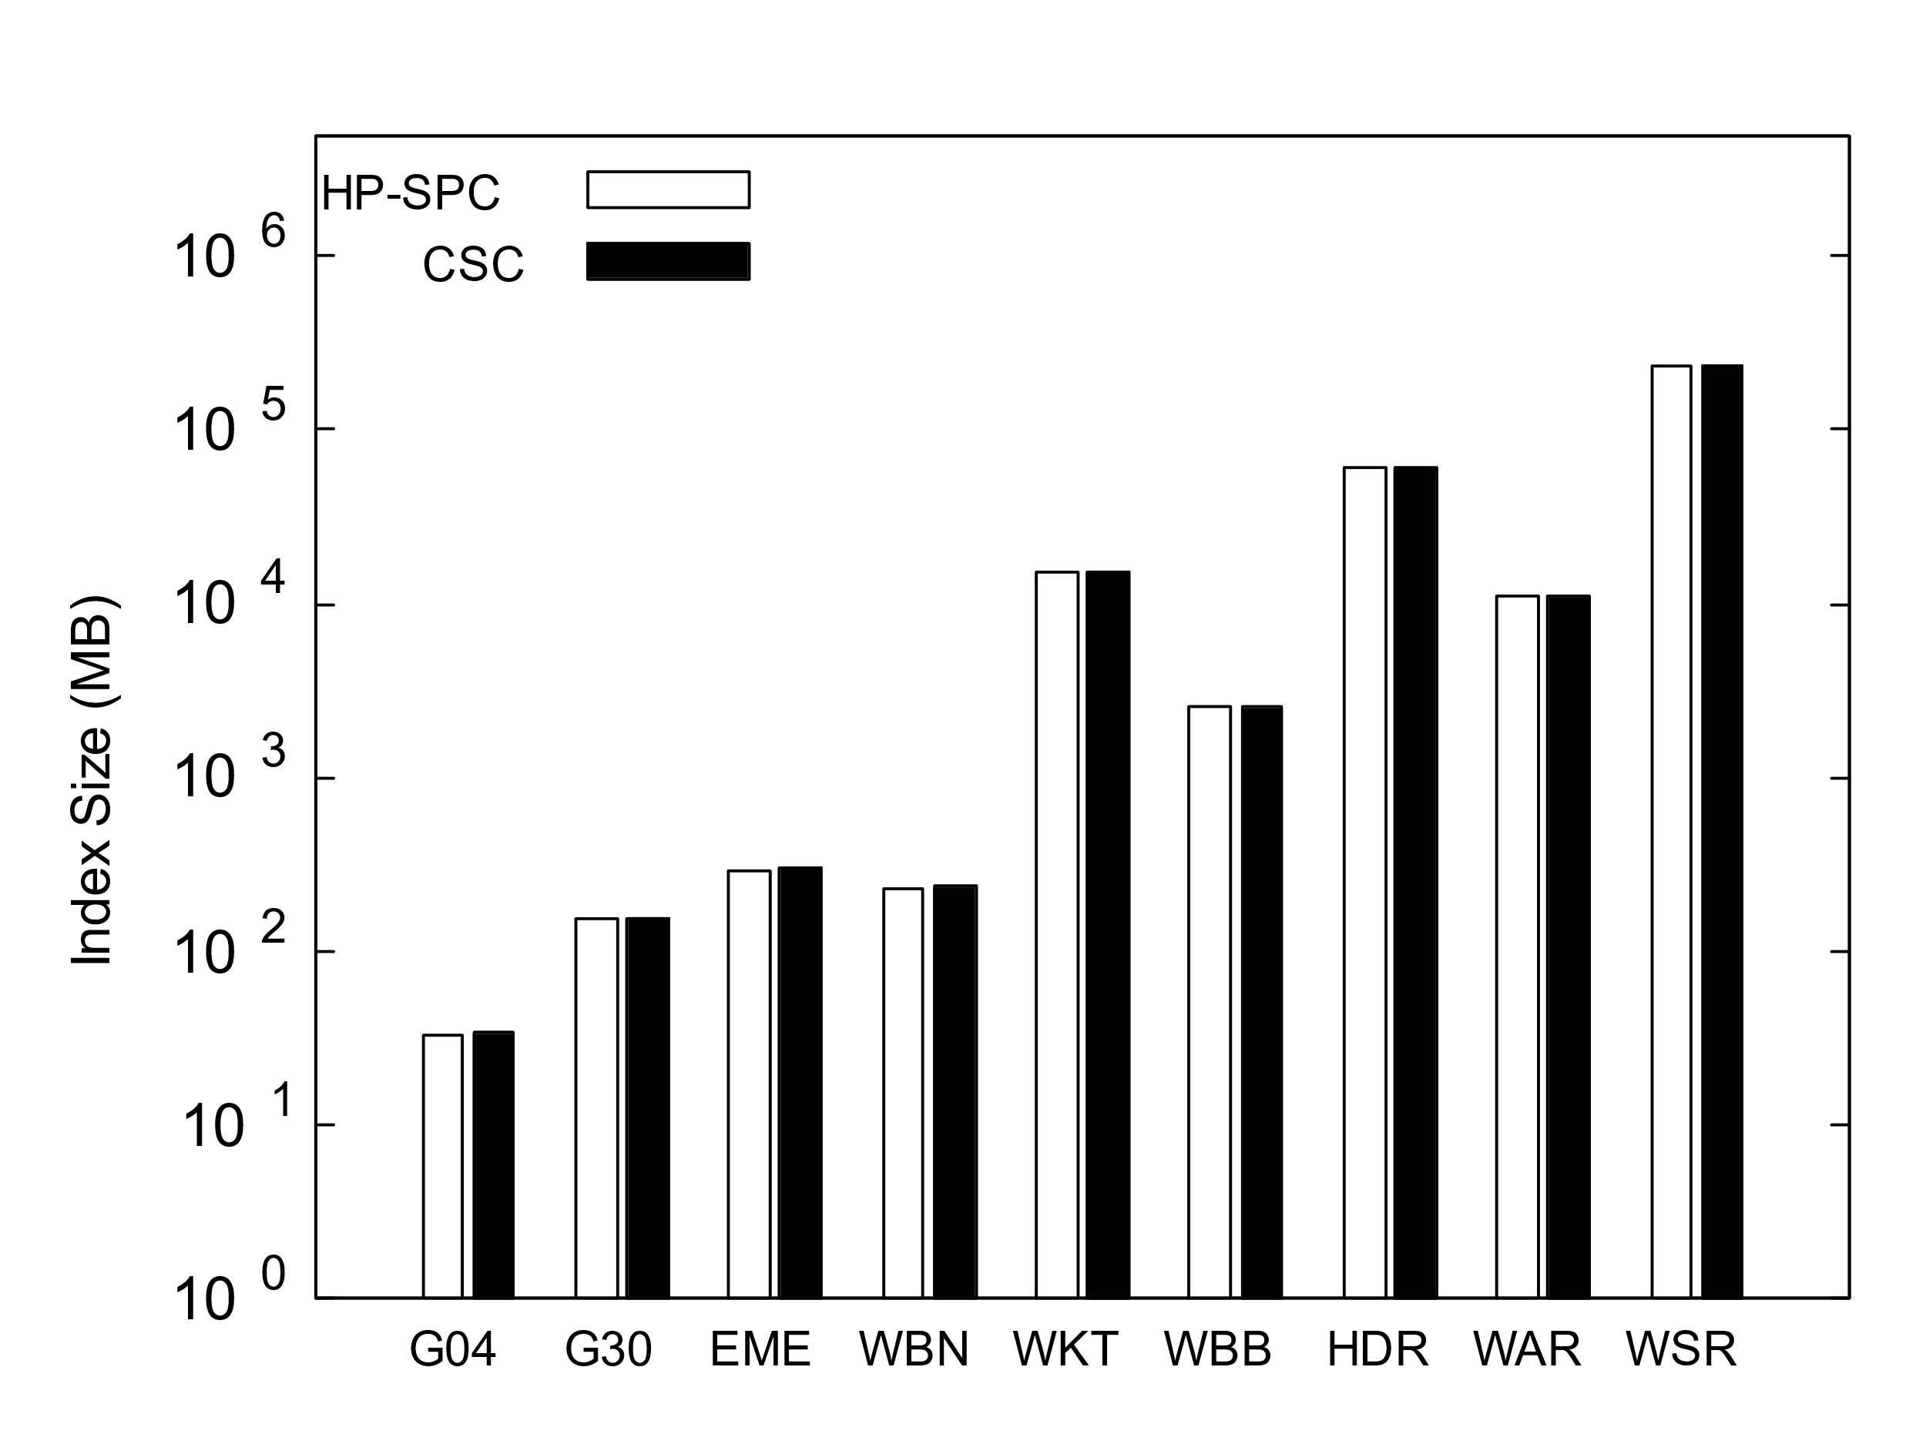
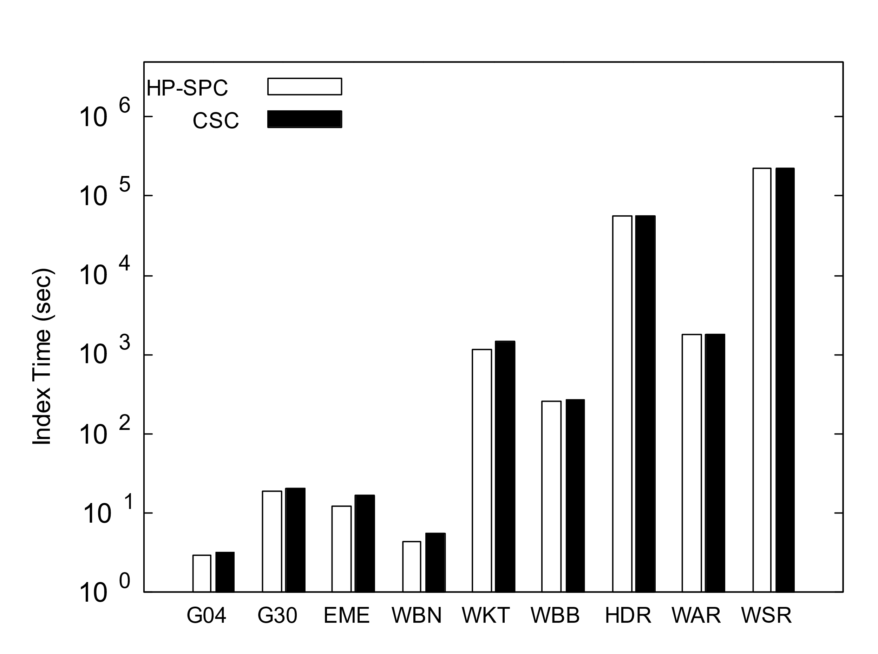
Index Time and Index Size
Index Time:
CSC takes slightly longer index time, not exceed 8% compared with HP-SPC
Most take less than 15.5 hours
Index Size:
The index size differences between CSC and HP-SPC for most graphs are less than 1%.

Slide 17
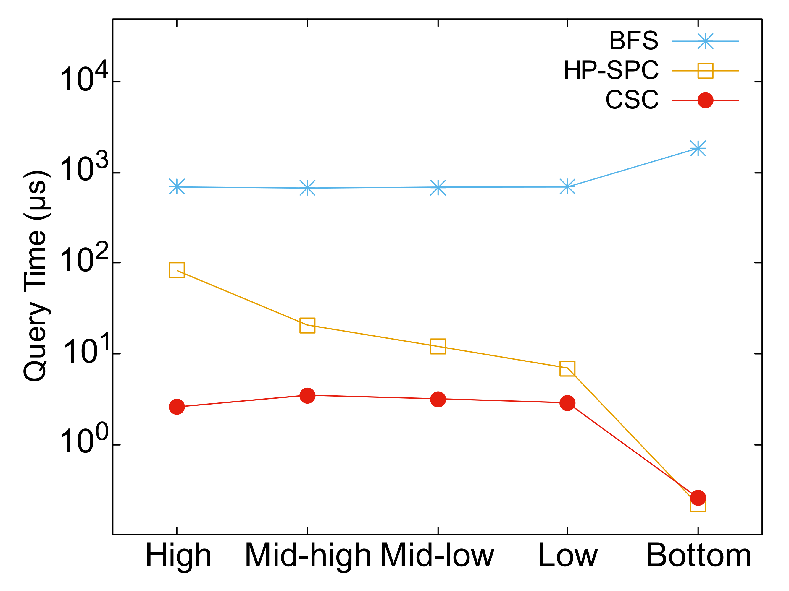
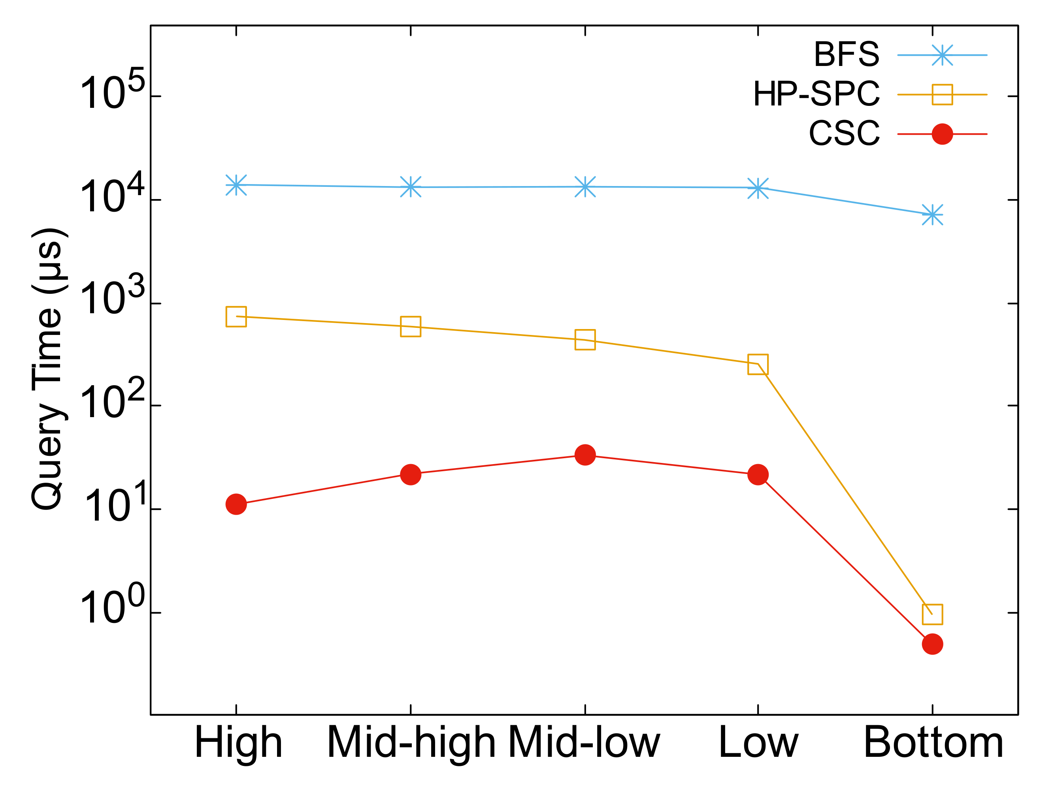
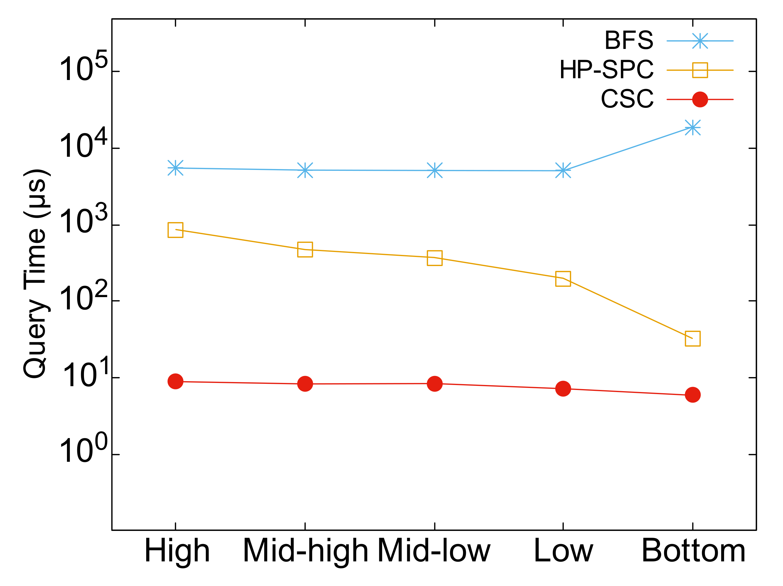
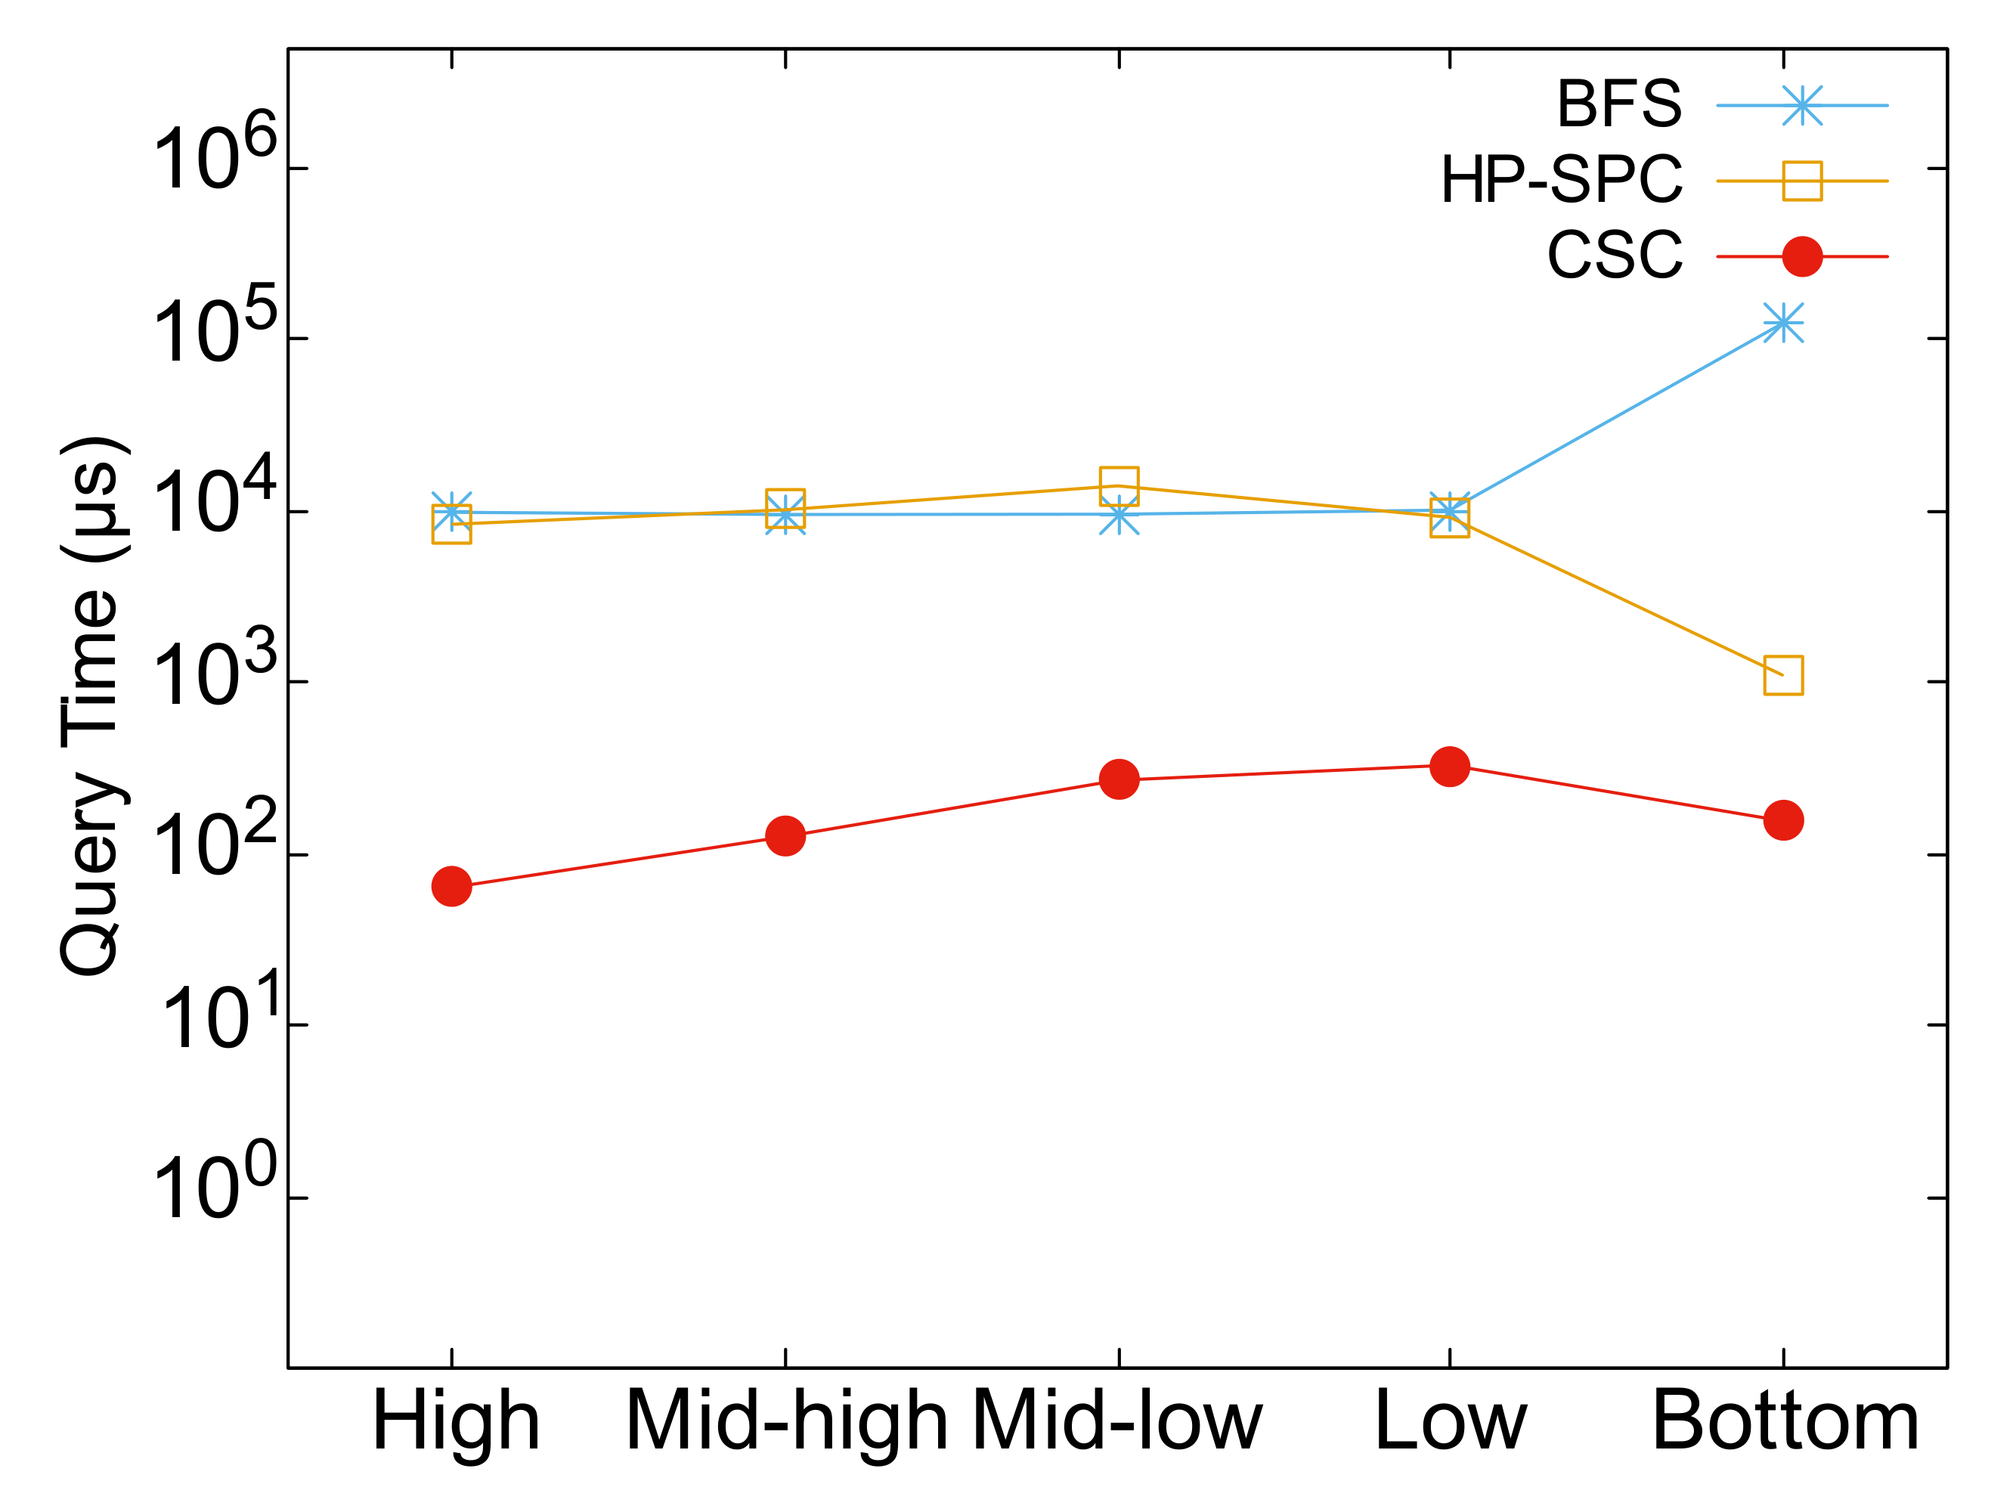
Query Time
Query vertices are divided into 5 clusters based on their $min⁡(|nbrin(∙)|, |{nbr}_{out} (∙)|)$. High cluster contains the ones with highest values.
Query Time:
the query time of CSC can stay at microsecond level for all tested graphs.
CSC is from 3.11 to 130.1 times faster than HP-SPC among High/Mid-high clusters.
CSC is still 1.3 to 51.8 times faster among Mid-low/Low clusters.
EME
WKT
WAR
WSR

Slide 18
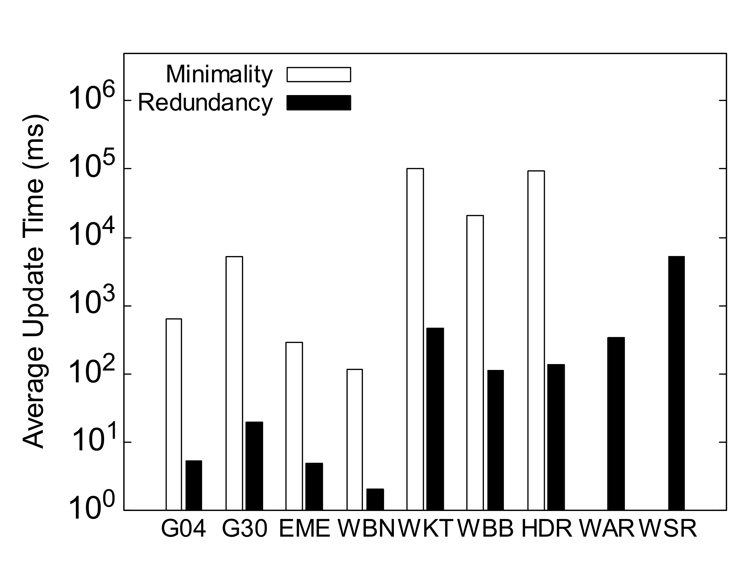
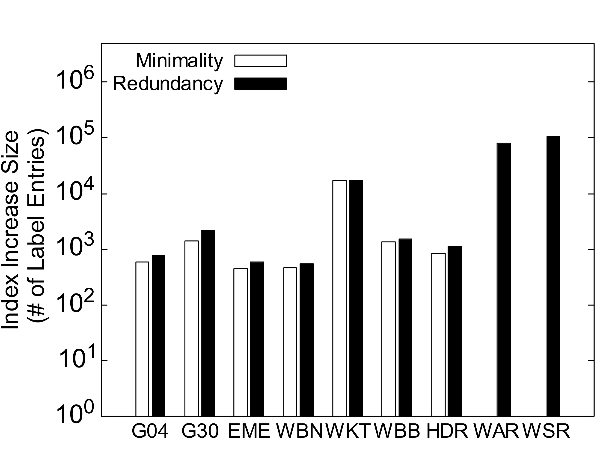
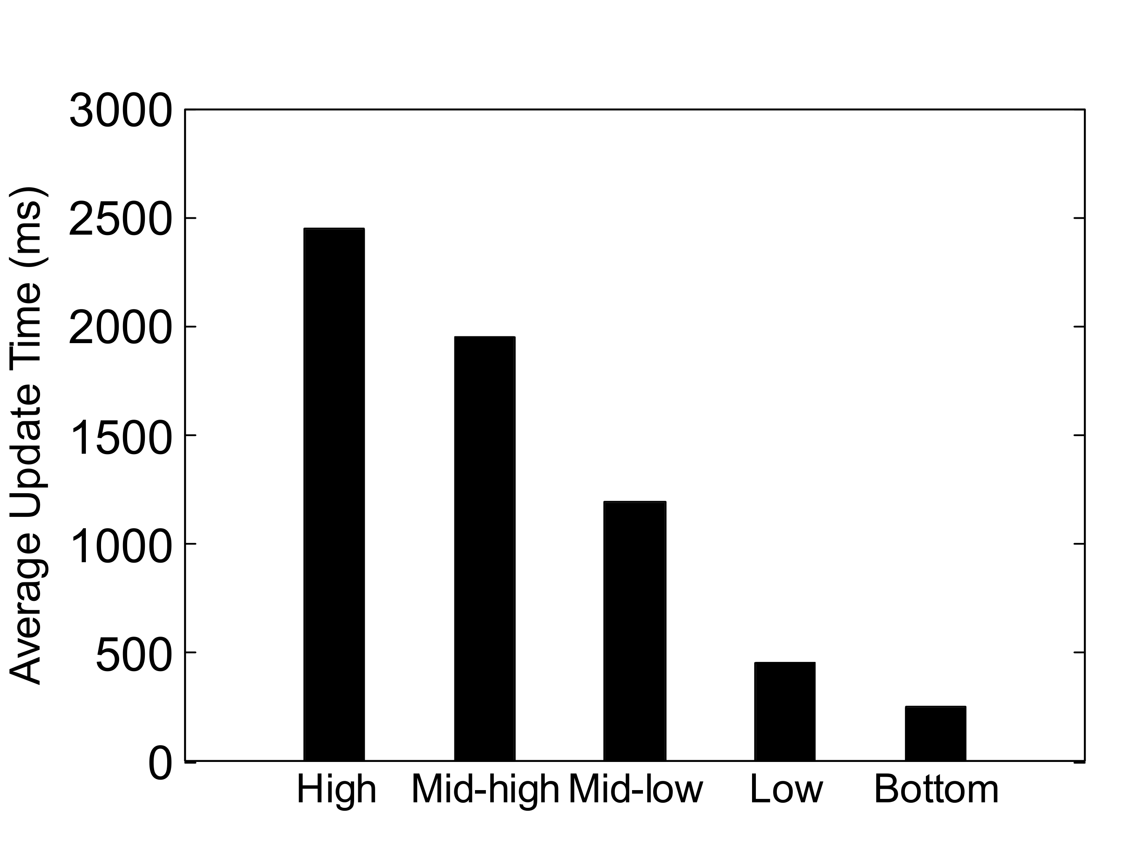
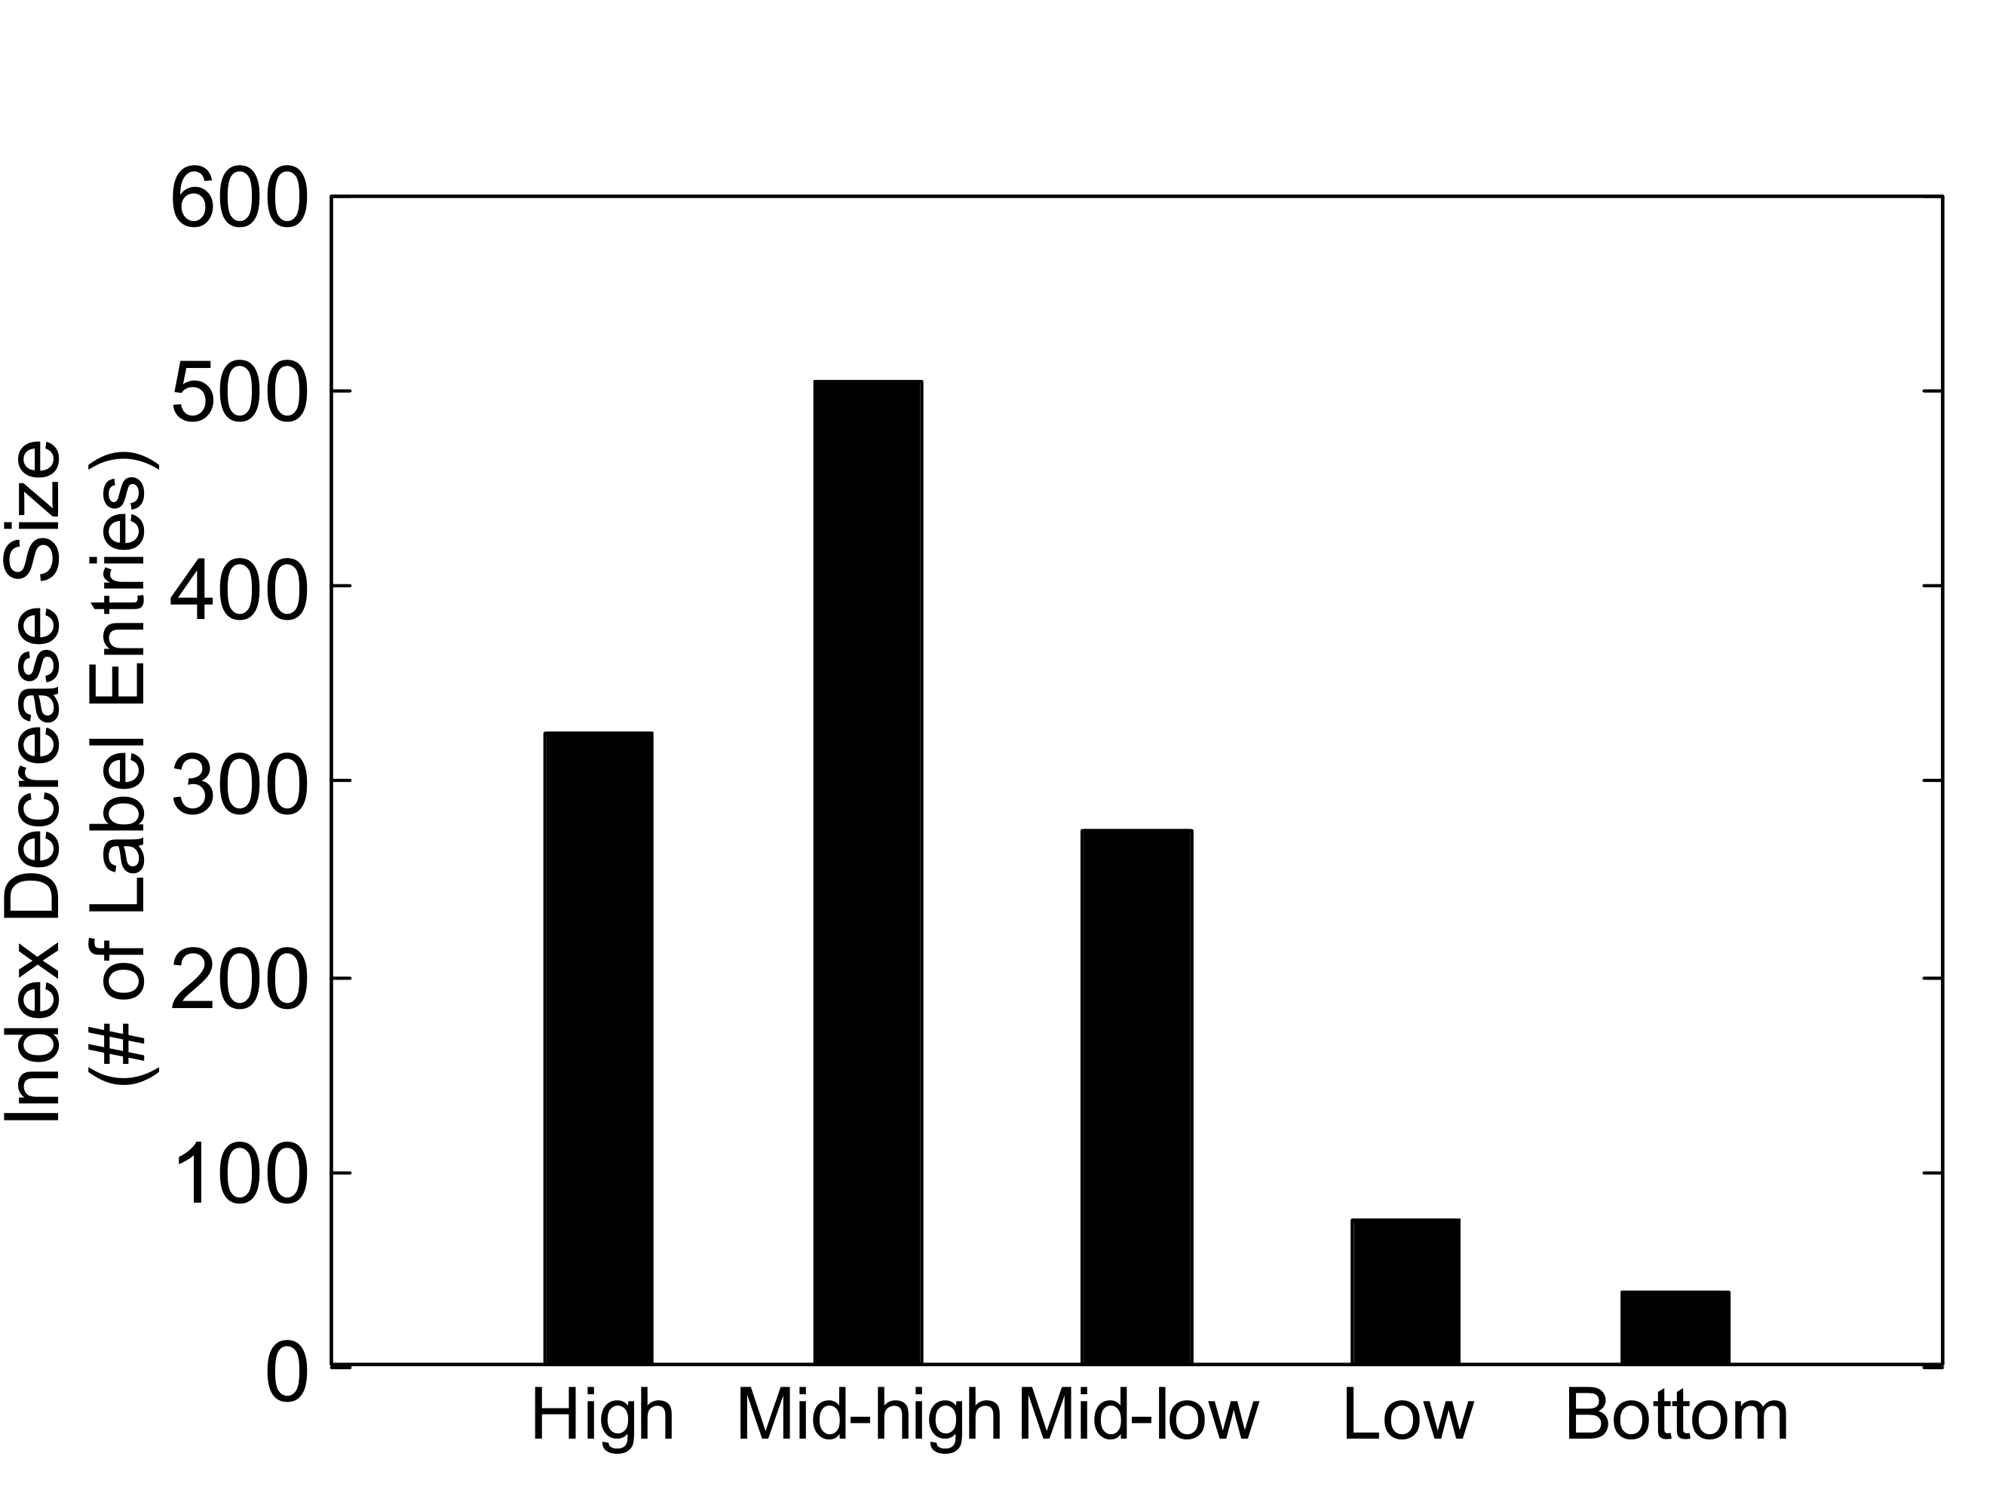
Update Time and Index Size Change
Update Time:
For incremental update, the average update time for million scale graphs is from 112ms to 469ms.
For the largest graph, the average update time is 5.2s which is 2.3×10⁻⁵ of the reconstruction time.
Index Size Change:
The average increased index size for most graphs is from 3.5KB to 11.5KB, which accounts for less than 0.01% of the original index.
Incremental Update Time
Index Increase Size
Decremental Update Time G04
Index Decrease Size G04

Slide 19
Conclusion
We propose a new 2-hop labeling based algorithm called CSC for counting shortest cycles through a given node in real-time.
We introduce Couple-Vertex Skipping technique to speed up index construction and reduce index size.
We also propose an index maintenance algorithm for edge insertion and deletion.
Our experiments on real networks show that our algorithms could achieve up to two orders of magnitude faster than state-of-the-art.

