Slide 1
ICDE 2022
Notes:
Hello everyone!
I’m Zhirong Yuan from East China Normal University.
Today I will present our work: Efficient k-clique Listing with Set Intersection Speedup

Slide 2
Motivations and Applications
Graph data is everywhere
Social network, biological network, finance...
Notes:
Let’s begin with the motivations and applications.
Graph data is everywhere, for example, social networks, biological networks and financial networks.

Slide 3
Motivations and Applications

Slide 4
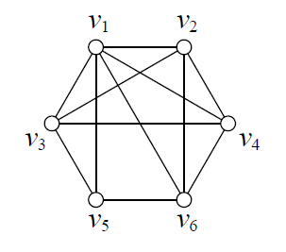
Motivations and Applications
4-clique
3-clique

Slide 5
Motivations and Applications
Graph data is everywhere
Social network, biological network, finance...
k-clique: common cohesive subgraph
Applications:
Detect overlapping communities with k-clique percolation
Spam-link farms in web graphs
Motif detection in biological networks
Notes:
In recent years, the requirement of efficiently listing k-cliques has been raised by the data mining and database communities. We introduce the applications of kclique listing as follows.
For example, detect overlapping communities with k-clique percolation, spam-link farms in web graphs and motif detection in biological networks.

Slide 6
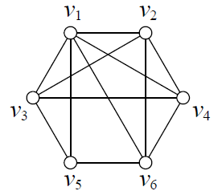
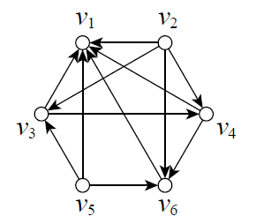
Related Work
Notes:
A common strategy to avoid redundancy and reduce the search space is the vertex ordering, which is a preprocessing step that transforms the original undirected graph into a DAG. The vertex ordering of the undirected graph is determined by an assignment function η. An undirected edge (u, v) can be converted into a directed one, where η(u) smaller than η(v).
For example, let η(u) be the degree of u, degree ordering can be shown in the figure.

Slide 7
Related Work
Vertex Ordering
Set Intersection
Hash join
Merge join
Galloping search
SIMD instructions:
_mm_lddqu_si128(), _mm_cmpeq_epi32(), _mm_shuffle_epi32(), etc.
Notes:
Set intersection is extensively involved in graph algorithms, such as triangle listing and maximal clique enumeration.
The k-clique listing problem also involves a large number of set intersections, which certainly causes a bottleneck.
Major methods for set intersections include hash join, merge join and galloping search.
Modern microprocessors are equipped with SIMD or vector instruction sets which allow compilers to exploit fine-grained data level parallelism. The application of SIMD instructions to accelerate set intersections is proposed by a bunch of algorithms. With SIMD instructions, the merge-based algorithm can be extended by reading and comparing multiple elements at a time.

Slide 8
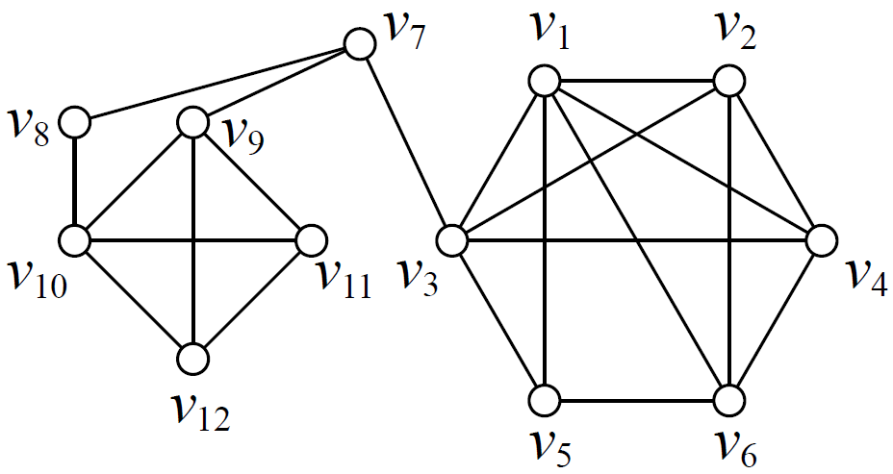
Preprocessing

Slide 9
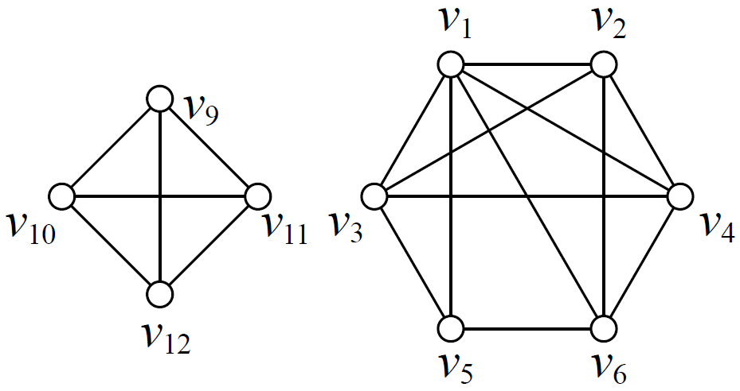
Preprocessing
Notes:
No more nodes can be removed and the graph is reduced as follows.

Slide 10
Preprocessing

Slide 11
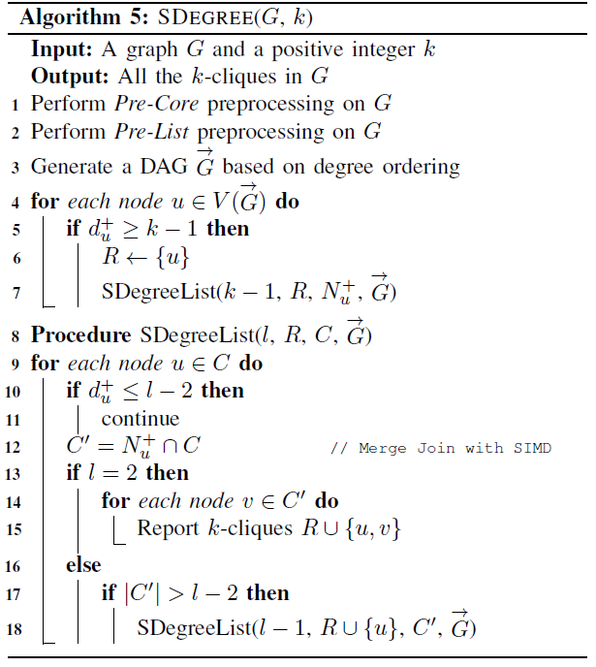
SDegree
DAG after preprocessing
Notes:
The technique of data level parallelism is hard to be implemented on the SOTA algorithms.
We introduce our first algorithm for listing k-cliques based on merge-join and degree ordering.
After Pre-Core and Pre-List, a DAG is generated based on degree ordering.
For example, the DAG based on degree ordering is shown in the figure.

Slide 12
SDegree
DAG after preprocessing

Slide 13
SDegree
DAG after preprocessing

Slide 14
SDegree
DAG after preprocessing

Slide 15
SDegree
DAG after preprocessing

Slide 16
SDegree
Pruning with size constraints
DAG after preprocessing

Slide 17
Optimization: BitCol
Color ordering
More pruning power
1
2
3
4
2
3

Slide 18
Optimization: BitCol

Slide 19
Set Intersection with BitMaps
00(000000)
10(001000)
32(011010)
74(111100)
10(001000)
32(011010)
Notes:
For example, we encode the out-neighbor set of each node with two numbers. Each number represents at most three neighbors.
The out-neighbor set of v-three is {v-one, v-two, v-five} and is encoded as (three, two). The other neighbor sets can be encoded similarly.
When computing the intersection between out-neighbor sets of v-three and v-four, we only need to perform the bitwise AND on (three, two) and (seven, four).
We get the result bitmap (three, zero), which represents {v-one, v-two}.

Slide 20
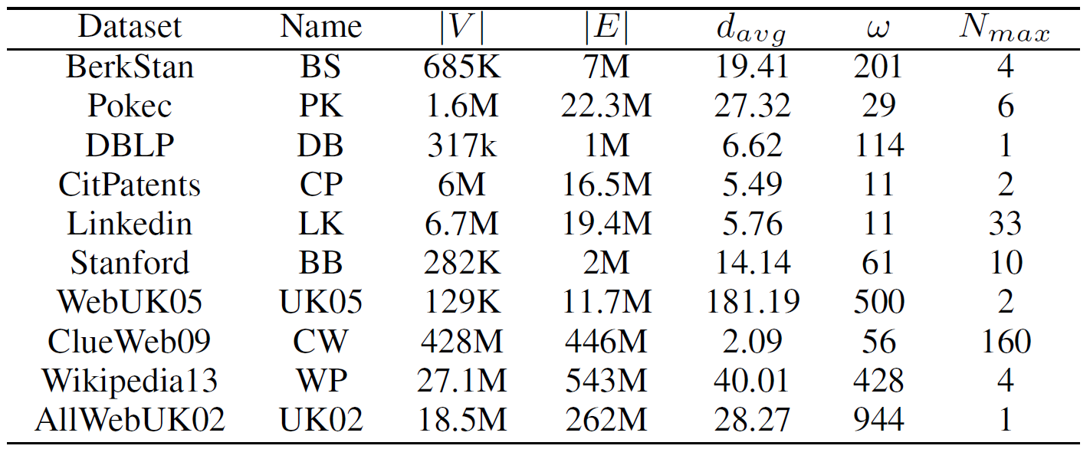
Evaluation

Slide 21
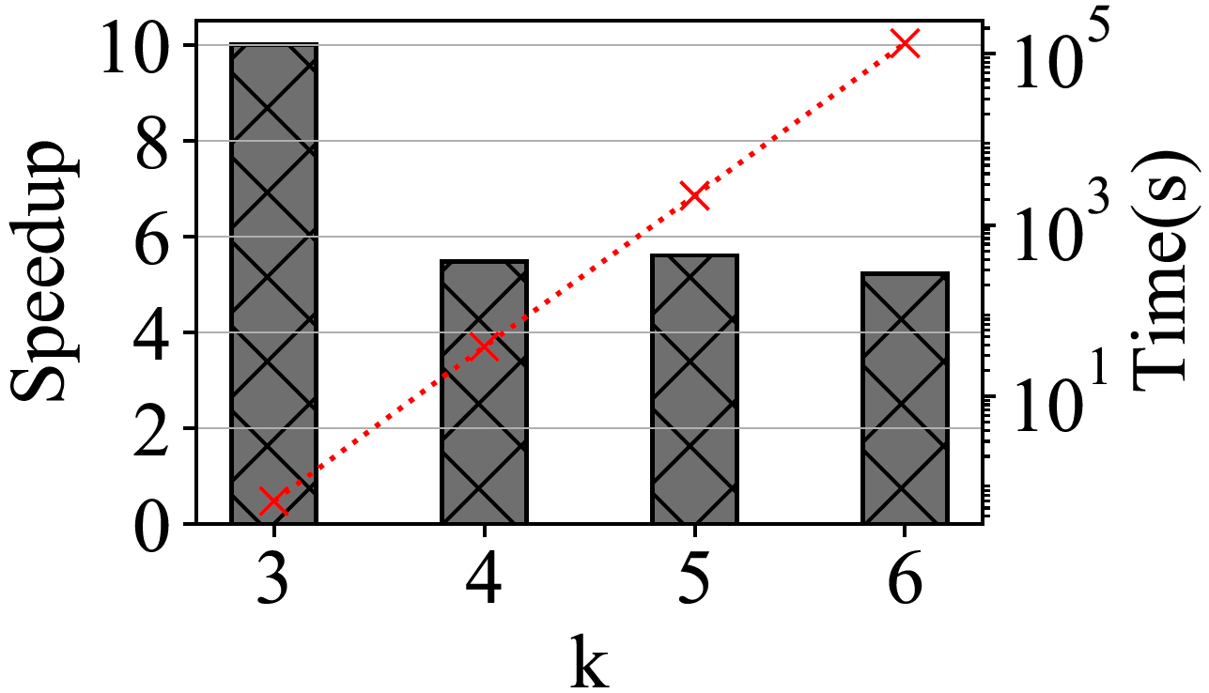
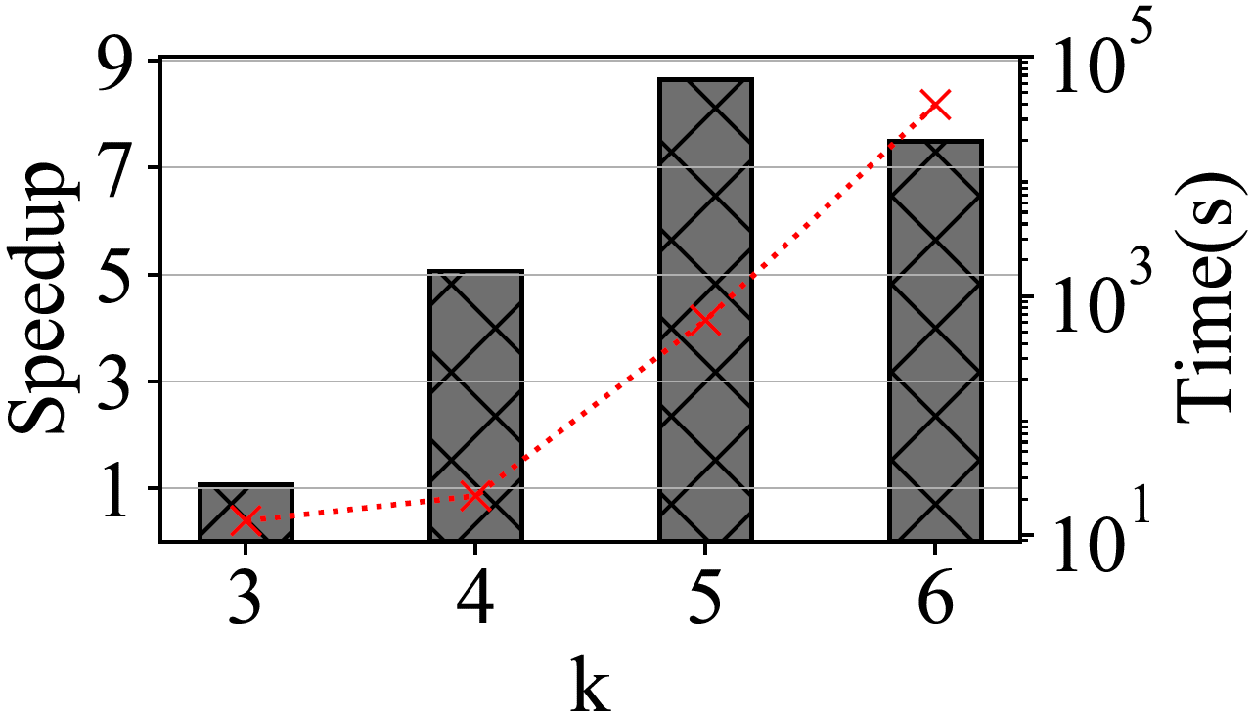
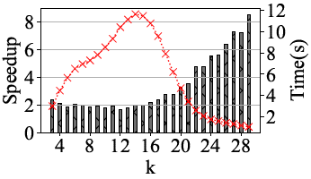
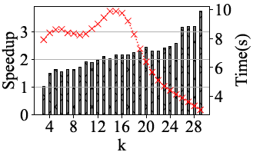
k-clique Listing Time in Serial
Notes:
First, we evaluate the k-clique listing time in serial with varying the size k.
Red lines represent running time and histograms represent speedups.
SDegree has a significant effect when dealing with triangle listing, since it does not need to construct induced subgraphs.
In Pokec, the running time for both the degree-ordering based and the color-ordering based algorithms first increases as k increases to around half of ω, and then drops as k increases to half of ω. The reason could be in two ways. First, our preprocessing and pruning techniques can prune more invalid nodes as k increases in advance. Furthermore, the number of k-cliques in maximum cliques first increases then decreases, as well.
Our algorithms outperform DDegree and DDegCol for fixed k, no matter based on degree ordering or color ordering.

Slide 22
Preprocessing and pruning techniques
(a)Preprocessing (Pokec)
(b)Pruning (Pokec)
Notes:
As shown in Fig.(a), both DDegree and DDegCol run faster after our preprocessing techniques on Pokec. What’s more, the pruning effects of the color constraint and the size constraint become more and more obvious as k increases, which is illustrated in Fig.(b). Similar results can be obtained on Pokec for SDegree and BitCol.

Slide 23
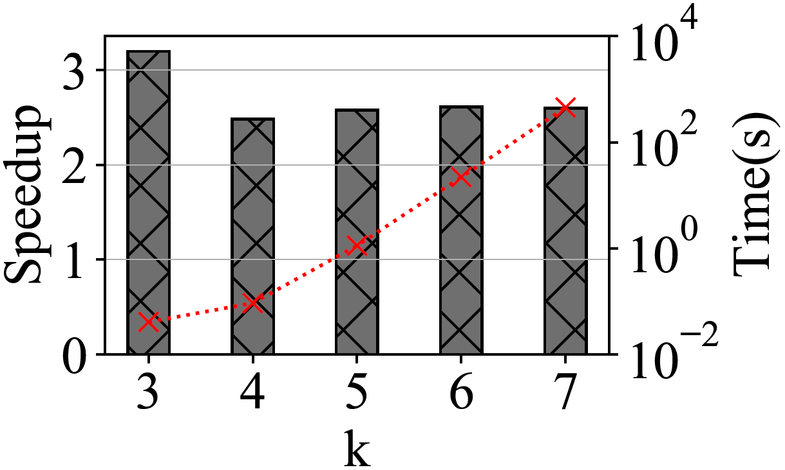
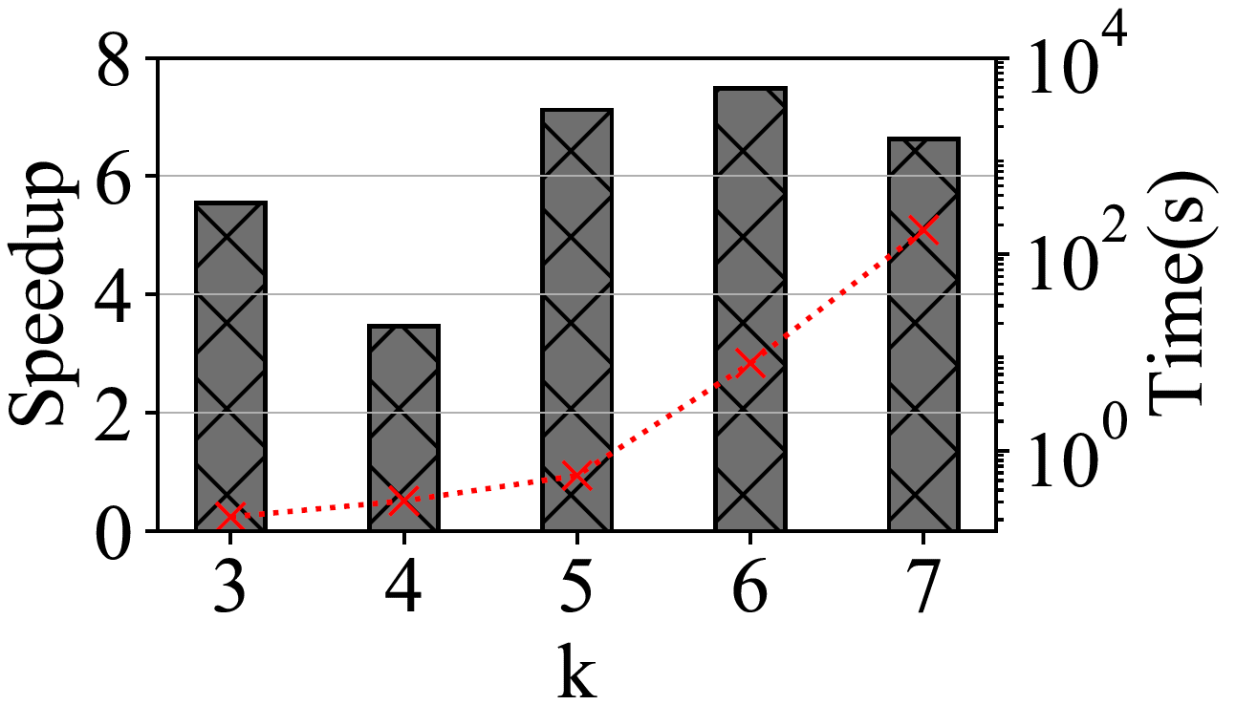
k-clique Listing Time in Parallel
NodeParallel
Notes:
Next we evaluate the performance of our algorithms with the strategy of NodeParalle with thirty-two threads. Each thread processes on each subgraph induced by an out-neighbor set.
In general, SDegree outperforms DDegree, and BitCol outperforms DDegCol, respectively.

Slide 24
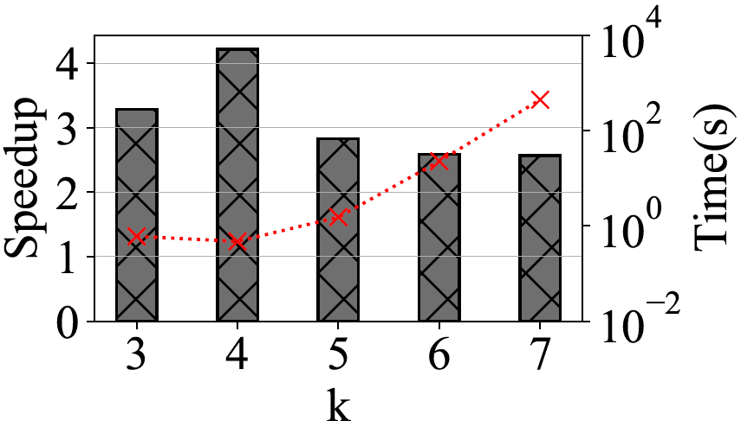
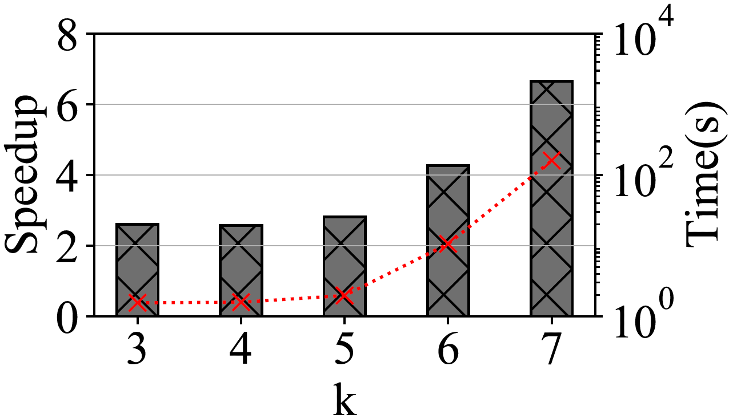
k-clique Listing Time in Parallel
EdgeParallel
Notes:
As illustrated in the figure, SDegree and BitCol still outperform DDegree and DDegCo with the strategy of EdgeParallel respectively, which also demonstrates the superiority of our algorithms.

Slide 25
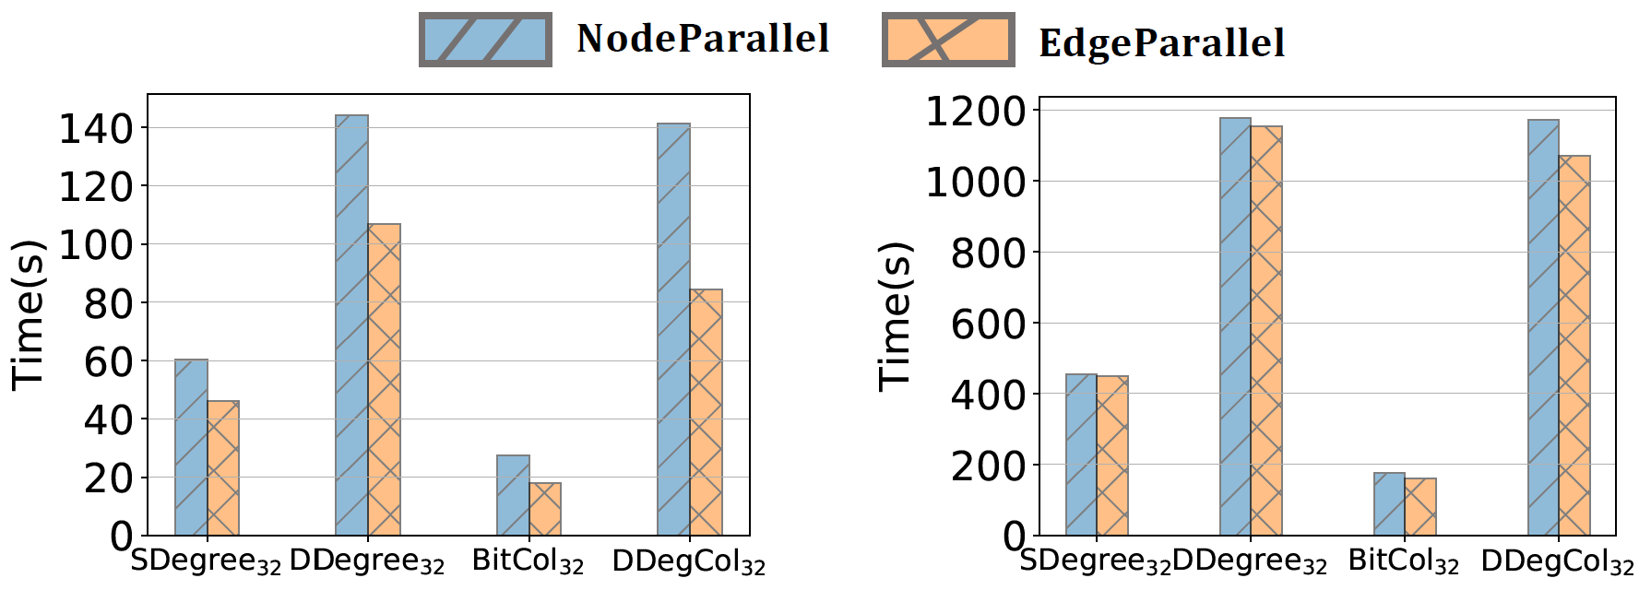
k-clique Listing Time in Parallel
NodeParallel vs. EdgeParallel
Notes:
Compared to NodeParallel, EdgeParallel processes “smaller” out-neighbor sets. Therefore, EdgeParallel can achieve a higher degree of parallelism.
The performance of NodeParallel is worse than that of EdgeParallel, indicating that EdgeParallel has a higher degree of parallelism

Slide 26
Conclusion
Future work
Enumerate the k-cliques within and outside the maximum (or near maximum) cliques separately.
Notes:
In conclusion, we proposed Pre-Core and Pre-List to prune the invalid search space in the preprocessing stage.
We proposed SDegree on degree ordering and BitCol for color ordering with set intersection speedup.
Our algorithms exploits data parallelism with SIMD or vector instruction sets.
One inherent limitation for all the existing algorithms is that, when the size of the maximum clique (omega) is large and k is close to half of ω, the problem of k-clique listing is often deemed infeasible.
Further studies can be conducted that whether we can enumerate the k-cliques within and outside the maximum (or near maximum) cliques separately.

Slide 27
THANKS
Notes:
Thanks for your listening!

Slide 31
ICDE 2022
Notes:
Hello everyone!
I’m Zhirong Yuan from East China Normal University.
Today I will present our work: Efficient k-clique Listing with Set Intersection Speedup

