Slide 1
Efficient Computation of Cohesive Subgraphs in
Uncertain Bipartite Graphs
Gengda Zhao, Kai Wang, Wenjie Zhang, Xuemin Lin, Ying Zhang, Yizhang He

Slide 2
Outline
Introduction
Solutions
Experiments
Conclusion

Slide 3
Introduction
An uncertain bipartite graph/network:
$$u_{1}$$
$$u_{2}$$
$$u_{3}$$
$$u_{4}$$
$0$.1
$0$.6
$0$.4
$0$.8
$0$.2
$0$.4
$0$.2
$0$.2
$0$.9
$0$.1
$0$.2
$0$.4
$0$.1
$0$.3
$$v_{1}$$
$$v_{2}$$
$$v_{3}$$
$$v_{4}$$
$$v_{5}$$

Slide 4
Introduction
$(α, β)$-core: Given a bipartite graph $G(V=(U,L),E)$, and degree constraints 𝛼 and 𝛽, the $(α, β)$-core is a subgraph $G′$ which satisfies $deg(u,G′)≥α$ for each$u∈U(G′)$ and $deg(v,G′)≥β$ for each $v∈L\left(G^{′}\right).$
An$G′$ is maximal, if any supergraph $G^{′′}⊃G^{′}$ is not an $(α, β)$-core .
$$u_{1}$$
$$u_{2}$$
$$u_{3}$$
$$u_{4}$$
$0$.1
$0$.6
$0$.4
$0$.8
$0$.2
$0$.4
$0$.2
$0$.2
$0$.9
$0$.1
$0$.2
$0$.4
$0$.1
$0$.3
$$v_{1}$$
$$v_{2}$$
$$v_{3}$$
$$v_{4}$$
$$v_{5}$$
The (3, 2)-core

Slide 5
Introduction
𝜂-degree: Given an uncertain bipartite graph $𝒢\left(V=\left(U,L\right),E,p\right)$, a vertex $u∈𝒢$, and a probabilistic threshold $η∈[0,1]$, the$η$-degree of a vertex $u$, denoted by $\deg_{η}(u,𝒢)$, is defined as $\deg_{η}\left(u,𝒢\right)=max⁡(k|Pr⁡[\deg_{η}\left(u,𝒢\right)≥k]≥η)$.
$$u_{1}$$
$$u_{2}$$
$$u_{3}$$
$$u_{4}$$
$0$.1
$0$.6
$0$.4
$0$.8
$0$.2
$0$.4
$0$.2
$0$.2
$0$.9
$0$.1
$0$.2
$0$.4
$0$.1
$0$.3
$$v_{1}$$
$$v_{2}$$
$$v_{3}$$
$$v_{4}$$
$$v_{5}$$
When $η≤0.02$, the$η$-degree of $v_{5}$ is 2.
When $0.02<η≤0.28$, the$η$-degree of $v_{5}$ is 1.
When$η>0.28$, the$η$-degree of $v_{5}$ is 0.

Slide 6
Introduction
$\left(α, β,η\right)$-core: Given an uncertain bipartite graph$𝒢\left(V=\left(U,L\right),E,p\right)$, two degree constraints 𝛼, 𝛽 and a probabilistic threshold$η∈[0,1]$, the $(α, β,η)$-core is a subgraph of $𝒢′$ if (1)$\deg_{η}(u,𝒢′)≥α$ for each$u∈U(𝒢′)$ and$\deg_{η}(v,𝒢′)≥β$ for each $v∈L\left(𝒢^{′}\right);$(2) $𝒢′$ is maximal, if any supergraph$𝒢′′ ⊃𝒢′$ is not an $(α, β,η)$-core .
$$u_{1}$$
$$u_{2}$$
$$u_{3}$$
$$u_{4}$$
$0$.1
$0$.6
$0$.4
$0$.8
$0$.2
$0$.4
$0$.2
$0$.2
$0$.9
$0$.1
$0$.2
$0$.4
$0$.1
$0$.3
$$v_{1}$$
$$v_{2}$$
$$v_{3}$$
$$v_{4}$$
$$v_{5}$$
The (3, 2, 0.04)-core
The (3, 2)-core

Slide 7
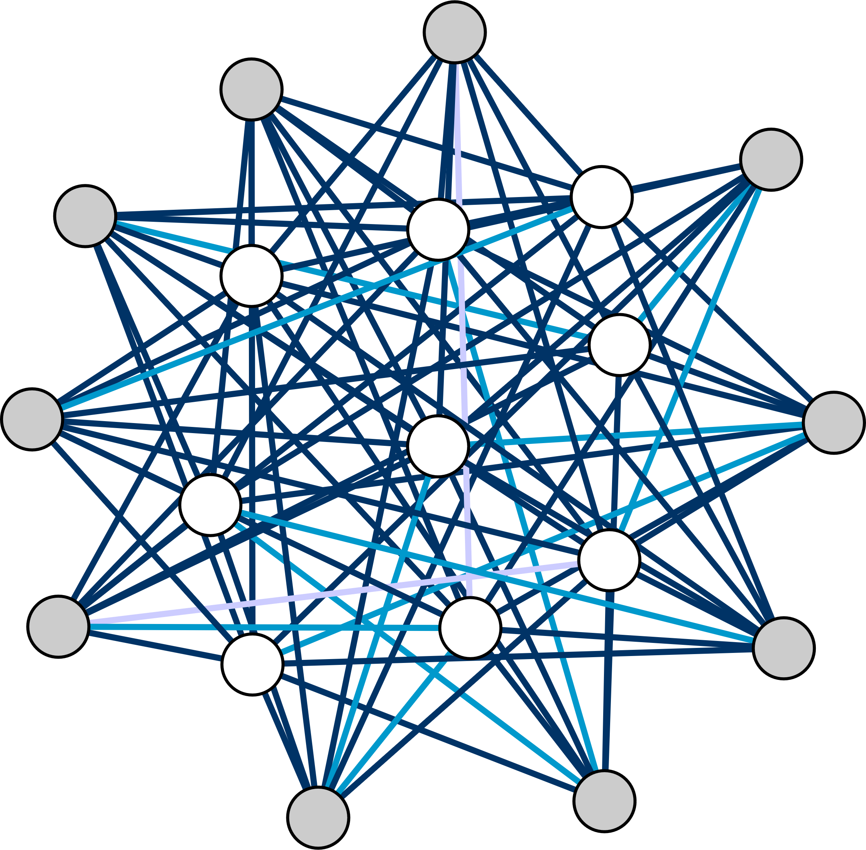
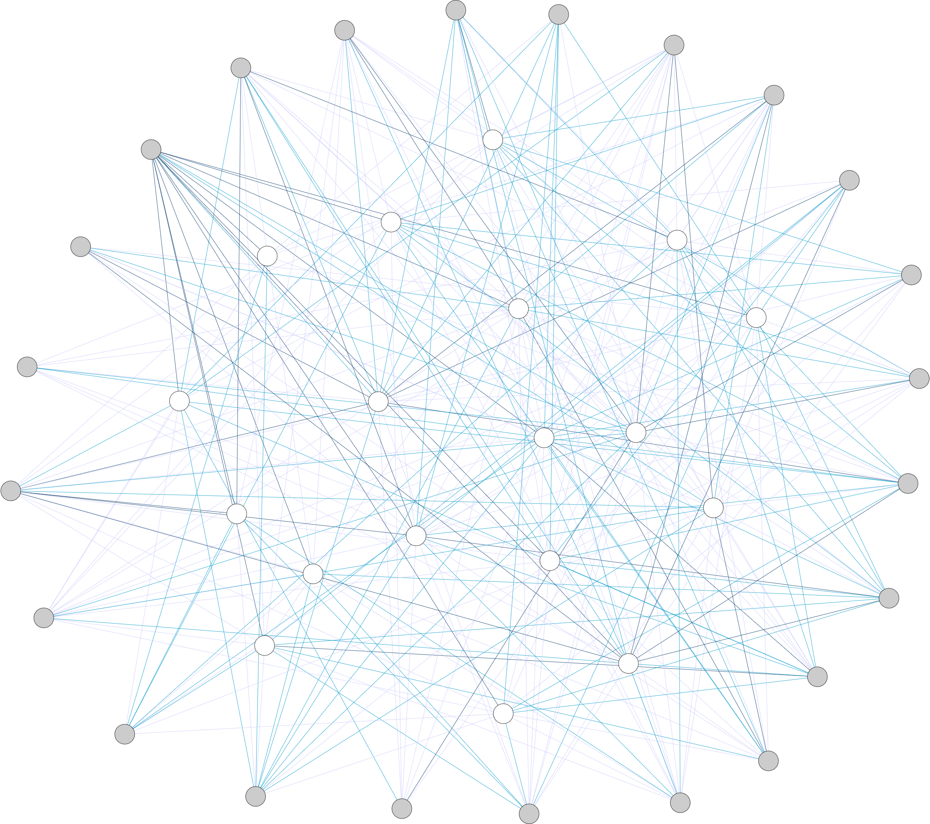
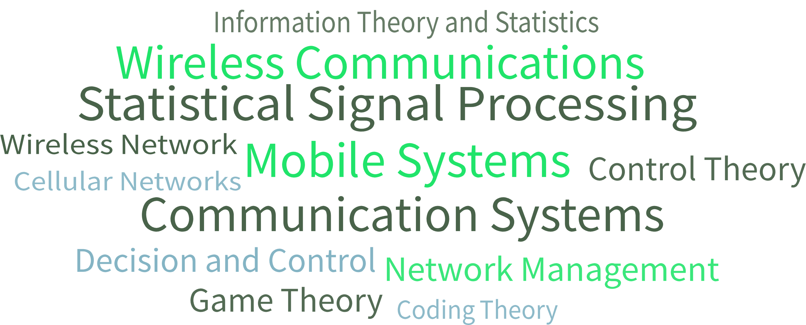
Applications
Task-driven Team formation
H. Vincent Poor
Gerhard P. Fettweis
[0.00, 0.33]
Stephen Boyd
WCNC
DSP
Victor C. M. Leung
(0.33, 0.66]
ACSSC
ICONIP
(0.66, 1.00]
CDC
Sherman Shen
NeurIPS
Emmanuel J. Candes
EUSIPCO
Zhu Han
ISIT
ICASSP
Björn Ottersten
($α$, β)-core
John A. Rogers
Lajos Hanzo
($α$, β,$η$)-core
Example of application
Notes:
.

Slide 8
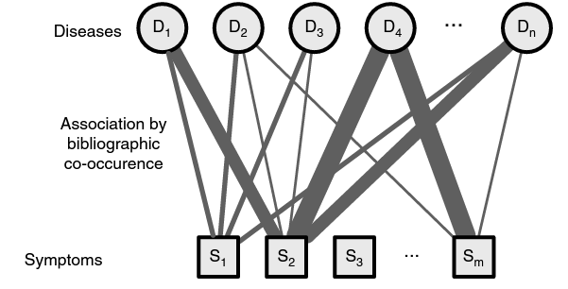
Applications
Categorization of new diseases.
Notes:
.

Slide 9
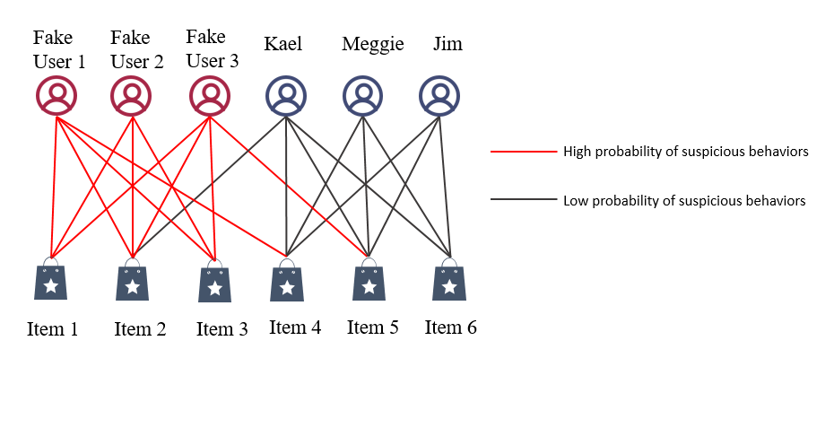
Applications
Fraud detection
Notes:
.

Slide 10
Related Works
Uncertain networks
- core-like models: (k, $η$)-core/ (k, $θ$)-core [1], [10], …
- truss-like model: (k, $γ$)-truss/ (k, $θ$)-truss [2], [3], …
- clique-like models [4],[5]…
Bipartite networks
- core-like models: (α, β)-core [6], [7], …
- truss-like model: k-bitruss/k-wing [8], [11], …
- clique-like models: biclique [9]…

Slide 11
Problem Definition
Given an uncertain bipartite graph $𝒢(V=\left(U,L\right),E,p)$, and two integers 𝛼, 𝛽 and a probabilistic threshold $η∈[0,1]$, we study the problem of computing the vertices in the $(α, β,η)$-core of$𝒢$.
$$u_{1}$$
$$u_{2}$$
$$u_{3}$$
$$u_{4}$$
$$u_{1}$$
$$u_{2}$$
$$u_{3}$$
$$u_{4}$$
$0$.1
$0$.6
$0$.4
$0$.8
$0$.2
$0$.4
$0$.1
$0$.6
$0$.4
$0$.8
$0$.2
$0$.4
$0$.2
$0$.2
$0$.9
$0$.2
$0$.2
$0$.9
$0$.1
$0$.2
$0$.4
$0$.1
$0$.1
$0$.2
$0$.4
$0$.1
$0$.3
$0$.3
$$v_{1}$$
$$v_{2}$$
$$v_{3}$$
$$v_{4}$$
$$v_{5}$$
$$v_{1}$$
$$v_{2}$$
$$v_{3}$$
$$v_{4}$$
$$v_{5}$$
(a) An uncertain bipartite graph G
(b) The (3, 2, 0.04)-core
A straightforward method is to directly compute from the input uncertain bipartite graph by iteratively removing the vertices without enough$η$-degrees.

Slide 12
Challenges
Challenge 1: How to design an index with well-bounded space complexity that supports efficient querying of $(α, β,η)$-core.
Challenge 2: How to construct such an index efficiently due to the large number of combinations of $α, β$ and$η$ that correspond to many $(α, β,η)$-cores.

Slide 13
Solution
Challenge 1: How to design an index with well-bounded space complexity that supports efficient querying of $(α, β,η)$-core.
To address Challenge 1: we propose the probability-aware index by only storing the vertices in the $(α, β,η)$-cores for some representative$η$ values. For each selected$η$, we build a sub-index (i.e., an$η$-index) that stores the upper and lower vertices in the $(α, β,η)$-cores separately in a space-compact manner as in [7].

Slide 14
Solution
Challenge 2: How to construct such an index efficiently due to the large number of combinations of $α, β$ and$η$ that correspond to many $(α, β,η)$- cores.
To address Challenge 2: we propose efficient algorithms to construct the probability-aware index. For each selected$η$, we build an$η$-index that records which vertices are contained in the $(α, β,η)$-cores. We devise two index construction algorithms: the bottom-up index construction algorithm (IC_{pa}-BU) and top-down index construction algorithm (IC_{pa}-TD).

Slide 15
Online Computation Algorithm UC-$Q_{o}$
Observation: Given an uncertain bipartite graph $𝒢$, for any$α, β$ and$η$,
$(α, β)$-core $⊇(α, β,η)$-core.
Step 1. Based on the above Observation, remove all the vertices that do not belong to the (𝛼, 𝛽)-core.
Step 2. Compute the $η$-degree of all vertices in$𝒢$.
Step 3. Iteratively remove the vertices that do not satisfied the$η$-degree constraint in$𝒢$, and update the $η$-degree of the neighbors of the removed vertices, until the resulting subgraph do not change.
Time complexity: $O\left(Δ∙m\right)$, $Δ$ represent the maximum$η$-degree in$𝒢.$

Slide 16
Online Computation Algorithm UC-$Q_{o}$
Query the (3, 2, 0.04)-core:
$$u_{1}$$
$$u_{2}$$
$$u_{3}$$
$$u_{4}$$
$0$.1
$0$.4
$0$.8
$0$.2
$0$.4
$0$.6
$0$.2
$0$.2
$0$.9
$0$.1
$0$.4
$0$.1
$0$.2
$0$.3
$$v_{1}$$
$$v_{2}$$
$$v_{3}$$
$$v_{4}$$
$$v_{5}$$

Slide 17
Full Index $I_{f}$
Lemma: Fixing$α$ and$β$, if a vertex $u$ is in $(α, β,η)$-core, then it is in $(α, β,η′)$-core for $η≥η′$.
The $η$-threshold of a vertex $u$, denoted by thres_{(𝛼, 𝛽)}($u$), is the largest $η$ such that an $(α, β,η)$-core containing$u$ exists.
Query Processing: a vertex $u$ is in the $(α, β,η)$-core if and only if thres_{(𝛼, 𝛽)}($u$) ≥ $η$.
first level pointer table
1
2
3
4
…
…
second level pointer table
1
2
3
4
1
2
3
4
Query: (2,2,0.1)-core
…
0.9
0.8
0.674
0.3472
0.108
0.1
0.064
0.36
0.344
0.168
…
Result: {u₁,u₂,u₃,u₄,v₂,v₃,v₄}
$$u_{4}, v_{4}$$
$$u_{2},u_{3},$$
$u_{4},v_{2},$ $v_{4}$
$$u_{1}, v_{3}$$
0.0108
$$u_{3},u_{4},$$
$v_{2},v_{3},$ $v_{4}$
0.124
$$u_{3}, v_{2}$$
$$u_{2},u_{3},$$
$$u_{4},v_{4}$$
$$u_{1}$$
$$u_{1},u_{2},$$
$$u_{3},u_{4},$$
$$v_{4}$$
$$v_{3}$$
$$u_{2}$$
$$u_{2},u_{3},$$
$$u_{4},v_{2},$$
$v_{3},$ $v_{4}$
$$u_{1}$$
0.76
0.616
$$u_{2}$$
$$v_{3}$$
$$v_{5}$$
$$v_{5}$$
$$v_{2}$$
0.0768
0.28
0.124
0.02
0.096
$$v_{3}$$
$$u_{1}$$
$$v_{5}$$
0.02
0.568
0.28
0.1
0.1
$$u_{1}$$
$$v_{5}$$
$$v_{1}$$
$$v_{1}$$
$C$ is the vertex set of the result $(α, β,η)$-core.
Time complexity: $O(|C|)$

Slide 18
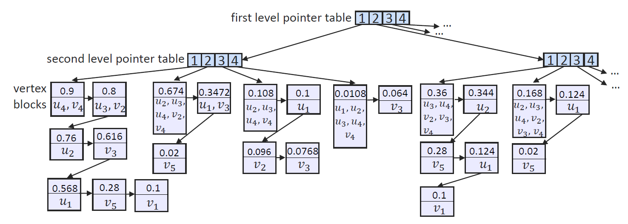
Full Index $I_{f}$
d-probability is the probability that $Pr⁡[deg\left(u\right)≥α]$ or $\operatorname{Pr}\left[deg\left(u\right)≥β\right]$.
Index Construction: Compute the $η$-thresholds of all the vertices regarding all possible$α$ and$β$ combinations, which iteratively removes the vertex with the minimum d-probability.
$α_{max}$ ($β_{max}$): the maximum$α$ ($β$) such that the $(α, 1)$-core ($(1,β)$-core ) exists. Time complexity: $O(\sum_{α=1}^{α_{max}}{\sum_{β=1}^{β_{max}}{\left(n.logn+△.m\right)}})$Space complexity: $O(\sum_{α=1}^{α_{max}}{β_{max}.n})$

Slide 19
Probability Aware Index $I_{pa}$
Observation and definition:
Large time consumption in the full index $I_{f}$. For the datasets larger than 1 million size, we cannot finish the $I_{f}$ construction within${10}^{5}$seconds.
It is intuitive that we only store the vertices in $(α, β,η)$-cores with important$η$ value. Thus, we propose the Probability Aware Index $I_{pa}$.
$α$-offset denoted as $s_{a}(u,α,η)$is the maximal value s.t. $u$ can be contained in an $(α, β,η)$-core. Likewise, the$β$-offset ($s_{b}(u,β,η)$) is the maximal value s.t. $u$ can be contained in an $(α, β,η)$-core.
Notes:
It is intuitive that for a given $η$ value, we can build an$η$-index to store the vertices in all $(α, β,η)$-cores (with the same$η$), whose structure is similar to the bicore index [7]. For the…we e can compute the $(α, β,η)$-core from the intermediate results fetched from the constructed indexes.

Slide 20
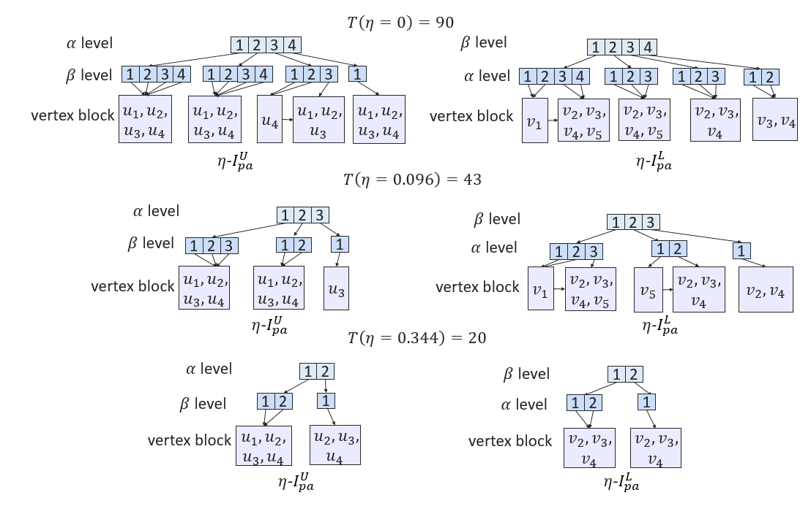
Probability Aware Index $I_{pa}$
Sturcure:
$I_{pa}$ consists of several $η$-indexes. Each$η$-index has two parts for vertices in U(G) and L(G), denoted by$η$-$I_{pa}^{U}$ and$η$-$I_{pa}^{L}$, respectively.
Each$η$-index has three levels including two levels of pointer tables and one level of vertex blocks.
In$η$-$I_{pa}^{U}$, each block is associated with an $(α, β)$ combination, which is pointed by the pointer stored in$η$-$I_{pa}^{U}\left[α\right][β]$. Each vertex block contains the vertices $u∈U(𝒢)$with $α$-offset=$β$.$η$-$I_{pa}^{L}$ also has the similar structure with $η$-$I_{pa}^{U}$.
Space complexity: $O(m.log⁡(m))$

Slide 21
Probability Aware Index $I_{pa}$
Select critical $η$ values:
$T\left(η\right)$approximate the total number of vertices in the $(α, β,η)$-cores that can be queried from the$η$-index.
$T\left(η\right)=m. \sum_{u∈V(𝒢)}{\max_{v∈N\left(u\right)}\deg_{η}(v)}$
Build the$η_{1}$-index with $η_{1}=0$. Then, we use a binary search to find the smallest $η_{2}$ value with ${T(η}_{2})≤{T(η}_{1})$. We repeat this process and halve the value of $T(η)$ each time to select a new$η.$
Notes:
We can estimate the ability of answering queries using the$η$-indexes (using $T\left(η\right)$) to avoid building$η$-indexes with similar contents.

Slide 22
Probability Aware Index $I_{pa}$
Query: (2,1,0.3)-core
Query with different probabilities:
First check whether there exists a $η_{q}$-index in the $I_{pa}$.
S1: might belong to (𝛼, 𝛽, $η_{q}$)-core.
{u₁,v₁,v₅}
S2: must belong to (𝛼, 𝛽, $η_{q}$)-core.
{u₂,u₃,u₄,v₂,v₃,v₄}
Verify the vertices in S1: calculate the upper/lower bounds of the $η_{q}$-degrees of the vertices in S1, and finalize the vertices that belong to $(α, β,η_{q})$-core.
$$T\left(η=0\right)=90$$
$α$ level
1
2
3
4
$β$ level
1
2
3
4
$β$ level
1
2
3
4
1
2
3
4
1
2
3
1
$α$ level
1
2
3
4
1
2
3
1
2
3
1
2
vertex block
$$u_{1},u_{2},$$
$$u_{3},u_{4}$$
$$u_{1},u_{2},$$
$$u_{3},u_{4}$$
$$u_{4}$$
$$u_{1},u_{2},$$
$$u_{3}$$
$$u_{1},u_{2},$$
$$u_{3},u_{4}$$
vertex block
$$v_{1}$$
$$v_{2},v_{3},$$
$$v_{4},v_{5}$$
$$v_{2},v_{3},$$
$$v_{4},v_{5}$$
$$v_{2},v_{3},$$
$$v_{4}$$
$$v_{3},v_{4}$$
$η$-$I_{pa}^{U}$
$η$-$I_{pa}^{L}$
$$T\left(η=0.096\right)=43$$
$α$ level
1
2
3
$β$ level
1
2
3
$β$ level
1
2
3
1
2
1
$α$ level
1
2
3
1
2
1
$$u_{1},u_{2},$$
$$u_{3},u_{4}$$
$$u_{1},u_{2},$$
$$u_{3},u_{4}$$
$$u_{3}$$
$$v_{2},v_{3},$$
$$v_{4}$$
$$v_{2}, v_{4}$$
$$u_{1},u_{2},$$
$$u_{3},u_{4}$$
$$v_{1}$$
$$v_{1}$$
$$v_{2},v_{3},$$
$$v_{4},v_{5}$$
$$v_{5}$$
vertex block
vertex block
$$v_{2},v_{3},$$
$$v_{4},v_{5}$$
$η$-$I_{pa}^{U}$
$$T\left(η=0.344\right)=20$$
$η$-$I_{pa}^{L}$
$α$ level
1
2
$β$ level
1
2
$β$ level
1
2
1
$α$ level
1
2
1
$$u_{2},u_{3},$$
$$u_{4}$$
vertex block
$$u_{1},u_{2},$$
$$u_{3},u_{4}$$
$$u_{2},u_{3},$$
$$u_{4}$$
$$v_{2},v_{3},$$
$$v_{4}$$
$$v_{2},v_{3},$$
$$v_{4}$$
vertex block
$$v_{2},v_{3},$$
$$v_{4}$$
$η$-$I_{pa}^{U}$
$η$-$I_{pa}^{L}$
Result: {u₂,u₃,u₄,v₂,v₃,v₄}
Time complexity: $O(\sum_{u∈S1}{deg{⁡(u,G)}^{3}})$

Slide 23
Bottom-up Sub-index Construction ${IC}_{pa}$-$BU$
Step1: Set $δ_{η}$as the maximum value s.t.${(δ}_{η},δ_{η},η)$-core$≠∅$. Then, for $α∈[1,δ_{η}]$, we first obtain the $(α,1,η)$-core using the $Q_{o}$.
Step2: Then, we follow a peeling paradigm to compute the $α$-offsets of the upper vertices and update some $β$-offsets of the lower vertices. In each iteration, we remove the vertices if their $η$-degrees do not satisfy the degree constraint. Similarly, we run$β$ from 1 to $δ_{η}$ to compute the remaining$α/β$-offsets.
Step3: After that, we organize the$α/β$-offsets into the$η$-index and combine the $η$-index into $I_{pa}$.
Time complexity: $O(\log\left(m\right).δ.△.m)$

Slide 24
Top-down Sub-index Construction ${IC}_{pa}$-$TD$
Step1: For$α∈[1,δ_{η}]$, we set 𝛽 from ${\text{β}}_{max}(α)$ to 1 to find the $(α, β,η)$-cores. Here ${\text{β}}_{max}(α)$ is the maximal value such that the $(α, β,η)$-core exists.
Step2: In each iteration, we first obtain the $(α, β)$-core from the deterministic
graph of$𝒢$ since$(α, β,η)$-core $⊆(α, β)$-core. Then, we perform the ${IC}_{pa}$-$TD$
based on the generated $(α, β)$-core.
Step3: After that, we use the similar peeling approach as ${IC}_{pa}$-$BU$to find the$(α, β,η)$-core. Note that when removing a lower vertex $v$ that does not satisfy the degree constraint, we only need to update the$η$-degree of its neighbor $u$ with $s_{a}\left(u,α,η\right)<β$. This rule also applies when removing an upper vertex.
Step4: Organize the $α/β$-offsets into the $η$-index.
Time complexity:$O\left(\log\left(m\right).δ.{\text{β}}_{max}.\left|V^{′′}\right|△\right)$
${|V}^{′′}|$ is the maximum number of vertices that need$η$-degree updating in $(α, β)$-coress.

Slide 25
Top-down Sub-index Construction ${IC}_{pa}$-$TD$
Example: $η$-index with$η$= 0.096.
For$α∈[1,δ_{η}]$, set 𝛽 from ${\text{β}}_{max}(α)$ to 1. When $α=1:$
$β$ = 4: Since $(1,4,η)$-core does not exist, $β=β−1$.
$β$ = 3: Compute from $(1,3)$-core. Get the $(1,3,η)$-core containing {u₁,u₂,u₃,u₄,v₂,v₄}. Then, $s_{a}\left(u_{i},1,η\right)=3$ ($i∈[1,4]$) and $s_{b}\left(v_{2},j,η\right)=s_{b}(v_{4},j,η)=1$ ($j∈[1,3]$).
$β$ = 2: Compute from $(1,2)$-core. Set $s_{b}\left(v_{3},k,η\right)=s_{b}\left(v_{5},k,η\right)=1$ ($k∈[1,2]$). Note that when removing the vertices violating the degree constraints, we do not update the $η$-degrees of their neighbors in the $(1,3,η)$-core.
Eg. When removing v₁, we skip updating the$η$-degree of u₁ since u₁ $∈$ $(1,3,η)$-core.
$β$ = 1: Compute the (1,1,$η$)-core and assign $s_{b}(v_{1},1,η)$=1.
$$u_{1}$$
$$u_{2}$$
$$u_{3}$$
$$u_{4}$$
$0$.1
$0$.6
$0$.4
$0$.8
$0$.2
$0$.4
$0$.2
$0$.2
$0$.9
$0$.1
$0$.2
$0$.4
$0$.1
$0$.3
$$v_{1}$$
$$v_{2}$$
$$v_{3}$$
$$v_{4}$$
$$v_{5}$$

Slide 26
Experiments
Algorithms:
Query processing algorithms.
$Q_{o}$ : the online query algorithm;
$Q_{f}$ : the full index-based query algorithm;
$Q_{pa}$ : the probability-aware index-based query algorithm.
(2) Indexing techniques.
$I_{f}$: the full index;
$I_{pa}$: the probability-aware index.
${IC}_{pa}$-$BU$: the bottom-up index construction algorithm.
${IC}_{pa}$-$TD$: the top-down index construction algorithm.
(3) Probability distribution.
The suffix “uni” (“exp”) of the algorithms indicates that the edge probabilities follow the uniform (exponential)distribution.

Slide 27
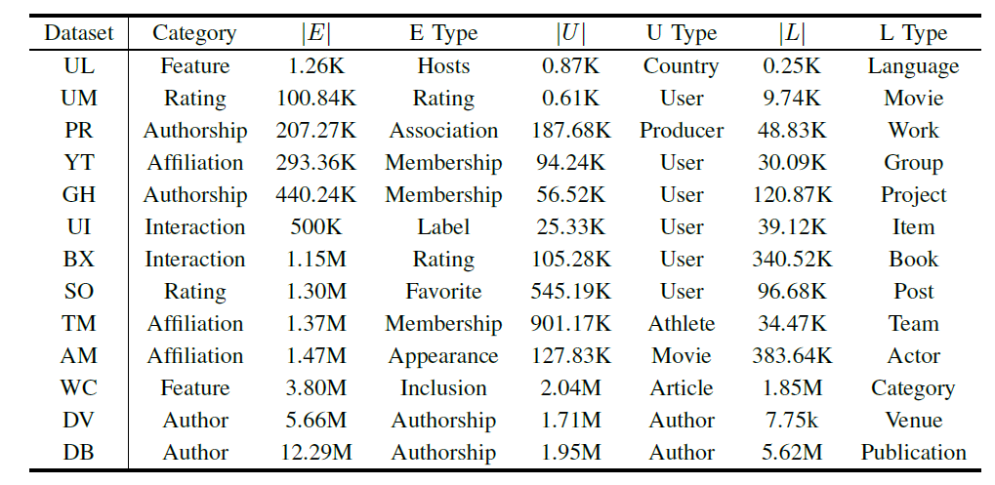
Datasets and Query processing algorithms
Datasets:
Query time:

Slide 28
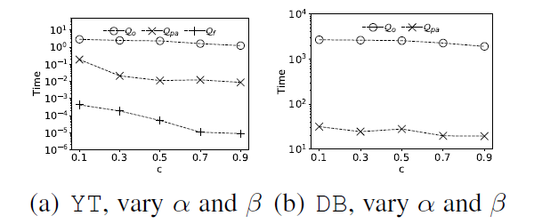
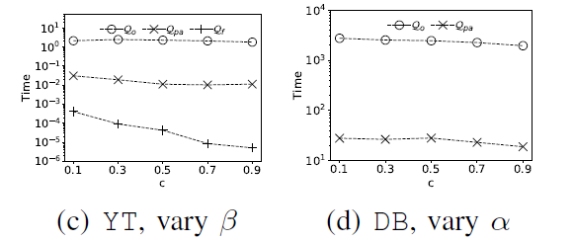
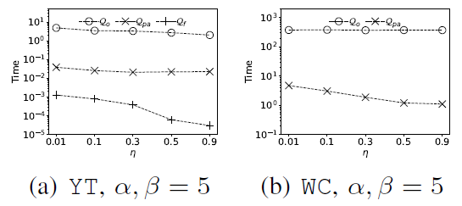
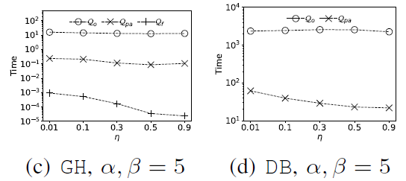
Query processing algorithms
Evaluating the effect of query parameters 𝛼 and 𝛽.
(a),(b): setting 𝛼, 𝛽 = 𝑐・𝛿. (c),(d): fixing 𝛼/𝛽, setting 𝛽/𝛼= 𝑐・𝛿.
Evaluating the effect of query parameter$η$.

Slide 29
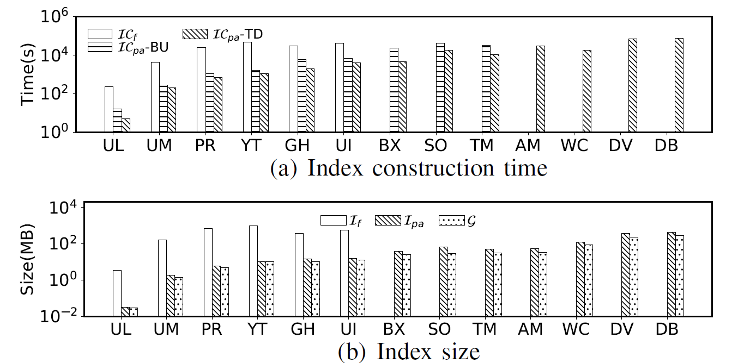
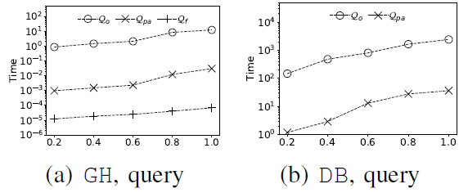
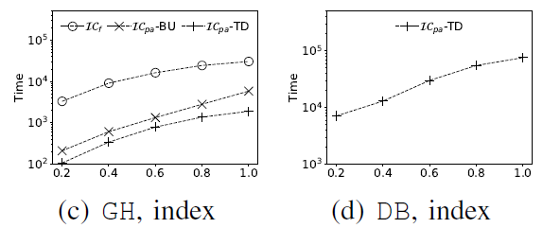
Indexing techniques
Index construction time and index size.
Evaluate the effect of probability distribution.

Slide 30
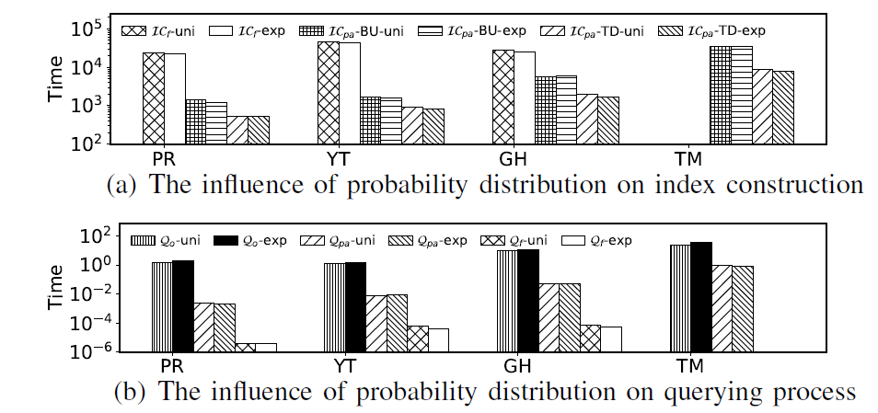
Indexing techniques
Evaluate the effect of probability distribution.

Slide 31
Conclusion
A novel model $(α, β,η)$-core, which is the first cohesive subgraph model on uncertain bipartite graphs.
An efficient online algorithm and a basic full index.
To strike a balance between index space cost and query processing time, we propose a probability-aware index with bounded space complexity$.$
Propose efficient algorithms to construct the probability-aware index in both bottom-up and top-down manner.
Conduct extensive experiments validate the effectiveness of the $(α, β,η)$-core model and the efficiency of the proposed algorithms.

Slide 32
Reference
[1] B. Yang, D. Wen, L. Qin, Y. Zhang, L. Chang, and R. Li, “Index-based optimal algorithm for computing k-cores in large uncertain graphs,” in
ICDE. IEEE, 2019, pp. 64–75.
[2] X. Huang, W. Lu, and L. V. S. Lakshmanan, “Truss decomposition of probabilistic graphs: Semantics and algorithms,” in SIGMOD. ACM,
2016, pp. 77–90.
[3] Z. Zou and R. Zhu, “Truss decomposition of uncertain graphs,” Knowl. Inf. Syst., vol. 50, no. 1, pp. 197–230, 2017.
[4] A. P. Mukherjee, P. Xu, and S. Tirthapura, “Mining maximal cliques from an uncertain graph,” in ICDE. IEEE Computer Society, 2015, pp.
243–254.
[5] R. Li, Q. Dai, G. Wang, Z. Ming, L. Qin, and J. X. Yu, “Improved algorithms for maximal clique search in uncertain networks,” in ICDE. IEEE, 2019, pp. 1178–1189.
[6] D. Ding, H. Li, Z. Huang, and N. Mamoulis, “Efficient fault-tolerant group recommendation using alpha-beta-core,” in CIKM. ACM, 2017,
pp. 2047–2050.
[7] B. Liu, L. Yuan, X. Lin, L. Qin, W. Zhang, and J. Zhou, “Efficient$(α, β)$-core computation: an index-based approach,” in WWW. ACM, 2019,
pp. 1130–1141.
[8] K. Wang, X. Lin, L. Qin, W. Zhang, and Y. Zhang, “Efficient bitruss decomposition for large-scale bipartite graphs,” in ICDE. IEEE, 2020, pp. 661–672.
[9] B. Lyu, L. Qin, X. Lin, Y. Zhang, Z. Qian, and J. Zhou, “Maximum biclique search at billion scale,” Proc. VLDB Endow., vol. 13, no. 9, pp. 1359–1372, 2020.
[10] Y. Peng, Y. Zhang, W. Zhang, X. Lin, and L. Qin, “Efficient probabilistic k-core computation on uncertain graphs,” in ICDE. IEEE, 2018, pp. 1192–1203.
[11] A. E. Sariy¨uce and A. Pinar, “Peeling bipartite networks for dense subgraph discovery,” in WSDM. ACM, 2018, pp. 504–512.

