Slide 1




Hierarchical Core Decomposition in Parallel:
From Construction to Subgraph Search
Deming Chu, Fan Zhang, Wenjie Zhang, Xuemin Lin, Ying Zhang

Slide 2
Core Decomposition
Powerful Tool in Network Analysis
Decompose a graph into layers

Slide 3


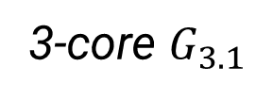
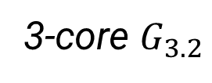
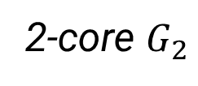
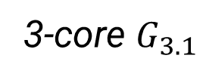
Limitations of Core Decomposition
$$≠$$
Connectivity of k-cores is lost
Containment of k-cores is lost
3-core $G_{3.1}$
3-core $G_{3.2}$
$$⊆$$
2.
3-core $G_{3.1}$
2-core $G_{2}$
Notes:
1. Eg two 3-cores

Slide 4
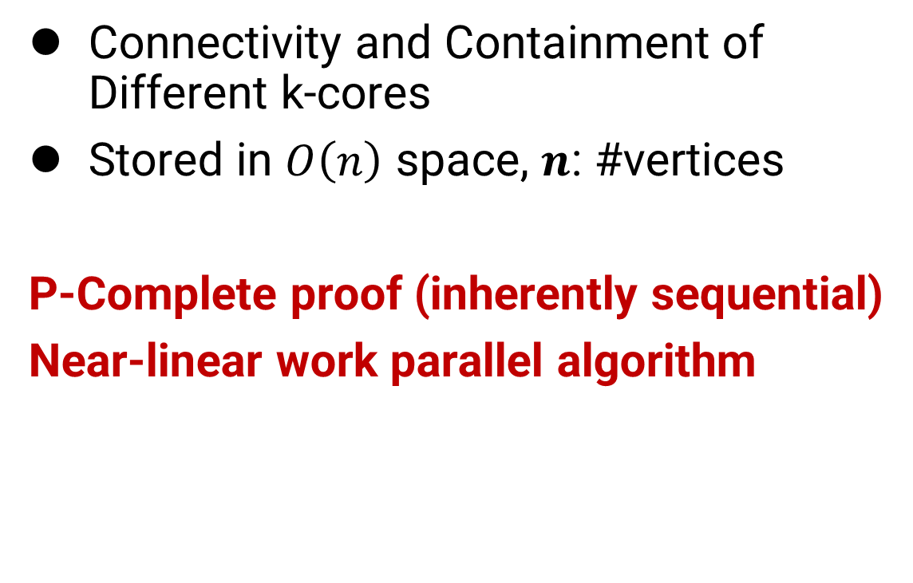
1. Hierarchical Core Decomposition (HCD)
Connectivity and Containment of Different k-cores
Stored in $O\left(n\right)$ space, $n$: #vertices
P-Complete proof (inherently sequential)
Near-linear work parallel algorithm

Slide 5
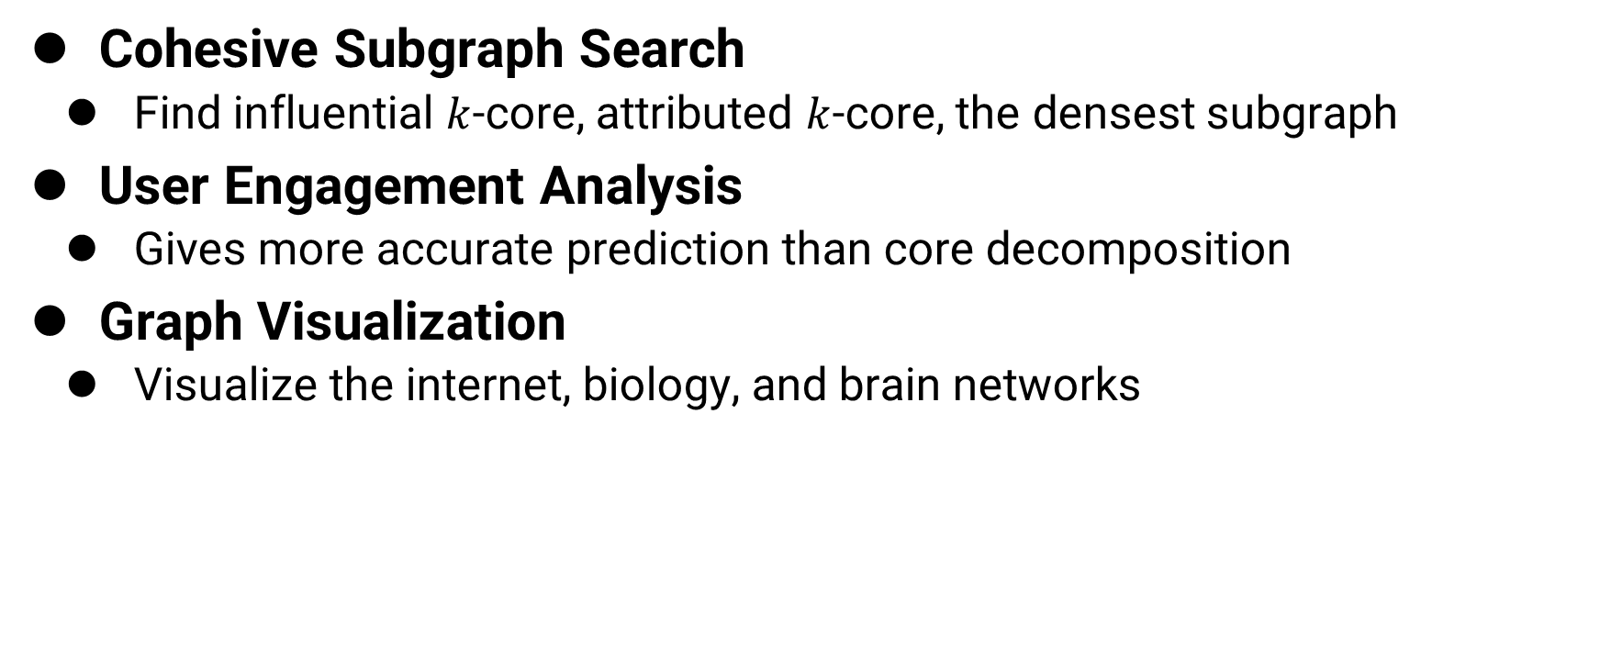
Applications of HCD
Cohesive Subgraph Search
  Find influential $k$-core, attributed $k$-core, the densest subgraph
User Engagement Analysis
  Gives more accurate prediction than core decomposition
Graph Visualization
  Visualize the internet, biology, and brain networks

Slide 6
2. Subgraph Search on HCD
Find high-quality subgraphs on HCD
Community scoring metric to evaluate subgraph quality
  E.g. average degree, clustering coefficient
Work-Efficient
Parallel Algorithms
Score=0.5
Score=0.4
Work-Efficient: #steps matches the best serial time complexity
Score=0.8
Score=0.6

Slide 7
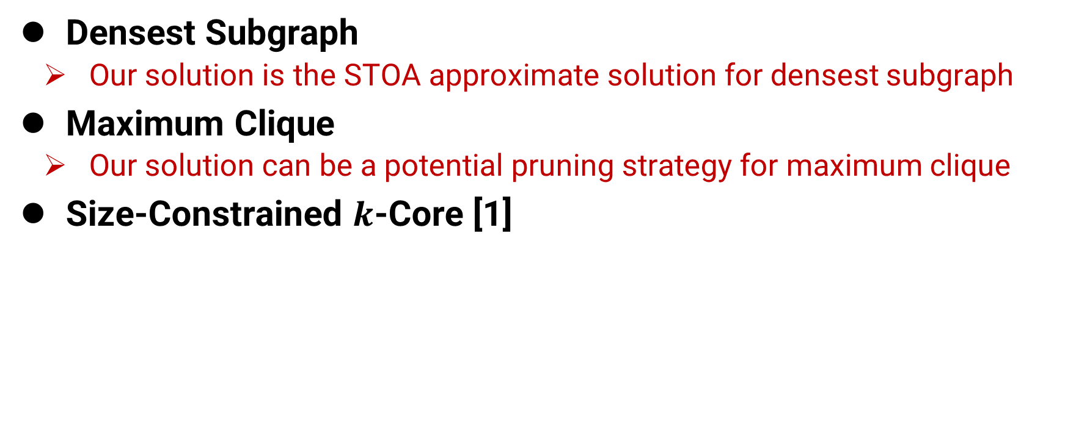
Applications of Subgraph Search on HCD
Densest Subgraph
  Our solution is the STOA approximate solution for densest subgraph
Maximum Clique
  Our solution can be a potential pruning strategy for maximum clique
Size-Constrained $k$-Core [1]
[1] D. Chu, F. Zhang, X. Lin, W. Zhang, Y. Zhang, Y. Xia, and C. Zhang, “Finding the best k in core decomposition: A time and space optimal solution,” in ICDE. IEEE, 2020, pp. 685–696.

Slide 8
Roadmap
Problem Definition
  HCD Construction
  Subgraph Search on HCD
Parallel Construction of HCD
Parallel Subgraph Search on HCD
Experimental Results
Conclusion

Slide 9

K-Core and Core Decomposition
$k$-Core: the maximal connected subgraph
where each node has at least $k$ neighbors
Coreness: largest $k$ such that the node is in the $k$-core
 Nodes with coreness 3
 Nodes with coreness 2
 Nodes with coreness 1

Slide 10
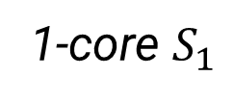
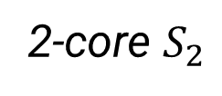
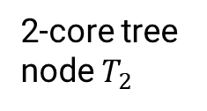
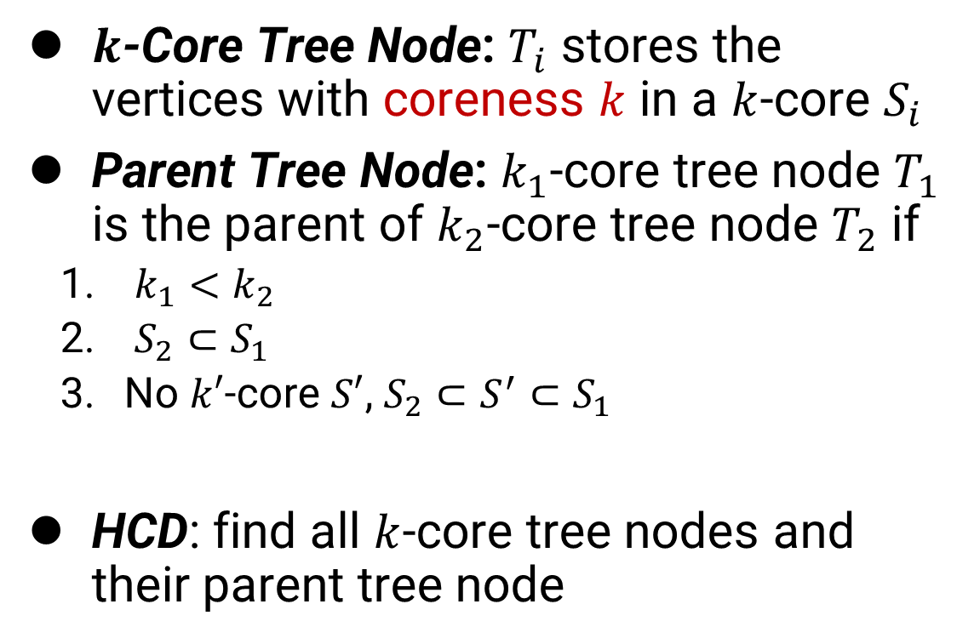
1. Hierarchical Core Decomposition
$k$-Core Tree Node: $T_{i}$ stores the vertices with coreness $k$ in a $k$-core $S_{i}$
Parent Tree Node: $k_{1}$-core tree node $T_{1}$ is the parent of $k_{2}$-core tree node $T_{2}$ if
  $k_{1}<k_{2}$
  $S_{2}⊂S_{1}$
  No $k′$-core $S′$, $S_{2}⊂S^{′}⊂S_{1}$
HCD: find all $k$-core tree nodes and their parent tree node
2-core $S_{2}$
1-core $S_{1}$
2-core tree node $T_{2}$

Slide 11

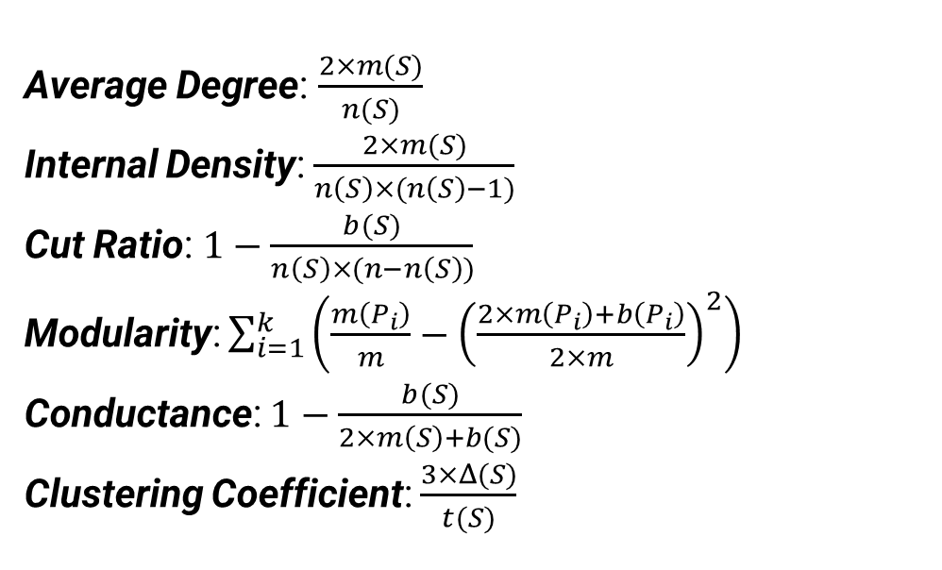
Definition: Community Scoring Metric
Primary Value (for a subgraph 𝑺)
Most metrics are based on Primary Values
Community Scoring Metric (for a subgraph 𝑺)
To measure community quality
𝒏(𝑺): # of nodes
𝒎(𝑺): # of edges
𝒃(𝑺): # of boundary edges
𝜟(𝑺): # of triangles
𝒕(𝑺): # of triplets
Average Degree: $\frac{2×m(S)}{n(S)}$
Internal Density: $\frac{2×m(S)}{n\left(S\right)×(n\left(S\right)−1)}$
Cut Ratio: $1−\frac{b(S)}{n\left(S\right)×(n−n\left(S\right))}$
Modularity: $\sum_{i=1}^{k}{\left(\frac{m\left(P_{i}\right)}{m}−{\left(\frac{2×m\left(P_{i}\right)+b\left(P_{i}\right)}{2×m}\right)}^{2}\right)}$
Conductance: $1−\frac{b(S)}{2×m\left(S\right)+b(S)}$
Clustering Coefficient: $\frac{3×Δ(S)}{t(S)}$
$$S$$
Type-A
Higher-Order
Type-B

Slide 12
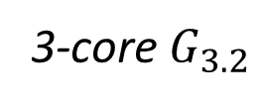
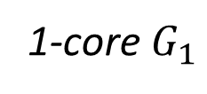
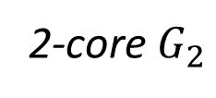
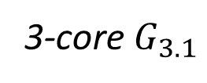

2. Subgraph Search on HCD
Given: Graph $G$, Community Scoring Metric $Q$
Subgraph Search: find the$k$-core with the highest score w.r.t. $Q$ among all k-cores
3-core $G_{3.1}$
3-core $G_{3.2}$
2-core $G_{2}$
1-core $G_{1}$

Slide 13
Roadmap
Problem Definition
Parallel Construction of HCD
Parallel Subgraph Search on HCD
Experimental Results
Conclusion

Slide 14
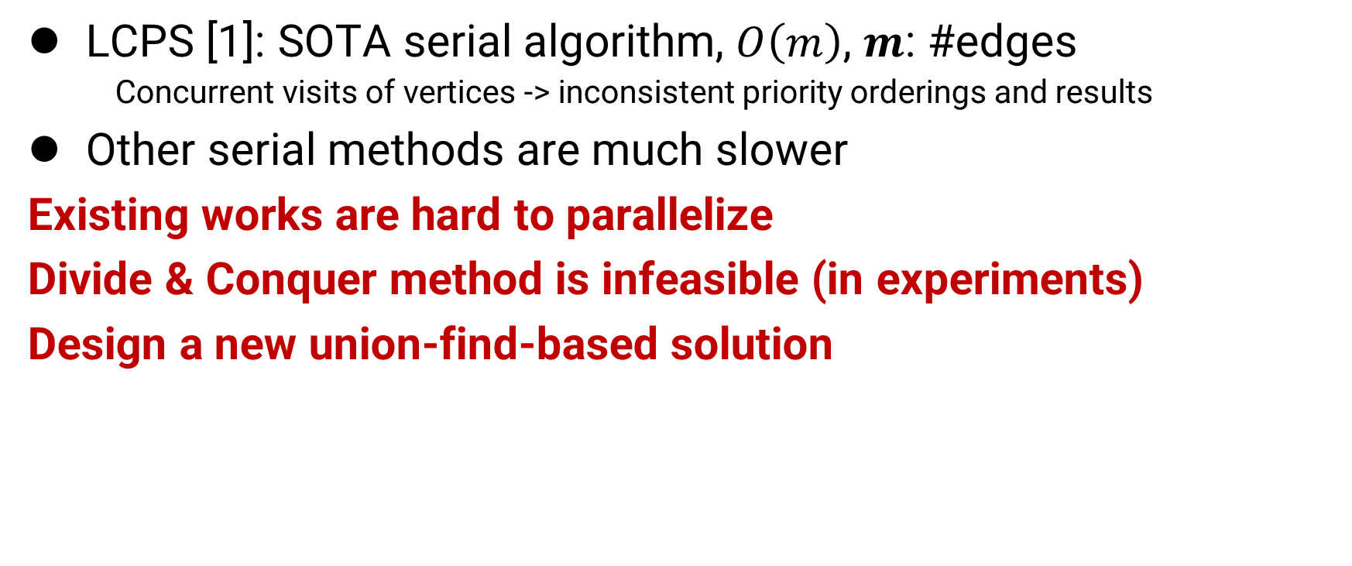
Existing Works of HCD Construction
LCPS [1]: SOTA serial algorithm, $O\left(m\right)$, $m$: #edges
    Concurrent visits of vertices -> inconsistent priority orderings and results
Other serial methods are much slower
Existing works are hard to parallelize
Divide & Conquer method is infeasible (in experiments)
Design a new union-find-based solution
[1] D. W. Matula and L. L. Beck, “Smallest-last ordering and clustering and graph coloring algorithms,” J. ACM, vol. 30, no. 3, pp. 417–427, 1983.

Slide 15
Intuition of Our Solution
Add vertices to union-find in decreasing coreness
Meanwhile, build HCD from bottom to up
Use pivot to identify tree node and its parent

Slide 16
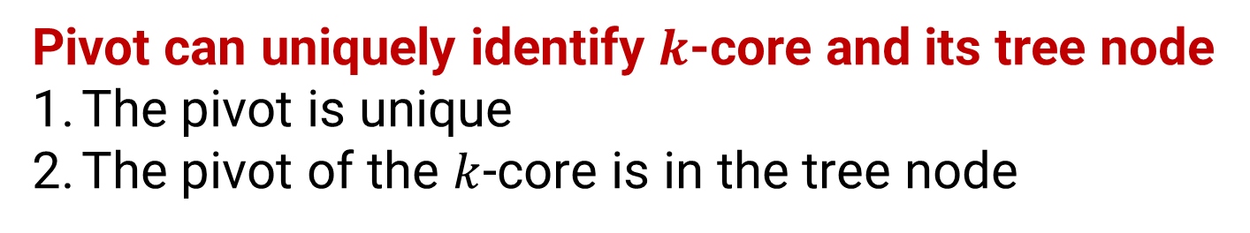
Vertex Rank and Pivot
Vertex Rank: sort nodes by coreness, and break tie by id
Pivot: the vertex with the lowest vertex rank in a subgraph
Pivot can uniquely identify $k$-core and its tree node
The pivot is unique
The pivot of the $k$-core is in the tree node
 Nodes with coreness 3
 Nodes with coreness 2
 Nodes with coreness 1
pivot

Slide 17
Vertex Rank and Pivot
1. Group Vertices
2. Find Parent
pivot
pivot
old pivot

Slide 18

Our Solution
for $k$ from $k_{max}$ down to 0:
    Find $k′$-Core Tree Node ($k^{′}>k$)
    Union in union-find
    Create Tree Nodes
    Find Parent Tree Node

Slide 19
Our Solution
pivot
for $k$ from $k_{max}$ down to 0:
    Find $k′$-Core Tree Node ($k^{′}>k$)
    Union in union-find
    Create Tree Nodes
    Find Parent Tree Node
old pivot
add ● to the graph

Slide 20
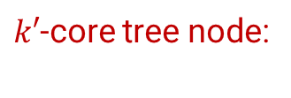
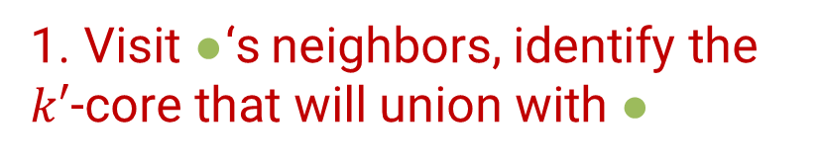

Our Solution
pivot
for $k$ from $k_{max}$ down to 0:
    Find $k′$-Core Tree Node ($k^{′}>k$)
    Union in union-find
    Create Tree Nodes
    Find Parent Tree Node
old pivot
1. Visit ●‘s neighbors, identify the $k′$-core that will union with ●
$k′$-core tree node:

Slide 21
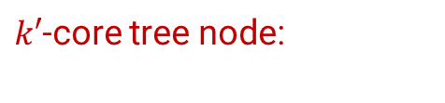

Our Solution
pivot
for $k$ from $k_{max}$ down to 0:
    Find $k′$-Core Tree Node ($k^{′}>k$)
    Union in union-find
    Create Tree Nodes
    Find Parent Tree Node
old pivot
2. Union ● with neighbors in union-find and pivot is changed
$k′$-core tree node:

Slide 22
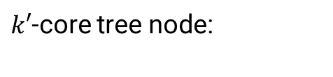

Our Solution
pivot
for $k$ from $k_{max}$ down to 0:
    Find $k′$-Core Tree Node ($k^{′}>k$)
    Union in union-find
    Create Tree Nodes
    Find Parent Tree Node
old pivot
3. Group ● by pivot into tree node
$k′$-core tree node:

Slide 23

Our Solution
pivot
for $k$ from $k_{max}$ down to 0:
    Find $k′$-Core Tree Node ($k^{′}>k$)
    Union in union-find
    Create Tree Nodes
    Find Parent Tree Node
old pivot
4. In the same CC, the tree node containing ● and ● have parent-child relation
$k′$-core tree node:

Slide 24

Union-find with Pivot
Wait-free Union-Find (parallel)
Maintain the pivot of connected component
Time: $O\left(n\sqrt{p}+mα\left(n\right)+F\right)$ work upon $m$ operations/edges
  $n$: #vertices $p:$ #threads $F$ failures in wait-free union-find
  $α(n)$ is the reverse Ackermann function, $α\left(n\right)≤4$ for any practical $n$

Slide 25


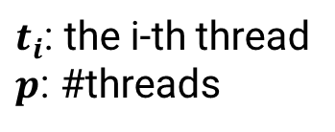
Parallel Vertex Rank Computation
$O(n)$ work
$t_{1}$: $v_{1},v_{2},⋯v_{\frac{n}{p}}$
……
……
……
……
$t_{P}$: $v_{n−\frac{n}{p}+1},⋯v_{n}$
$t_{i}$: the i-th thread
$p$: #threads
1. Distribute vertices
2. Group vertices by coreness
3. Place back into array, obtain vertex rank
is parallel

Slide 26
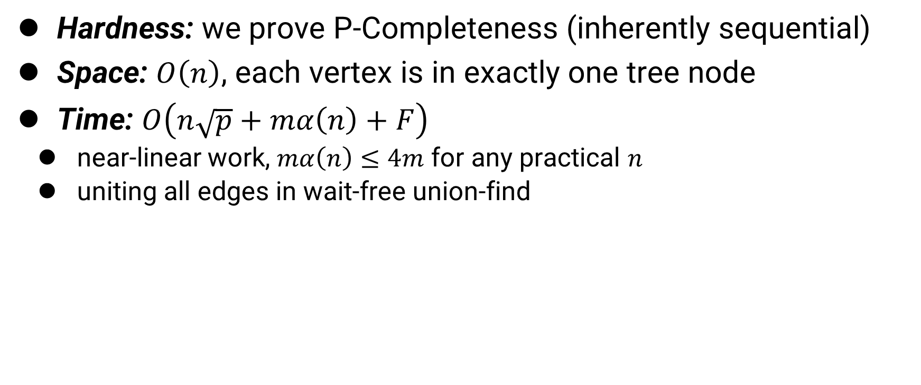
PHCD Analysis
Hardness: we prove P-Completeness (inherently sequential)
Space: $O\left(n\right)$, each vertex is in exactly one tree node
Time: $O\left(n\sqrt{p}+mα\left(n\right)+F\right)$
  near-linear work, $mα\left(n\right)≤4m$ for any practical $n$
  uniting all edges in wait-free union-find
  $n$: #vertices $m:$ #edges $p:$ #threads $F$ failures in wait-free union-find
  $α(n)$ is the reverse Ackermann function, $α\left(n\right)≤4$ for any practical $n$

Slide 27
Roadmap
Problem Definition
Parallel Construction of HCD
Parallel Subgraph Search on HCD
Experimental Results
Conclusion

Slide 28
Existing Works of Subgraph Search
Limitations of BKS [1] (time- and space-optimal serial solution)
  Compute in decreasing coreness, rely on the results of larger coreness
  Preprocessing in BKS is inefficient to parallelize
Our Solution
Vertex-centric solution (no dependency)
A novel preprocessing
Efficient to parallelize
[1] D. Chu, F. Zhang, X. Lin, W. Zhang, Y. Zhang, Y. Xia, and C. Zhang, “Finding the best k in core decomposition: A time and space optimal solution,” in ICDE. IEEE, 2020, pp. 685–696.

Slide 29
Our Solution
Compute HCD
Preprocessing
Score Computation on HCD
Output the Best K-Core

Slide 30
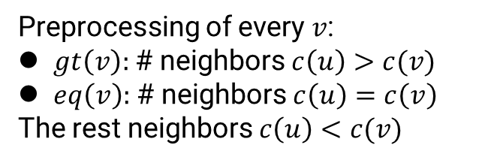
Our Solution
Compute HCD
Preprocessing
Score Computation on HCD
Output the Best K-Core
Preprocessing of every $v$:
$gt\left(v\right):$# neighbors $c\left(u\right)>c(v)$
$eq\left(v\right):$# neighbors $c\left(u\right)=c\left(v\right)$
The rest neighbors $c\left(u\right)<c(v)$

Slide 31
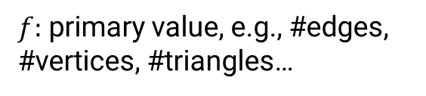
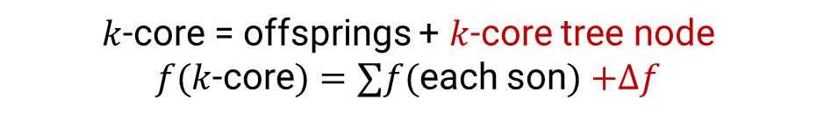
3. Score Computation on HCD (Intuition)
$f:$ primary value, e.g., #edges, #vertices, #triangles…
$k$-core = offsprings + $k$-core tree node
$f(k$-core$)=∑f($each son$)$ $+Δf$

Slide 32
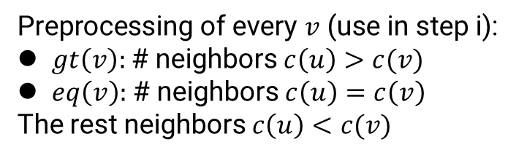
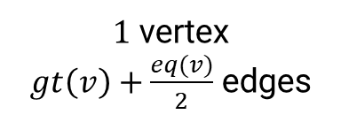
3. Type-A Score Computation on HCD
Preprocessing of every $v$ (use in step i):
$gt\left(v\right):$# neighbors $c\left(u\right)>c(v)$
$eq\left(v\right):$# neighbors $c\left(u\right)=c\left(v\right)$
The rest neighbors $c\left(u\right)<c(v)$
E.g. Average Degree, #vertices, #edges
$1$ vertex
$gt\left(v\right)+\frac{eq(v)}{2}$ edges
Compute
Aggregate
9v, 9e
Bottom-Up
Summation
27v, 37e
2.74
Score
……
9v, 14e
18v, 28e
3.11
……
5v, 8e
4v, 6e
5v, 8e
4v, 6e
3.2
3
is parallel
i. Vertex-centric
contribution
ii. Tree node contribution
iii. Primary value of k-cores
iv. Score of k-cores

Slide 33
3. Type-B Score Computation on HCD
Similar but more complex compared with type-A
Triangle: use lower-degree endpoint to check triangle existence
Triplet: count triplets based on the coreness of neighbors

Slide 34
Our Solution
Compute HCD
Preprocessing
Score Computation on HCD
Output the Best K-Core
The highest score

Slide 35
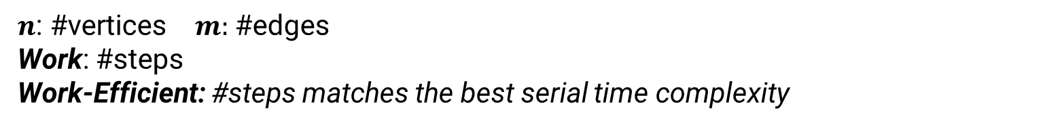

PBKS Time Analysis
Preprocessing: $O(m)$ work
Score Computation: Type-A: $O(n)$ work, Type-B: $O(m^{1.5})$ work
  Work-efficient
$n$: #vertices $m:$ #edges
Work: #steps
Work-Efficient: #steps matches the best serial time complexity

Slide 36
Roadmap
Problem Definition
Parallel Construction of HCD
Parallel Subgraph Search on HCD
Experimental Results
  Experimental Setting
  Runtime Performance
  Application Performance
Conclusion

Slide 37
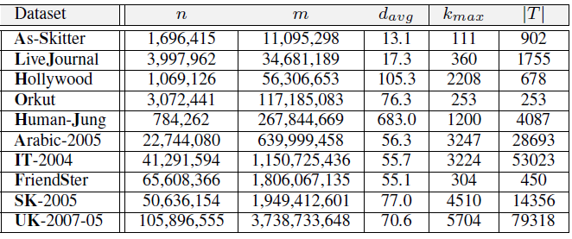
Dataset Statistics & Experimental Setting
10 Public Networks, Up to 100M nodes & 4B edges
A Quad-Core (up to 40 threads) Linux server with 128G memory

Slide 38
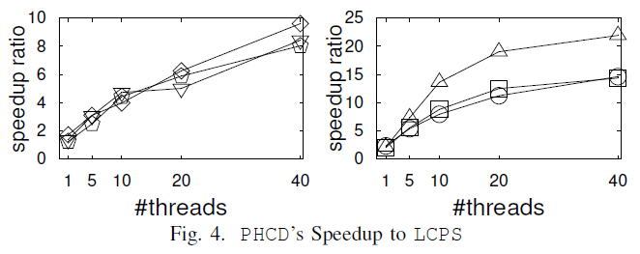
Parallel HCD Construction Time
Serial PHCD is 1.24-2.33x faster than LCPS
40-cores
  Small graphs: 10x
  Large graphs: 15-20x
Significantly faster than LCPS
Increasing network size

Slide 39
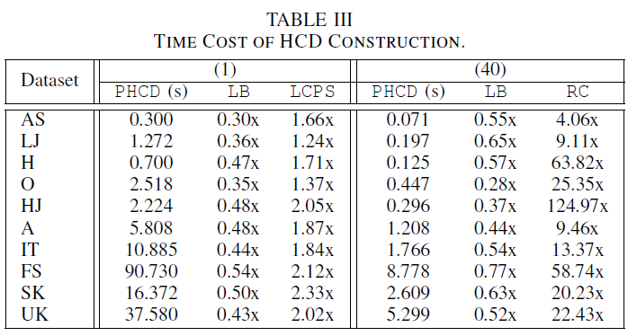
Parallel HCD Construction Time
LB: the lower-bound cost of the UF-based method
  LB is ~0.5 the cost of our method
Our PHCD is close to lower bound

Slide 40
Parallel HCD Construction Time
LB: the lower-bound cost of the UF-based method
  LB is ~0.5 the cost of our method
Our PHCD is close to lower bound
RC is required in Divide and Conquer method
D&C paradigm is inefficient in building HCD

Slide 41
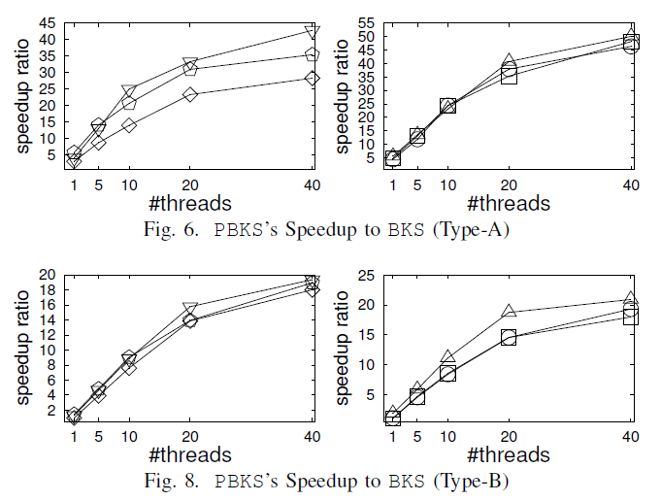
Parallel Subgraph Search Time
Score Computation (40-cores)
Type-A: Small 30-45x
Large 50x
Type-B: ~20x
Significantly faster than BKS
Increasing network size

Slide 42
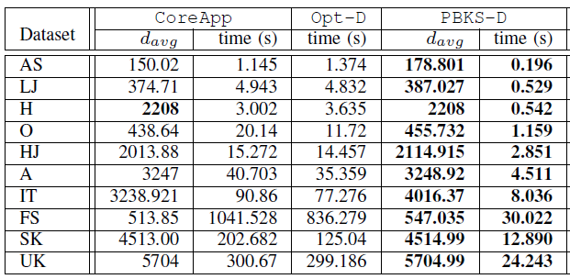
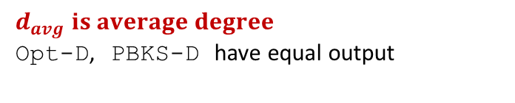
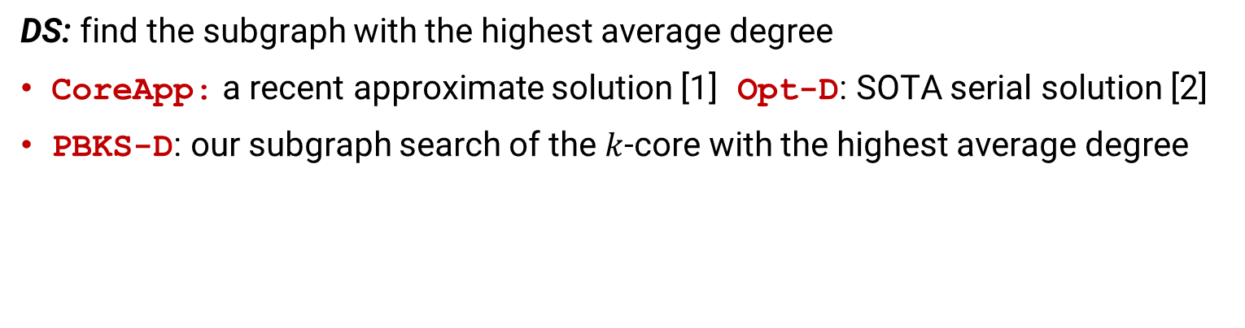
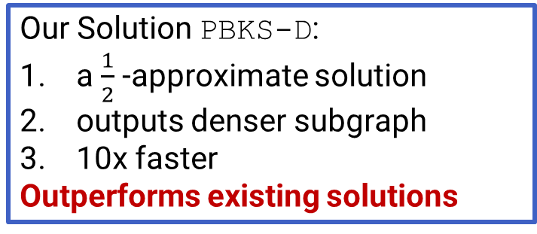
Application: Densest Subgraph
DS: find the subgraph with the highest average degree
CoreApp: a recent approximate solution [1] Opt-D: SOTA serial solution [2]
PBKS-D: our subgraph search of the $k$-core with the highest average degree
Our Solution PBKS-D:
a $\frac{1}{2}$ -approximate solution
outputs denser subgraph
10x faster
Outperforms existing solutions
Better is bold
$$d_{avg} is average degree$$
Opt-D, PBKS-D have equal output
[1] Fang, Yixiang, et al. Efficient algorithms for densest subgraph discovery. PVLDB 2019.
[2] D. Chu, F. Zhang, X. Lin, W. Zhang, Y. Zhang, Y. Xia, and C. Zhang, “Finding the best k in core decomposition: A time and space optimal solution,” in ICDE. IEEE, 2020, pp. 685–696.

Slide 43
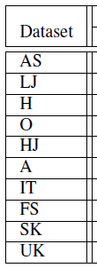
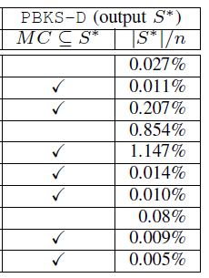


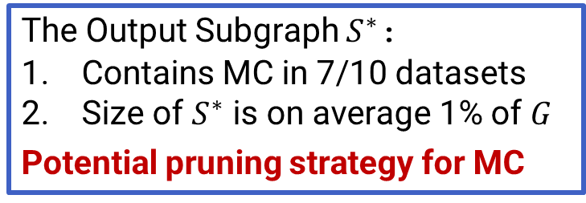

Application: Maximum Clique
MC: find the largest subgraph where every pair of nodes is adjacent (NP-Hard)
PBKS-D: our subgraph search of the $k$-core with the highest average degree
$S^{∗}$ is the output of PBKS-D
The Output Subgraph $S^{∗}$:
Contains MC in 7/10 datasets
Size of $S^{∗}$ is on average 1% of $G$
Potential pruning strategy for MC
$S^{∗}$ contains the MC
The node proportion of $S^{∗}$in the whole graph

Slide 44
Roadmap
Problem Definition
Parallel Construction of HCD
Parallel Subgraph Search on HCD
Experimental Results
Conclusion

Slide 45

Conclusion
Parallel HCD Construction
  P-Complete Proof (difficult to parallelize effectively)
  First parallel algorithm: near-linear work $O(n\sqrt{p}+mα\left(n\right)+F)$
Parallel Subgraph Search on HCD
  First parallel algorithm
  Score Computation: work-efficient
    $O(n)$ for type-A, $O(m^{1.5})$ for type-B, after $O(m)$ preprocessing
Useful in Related Problems
  Application: Approximate Densest Subgraph, Maximum Clique
  Runtime: Outperform existing works significantly

Slide 46

Q & A

