Slide 1



Efficient Personalized Maximum Biclique Search
Kai Wang, Wenjie Zhang, Xuemin Lin, Lu Qin, Alexander Zhou

Slide 2
Outline
Introduction
Solutions
Experiments
Conclusion

Slide 3
Introduction

Slide 4




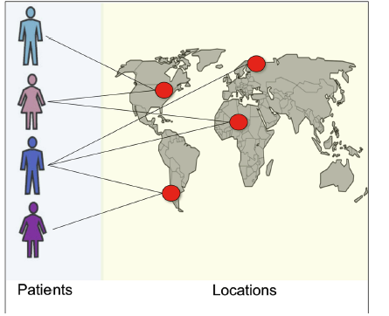




Bipartite graphs
Bipartite graph serves as a useful data model when modelling relationships between two different types of entities.
Andy
Kane
Eric
Phoebe
Adam
Mark
Shego
Taylor
Balm
Doll
Hat
Wine
Carpet
Alien
Avatar
A.I.
X-Men
Star Wars
User-movie Network
People-location Network
Customer-product Network
Notes:
Contact tracing, reveal the transmission chain
Examples:
Authors-to-Papers (they authored)
Actors-to-Movies (they appeared in)
Users-to-Movies (they rated)
People-to-Locations (they visited)
Customers-to-Products (they bought)

Slide 5
Definition of bipartite graph
Bipartite graph is a graph whose vertices can be divided into two disjoint vertex layers U and L such that every link connects a vertex in U to one in L; that is, U and L are independent sets.
u0
u1
u2
u3
    The upper layer
U
E
L
    The lower layer
v0
v1
v2
v3
v4
G = (V = (U, L), E)

Slide 6


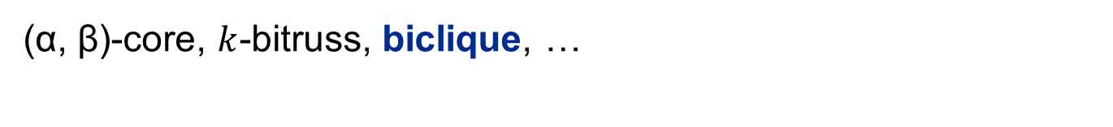
Cohesive subgraphs in bipartite graphs
Cohesive Subgraphs: subgraphs where the vertices are densely connected inside according to specific cohesive constraints.
(α, β)-core, $k$-bitruss, biclique, …
u0
u1
u2
u3
v0
v1
v2
v3
v4
Notes:
These butterflies can reflect intercorporate relations. The number of butterflies indicates the extent to which directors re-meet one another on two or more boards. A large butterfly counting number indicates a large number of inter-corporate relations and formal alliances between companies.

Slide 7
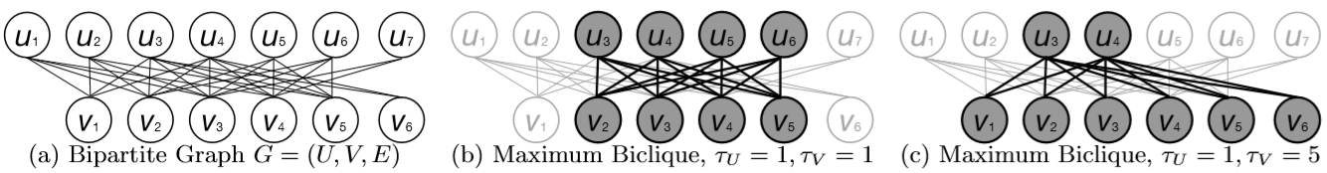
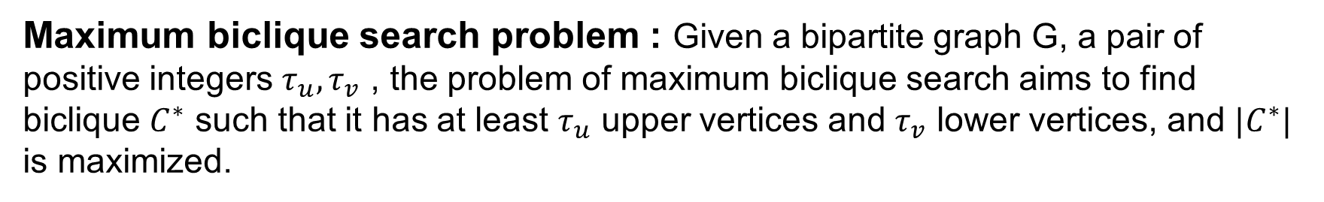
Maximum biclique search
Maximum biclique search problem : Given a bipartite graph G, a pair of positive integers $τ_{u}, τ_{v}$ , the problem of maximum biclique search aims to find biclique $C^{∗}$ such that it has at least $τ_{u}$ upper vertices and $τ_{v}$ lower vertices, and ${|C}^{∗}|$ is maximized.
Lyu B, et al. Maximum Biclique Search at Billion Scale[J]. Proc. VLDB Endow., 2020, 13(9): 1359-1372. [Best paper runner-up award in VLDB 2020]
Notes:
The above-mentioned SOTA algorithm for maximal biclique enumeration can be extended to solve the maximum biclique search problem.
Here we formulate the maximum biclique search problem as follows.
Given positive integers tau_u and tau_v, it aims to find the maximum biclique with at least \tau_u upper
Vertices and \tau_v lower vertices.
If we set \tau_u and \tau_v to 1, the maximum biclique search problem is equivalent to the Maximum edge biclique problem.
For example:
Example bipartite graph
the maximum edge biclique in G with at least one upper vertex and at least one lower vertex. (this is equivalent to the maximum edge biclique)
the maximum edge biclique in G with at least one upper vertex and at least five lower vertex.

Slide 8
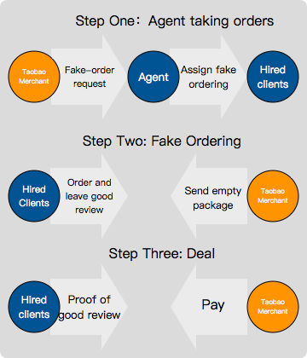
Application – detecting farm clicking actions
Alibaba: Detecting farm clicking actions
  Challenges:
    Billions of buyers and productions, 10+ billions of transactions
  Solution:
    Efficient maximum biclique search on bipartite graphs
  Outcome:
    Significantly increase the recall in double 11 festival in 2017 by ~50%
Lyu B, et al. Maximum Biclique Search at Billion Scale[J]. Proc. VLDB Endow., 2020, 13(9): 1359-1372. [Best paper runner-up award in VLDB 2020]
Notes:
Note that topKMax improves the recall rate of fraudulent transaction by 50% according to the feedback of the risk management team from Alibaba Group.
解决方案：在人和商品的二分图中，将刷单模拟成完全二分图，认为多人同时购买多种商品的行为具有较高刷单可疑性。传统方法通过人为定义规则等检测作弊行为，而我们从图结构出发，切合实际刷单背景，找出上百点规模的biclique，代表一批人刷单购买一批商品的情况。

Slide 9
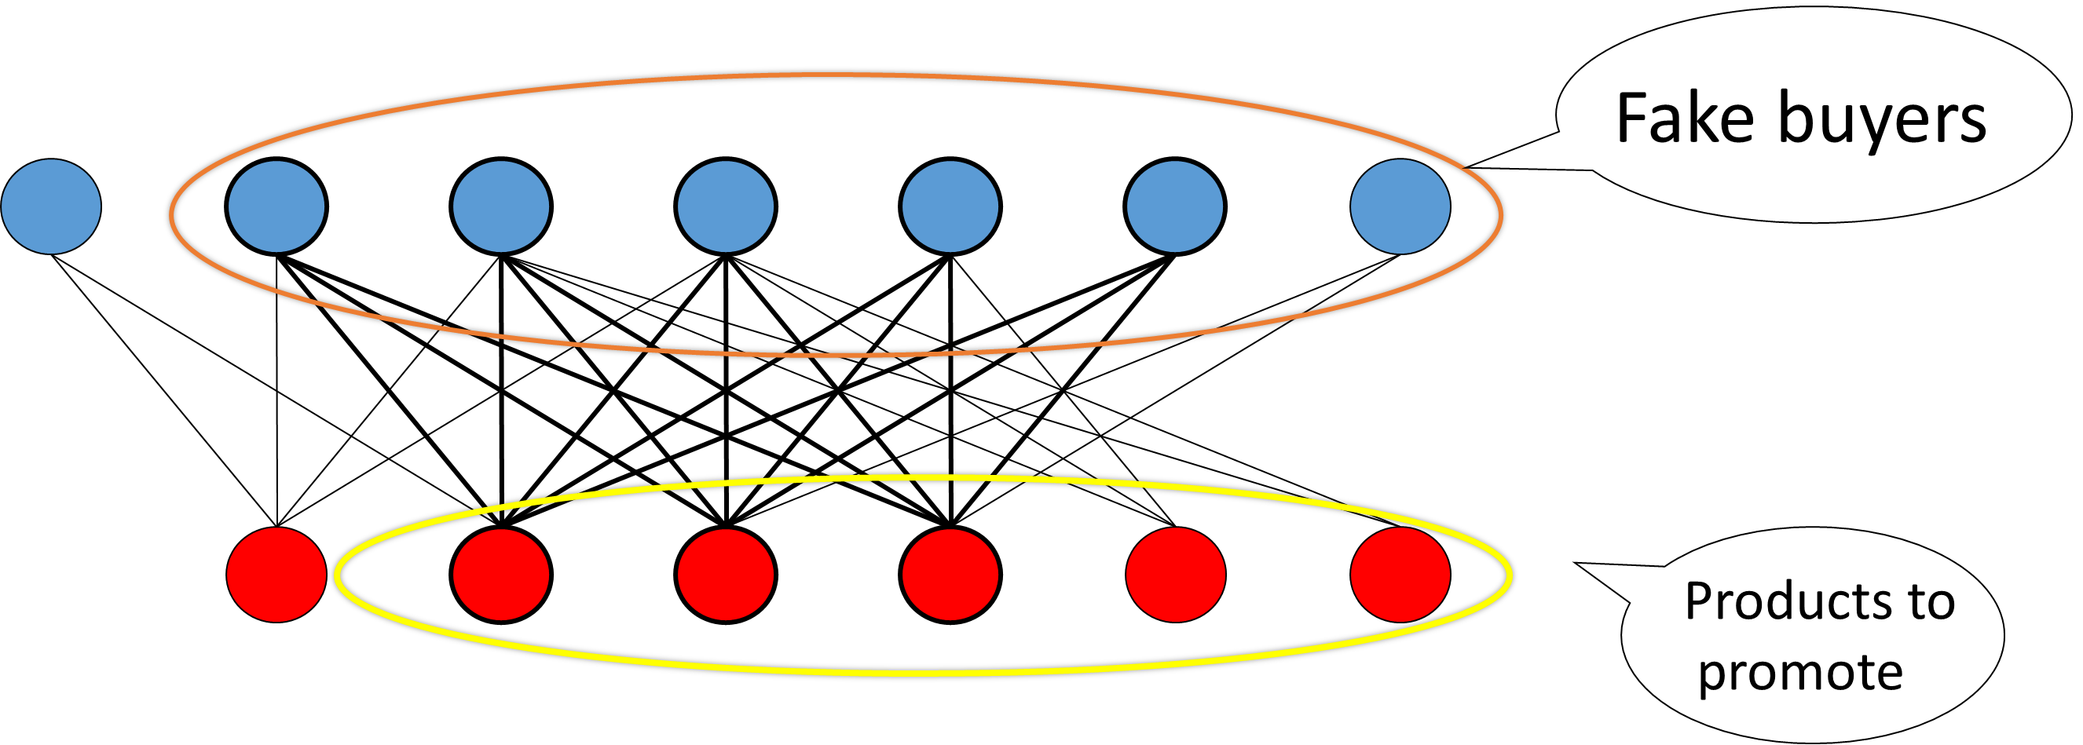
Motivation
Maximum biclique search only finds the biclique with the globally maximum size.
Many fraud detection techniques require a query seed (i.e., a confirmed risky account) as the input, where the seeds can be obtained by user reporting or other security mechanisms (e.g., monitoring accounts that make a large number of fake transactions within a short time period).
Q
Lyu B, et al. Maximum Biclique Search at Billion Scale[J]. Proc. VLDB Endow., 2020, 13(9): 1359-1372. [Best paper runner-up award in VLDB 2020]
Notes:
Note that topKMax improves the recall rate of fraudulent transaction by 50% according to the feedback of the risk management team from Alibaba Group.
解决方案：在人和商品的二分图中，将刷单模拟成完全二分图，认为多人同时购买多种商品的行为具有较高刷单可疑性。传统方法通过人为定义规则等检测作弊行为，而我们从图结构出发，切合实际刷单背景，找出上百点规模的biclique，代表一批人刷单购买一批商品的情况。
Maximum biclique search only finds the biclique with the globally maximum size, while fast personalized analysis is required in many real-world scenarios.

Slide 10
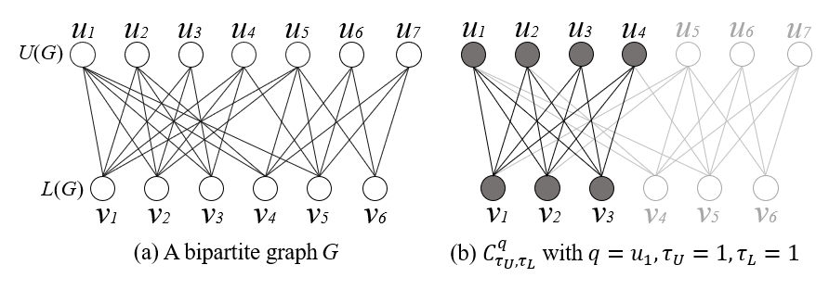
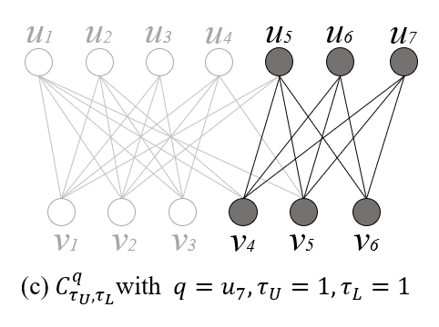
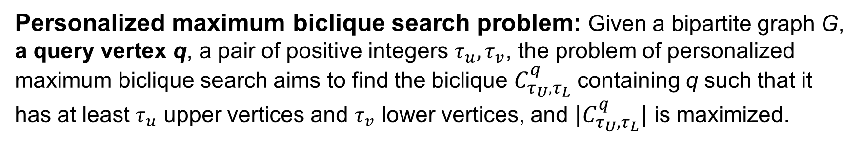
Personalized Maximum Biclique Search
Personalized maximum biclique search problem: Given a bipartite graph G, a query vertex q, a pair of positive integers $τ_{u}, τ_{v}$, the problem of personalized maximum biclique search aims to find the biclique $C_{τ_{U},τ_{L}}^{q}$containing q such that it has at least $τ_{u}$ upper vertices and $τ_{v}$ lower vertices, and ${|C}_{τ_{U},τ_{L}}^{q}|$ is maximized.
Lyu B, et al. Maximum Biclique Search at Billion Scale[J]. Proc. VLDB Endow., 2020, 13(9): 1359-1372. [Best paper runner-up award in VLDB 2020]
Notes:
The above-mentioned SOTA algorithm for maximal biclique enumeration can be extended to solve the maximum biclique search problem.
Here we formulate the maximum biclique search problem as follows.
Given positive integers tau_u and tau_v, it aims to find the maximum biclique with at least \tau_u upper
Vertices and \tau_v lower vertices.
If we set \tau_u and \tau_v to 1, the maximum biclique search problem is equivalent to the Maximum edge biclique problem.
For example:
Example bipartite graph
the maximum edge biclique in G with at least one upper vertex and at least one lower vertex. (this is equivalent to the maximum edge biclique)
the maximum edge biclique in G with at least one upper vertex and at least five lower vertex.

Slide 11
Solutions

Slide 12
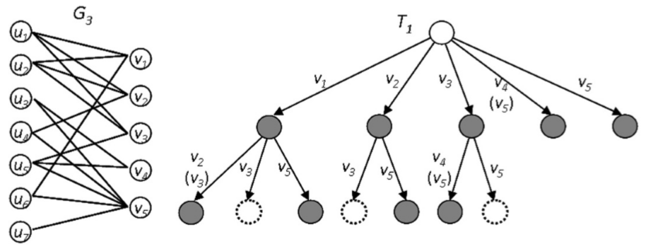
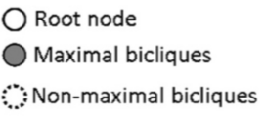
The branch&bound framework
The branch&bound framework for solving biclique search problems:
Yun Zhang, Charles A Phillips, Gary L Rogers, Erich J Baker, Elissa J Chesler, and Michael A Langston. 2014. On finding bicliques in bipartite graphs: a novel algorithm and its application to the integration of diverse biological data types. BMC bioinformatics 15,1(2014),110.
Notes:
Based on above-mentioned, a branch-and-bound framework is proposed, which aims to list all maximal bicliques by pruning non-maximal candidates.

Slide 13
Baseline - The online algorithms PMBC-OL & PMBC-OL*
PMBC-OL - Idea: shrink the search space according to the query vertex and then apply the state-of-the-art maximum biclique search algorithm (based on the branch&bound framework) in VLDB 2020.
Two-hop subgraph: Given a bipartite graph G and a query vertex q, the two-hop subgraph of q, denoted by H_{q}, is the subgraph induced by the one-hop and two-hop neighbors of q.
Lemma: Given a bipartite graph G, a query vertex q, and size constraints $τ_{U}$and $τ_{L}$, |$C_{τ_{U},τ_{L}}^{q}$| = |$C^{∗}$|, where $C_{τ_{U},τ_{L}}^{q}$is the personalized maximum biclique in G, and $C^{∗}$denotes the maximum biclique in H_{q}.
u1
u2
u3
u4
u5
u6
u7
Finding the personalized maximum biclique in G
Finding the maximum biclique in H_{q}
v1
v2
v3
v4
v5
v6
$$q=u_{7}, τ_{U}=1,τ_{L}=1$$
PMBC-OL*: We further design upper bounding techniques based on (𝜶,𝜷)-core to accelerate PMBC-OL.

Slide 14
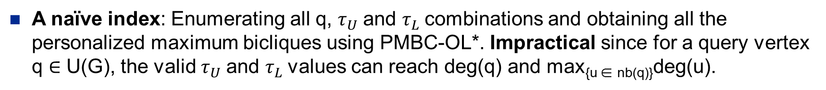
Motivation and challenges
Motivation: The online computation approaches cannot satisfy the real-time requirements in many scenarios.
A naïve index: Enumerating all q, $τ_{U}$and $τ_{L}$combinations and obtaining all the personalized maximum bicliques using PMBC-OL*. Impractical since for a query vertex q $∈$ U(G), the valid $τ_{U}$and $τ_{L}$values can reach deg(q) and max_{{u ∈ nb(q)}}deg(u).
Challenges:
Challenge 1. How to design a size-bounded index which allows both efficient construction and query processing.
Challenge 2. How to further reduce the indexing time via cost-sharing and optimization techniques.
Notes:
Although the online algorithm can be finished in reasonable time in many cases, this totally online computation approach cannot satisfy the real-time requirements in many scenarios where queries are frequently posted and responses are quickly needed. As a result, we resort to index-based solutions to solve the personalized maximum biclique search problem in a more efficient way. A straightforward index can be built by enumerating all $q$, $\tu$, $\tv$ combinations and obtaining all the \ccoms using \bicbs. This idea is clearly impractical since for a query vertex $q \in U(G)$, the valid $\tu$ and $\tv$ values can reach $\degree(q)$ and $\max_{u \in \nb(q)}\degree(u)$, respectively. Here $\degree(q)$ denotes the degree of a vertex $q$, and $\nb(q)$ denotes the neighbor set of $q$. Thus, it is cost-prohibitive to compute the results of all combinations of $q$, $\tu$, and, $\tv$ values.

Slide 15
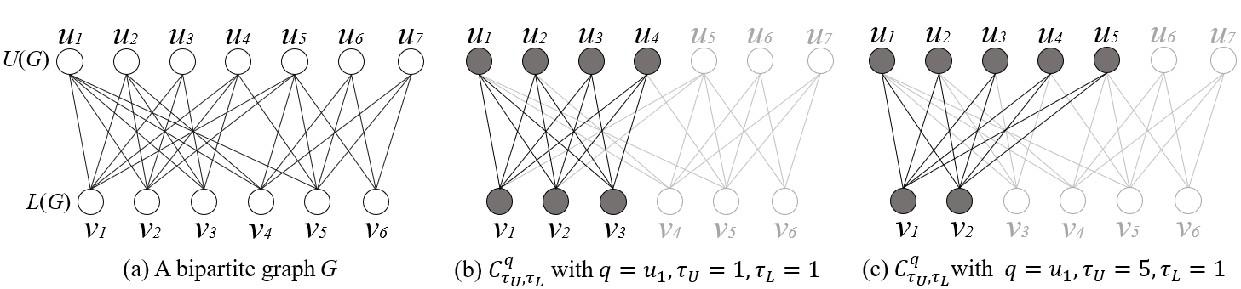
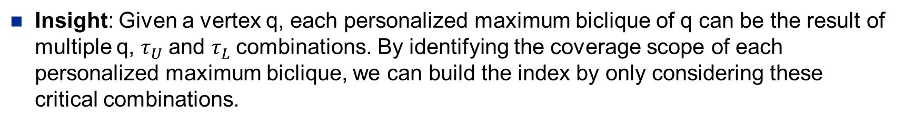
The PMBC-Index
Insight: Given a vertex q, each personalized maximum biclique of q can be the result of multiple q, $τ_{U}$and $τ_{L}$combinations. By identifying the coverage scope of each personalized maximum biclique, we can build the index by only considering these critical combinations.

Slide 16
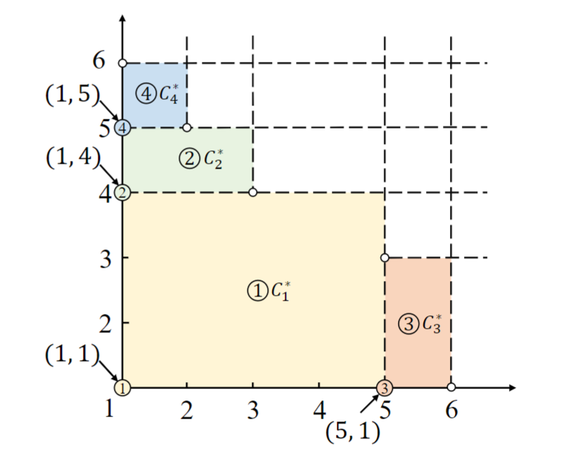
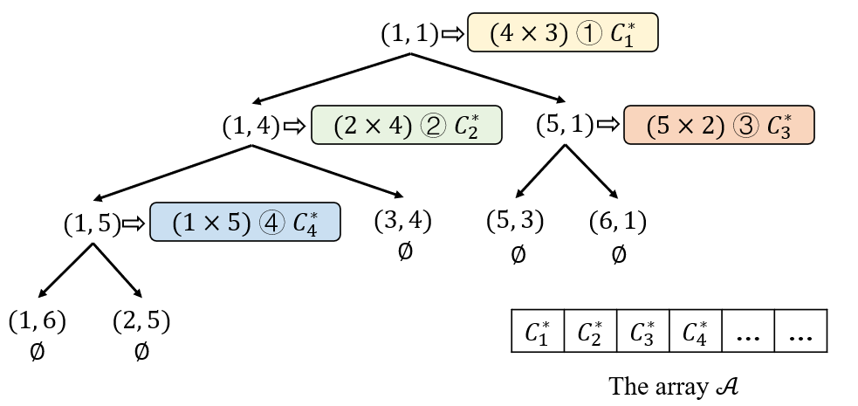
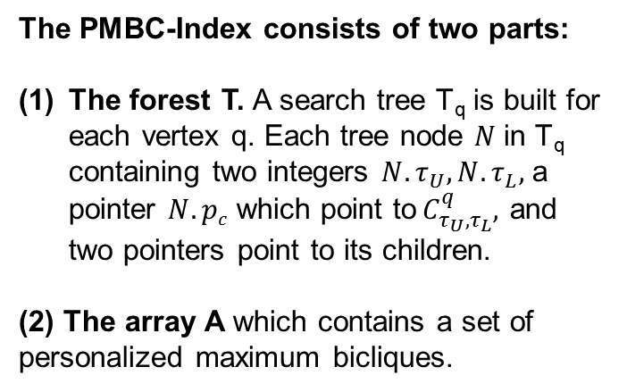

The PMBC-Index
The PMBC-Index consists of two parts:
The forest T. A search tree T_{q} is built for each vertex q. Each tree node $N$in T_{q} containing two integers ${N.τ}_{U}, N.τ_{L},$ a pointer $N.pc$ which point to${ C}_{τ_{U},τ_{L}}^{q},$ and two pointers point to its children.
(2) The array A which contains a set of personalized maximum bicliques.
The search tree T_{u1} of u₁ and the array A
Total space complexity: $O\left(\sum_{q∈V(G)}{\deg\left(q\right)∗Hq}\right)$.
the rationale of the \bicindex

Slide 17
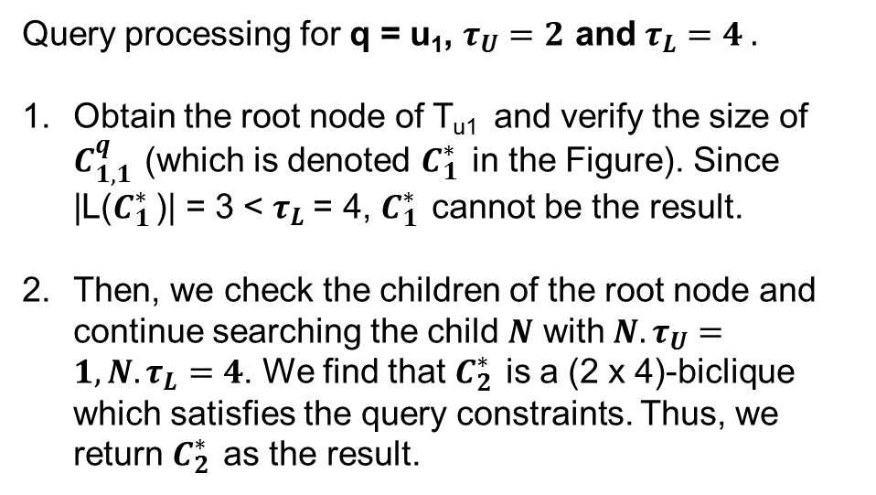
Query based on the PMBC-Index
Query processing for q = u₁, $τ_{U}=2$ and $τ_{L}=4 .$
Obtain the root node of T_{u1} and verify the size of $C_{1,1 }^{q}$(which is denoted $C_{1 }^{∗}$in the Figure). Since |L($C_{1 }^{∗}$)| = 3 < $τ_{L}$= 4, $C_{1 }^{∗}$cannot be the result.
Then, we check the children of the root node and continue searching the child $N$ with ${N.τ}_{U}=1,{N.τ}_{L}=4$. We find that $C_{2 }^{∗}$is a (2 x 4)-biclique which satisfies the query constraints. Thus, we return $C_{2 }^{∗}$as the result.
The search tree T_{u1} of u₁ and the array A
Query time complexity: $O\left(\deg\left(q\right)\text{+}\text{|}C_{τ_{U},τ_{L}}^{q}\text{|}\right)$for a given query q, $τ_{U}$and $τ_{L}$.

Slide 18
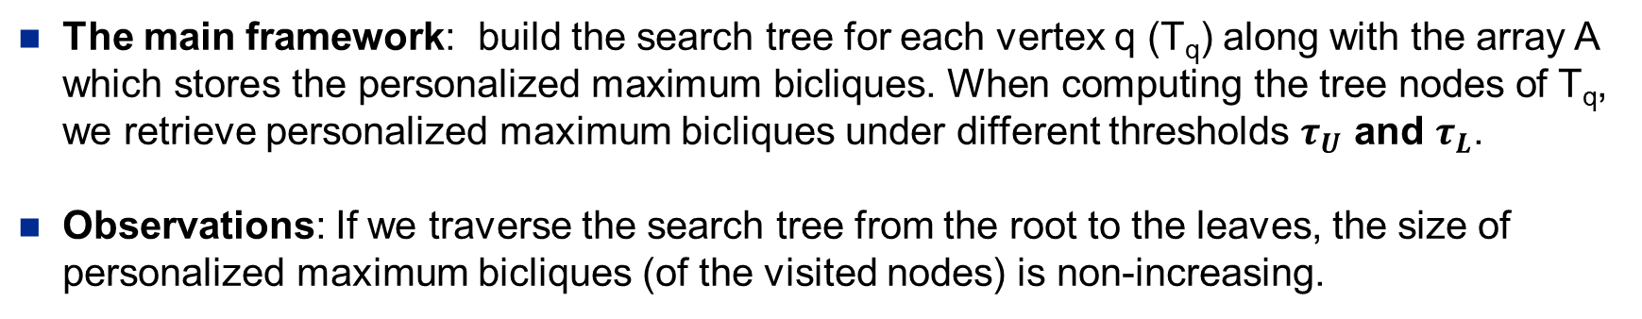
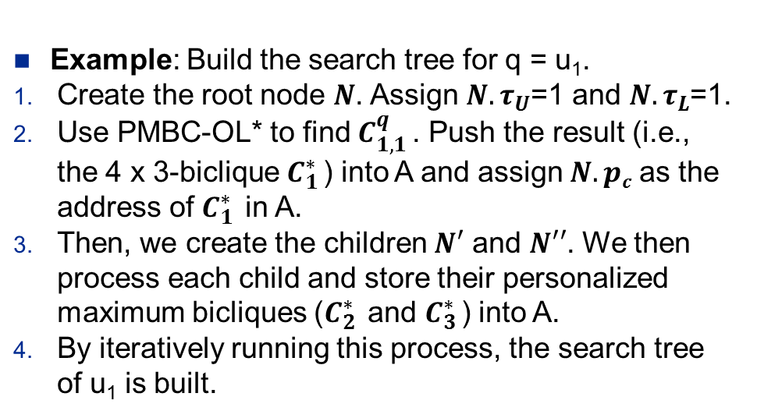
The construction of the PMBC-Index
The main framework: build the search tree for each vertex q (T_{q}) along with the array A which stores the personalized maximum bicliques. When computing the tree nodes of T_{q}, we retrieve personalized maximum bicliques under different thresholds $τ_{U}$ and $τ_{L}$.
Observations: If we traverse the search tree from the root to the leaves, the size of personalized maximum bicliques (of the visited nodes) is non-increasing.
Example: Build the search tree for q = u₁.
Create the root node $N$. Assign $N.τ_{U}$=1 and $N.τ_{L}$=1.
Use PMBC-OL* to find $C_{1,1 }^{q}$. Push the result (i.e., the 4 x 3-biclique $C_{1 }^{∗}$) into A and assign $N.pc$ as the address of $C_{1 }^{∗}$in A.
Then, we create the children $N′$ and $N′′$. We then process each child and store their personalized maximum bicliques ($C_{2 }^{∗}$and $C_{3 }^{∗}$) into A.
By iteratively running this process, the search tree of u₁ is built.

Slide 19
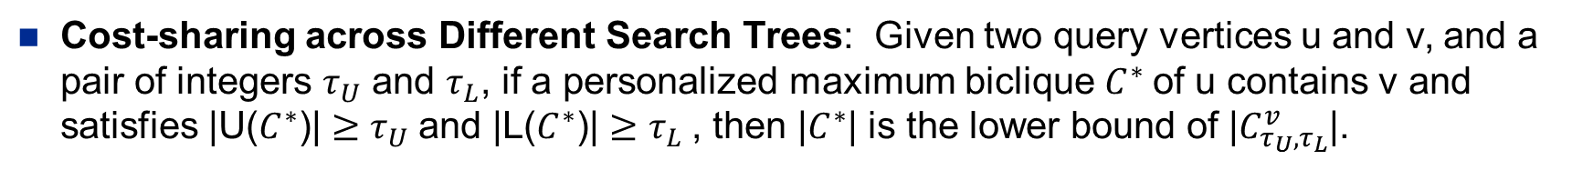
Optimizations
Cost-sharing across Different Search Trees: Given two query vertices u and v, and a pair of integers $τ_{U}$ and $τ_{L}$, if a personalized maximum biclique $C^{∗}$of u contains v and satisfies |U($C^{∗}$)| ${≥τ}_{U}$and |L($C^{∗}$)| ${≥τ}_{L}$, then |$C^{∗}$| is the lower bound of |$C_{τ_{U},τ_{L}}^{v}$|.
Shared-memory Parallelization: Building the search trees is almost independent for each vertex. In other words, it does not need to update any data structures shared with other vertices (except for checking the lower bound) when building the search trees. Thus, we can process each vertex in parallel.
Notes:
Utilizing the \bicic algorithm, the \bicindex can be correctly constructed. When we examine the algorithm, we observe that in the process of computing a search tree (of a vertex), its tree nodes may contain results from previously built search trees. {\color{black}Naturally, we wish to use these previously computed results to accelerate the construction of the current search tree. We thus propose a light-weight auxiliary structure to achieve this goal.

Slide 20
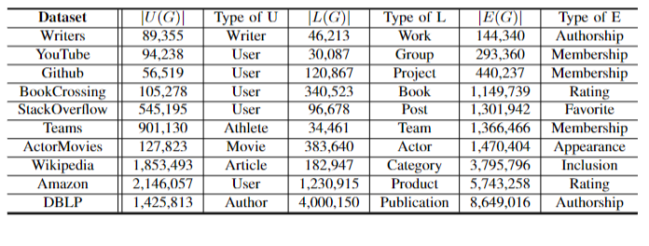
Experiments
10 Real-world Datasets
Notes:
Utilizing the \bicic algorithm, the \bicindex can be correctly constructed. When we examine the algorithm, we observe that in the process of computing a search tree (of a vertex), its tree nodes may contain results from previously built search trees. {\color{black}Naturally, we wish to use these previously computed results to accelerate the construction of the current search tree. We thus propose a light-weight auxiliary structure to achieve this goal.

Slide 21
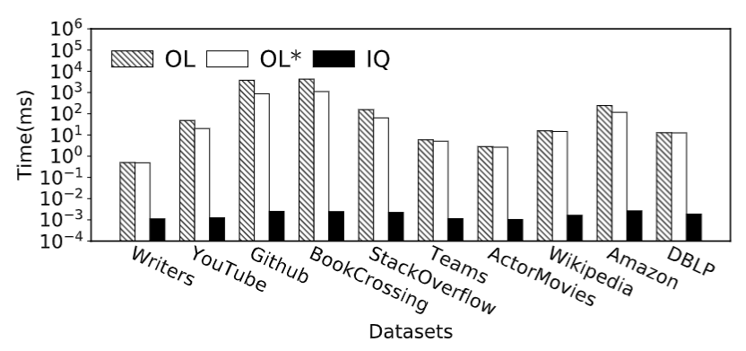
Query Performance
Benefiting from the PMBC-Index, IQ significantly outperforms the online computation algorithms OL and OL* by up to 5 orders of magnitude.
On all the datasets, the IQ algorithm can answer the queries within milliseconds.
Notes:
In Figure \ref{fig:query_time}, we evaluate the performance of \bicbs, \bicbsa, and \biciq on all datasets by setting $\tu = 5$ and $\tv = 5$, {\color{black} which are also the largest $\tu$ and $\tv$ settings in \cite{lyu2020maximum}}. We can see that benefiting from the \bicindex, \biciq significantly outperforms the online computation algorithms \bicbs and \bicbsa by up to 5 orders of magnitude. On all the datasets, the \biciq algorithm can answer the queries within milliseconds.

Slide 22
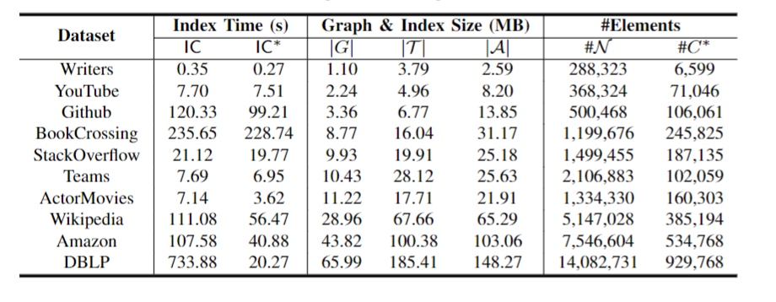
Index Construction
Compared with IC, IC* can usually obtain a better sub-optimal result (or even the optimal result) with cost-sharing strategies across different trees. Thus, IC* can avoid many check/update operations on A while IC has to check/update for many distinct bicliques on IC.
The total size of the complete PMBC-Index constructed by IC* is only 3.5x-6.1x to the graph size (i.e., |G|).
Notes:
Firstly, we report the index construction time and index size. Secondly, we evaluate the effect of the number of threads $t$. We set $t$ as 48 by default.
In Table \ref{table:index_main}, we list the indexing time and index size on different datasets. We also report the number of tree nodes in $\bicidx$ (i.e., \#$\treenode$) and the number of bicliques in $\bicidxa$ (i.e., \#$C^*$). We can see that the \bicindex can be efficiently constructed on all the datasets. In addition, with the cost-sharing optimizations proposed in Section \ref{sct:index_construction_optimization}, \bicica outperforms \bicic on large datasets such as \texttt{Wikipedia}, \texttt{Amazon}, and \texttt{DBLP}. Notably, the performance of \bicica on \texttt{DBLP} is much better than \bicic since \texttt{DBLP} is a sparse graph with many distinct personalized maximum bicliques (i.e., the maximum degree is 951 and the size of the biclique array $\bicidxa$ is 929{,}768). Compared with \bicic, \bicica can usually obtain a better sub-optimal result (or even the optimal result) with cost-sharing strategies across different trees. Thus, \bicica can avoid many check/update operations on $\bicidxa$ while \bicic has to check/update for many distinct bicliques on $\bicidxa$. In addition, the total size of the complete \bicindex (i.e., $|\bicidx|$ + $|\bicidxa|$) constructed by \bicica is only $3.5\times$-$6.1\times$ to the graph size (i.e., $|G|$).

Slide 23
Conclusion
The First Work to Study Personalized Maximum Biclique Search.
An Index Structure with Bounded Index Size.
Effective Techniques for Efficient Index Construction.
Extensive Empirical Studies on Real-world Graphs.
Notes:
\item {\em The First Work to Study Personalized Maximum Biclique Search.} To the extent of our knowledge, this is the first work to study this important problem on bipartite graphs. Although the problem is NP-hard, we aim to devise solutions to efficiently answer a user query in practice.
\item {\em {\color{black}An Index Structure with Bounded Index Size.}} We propose the \bicindex which allows for both efficient construction and query processing. As evaluated in our experiments, our index-based algorithm is up to five orders of magnitude faster than the baseline algorithms. We also theoretically prove that the index-based query can be answered within $O(\degree(q) + |\bicq|)$ time and the index size is bounded by $O(\sum_{q \in V(G)}\degree(q) \cdot (\degree(q)+\max_{u \in \nb(q)}\degree(u)))$, which is much smaller in practice. %Here, $\degree(v)$ denote the degree of $v$, and $\nb(v)$ denotes the neighbor set of $v$. can be efficiently constructed and support efficient retrieval of \ccoms.
\item {\em Effective Techniques for Efficient Index Construction.} We study how to efficiently construct the \bicindex by exploring the relations of results with different combinations of parameters. Effective optimization techniques are proposed by exploring cost-sharing among vertices and upper bounds. In addition, a significant speedup ratio can be achieved by utilizing our parallelization techniques.
\item {\em Extensive Empirical Studies on Real-world Graphs.} We conduct comprehensive experimental evaluations on 10 real-world bipartite graphs. Experimental results validate both the effectiveness and efficiency of our query algorithms and indexing techniques.

Slide 24
The End
Thank you!

