Slide 1




Efficient Community Search with Size Constraint
Computer Science and Engineering
Boge Liu Fan Zhang Wenjie Zhang
^{Xuemin Lin Ying Zhang}
The University of New South Wales
^{ICDE 2021}

Slide 2


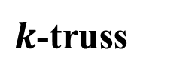
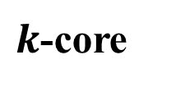
Community Search
Given a query vertex or a set of vertices
Find communities containing given vertex (vertices)
$k$-core
Cohesiveness and connectivity
$k$-truss
Exploits the higher-order graph motif, triangle

Slide 3




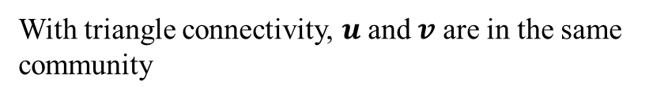





Community Search
Connectivity: triangle connectivity
Reachable through a series of adjacent triangles
$e_{1}$ is triangle-connected with $e_{2}$ but not with $e_{3}$
$$e_{2}$$
$$e_{3}$$
$$v$$
$$w$$
$$e_{1}$$
With triangle connectivity, $u$ and $v$ are in the same community
$$u$$
More rigorous than primitive connectivity which only requires two vertices are reachable from each other through a simple path
Triangle-connected community

Slide 4






Community Search
Size constraint
Find a community with size no larger than a given threshold
$$e_{2}$$
$$e_{3}$$
Team Formation
Biological Network Analysis
Suspicious Group Detection
$$v$$
$$w$$
$$e_{1}$$
$$u$$
Triangle-connected community
Size-constraint triangle-connected community

Slide 5




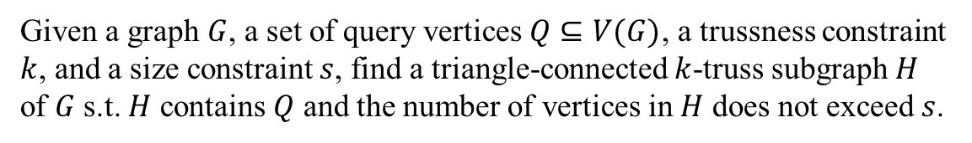









Problem Statement
Given a graph $G$, a set of query vertices $Q⊆V(G)$, a trussness constraint $k$, and a size constraint $s$, find a triangle-connected $k$-truss subgraph $H$ of $G$ s.t. $H$ contains $Q$ and the number of vertices in $H$ does not exceed $s$.
$$v_{2}$$
$$v_{7}$$
$$v_{8}$$
$$v_{1}$$
$$v_{3}$$
$$v_{9}$$
$$v_{5}$$
SCkT
$$v_{11}$$
$$v_{4}$$
$$v_{6}$$
$$v_{10}$$
NP-hard

Slide 6
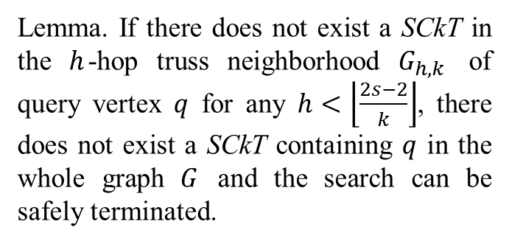
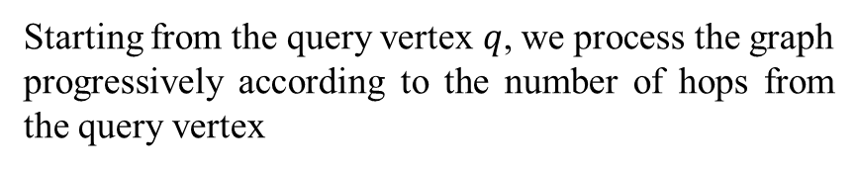
Framework
Starting from the query vertex $q$, we process the graph
progressively according to the number of hops from the query vertex
Lemma. If there does not exist a SCkT in the $h$-hop truss neighborhood $G_{h,k}$ of query vertex $q$ for any $h<\left\lfloor \frac{2s−2}{k}\right\rfloor$, there does not exist a SCkT containing $q$ in the whole graph $G$ and the search can be safely terminated.
2-hop neighbors
1-hop neighbors
3-hop neighbors
Query vertex
Multi-vertex query
Use the union of h-hop truss neighborhood

Slide 7



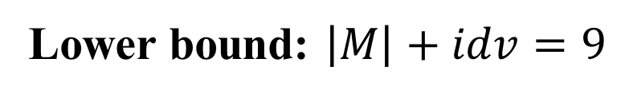









Lower Bound Computation
Given a vertex $u$ and a partial solution $M$, the minimum number of extra vertices that are needed to
make $u$ contained in a triangle-connected k-truss?
$$k=5$$
$$v_{2}$$
$${idv}_{1}$$
Degree constraint: $\deg\left(u\right)≥k−1$
$$v_{1}$$
$$v_{3}$$
Structure constraint
$$u$$
$$sup\left(u,v_{1}\right)=sup\left(u,v_{6}\right)=1$$
$$sup\left(u,v_{2}\right)=sup\left(u,v_{3}\right)=sup\left(u,v_{4}\right)=sup\left(u,v_{5}\right)=2$$
$$v_{6}$$
$$v_{4}$$
After adding $idv_{1}$
$${idv}_{2}$$
$$v_{5}$$
$$sup\left(u,v_{1}\right)=sup\left(u,v_{6}\right)=2$$
$$sup\left(u,v_{2}\right)=sup\left(u,v_{3}\right)=sup\left(u,v_{4}\right)=sup\left(u,v_{5}\right)=3$$
Lower bound: $\left|M\right|+idv=9$

Slide 8
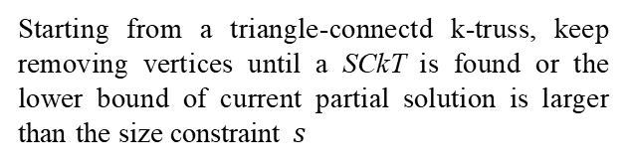
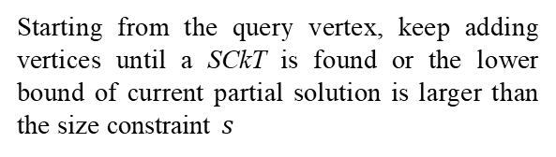
Search Strategies
Expand
Shrink
Starting from the query vertex, keep adding vertices until a SCkT is found or the lower bound of current partial solution is larger than the size constraint $s$
Starting from a triangle-connectd k-truss, keep removing vertices until a SCkT is found or the lower bound of current partial solution is larger than the size constraint $s$
How to choose the next vertex to be added or removed?
The number of neighbors in partial solution whose structure constraint is not satisfied
The number of neighbors in partial solution

Slide 9
Search Strategies
Hybrid Approach
Expand: quickly find a SCkT if the SCkT is closely connected to current partial solution
Shrink: removing some vertices can lead to the removal of other unpromising vertices, therefore largely reduces the search space
Automatically determine the search strategy using the following creteria:
Yes
No
Expand
Shrink

Slide 10
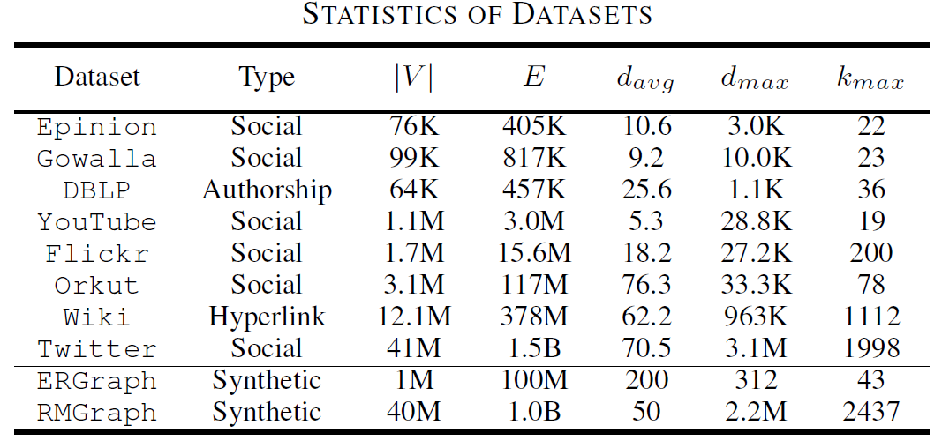
Experimental Evaluation

Slide 11
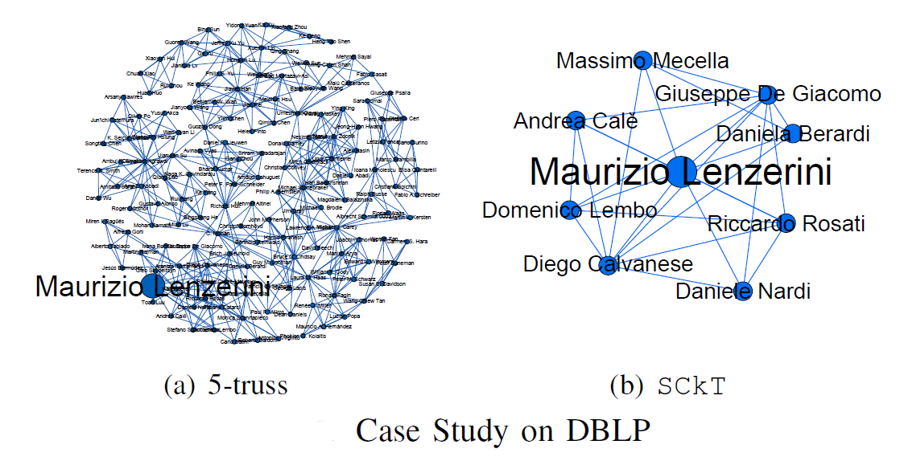

Experimental Evaluation
$$k=5 s=10$$

Slide 12
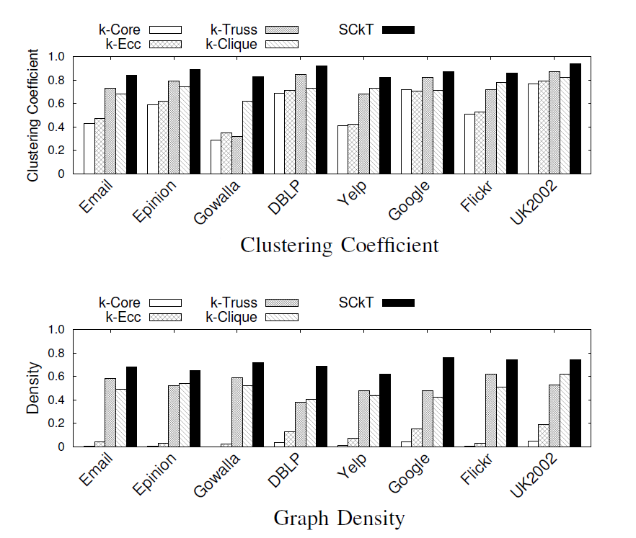
Experimental Evaluation

Slide 13
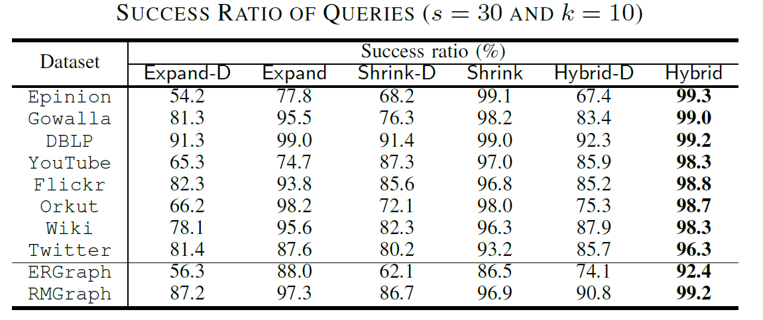
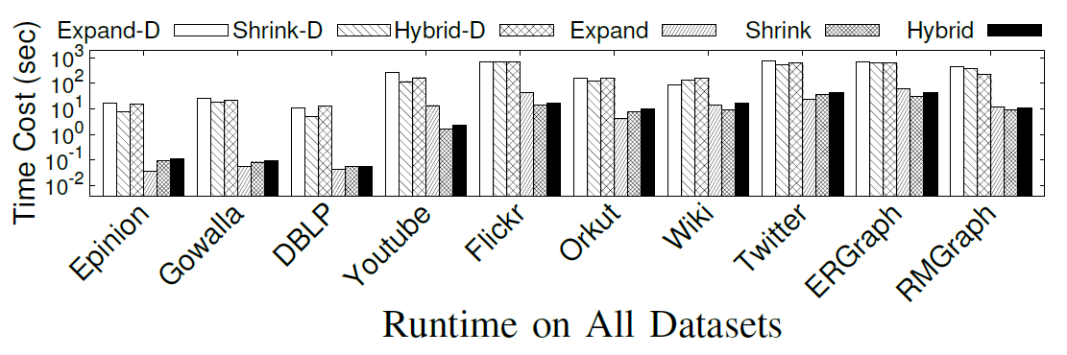
Experimental Evaluation

Slide 14
Summary
Applying the size constraint to the triangle-connected k-truss community model
A novel and effective lower bound is proposed to early terminate unpromising search branches to enhance efficiency
A hybrid search strategy to return triangle-connected k-truss communities with high quality
Extensive experiments are conducted to show the effectiveness of the proposed algorithms

Slide 15
THANKS
Q&A

