Slide 1


On Querying Historical K-Cores
Michael Yu¹, Dong Wen², Lu Qin², Ying Zhang², Wenjie Zhang¹, Xuemin Lin¹
¹ University of New South Wales
² University of Technology Sydney

Slide 2
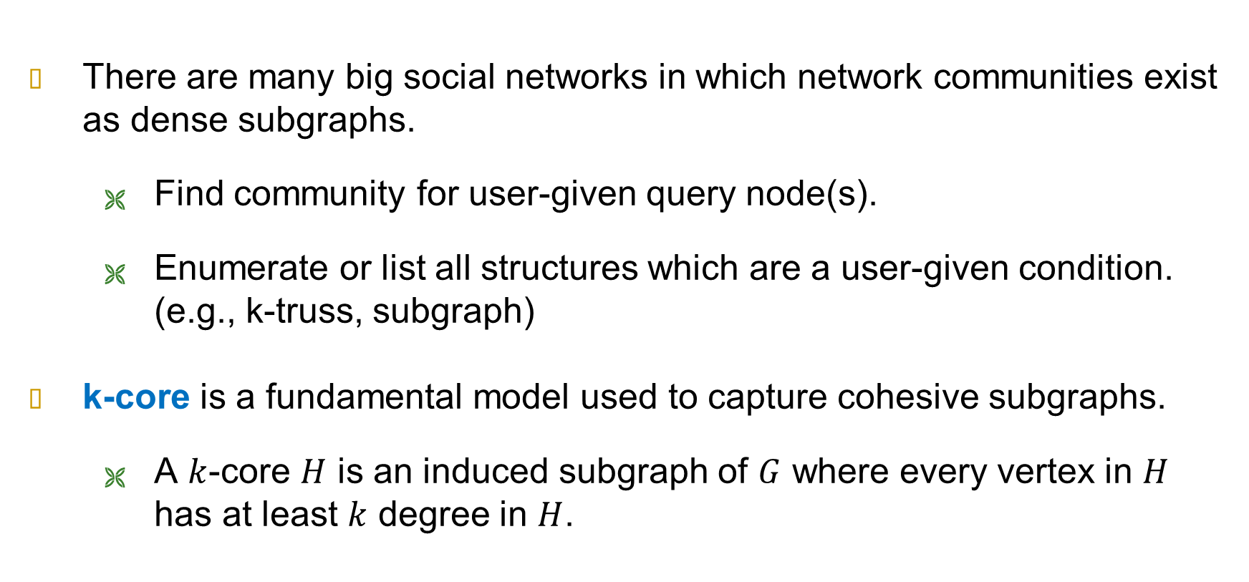
The Motivation
There are many big social networks in which network communities exist as dense subgraphs.
  Find community for user-given query node(s).
  Enumerate or list all structures which are a user-given condition. (e.g., k-truss, subgraph)
k-core is a fundamental model used to capture cohesive subgraphs.
  A $k$-core $H$ is an induced subgraph of $G$ where every vertex in $H$ has at least $k$ degree in $H$.

Slide 3
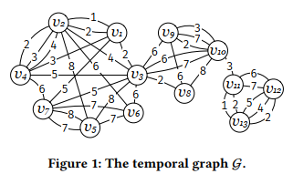
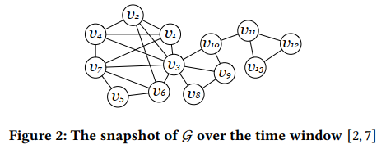
Temporal Graphs
There can be multiple edges between any two vertices, where each edge has a timestamp associated.
Graph snapshot: An induced subgraph where all edges fall within a defined time-window.

Slide 4
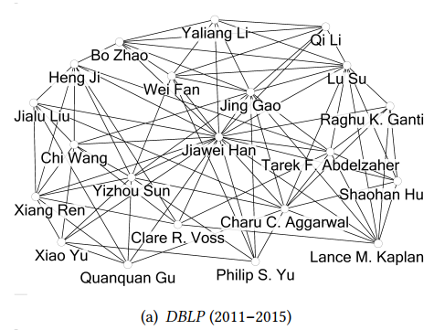

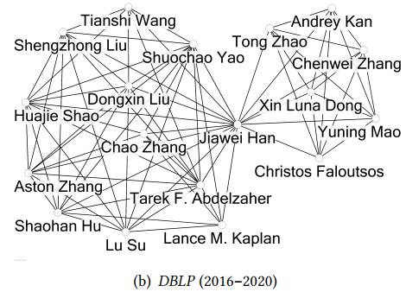
Historical K-Core Query
Given a time window [𝑡𝑠, 𝑡𝑒 ] and an integer 𝑘, find the 𝑘-core in the graph snapshot of the query time window.
It could be useful to analyze the evolution of k-cores memberships…

Slide 5
An Index-based Solution
A naïve online solution: Perform core decomposition for the graph snapshot.
  Given an integer 𝑘, all 𝑘-cores of a graph 𝐺 can be computed in 𝑂(𝑚) time where 𝑚 represents the number of edges in 𝐺.
  Disadvantage: cannot effectively query multiple snapshots.
We want to design an index-based solution to support the historical 𝑘-core query for every possible time window and integer 𝑘.

Slide 6
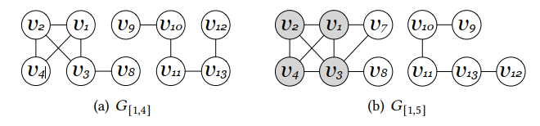
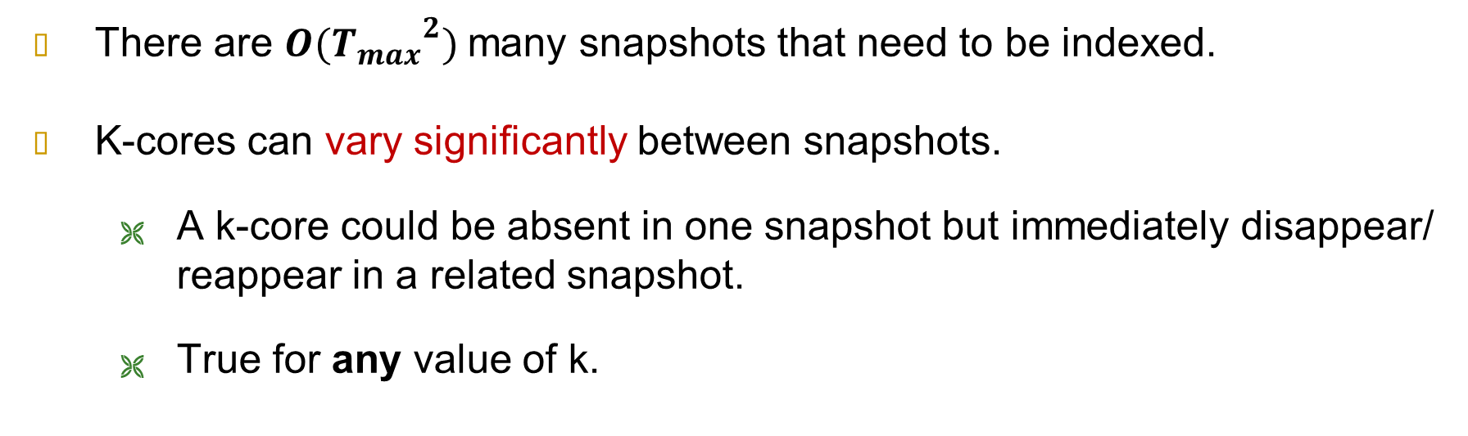
The Challenge
There are $O({T_{max}}^{2})$many snapshots that need to be indexed.
K-cores can vary significantly between snapshots.
  A k-core could be absent in one snapshot but immediately disappear/ reappear in a related snapshot.
  True for any value of k.

Slide 7
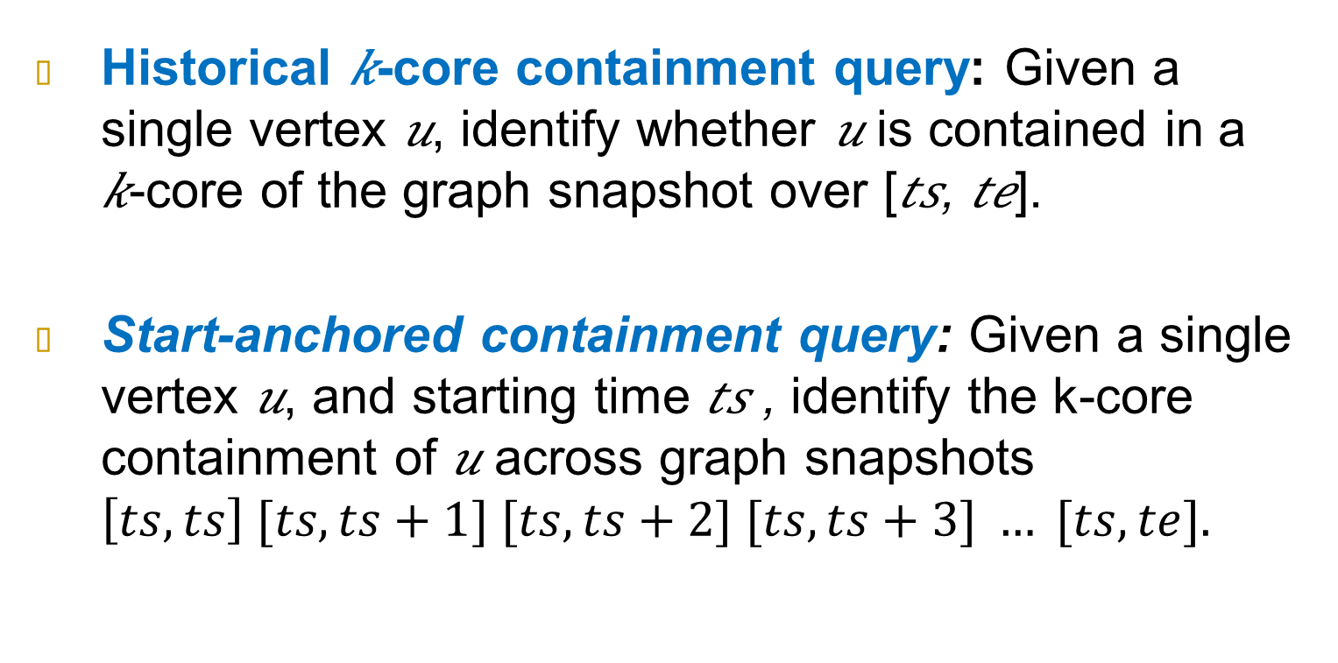
Two Historical Queries
Historical 𝑘-core containment query: Given a single vertex 𝑢, identify whether 𝑢 is contained in a
𝑘-core of the graph snapshot over [𝑡𝑠, 𝑡𝑒].
Start-anchored containment query: Given a single vertex 𝑢, and starting time 𝑡𝑠 , identify the k-core containment of 𝑢 across graph snapshots $\left[ts,ts\right] [ts, ts+1] [ts, ts+2] [ts, ts+3] … [ts, te].$

Slide 8

The Observation
For starting time anchored queries, core numbers only monotonically updates in 𝐺 [𝑡𝑠,$ti$ ] as $ti$increases from 𝑡𝑠 to 𝑡𝑚𝑎𝑥.
We define the Core Time based on the monotonically updating property
  The core time of 𝑢 for an integer 𝑘 and a start time 𝑡𝑠, is the smallest time 𝑡𝑒 such that 𝑢 is in a 𝑘-core of the graph snapshot 𝐺 [𝑡𝑠,𝑡𝑒 ].
Advantage: for a given vertex $u$, start time $ts$ and $k$, knowing the core time effectively solves the problem for all end times with start time $ts$ .

Slide 9
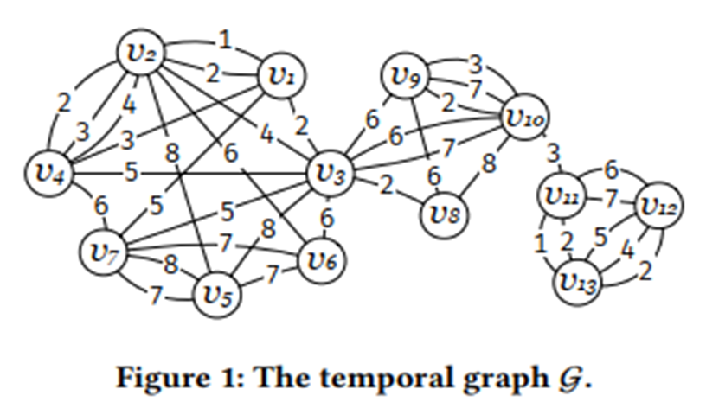
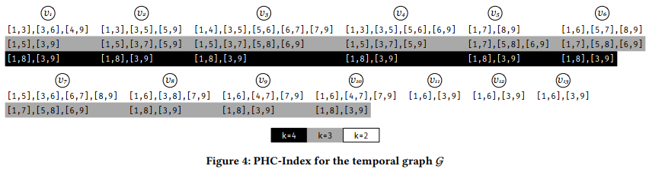
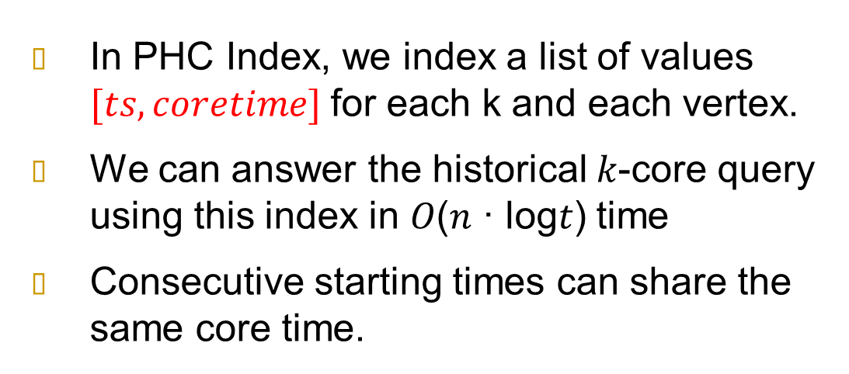
The PHC Index
In PHC Index, we index a list of values $[ts, coretime]$for each k and each vertex.
We can answer the historical 𝑘-core query using this index in 𝑂(𝑛 · log𝑡) time
Consecutive starting times can share the same core time.

Slide 10
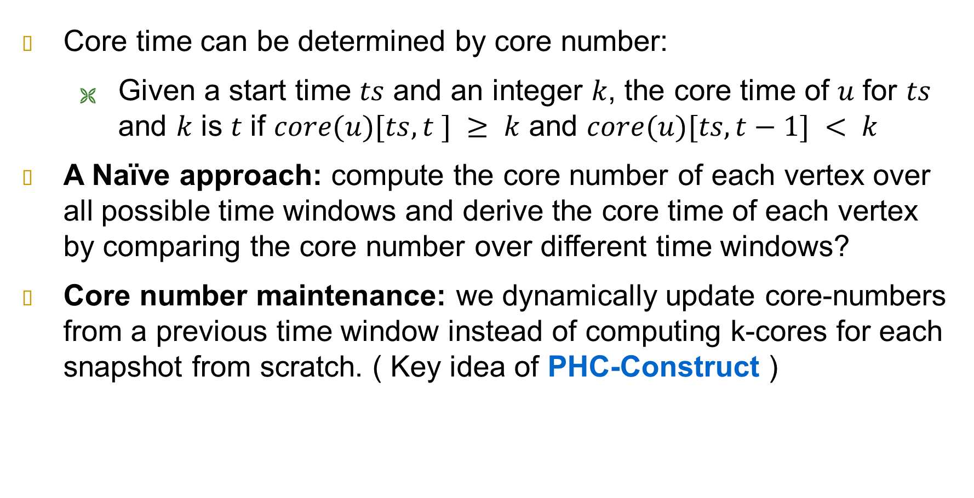
PHC-Index Construction
Core time can be determined by core number:
  Given a start time 𝑡𝑠 and an integer 𝑘, the core time of 𝑢 for 𝑡𝑠 and 𝑘 is 𝑡 if $core(u)[ts,t ] ≥ k$ and $core(u)[ts,t−1] < k$
A Naïve approach: compute the core number of each vertex over all possible time windows and derive the core time of each vertex by comparing the core number over different time windows?
Core number maintenance: we dynamically update core-numbers from a previous time window instead of computing k-cores for each snapshot from scratch. ( Key idea of PHC-Construct )

Slide 11
To Compute Core Times More Efficiently
PHC-Construct is not efficient enough because we still only compute start-anchored queries separately, for all possible snapshot start times.
  We observe that the core time of a vertex 𝑢 for a specific 𝑘 can be the same at different start times 𝑡𝑠, for a different start-anchored query.
We can use the core time computed from a previous start-anchored query. ( Key idea of PHC-Construct* )

Slide 12
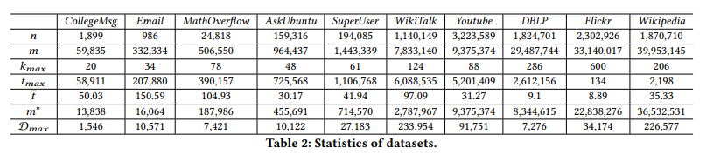
The Experiments

Slide 13
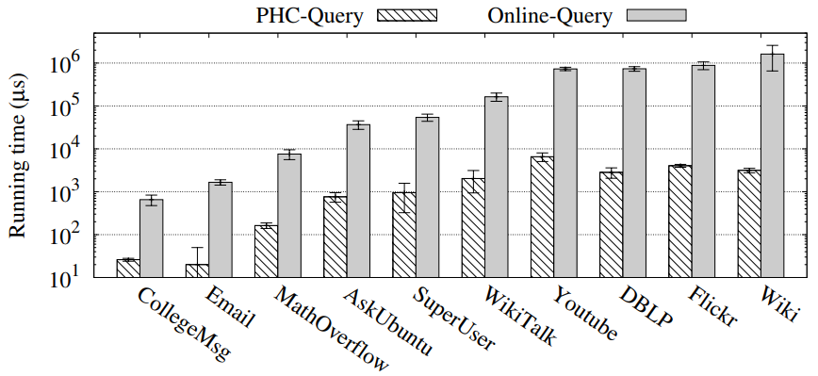
Query Processing Time
PHC-Query is at least one order of magnitude faster than Online-Query
PHC-Query is over two orders of magnitude faster in larger datasets than Online-Query.
For WikiTalk: PHC-Queries on average take an average 2ms for each query; Online-Queries on average take up to 165ms

Slide 14
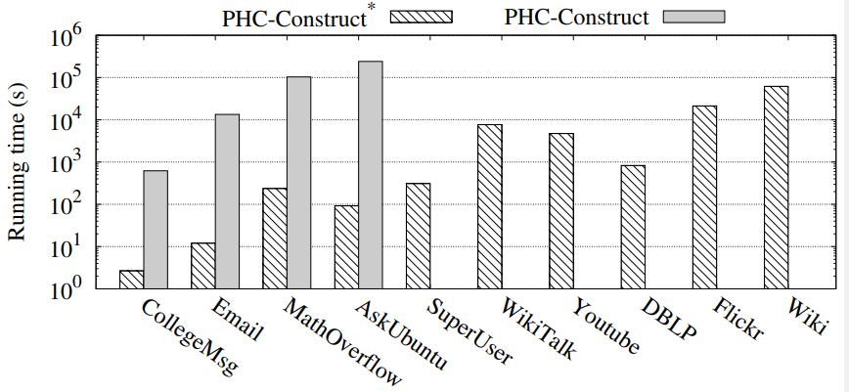
Index Construction Time
PHC-Construct∗ is several orders of magnitude faster than PHC-Construct
CollegeMsg: the PHC-Construct∗ takes about 2.5s, PHC-Construct takes up to 620s.
DBLP and WikiTalk: PHC-Construct∗ finishes in 14mins and in about 2hrs respectively

Slide 15
Conclusion
First systematic work for the problem of efficiently querying historical
𝑘-cores in a large temporal graph for every time window.
An index-based solution for historical 𝑘-core queries.
An elegant index structure whose size is bounded by 𝑂(𝑚∗ ·𝑡), where
𝑡 ≪ 𝑡𝑚𝑎𝑥 in practice.
An optimized index construction algorithm, where we propose a new
paradigm that compute and update the core time of each vertex.

