Slide 1
Efficient and Effective Community Search on Large-scale Bipartite Graphs
Kai Wang, Wenjie Zhang, Xuemin Lin,
Ying Zhang, Lu Qin, Yuting Zhang

Slide 2
Outline
Introduction
Solutions
Experiments
Conclusion

Slide 3
Introduction
A bipartite graph/network:
Andy
Kane
Eric
Taylor
Kate
Emma
Kelly
Alien
Avatar
A.I.
X-Men
Star Wars
Lover
Titanic
Notes:
When modelling relationships between two different types
of entities, the bipartite network arises naturally as a data
model in many real-world applications. For example,
in online shopping services (e.g., Amazon and Alibaba),
the purchase relationships between users and products can
be modelled as a bipartite network, where users form one
layer, products form the other layer, and the links between
users and productions represent purchase records. Other examples include author-paper relationships,actor-movie networks/

Slide 4
Introduction
(𝛼,𝛽)-core: Given a bipartite graph $G(\left(U,L\right),E)$ and degree constraints $α$and $β$, a subgraph $ℛ_{α,β}$ is the ($α$,$β$)-core of $G$ if
(1) $deg⁡(u,ℛ_{α,β})$ for each $u∈U(ℛ_{α,β})$ and $deg⁡(v,ℛ_{α,β})$ for each $v∈L(ℛ_{α,β})$;
(2) $R_{α,β}$ is maximal, i.e., any supergraph $G^{′}⊃ℛ_{α,β}$ is not an $\left(α,β\right)$-core.
Andy
Kane
Eric
Taylor
Kate
Emma
Kelly
(3, 2)-core
Alien
Avatar
A.I.
X-Men
Star Wars
Lover
Titanic
Notes:
Community structures naturally exist in bipartite networks. Given a query vertex $q$, {\em community search} aims to find communities (connected subgraphs) containing $q$ which satisfy specific cohesive constraints. On bipartite graphs, various dense subgraph models are designed (e.g., ($\alpha, \beta$)-core \cite{liu2019,ding2017efficient}, bitruss \cite{wang2020efficient,zou2016bitruss, sariyuce2018peeling} and biclique \cite{zhang2014finding}) which can be used as the cohesive measurement of a community. ($\alpha, \beta$)-core is a well-known cohesive subgraph model which imposes different degree constraints on different layers.

Slide 5
Introduction
(𝛼,𝛽)-community: Given a bipartite graph $G\left(\left(U,L\right),E\right),$degree constraints $α$and $β$ and a query vertex q, a subgraph $C_{α,β}(q)$ is the ($α$,$β$)-community of $G$ if
(1) $C_{α,β}\left(q\right)$ is connected, $C_{α,β}\left(q\right)⊆ℛ_{α,β}$ and $q⊆C_{α,β}\left(q\right)$;
(2) $C_{α,β}(q)$ is maximal, i.e., any supergraph $G^{′}⊃C_{α,β}(q)$ is not an $\left(α,β\right)$-community.
Andy
Kane
Eric
Taylor
Kate
Emma
Kelly
(3, 2)-core
Alien
Avatar
A.I.
X-Men
Star Wars
Lover
Titanic
Notes:
When modelling relationships between two dierent types
of entities, the bipartite network arises naturally as a data
model in many real-world applications. For example,
in online shopping services (e.g., Amazon and Alibaba),
the purchase relationships between users and products can
be modelled as a bipartite network, where users form one
layer, products form the other layer, and the links between
users and productions represent purchase records. Other examples include author-paper relationships,actor-movie networks/

Slide 6
Introduction
The (𝛼,𝛽)-core/community model overlooks the edge weight in forming the community. A weighted bipartite graph/network:
Andy
Kane
Eric
Taylor
Kate
Emma
Kelly
2
5
5
5
4
2
4
2
5
4
4
4
2
1
3
4
3
4
5
4
Alien
Avatar
A.I.
X-Men
Star Wars
Lover
Titanic
Notes:
However, simply applying these cohesive measurements only ensures the structure cohesiveness of communities but ignores another important characteristic, the weight (or significance) of interactions between the two sets of vertices. For example, ($\alpha, \beta$)-core is defined as the maximal subgraph where each vertex in upper layer has at least $\alpha$ neighbors and each vertex in lower layer has at least $\beta$ neighbors. In the customer-movie network shown in Figure \ref{fig:motivation}, each edge has a weight denoting the rating of a user to a movie. If the ($\alpha, \beta$)-core model is applied to search a community of ``Eric'', e.g., the maximal connected subgraph of (3, 2)-core containing ``Eric'', we will get the community formed by the four users and the five movies on the left side. Note that, this community includes ``Alien'' (not liked by ``Andy'' or ``Kane'') and ``Taylor'' (who has less interest in this genre of movies).

Slide 7
Introduction
Bipartite Graph Weight: the weight value of a bipartite graph $G$ denoted by $f(G)$ is defined as the minimum edge weight in $G$.
Significant $\left(α,β\right)$-community: Given a weighted bipartite graph $G$, degree constraints $α$, $β$ and query vertex $q$, a subgraph $ℛ$ is the significant $\left(α,β\right)$-community of $G$ if it satisfies the following constraints:
Connectivity Constraint.$ℛ$ is a connected subgraph which contains $q$;
Cohesiveness Constraint. Each vertex $u∈U(ℛ)$ satisfies $deg\left(u,ℛ\right)≥α$ and each vertex $v∈L(ℛ)$ satisfies $deg\left(v,ℛ\right)≥β$;
Maximality Constraint. There exists no other $G^{′}⊆C_{α,β}\left(q\right)$ satisfying constraints 1) and 2) with $f\left(G^{′}\right)>f(ℛ)$. In addition, there exists no other supergraph $G^{′′}⊃ℛ$satisfying constraints 1) and 2) with$f\left(G^{′′}\right)=f(ℛ$).
Andy
Kane
Eric
Taylor
Kate
Emma
Kelly
2
2
4
5
5
1
3
5
4
2
5
4
4
4
2
4
3
4
5
4
Alien
Avatar
A.I.
X-Men
Star Wars
Lover
Titanic
The subgraph in blue color, which excludes “Alien” and “Taylor”, is the significant (3, 2)-community of “Eric”.
Notes:
For example, in Figure 1, the subgraph in blue color, which excludes “Alien” and “Taylor”, is the significant (3, 2)-community of “Eric”.

Slide 8
Applications
Personalized recommendation on user-item networks.
Aladdin
Aladdin
Monsters
Monsters
Moonrise Kingdom
Moonrise Kingdom
Back to the Future
Back to the Future
Wedding Crashers
Mrs. Doubtfire
5
$4 –$ 4.5
SC
3 $–$ 3.5
$\left(α,β\right)$-core
$2$ $–$ 2.5
Notes:
In social media such as Facebook, there exist fraudulent users who give fake “like”s. Also, with the improvement of the fraud detection techniques, the cost of opening fake accounts is increased, thus frauds cannot rely on too many fake accounts [10]–[12]. Therefore, these malicious users tend to form a closely connected group. Although the size of the cluster of frauds is unknown, the output of bitruss decomposition applied on the bipartite network (e.g., user-page network) can reveal the close communities at different levels of granularity for further investigation.

Slide 9
Applications
Fraud detection in e-commerce platforms (i.e., social networks).
The edge weight can measure the number of purchases or the total transaction amount.
Since the cost of opening fake accounts is increased with the improvement of fraud detection techniques, frauds cannot rely on many fake accounts [1]. Thus, the number of purchases or the total transaction amount per account is increased. Additionally, fraudsters and the items they promote are prone to form cohesive subgraphs [2,3].
Given a suspicious item or customer as the query vertex, our model allows us to find the most suspicious fraudsters and related items in the customer-item bipartite graphs and reduce false positives.
(Adam)
(Mark)
(Shego)
(Taylor)
10
10
10
10
1
1
10
1
1
10
1
(Balm)
(Doll)
(Hat)
(Wine)
(Carpet)
A customer-item bipartite graph
Notes:
In social media such as Facebook, there exist fraudulent users who give fake “like”s. Also, with the improvement of the fraud detection techniques, the cost of opening fake accounts is increased, thus frauds cannot rely on too many fake accounts [10]–[12]. Therefore, these malicious users tend to form a closely connected group. Although the size of the cluster of frauds is unknown, the output of bitruss decomposition applied on the bipartite network (e.g., user-page network) can reveal the close communities at different levels of granularity for further investigation.

Slide 10
Related Works
Unipartite networks
- cohesive subgraph models: k-core [4], [5], k-truss [6], [7], clique [8], [9], …
Bipartite networks
- core-like models: (α, β)-core [2], [10], …
- truss-like model: k-bitruss/k-wing [11], [12], …
- clique-like models: biclique [13], …

Slide 11
Problem Definition
Given a weighted bipartite graph G, parameters $α$, $β$ and a query vertex $q$, the significant ($α$,$β$)-community search problem aims to find the significant ($α$,$β$)-community in G.
Example graph G, w(u, v) = 5 * u.id - v.id
The (2, 2)-community of u3 in G.
Naively, we can iteratively remove the vertices without enough neighbors and the edges with small weights from the original graph. However, when the graph size is large and there are many vertices and edges that need to be removed, this approach is inefficient.
Notes:
Consider the bipartite graph G in Figure 2(a). Figure 2(b) shows the (2,2)-community of u3.
In addition, the significant (2,2)-community of u3 is shown in Figure 2(b) (in red color)
which is formed by the edges (u3, v1), (u3, v2), (u4, v1) and (u4, v2)
To obtain the significant ($α$,$β$)-community, we can iteratively remove the vertices without enough neighbors
and the edges with small weights from the original graph. However, when the graph size is large and there are many
vertices and edges that need to be removed, this approach is inefficient. For example, Figure 2(a) shows the graph G with
2,003 edges. We need to remove 1,999 edges from G to get the significant (2, 2)-community of u3 with only 4 edges.

Slide 12
Problem Definition
Given a weighted bipartite graph G, parameters $α$, $β$ and a query vertex $q$, the significant ($α$,$β$)-community search problem aims to find the significant ($α$,$β$)-community in G.
Two-step framework:
Step 1: Obtain the ($α$,$β$)-community that containing $q$.
In [2], the authors propose the bi-core index which can obtain the vertex set of the (𝛼,𝛽)-core (i.e., $V$((𝛼,𝛽)-core)) in optimal time. However, to obtain $C_{α,β}\left(q\right)$ after having $V$((𝛼,𝛽)-core), we still need to traverse all the neighbors of each vertex in $C_{α,β}\left(q\right)$(starting from the query vertex) including those neighbors which are not in $C_{α,β}\left(q\right)$.
The (2, 2)-community of u3 in G.
Step 2: Identify the significant ($α$,$β$)-community from the ($α$,$β$)-community.
Notes:
Consider the bipartite graph G in Figure 2(a). Figure 2(b) shows the (2,2)-community of u3.
In addition, the significant (2,2)-community of u3 is shown in Figure 2(b) (in red color)
which is formed by the edges (u3, v1), (u3, v2), (u4, v1) and (u4, v2)
To obtain the significant ($α$,$β$)-community, we can iteratively remove the vertices without enough neighbors
and the edges with small weights from the original graph. However, when the graph size is large and there are many
vertices and edges that need to be removed, this approach is inefficient. For example, Figure 2(a) shows the graph G with
2,003 edges. We need to remove 1,999 edges from G to get the significant (2, 2)-community of u3 with only 4 edges.

Slide 13
Challenges
Challenge 1: How to build an index to cover all (𝛼,𝛽)-communities.
Challenge 2: How to bound the index size and the indexing time.
Challenge 3: How to efficiently obtain the significant (𝛼,𝛽)-community from the (𝛼,𝛽)-community of a query vertex.

Slide 14
Solutions
Challenge 1: How to build an index to cover all (𝛼,𝛽)-communities.
To conquer Challenge 1: we propose a novel index $I_{bs}$to support the retrieval of the (𝛼,𝛽)-community in optimal time.
Notes:
after retrieving the (𝛼,𝛽)-community $C_{α,β}(q)$, we first propose the peeling algorithm SCS-Peel which iteratively removes the edge with the minimal weight from $C_{α,β}(q)$ to obtain $R$. We also propose the expansion algorithm SCS-Expand which iteratively adds the edge with maximal weights into an empty graph until R is found.
$I_{bs}^{α }{ I}_{bs}^{β}$

Slide 15
Basic Index $I_{bs}$
Observation:
The model of (𝛼,𝛽)-core has a hierarchical property. In other words, $\left(α,β\right)$-core $⊆\left(α^{′},β′\right)$-core if $α≥α′$ and $β≥β′$. For instance, $(1,3)$-core $⊇\left(1,2\right)$-core $⊇\left(1,1\right)$-core.
Approach:
All the $\left(1,β\right)$-community with $β≥1$ can be organized hierarchically in the $(1, 1)$-core. For each vertex existing in $\left(1,1\right)$-core, we sort its neighbors according to the maximal $β$ value where they exist in the $(1,β)$-core (i.e., the $α$-offset) in non-increasing order. Then, when querying a $(1,β)$-community with $β≥1$, we only need to take the vertices and edges in this community using breath-first search.

Slide 16
Optimal retrieval of $C_{α,β}(q)$based on $I_{bs}$
Example: retrieve $(3,3)$-community of $u_{1}$
Traverse $I_{bs}^{α}\left[u_{1}\right]\left[3\right]$ to get all the neighbors with $α$-$offsets≥3$.
Visit index nodes $I_{bs}^{α}\left[v_{1}\right]\left[3\right]$, $I_{bs}^{α}\left[v_{2}\right]\left[3\right]$ and $I_{bs}^{α}\left[v_{3}\right]\left[3\right]$.
u1
$$α$$
1
2
3
4
999
v1
v2
v3
v4
v5
v999
v1
v2
v3
v4
v5
v999
$α$-offset
999
4
3
2
1
1
1
1
1
1
1
1
v1
v2
v3
v4
v5
v999
2
2
1
1
1
1
v1
v2
v3
v4
v5
v999
v1
v2
v3
v4
v5
v999
4
4
3
2
1
1
3
3
3
2
1
1
$$I_{bs}^{α}\left[u_{1}\right]$$
Observation: $I_{bs}$can be very large when high degree vertices exist in $U(G)/L(G)$.
Notes:
For example, $I_{bs}^{α}$ needs to store 999 copies of neighbors of u1 since u1 is contained in (999, 1)-core. The same issue occurs when stores v1’s neighbors.

Slide 17
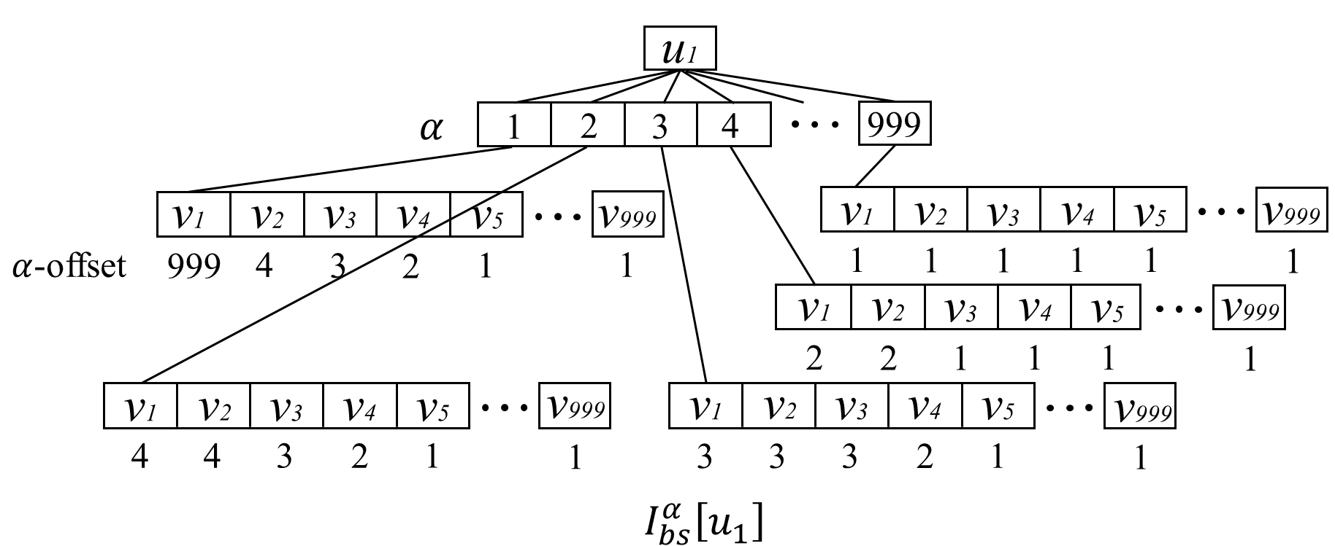
Basic Index $I_{bs}$
Time Complexity and Space Complexity:
We observe that $I_{bs}^{α}$($I_{bs}^{β}$) can be very large when high degree vertices exist in $U(G)$($L(G)$). For example, $I_{bs}^{α}$ needs to store $999$ copies of neighbors of $u_{1}$ since $u_{1}$ is contained in $(999, 1)$-core.
$I_{bs}^{α}:$
$I_{bs}^{β}$:

Slide 18
Solutions
Challenge 2: How to bound the index size and the indexing time..
To conquer Challenge 2: we propose the degeneracy-bounded index $I_{δ}$.
Notes:
after retrieving the (𝛼,𝛽)-community $C_{α,β}(q)$, we first propose the peeling algorithm SCS-Peel which iteratively removes the edge with the minimal weight from $C_{α,β}(q)$ to obtain $R$. We also propose the expansion algorithm SCS-Expand which iteratively adds the edge with maximal weights into an empty graph until R is found.
$I_{bs}^{α }{ I}_{bs}^{β}$

Slide 19
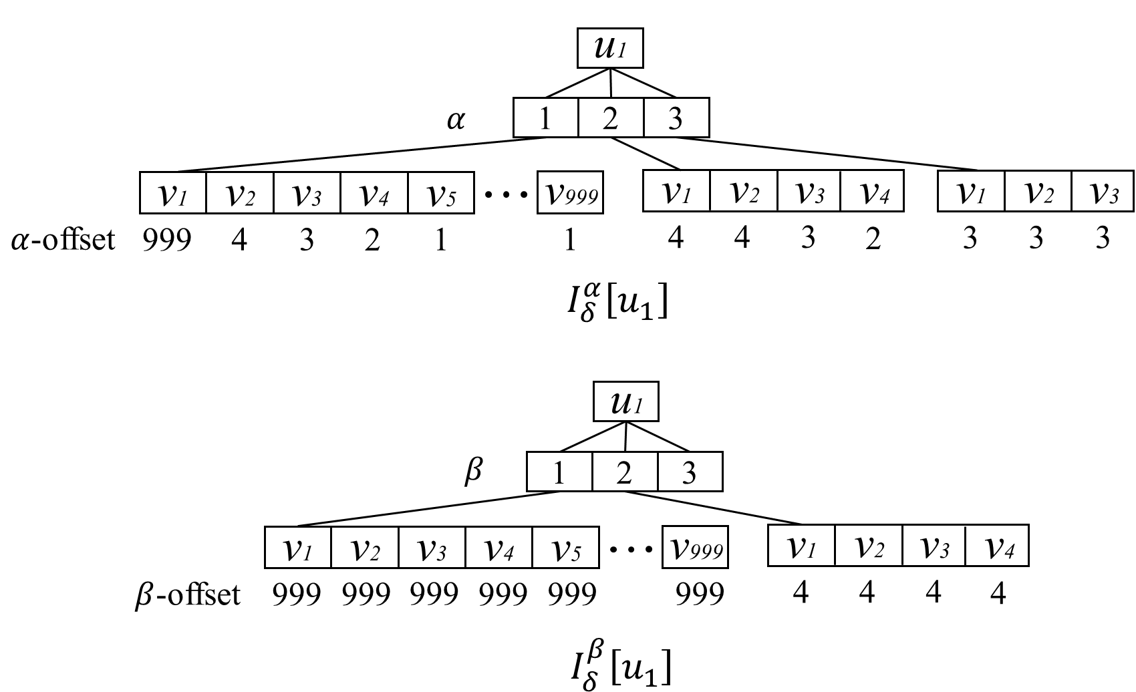
Degeneracy-bounded Index $I_{δ}$
Given a bipartite graph G, a nonempty (𝛼,𝛽)-core in $G$ must have $\min\left(α,β\right)≤δ. \text{Here}\text{, }\text{the} \text{degeneracy}δ \text{is} \text{the} \text{largest} \text{number} \text{where} \text{the} (δ\text{,}δ\text{)−}\text{core} \text{is} \text{nonempty} \text{in} \text{G}\text{.}$
All $\left(α,β\right)$-communities with $α≤β$ can be organized in the $\left(α,α\right)$-core and all $\left(α,β\right)$-communities with$β<α$ can be organized in the $\left(β,β\right)$-core. In this manner, $I_{δ}$ only needs to store all the $\left(τ,τ\right)$-cores for each $τ∈\left[1,δ\right]$ to cover all the $\left(α,β\right)$-communities. For example, unlike $I_{bs}^{α}$ which needs to store $\left(1,1\right)$-core to $(999, 1)$-core, $I_{δ}$ only needs to store $(1, 1)$-core, $(2, 2)$-core and $(3, 3)$-core since $δ=3$.

Slide 20
Optimal retrieval of $C_{α,β}$based on $I_{δ}$
If the query parameter $α≤δ$, we use $I_{δ}^{α}$ to support the query process. Otherwise, we go for $I_{δ}^{β}$.

Slide 21
Analysis of $I_{δ}$
Time Efficient:
Time complexity of constructing$I_{δ}$: $O\left(δ∙m\right)$.
Space Efficient:
Space complexity of $I_{δ}$: $O\left(\sum_{τ=1}^{δ}{(size(ℛ_{τ,τ})}\right)=O\left(δ∙m\right)$.
Remark: The indexing techniques can directly support finding the ($α$,$β$)-community on unweighted bipartite graph.

Slide 22
Solutions
Challenge 3: How to efficiently obtain the significant (𝛼,𝛽)-community from the (𝛼,𝛽)-community of a query vertex.
To conquer Challenge 3: after retrieving the (𝛼,𝛽)-community $C_{α,β}(q)$, we propose the peeling algorithm SCS-Peel and the expansion algorithm SCS-Expand to obtain $R$.
Notes:
after retrieving the (𝛼,𝛽)-community $C_{α,β}(q)$, we first propose the peeling algorithm SCS-Peel which iteratively removes the edge with the minimal weight from $C_{α,β}(q)$ to obtain $R$. We also propose the expansion algorithm SCS-Expand which iteratively adds the edge with maximal weights into an empty graph until R is found.
$I_{bs}^{α }{ I}_{bs}^{β}$

Slide 23
SCS-Peel
Query the $(2, 2)$-community of $u_{3}$.
u1
u2
u3
u4
6
19
1
9
14
4
3
8
12
18
2
7
13
v1
v2
v3
v4
Time Complexity :
Space Complexity :
Notes:
Retrieving $C_{α,β}(q)$ based on the index needs (size($C_{α,β}(q)$)) time. Peeling process
Retrieve $C_{α,β}(q)$ based on the indexes.
Sort the edges in $C_{α,β}(q)$ in non-decreasing order by weights.
Remove edge with the minimal weigh and remove the edges of vertices which not have enough degree.
Repeat step1-3 until $q$ does not satisfy the degree constrain.
Remove the vertices without enough degree and run BFS from $q$ to get the connected subgraph.

Slide 24
SCS-Expand
Initializes a subgraph $G^{∗}$ as empty.
Iteratively adds the edges with the maximal weight to $G^{∗}$ from $C_{α,β}(q)$, until$G^{∗}$ contains $ℛ$.
Checking the existence of R:
$αβ−α−β≤\left|E\left(C^{∗}\right)\right|−\left|U\left(C^{∗}\right)\right|−\left|L\left(C^{∗}\right)\right|$
Must contain $α$ vertices having $u∈{U(C}^{∗}), deg(u,C^{∗})≥β$, and $β$ vertices having $v∈{L(C}^{∗}), deg(v,C^{∗})≥α$. The query vertex should be one of these vertices.
Time Complexity :
Space Complexity :
Notes:
Union-find structure.
Continue adding edge until the size grows at least $ε$ times.

Slide 25
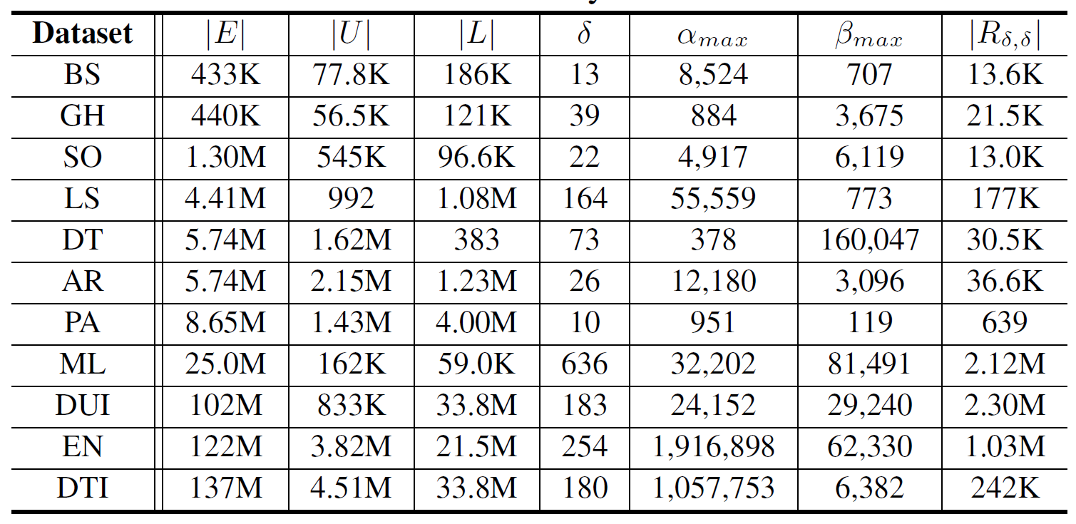
Experiments
Datasets
Algorithms: $Q_{o}$,${ Q}_{v}$,${ Q}_{opt}$, SCS-Baseline, SCS-Peel, SCS-Expand

Slide 26
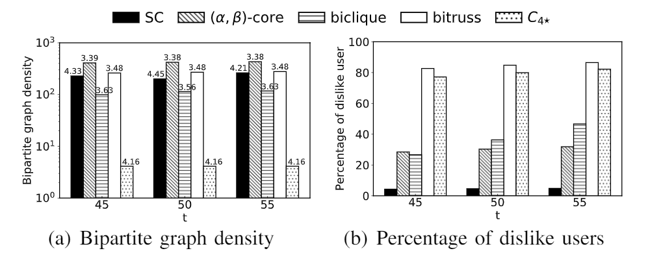
Performance Study
Evaluating the community quality, varying $\left(α,β\right)$= $\left(t,t\right)$

Slide 27
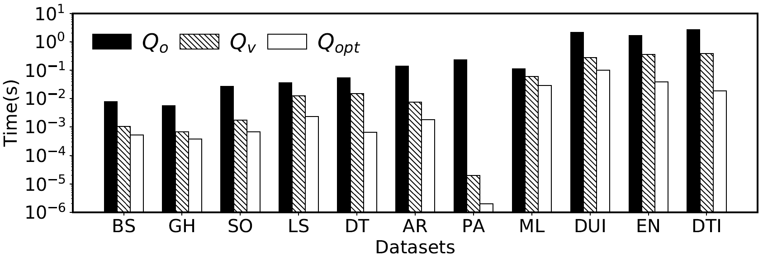
Performance Study
Retrieving the $\left(α,β\right)$-communities

Slide 28
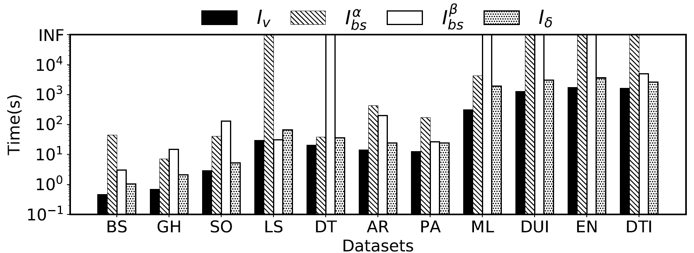
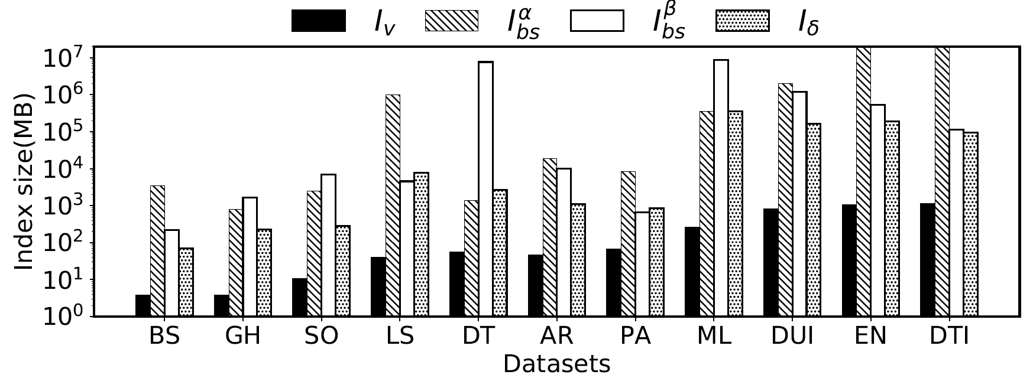
Performance Study
Index construction time
Index size

Slide 29
Performance Study
Query performance on different datasets

Slide 30
Conclusion
Propose the significant ($α$,$β$)-community model and solve the significant ($α$,$β$)-community search problem with a two-step framework.
Develop a novel index $I_{δ}$ to retrieve ($α$,$β$)-communities in optimal time.
To obtain the significant ($α$,$β$)-community, we propose efficient peeling and expansion algorithms.
We conduct extensive experiments on real bipartite graphs. The results demonstrate the effectiveness of the significant ($α$,$β$)-community model and the proposed techniques.

Slide 31
Thank You! Q&A
End

Slide 32
References
[1] A. Beutel, W. Xu, V. Guruswami, C. Palow, and C. Faloutsos, “Copycatch: stopping group attacks by spotting lockstep behavior in social networks,” in WWW. ACM, 2013, pp. 119–130.
[2] B. Liu, L. Yuan, X. Lin, L. Qin, W. Zhang, and J. Zhou, “Efficient ($α,β$)-core computation: An index-based approach,” in WWW. ACM, 2019, pp. 1130–1141.
[3] K. Wang, X. Lin, L. Qin, W. Zhang, and Y. Zhang, “Efficient bitruss decomposition for large-scale bipartite graphs,” in ICDE. IEEE, 2020, pp. 661–672.
[4] W. Cui, Y. Xiao, H. Wang, and W. Wang, “Local serach of communities in large graphs,” in SIGMOD, 2014, pp. 991–1002.
[5] M. Sozio and A. Gionis, “The community-search problem and how to plan a succesful cocktail party,” in SIGKDD, 2010, pp. 939–948.
[6] X. Huang, H. Cheng, L. Qin, W. Tian, and J. X. Yu, “Querying k-truss community in large and dynamic graphs,” in SIGMOD, 2014, pp. 1311–1322.
[7] X. Huang, L. V. S. Lakshmanan, J. X. Yu, and H. Cheng, “Approximate closest community search in networks,” PVLDB, vol. 9, no. 4, pp. 276– 287, 2015.
[8] L. Yuan, L. Qin, W. Zhang, L. Chang, and J. Yang, “Index-based densest clique percolation community search in networks,” TKDE, vol. 30, no. 5, pp. 922–935, 2017.
[9] Y. Fang, K. Yu, R. Cheng, L. V. S. Lakshmanan, and X. Lin, “Efficient algorithms for densest subgraph discovery,” PVLDB, vol. 12, no. 11, pp. 1719–1732, Jul. 2019.
[10] D. Ding, H. Li, Z. Huang, and N. Mamoulis, “Efficient fault-tolerant group recommendation using alpha-beta-core,” in CIKM, 2017, pp.
2047–2050.
[11] K. Wang, X. Lin, L. Qin, W. Zhang, and Y. Zhang, “Vertex priority based butterfly counting for large-scale bipartite networks,” PVLDB, vol. 12, no. 10, pp. 1139–1152, 2019.
[12] K. Wang, X. Lin, L. Qin, W. Zhang, and Y. Zhang, “Efficient bitruss decomposition for large-scale bipartite graphs,” in ICDE. IEEE, 2020, pp. 661–672.
[13] Y. Zhang, C. A. Phillips, G. L. Rogers, E. J. Baker, E. J. Chesler, and M. A. Langston, “On finding bicliques in bipartite graphs: a novel algorithm and its application to the integration of diverse biological data types,” BMC bioinformatics, vol. 15, no. 1, p. 110, 2014.

