Slide 1


DPTL+: Efficient Parallel Triangle Listing on Batch-Dynamic Graphs
Michael Yu¹, Lu Qin², Ying Zhang², Wenjie Zhang¹, Xuemin Lin¹
¹ University of New South Wales
² University of Technology Sydney

Slide 2
The Motivation
There are many big social networks in which network communities exist as dense subgraphs.
  Find community for user-given query node(s).
  Enumerate or list all structures which are a user-given condition.
  (e.g., k-core, k-truss, subgraph)
A triangle is a smallest dense subgraph with three vertices.
Subgraphs with more triangles are considered dense. This motives us to study fast triangle listing which is to list all triangles in a big graph.

Slide 3
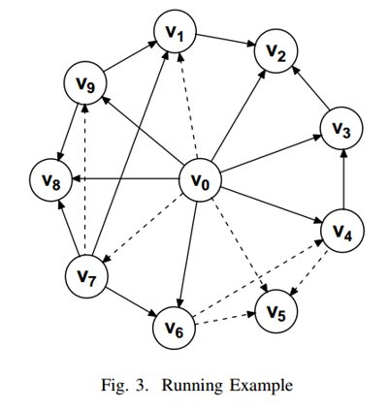
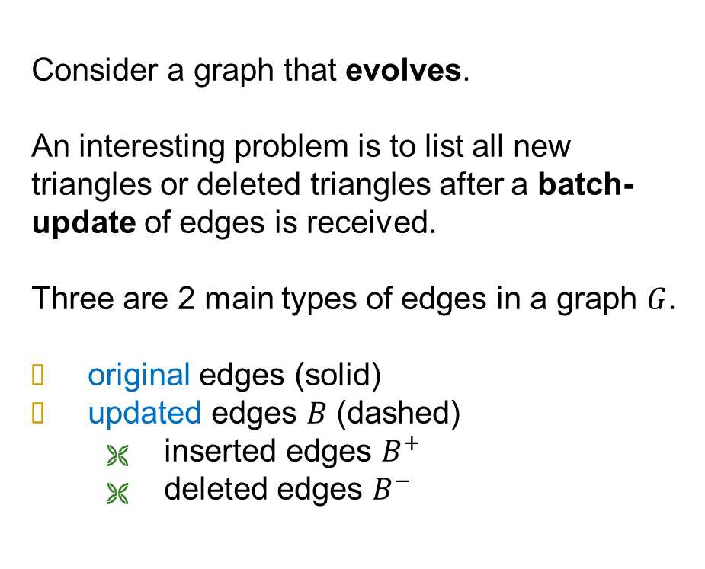
Batch-Update Graph
Consider a graph that evolves.
An interesting problem is to list all new triangles or deleted triangles after a batch-update of edges is received.
Three are 2 main types of edges in a graph $G$.
original edges (solid)
updated edges $B$ (dashed)
  inserted edges $B^{+}$
  deleted edges $B^{−}$

Slide 4
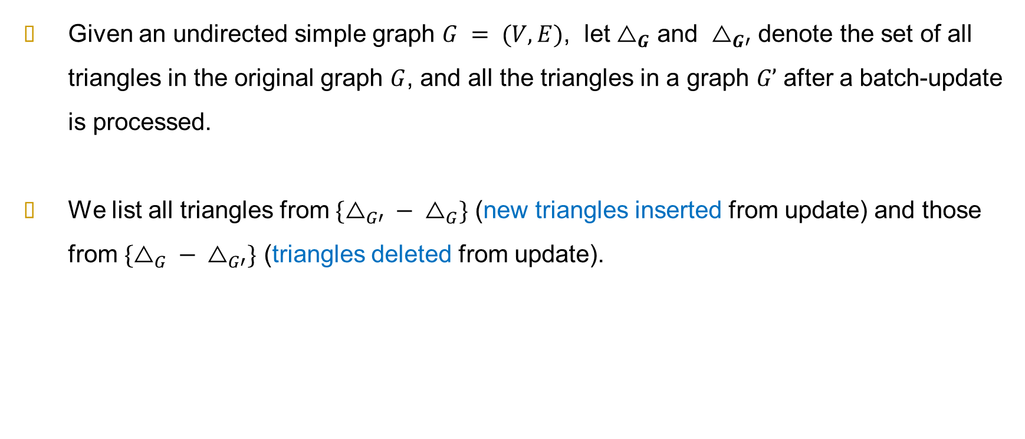
The Problem Statement
Given an undirected simple graph $G = (V,E)$, let $△_{G}$ and $△_{G′}$ denote the set of all triangles in the original graph $G$, and all the triangles in a graph $G’$ after a batch-update is processed.
We list all triangles from $\{{△_{G′} − △}_{G}\}$ (new triangles inserted from update) and those from $\{{△_{G} − △}_{G′}\}$ (triangles deleted from update).

Slide 5
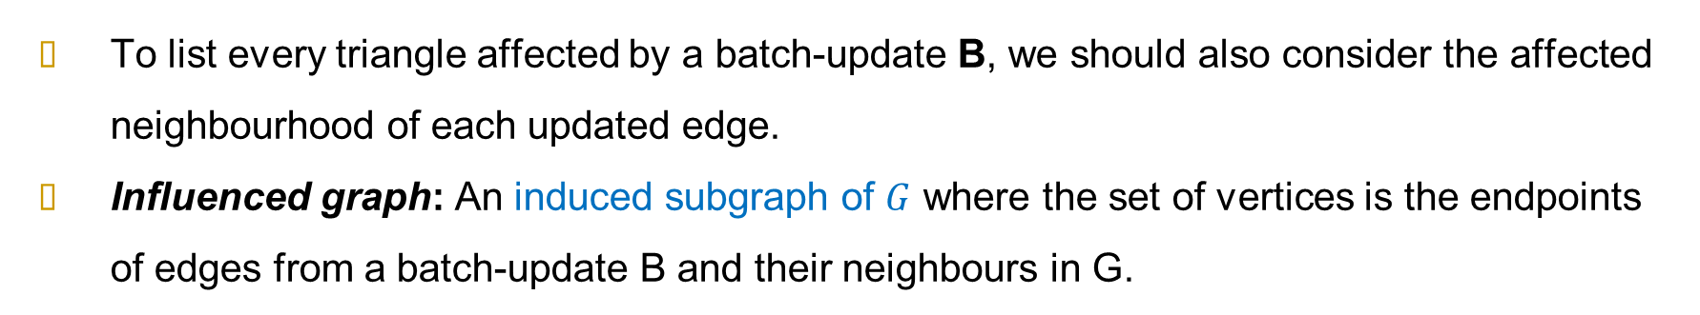
Influenced Graph
To list every triangle affected by a batch-update B, we should also consider the affected neighbourhood of each updated edge.
Influenced graph: An induced subgraph of $G$ where the set of vertices is the endpoints of edges from a batch-update B and their neighbours in G.

Slide 6
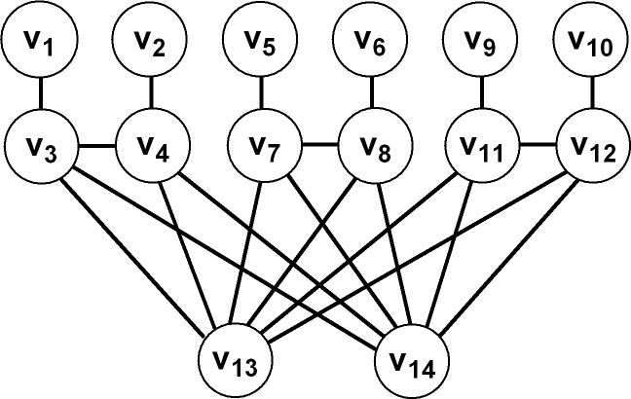
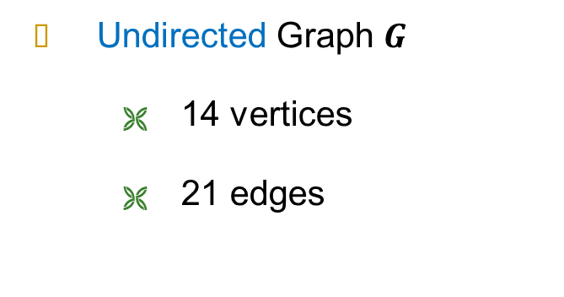
The Orientation Technique: An Example
Undirected Graph $G$
  14 vertices
  21 edges

Slide 7
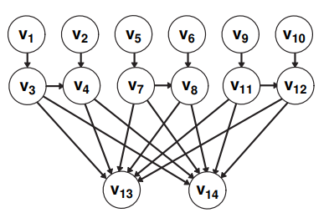
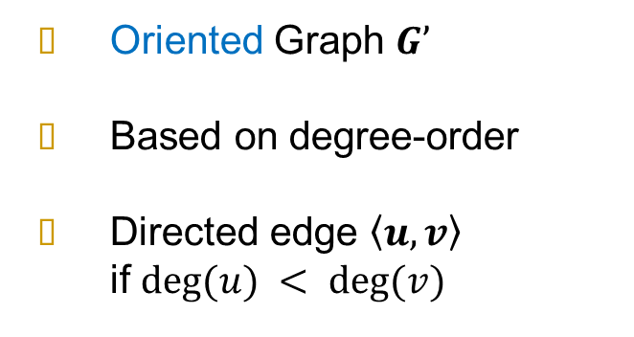
The Orientation Technique: An Example
Oriented Graph $G’$
Based on degree-order
Directed edge $\left\langle u,v\right\rangle$
if $deg⁡(u) < deg⁡(v)$

Slide 8
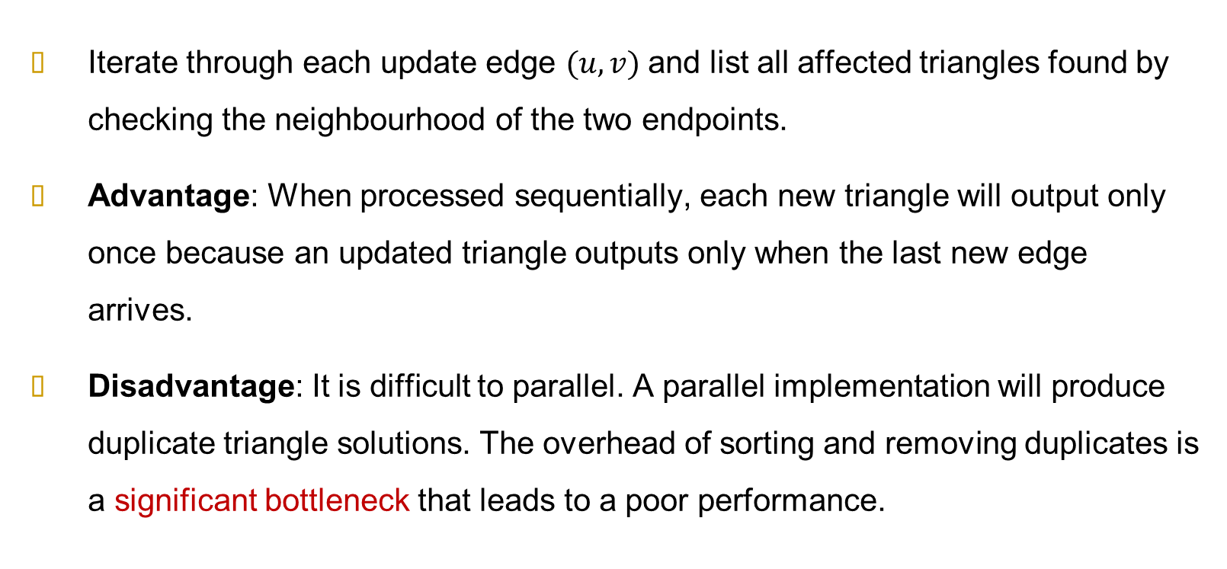
A Naïve Solution
Iterate through each update edge $(u, v)$and list all affected triangles found by checking the neighbourhood of the two endpoints.
Advantage: When processed sequentially, each new triangle will output only once because an updated triangle outputs only when the last new edge arrives.
Disadvantage: It is difficult to parallel. A parallel implementation will produce duplicate triangle solutions. The overhead of sorting and removing duplicates is a significant bottleneck that leads to a poor performance.

Slide 9
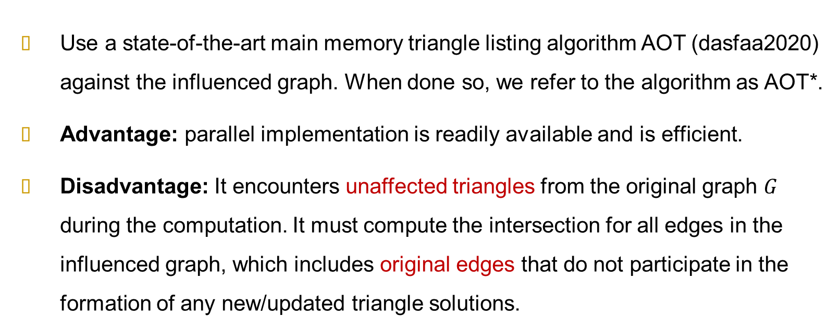
The AOT Algorithm
Use a state-of-the-art main memory triangle listing algorithm AOT (dasfaa2020) against the influenced graph. When done so, we refer to the algorithm as AOT*.
Advantage: parallel implementation is readily available and is efficient.
Disadvantage: It encounters unaffected triangles from the original graph $G$ during the computation. It must compute the intersection for all edges in the influenced graph, which includes original edges that do not participate in the formation of any new/updated triangle solutions.

Slide 10
The Key Issues
We need some techniques to achieve the following.
  List each updated triangle only once in parallel
  Only compute the intersection for updated edges in B exclusively.
The existing algorithms, with the orientation techniques developed, can achieve the first but cannot do well for the second.

Slide 11
Only Compute for the Updated Edges
AOT* uses the orientation technique.
  Lists triangle on the oriented graph
  There is only one type of edge (original)
  All triangles can be listed by iterating all edges and taking the intersection of just the out-neighbourhoods (since cyclic triangles are impossible)
  Solutions are complete, and non duplicating
Following this orientation method, we have iterate through all edges. Including original edges as well as updated edges. If we only iterate update edges, we will miss some updated-triangle solutions.

Slide 12
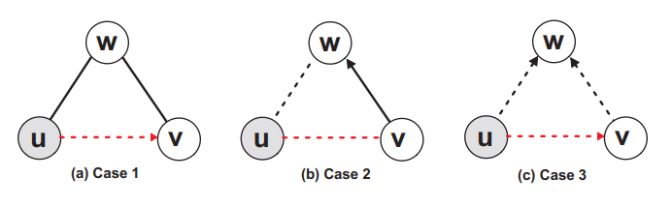
Dynamic Triangles Processing (1)
We define three triangle types that consider the combination of original and new edges: ∆1, ∆2, and ∆3, referring to updated triangles with one, two and three new edges, respectively.
Each triangle solution must belong to exactly one of the three. Note that the pivot edge is always an updated edge.
With the basic orientation technique, we list all triangles without duplicates in parallel.

Slide 13
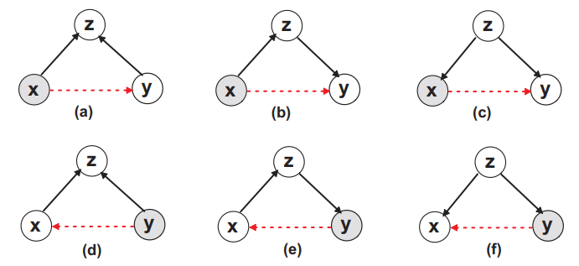
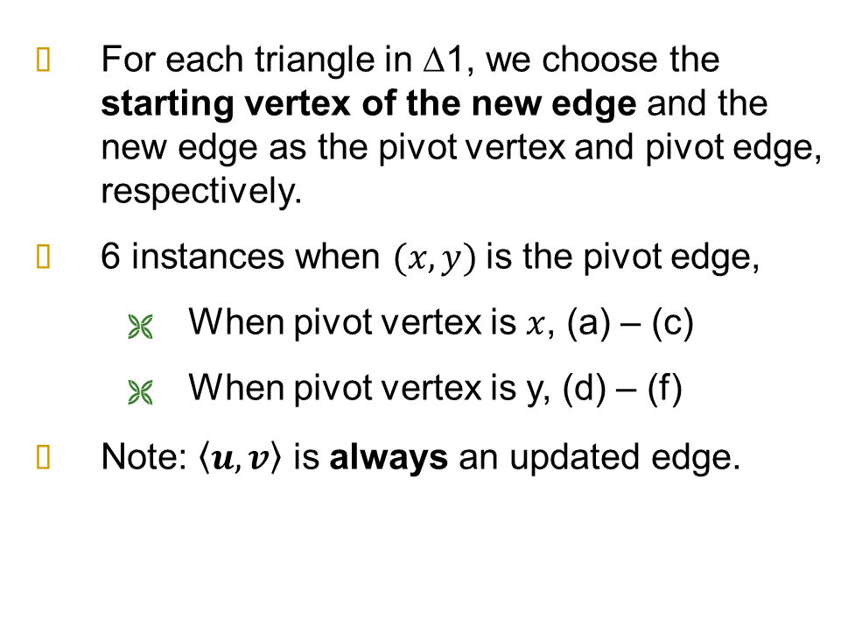
Dynamic Triangles Processing (2)
For each triangle in ∆1, we choose the starting vertex of the new edge and the new edge as the pivot vertex and pivot edge, respectively.
6 instances when $(x,y)$is the pivot edge,
  When pivot vertex is $x$, (a) – (c)
  When pivot vertex is y, (d) – (f)
Note: $\left\langle u,v\right\rangle$ is always an updated edge.

Slide 14
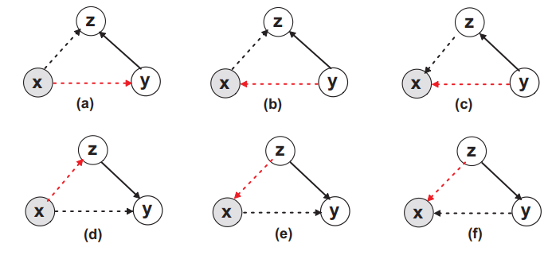
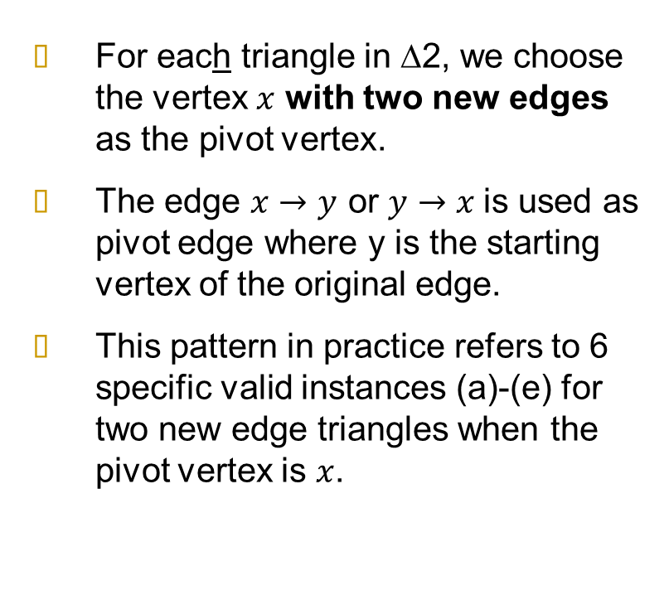
Dynamic Triangles Processing (3)
For each triangle in ∆2, we choose the vertex $x$ with two new edges as the pivot vertex.
The edge $x→y$ or $y→x$is used as pivot edge where y is the starting vertex of the original edge.
This pattern in practice refers to 6 specific valid instances (a)-(e) for two new edge triangles when the pivot vertex is $x$.

Slide 15
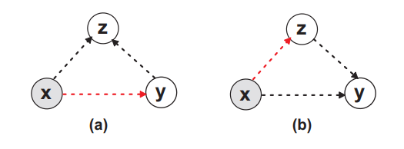
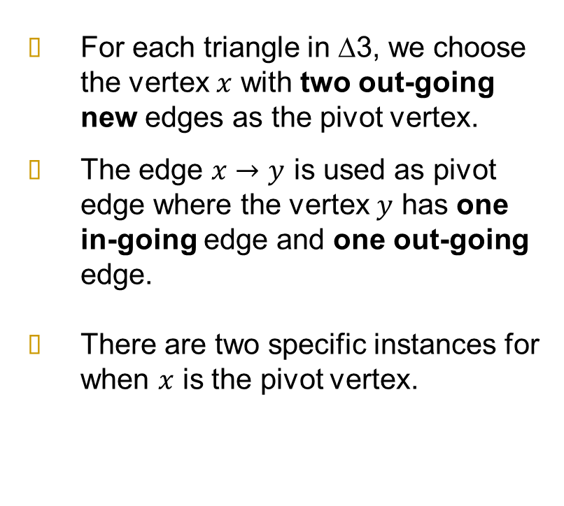
Dynamic Triangles Processing (4)
For each triangle in ∆3, we choose the vertex $x$ with two out-going new edges as the pivot vertex.
The edge $x→y$ is used as pivot edge where the vertex $y$ has one in-going edge and one out-going edge.
There are two specific instances for when $x$ is the pivot vertex.

Slide 16
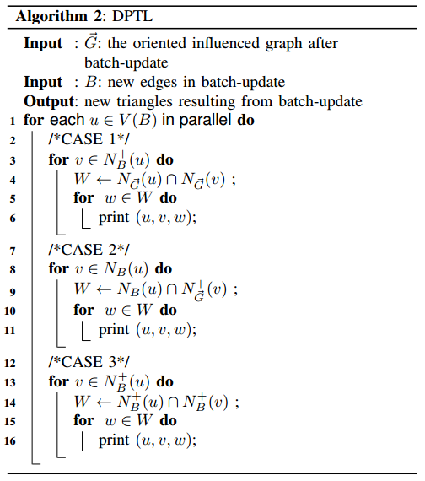
DPTL
We only need to iterate updated edges in B exclusively. The definitions make it possible to execute in parallel by processing different pivot edges per thread
There are 3 patterns that in total cover 42 cases for Pivot Edge and Pivot Vertex Assignment.
We can list all triangles by listing all the triangle cases in each pivot vertex.
DPTL solves the two issues and achieves a satisfactory solution for listing updated triangle.

Slide 17

Hashed-based Intersections
DPTL is not efficient enough.
  DPTL uses merge-sort to perform every set-intersection, which is a time complexity of Θ(max(deg(u), deg(v))) per edge
  This is the same as the Naïve method
Hashing methods exist for calculating intersection computation.
  Building a hash-table for each updated edge is not affordable
  Better to build a hash-table once per pivot vertex u, and process all pivot edges $u→v$ since, by using orientation technique, we already ensured that $deg⁡(u)≥deg⁡(v)$ for each edge $u→v$.
  In theory, we want to achieve Θ(min(deg(u); deg(v))) hash based intersection

Slide 18

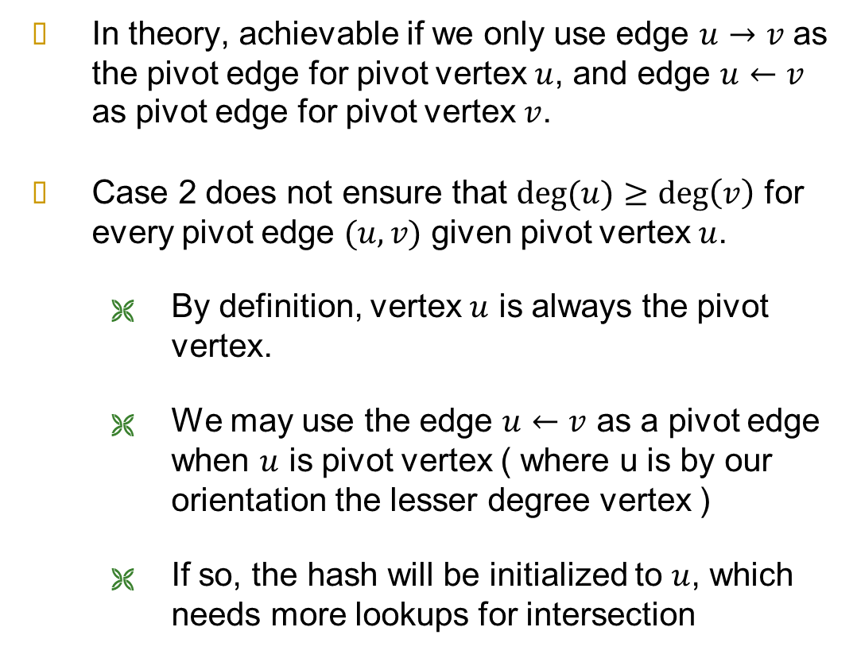
DTPL: Cannot Use Hashing (1)
In theory, achievable if we only use edge $u→v$ as the pivot edge for pivot vertex $u$, and edge $u←v$ as pivot edge for pivot vertex $v$.
Case 2 does not ensure that $deg⁡(u)≥\deg\left(v\right)$ for every pivot edge $(u, v)$ given pivot vertex $u$.
  By definition, vertex $u$ is always the pivot vertex.
  We may use the edge $u←v$ as a pivot edge when $u$ is pivot vertex ( where u is by our orientation the lesser degree vertex )
  If so, the hash will be initialized to $u$, which needs more lookups for intersection

Slide 19

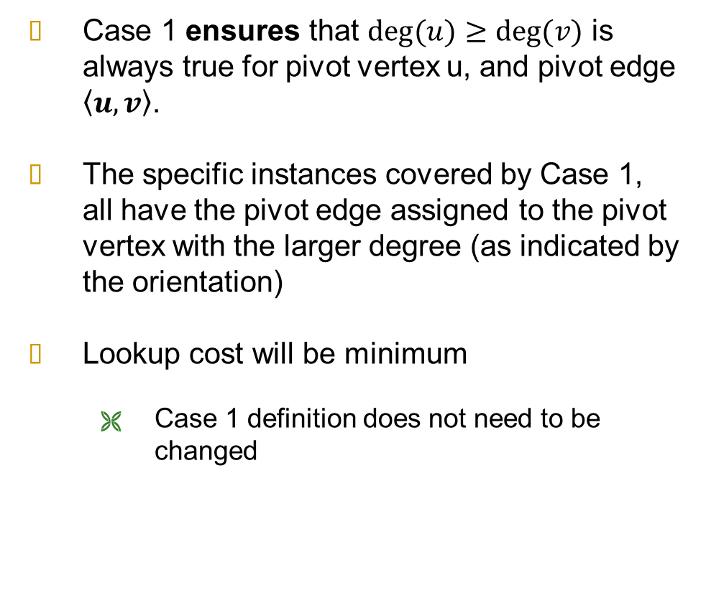
DTPL: Cannot Use Hashing (2)
Case 1 ensures that $deg⁡(u)≥deg⁡(v)$ is always true for pivot vertex u, and pivot edge $\left\langle u,v\right\rangle$.
The specific instances covered by Case 1, all have the pivot edge assigned to the pivot vertex with the larger degree (as indicated by the orientation)
Lookup cost will be minimum
  Case 1 definition does not need to be changed

Slide 20
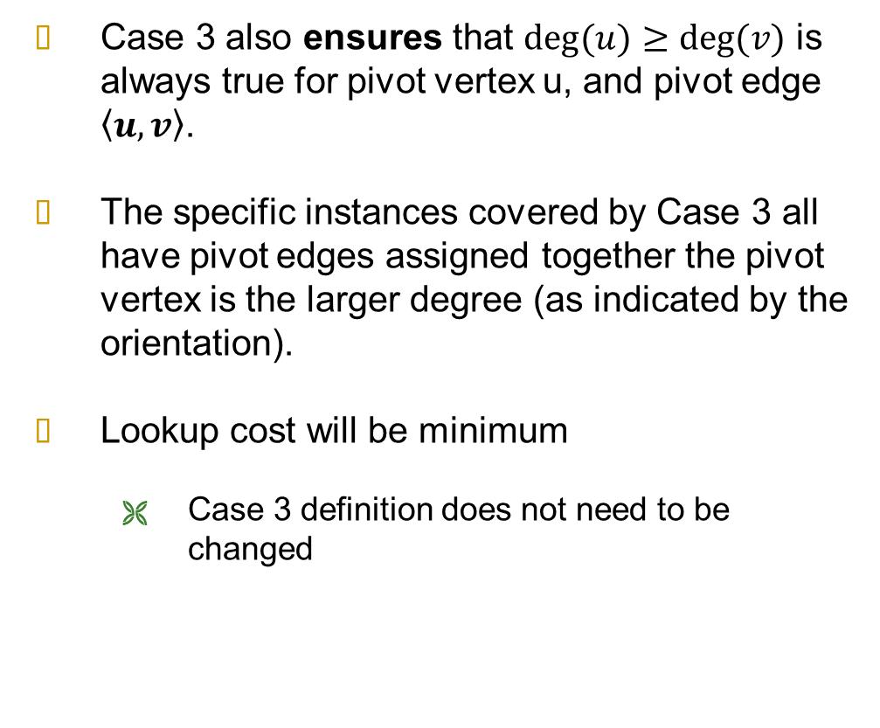
DTPL: Cannot Use Hashing (3)
Case 3 also ensures that $deg⁡(u)≥deg⁡(v)$ is always true for pivot vertex u, and pivot edge $\left\langle u,v\right\rangle$.
The specific instances covered by Case 3 all have pivot edges assigned together the pivot vertex is the larger degree (as indicated by the orientation).
Lookup cost will be minimum
  Case 3 definition does not need to be changed

Slide 21
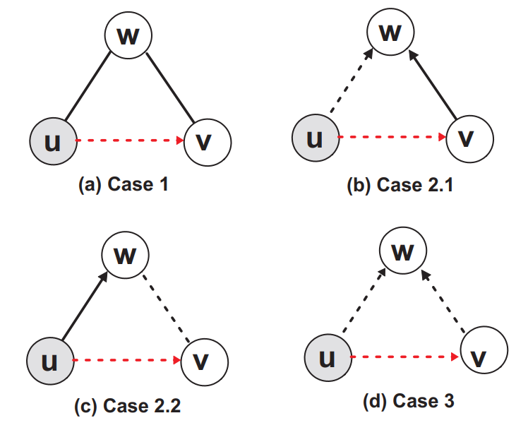
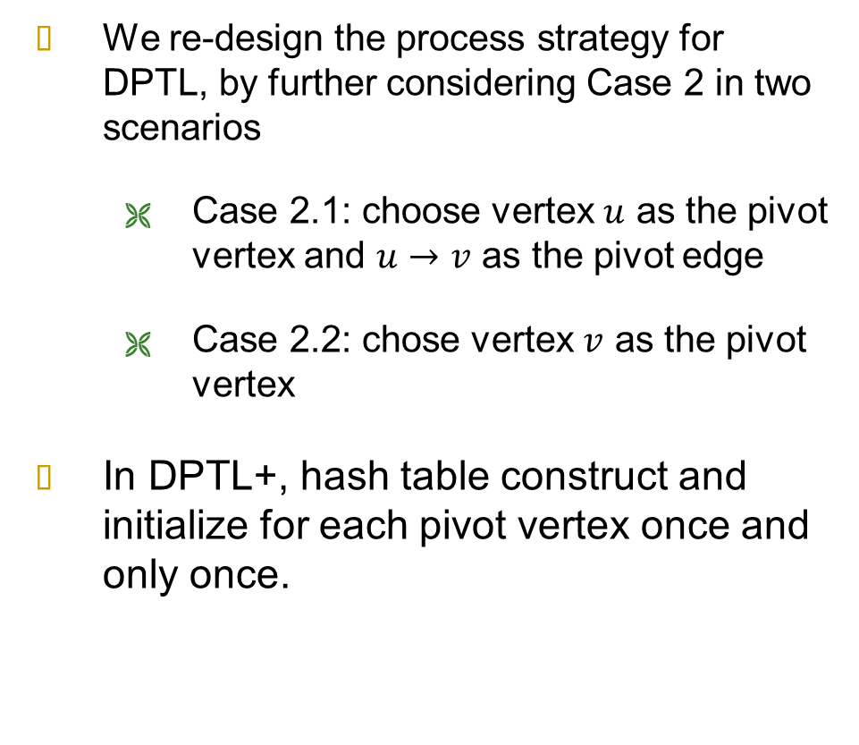
DPTL+
We re-design the process strategy for DPTL, by further considering Case 2 in two scenarios
  Case 2.1: choose vertex $u$ as the pivot vertex and $u→v$ as the pivot edge
  Case 2.2: chose vertex $v$ as the pivot vertex
In DPTL+, hash table construct and initialize for each pivot vertex once and only once.

Slide 22
The Experiments
28 real-world graphs
Baseline as comparator: Naive and AOT*
Our Algorithms: DPTL and DPTL+
Default batch size (4%) and number of threads (8).

Slide 23
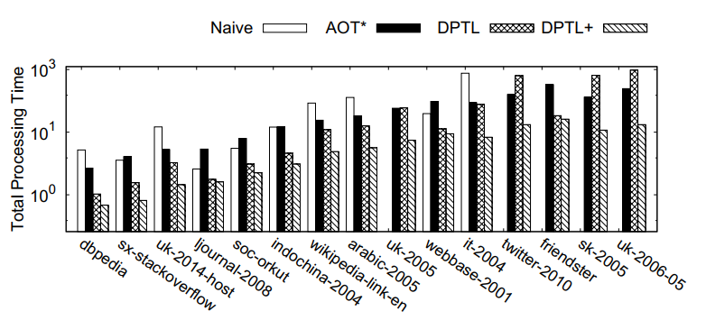
Results
DPTL+ algorithm performs consistently better than the three methods tested.
Compared with base design DPTL, addition of the hash-based technique does show an improvement.

Slide 24
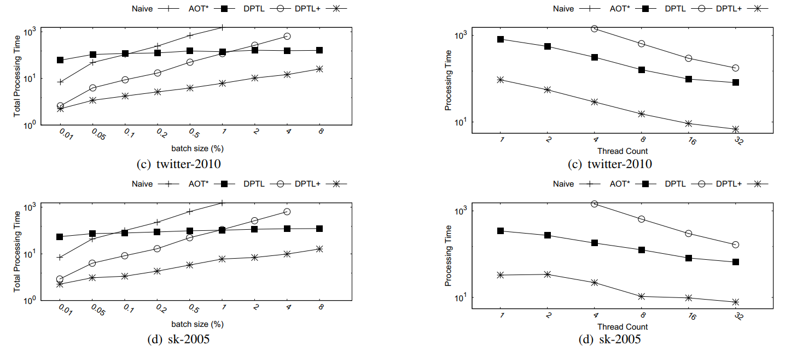
Results – Batch Size
Given a fixed 8-threaded execution, we measure the performance given batch sizes set between 0.01% to 8% of the graph being processed.
DPTL+ consistently outperforms other competitors under all settings.
Note: Where the update-batch size increases, the increase in edge counts of the influenced graph increases at a significantly lower rate.

Slide 25
Result – Parallel Capacity
Threads between 1 to 32 threads.
(Naive is not plotted because running-time exceeds an hour.)
The efficiency of DPTL+ remains significantly faster in comparison
For twitter-2010 and sk-2005, AOT* is faster than DPTL.

Slide 26
Conclusion
First systematic work for triangle listing on a batch-dynamic graph setting
Designed a new parallel triangle listing algorithm for batch-dynamic graphs
Improved our initial algorithm to consider the degree distribution of triangle pivot edges, and bound the computation with a good time complexity

Slide 27
End
This is the end of the presentation.
Thank you.

