Slide 1
Effective and Efficient Truss Computation over Large Heterogeneous Information Networks
Computer Science and Engineering
Speaker: Yixing Yang
Yixing Yang, Yixiang Fang, Wenjie Zhang, Xuemin Lin
The University of New South Wales

Slide 2
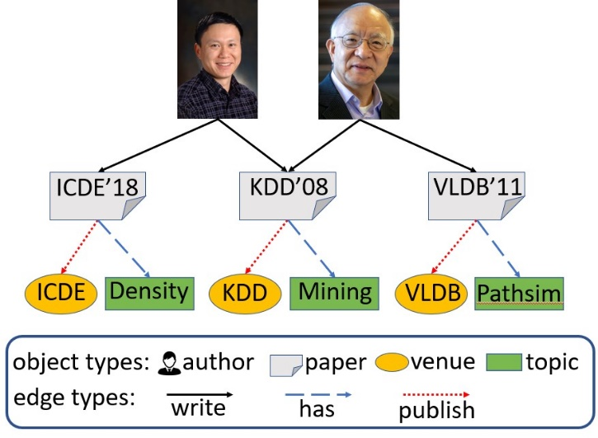
Heterogeneous Information Networks (HINs)
Traditional homogeneous information networks
All vertices are of the same type
All edges are of the same type
Facebook friendship network
Heterogeneous information networks
Vertices and edges have multiple types
Network schema
A simple DBLP network
A
$write$
P
$publish$
$has$
V
T
DBLP network schema

Slide 3
What is a truss?
The classic definition of truss
Given a homogenous network and an integer $k$, the $k$-truss is the largest subgraph s.t. each edge participates at lest ($k$-$2$) triangles
Used for cohesive subgraphs mining
Good balance between cohesiveness and computational complexity
Cohesiveness: vertices are densely connected via triangles
Computational complexity: it takes less than quadratic time cost to compute a k-truss
The initial graph
The 3-truss
The 4-truss

Slide 4
Related work
Truss computation
Truss decomposition
Truss based community search
I/O efficient truss computation
Cohesive subgraph computation over HIN
$k$-core computation over HIN
Clique computation over HIN
[1] J. Cohen, “Trusses: Cohesive subgraphs for social network analysis,” 2008.
[2] X. Huang, H. Cheng, L. Qin, W. Tian, and J. X. Yu, “Querying k-truss community in large and dynamic graphs,” SIGMOD 2014.
[3] X. Huang, L. V. S. Lakshmanan, J. X. Yu, and H. Cheng, “Approximate closest community search in networks,” PVLDB 2015.
[4] J. Wang and J. Cheng, “Truss decomposition in massive networks,” PVLDB 2012.
[5] J. Hu, R. Cheng, K. Chen, A. Sankar, Y. Fang and B. Y. H. Lam, “Discovering Maximal Motif Cliques in Large Heterogeneous Information Networks”, ICDE 2019
[6] Y. Fang, Y. Yang, W. Zhang, X. Lin and X. Cao “Effective and Efficient Community Search over Large Heterogeneous Information Networks”, PVLDB 2020

Slide 5
How to formulate a truss over an HIN?
What is a truss over an HIN?
A set of vertices with the same type
They are densely connected via “triangle”-based cohesiveness
Key challenges for formulating such a truss
Challenge 1: How to connect two vertices with the same type?
Vertices with the same type may not be directly connected
Challenge 2: How to connect three vertices to form a triangle?
Meta-path
Meta-triangle

Slide 6
Problem formulation
Meta-path
A path over network schema
A sequence of relationships between two vertex types
We focus on symmetrical meta-paths in this work
A
$write$
$write$
${write}^{−1}$
A
P
A
P
$publish$
$has$
V
$write$
$has$
${has}^{−1}$
${write}^{−1}$
T
A
P
T
P
A
DBLP network schema

Slide 7
Problem formulation
P-pair
Two vertices connected by an instance of P
E.g., ($a1$, $a2$) is a P-pair, where P=(APA)
P-graph
Vertex set: each vertex is with the end type of P
Edge set: each edge denotes a P-pair
E.g., the P-graph is shown in the right
$$t_{1}$$
$$v_{1}$$
$$p_{1}$$
$$p_{2}$$
$$p_{3}$$
$$p_{4}$$
$$p_{5}$$
$$a_{1}$$
$$a_{2}$$
$$a_{3}$$
$$a_{4}$$
$$a_{5}$$
$$a_{6}$$
A simple HIN
$write$
${write}^{−1}$
A
P
A
$$a_{3}$$
$$a_{5}$$
$$a_{1}$$
$$a_{4}$$
$$a_{2}$$
$$a_{6}$$
The P-graph

Slide 8
How do we define triangles in HINs?
Basic triangle, or b-triangle
Three vertices form a b-triangle, if each pair is connected by an instance of P
$$t_{1}$$
$$v_{1}$$
$$p_{1}$$
$$p_{2}$$
$$p_{3}$$
$$p_{4}$$
$$p_{5}$$
Circle triangle, or c-triangle
Three vertices form a c-triangle, if each pair is connected by an instance of P, and the three paths for a circle
Weak cohesiveness!
$$a_{1}$$
$$a_{2}$$
$$a_{3}$$
$$a_{4}$$
$$a_{5}$$
$$a_{6}$$
A simple HIN
$$p_{5}$$
$$a_{4}$$
$$a_{5}$$
$$a_{6}$$
A c-triangle is a b-triangle!
$(a_{4}, a_{5}, a_{6})$forms a b-triangle
Two types of supports for a P-pair
b-support: number of b-triangles containing the P-pair
c-support: number of c-triangles containing the P-pair
$$p_{2}$$
$$p_{3}$$
$$p_{4}$$
$$a_{2}$$
$$a_{3}$$
$$a_{4}$$
$(a_{2}, a_{3}, a_{4})$forms a c-triangle

Slide 9
How do we define truss over HINs?
$$t_{1}$$
$$v_{1}$$
($k$, P)-Btruss, or $k$-Btruss
Based on b-triangle
The largest set of P-pairs
Each P-pair has a b-support of $\left(k−2\right)$ or more
($k$, P)-Ctruss, or $k$-Ctruss
Based on c-triangle
The largest set of P-pairs
Each P-pair has a c-support of $\left(k−2\right)$or more
$$p_{1}$$
$$p_{2}$$
$$p_{3}$$
$$p_{4}$$
$$p_{5}$$
$$a_{1}$$
$$a_{2}$$
$$a_{3}$$
$$a_{4}$$
$$a_{5}$$
$$a_{6}$$
A simple HIN
$write$
${write}^{−1}$
A
P
A
$$a_{3}$$
$$a_{5}$$
$$a_{3}$$
$$a_{1}$$
$$a_{4}$$
$$a_{1}$$
$$a_{4}$$
$$a_{2}$$
$$a_{6}$$
$$a_{2}$$
The 3-Btruss
The 3-Ctruss
The k-Ctruss is contained by the k-Btruss

Slide 10
A straightforward Btruss algorithm: BasicBtruss
Main steps
Obtain the P-graph
Recursively remove P-pairs with b-support less than $(k−2)$
Why BasicBtruss is inefficient?
P-graph is extremely dense
Average degree of authors in DBLP: 2.86
Average degree of authors in (APTPA)-graph: 162.78

Slide 11
An advanced Btruss algorithm: FastBtruss
Prune P-pairs in the $k$-Btruss
P-star: detect star-shaped cliques
Prune P-pairs out of the $k$-Btruss
Vertex-pruning
Edge-pruning
$$t_{1}$$
$$v_{1}$$
$$p_{1}$$
$$p_{2}$$
$$p_{3}$$
$$p_{4}$$
$$p_{5}$$
$$a_{1}$$
$$a_{2}$$
$$a_{3}$$
$$a_{4}$$
$$a_{5}$$
$$a_{6}$$
Red edges depict a (APA)-star
$$a_{2}$$
$$a_{4}$$
$$a_{3}$$
$$a_{3}$$
$$a_{5}$$
$$a_{1}$$
$$a_{4}$$
$$a_{5}$$
$$a_{1}$$
$$a_{2}$$
Vertex-pruning
Edge-pruning

Slide 12
$k$-Ctruss computation
Key challenges
$k$-Ctruss can not be directly computed on P-graph
How to efficiently verify c-triangles?
How to efficiently use c-triangles verification algorithm?

Slide 13
$k$-Ctruss computation: verifying c-triangles
OneD-Verifier
Search the c-triangle in one direction
Behave like a DFS search
Complexity: $O\left(d^{2}\right)$
$$a_{1}$$
$$p_{1}$$
$$p_{3}$$
$$a_{2}$$
$$p_{2}$$
$$a_{3}$$
$$a_{1}$$
BiD-Verifier
Bi-Directionally search the c-triangle
Complexity: $O\left(d\right)$
$$p_{1}$$
$$p_{3}$$
$$a_{2}$$
$$p_{2}$$
$$a_{3}$$
BiD-Verifier can be generalized for longer meta-paths

Slide 14
A straightforward Ctruss algorithm: PeelCtruss
Main steps
Enumerate all the c-triangles and collect them in a set
Compute c-support for each P-pair
Recursively remove those P-pairs whose c-support are less than ($k−2$)
Enumerating all the c-triangles is very time consuming
Can we avoid enumerating all the c-triangles?

Slide 15
A progressive Ctruss algorithm: ProgCtruss
Intuition
We do not need to enumerate all the c-triangles
Progressively find more c-triangles for each P-pair
Main steps
For each P-pair, find up to $\left(k−2\right)$ c-triangles containing it
Remove P-pairs contained in less than $(k−2)$ c-triangles
Repeat the above steps until the $k$-Ctruss is obtained

Slide 16
Experiments
Datasets used in our experiments
Dataset | Vertices | Edges | Vertex types | Edge types | Meta-paths
Foursquare | 43,199 | 405,476 | 5 | 4 | 10
IMDB | 471,822 | 520,971 | 4 | 3 | 10
DBLP | 490,683 | 1,071,815 | 4 | 3 | 10
DBpedia | 8,970,120 | 31,216,862 | 414 | 673 | 100
Freebase | 29,119,948 | 105,559,649 | 984 | 1290 | 100
Parameter settings:
Default value of $k$: 5
A machine: Intel(R) Xeon(R) 2.7GHz, 64GB, Ubuntu installed

Slide 17
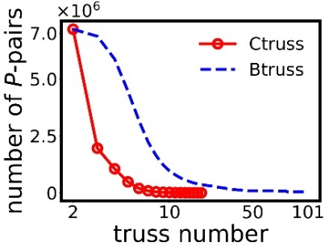
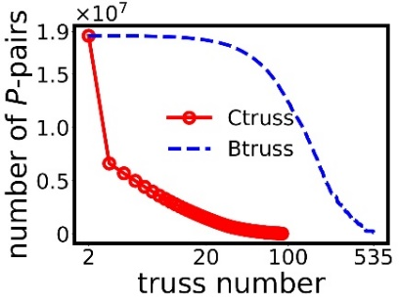
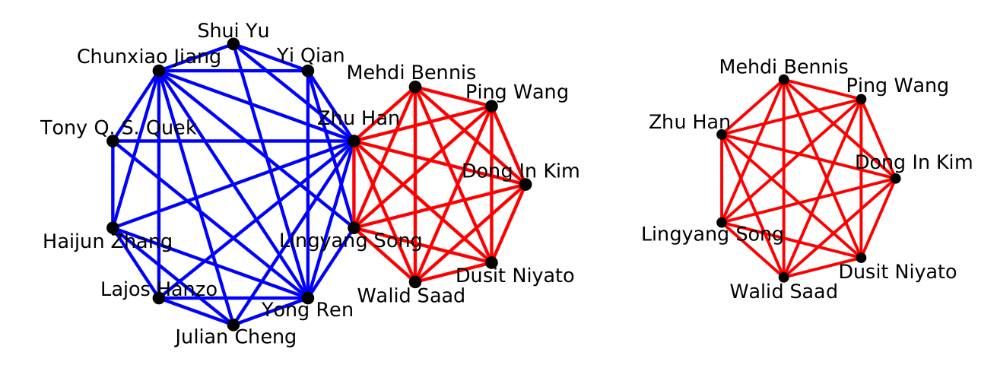
Effectiveness evaluation
Truss size evaluation
(a) P$1=(APA)$
(a) P$2=(APTPA)$
Truss size distributions
A case study of community search (Zhu Han)
(a) The community of 5-Btruss
(b) The community of 5-Ctruss

Slide 18
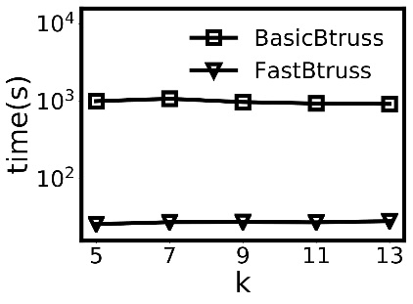
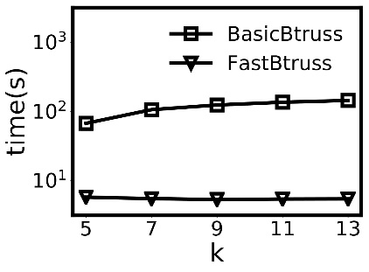
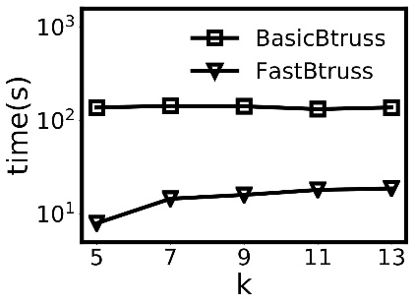
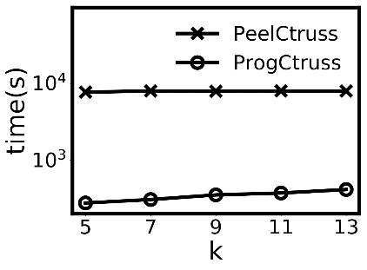
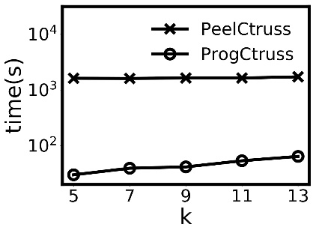
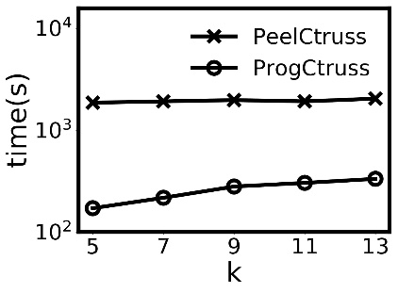
Efficiency evaluation
$k$-Btruss algorithms
30X
20X
10X
(a) DBLP
(b) IMDB
(c) Freebase
Efficiency results of k-Btruss computation algorithms
$k$-Ctruss algorithms
20X
50X
10X
(a) DBLP
(b) IMDB
(c) Freebase
Efficiency results of k-Ctruss computation algorithms

Slide 19
Conclusion and future work
Conclusions
We propose two truss models over HINs
We develop efficient algorithms for each truss model
We perform extensive experimental evaluation
Future work
We will develop efficient distributed algorithms
We will use our truss models in more real applications

Slide 20
Thank you!
Yixiang Yang: yixing.yang@student.unsw.edu.au

