Slide 1
Answering Billion-Scale Label-Constrained Reachability Queries within Microsecond
You Peng, Ying Zhang, Xuemin Lin, Lu Qin, Wenjie Zhang
The University of New South Wales
The University of Technology Sydney
Notes:
Good morning, everyone. My name is YouPeng. I am a postdoc researcher from the university of new south wales.
The title of my paper is “Answering Billion-Scale Label-Constrained Reachbility Queries within Microsecond”.
All the authors are from the university of new South Wales, and the university of Technology Sydney.

Slide 2
Outline of This Paper
Introduction
Problem Definition
Existing Works
Proposed Method
Experiment
Conclusion

Slide 3
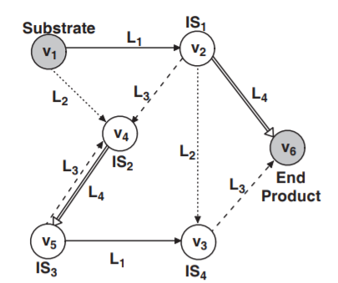
Introduction
Big graph data sets are ubiquitous
Social networks(e.g., Facebook, Twitter)
Knowledge graphs (e.g., DBPedia, MS Academic Graph)
Biological networks
We Focus on “things”(nodes or vertices) and their relationships (labeled directed edges.)

Slide 4
Problem Definition
Label-Constrained Reachability(LCR) Queries:
Given a graph G, a query pair(s, t) and label set, an LCR query is to ask whether a vertex s can reach another vertex t through only edges with the labels in set L.
Example:
A metabolic network, Label Constraints = {L1, L2, L3, L4}.
IS_{i} indicates the i_{th} intermediate substrate.
L_{i} indicates the i_{th} enzyme.
Query(v1,v6,{L1,L4}) = True
Query(V1,V5,{L3}) = False
LCR Queries
Natural generalization of reachability queries.
An important fragment of the language of regular path queries.
Implemented in W3C’s SPARQL 1.1, Neo4j’s Cypher, and Oracle’s PGQL

Slide 5
Existing Works
Two approaches: exhaustive search using state-of-the-art methods such as direction-optimizing BFS(DBFS)
Beamer et al. Scientific Programming 21, 2013
Or graph indexing for accelerated search:
Jin et al. SIGMOD 2010,
Bonchi et al. EDBT, 2014
Zou et al. Information Systems 40, 2014
Valstar et a., SIGMOD 2017. (LI+: the state-of-the-art)
Landmark Index(LI+):
Key idea: construct an index for partial landmarks by BFS from landmark.
Insert a new index entry: compare to the existing index entries and only keep the minimal one.
Answer an LCR-query: use pruned BFS which uses the landmarks index.
Extended index techniques: e.g. index non-landmarks, pruning for accelerating false-queries.

Slide 6
Our contributions
New indexing methods based 2-hop labeling framework to the well-studied LCR problem.
New Vertices orders and BFS search Orders are proposed to speed up the performance.
Scales to billion-scale graphs, where all the existing works could not address.
Up to orders of magnitude faster query evaluation, indexing time, and smaller indexing size than the state-of-the-art LI+ algorithm.

Slide 7
Proposed Method
2-hop cover framework
In labels(L_{in}) and out labels(L_{out}) for each vertex
Ideal Properties for 2-hop index
Soundness
Completeness
Minimal

Slide 8
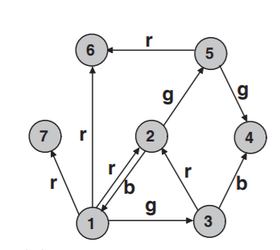
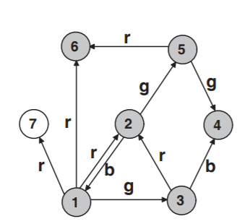
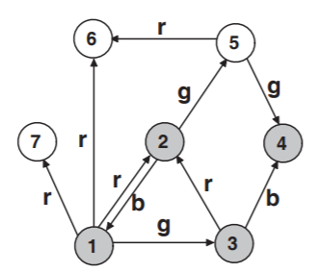
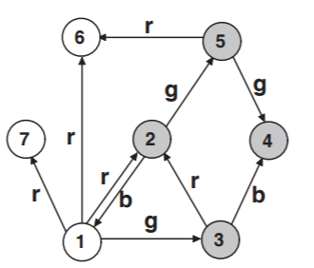
Proposed Method
P2H: pruned landmark
id | 1 | 2 | 3 | 4 | 5 | 6 | 7
L_{in} | -
L_{out} | - |  |  | - |  | - | -
(1,r)
(1,g)
(1,rg),1(gb),
(1,rg)
,(2,g)
(1,r)
,(2,rg)
(1,r)
(2,g)
,(3,b)
(5,r)
(1,b)
(1,rb)
(2,r)
(4,g)

Slide 9
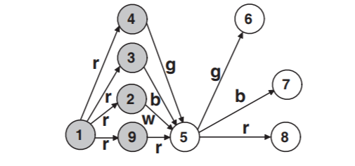
Proposed Method
P2H+: pruned landmark with minimal property
Minimal property: BFS Search order
Original BFS Order in distance order.
L_{in}[5] = {(1,r), (1,rg), (1,rb), (1,rw)}
L_{in}[6], L_{in}[7], L_{in}[8]…
BFS Order from in label size order.
L_{in}[5] = {(1,r)}
L_{in}[6] = {(1,rg)}
L_{in}[7] = {(1,rb)}
L_{in}[8] = {(1,r)}
Minimal Property

Slide 10
Proposed Method
Vertex Ordering Strategies:
Degree
Significant path
Dealing with large labels:
Primary Label Index
Secondary Label Index

Slide 11
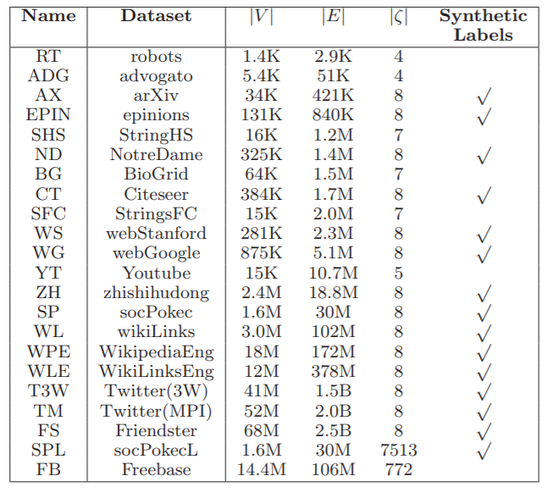
Experiment
Algorithms:
Billion-Scale Edges
Graphs with large labels

Slide 12
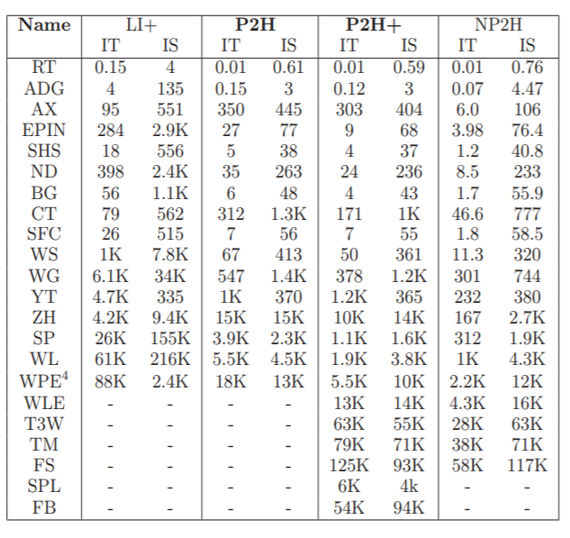
Performance
Algorithms:
LI+: The state-of-the-art landmark index-based
NP2H: Naïve One-label 2-hop index
P2H: proposed LC 2-hop index
P2H+: LC 2-hop index algorithm with advanced BFS Search Order and Vertex Order Strategy.
IT: Index Time(S)
IS: Index Size(MB)

Slide 13
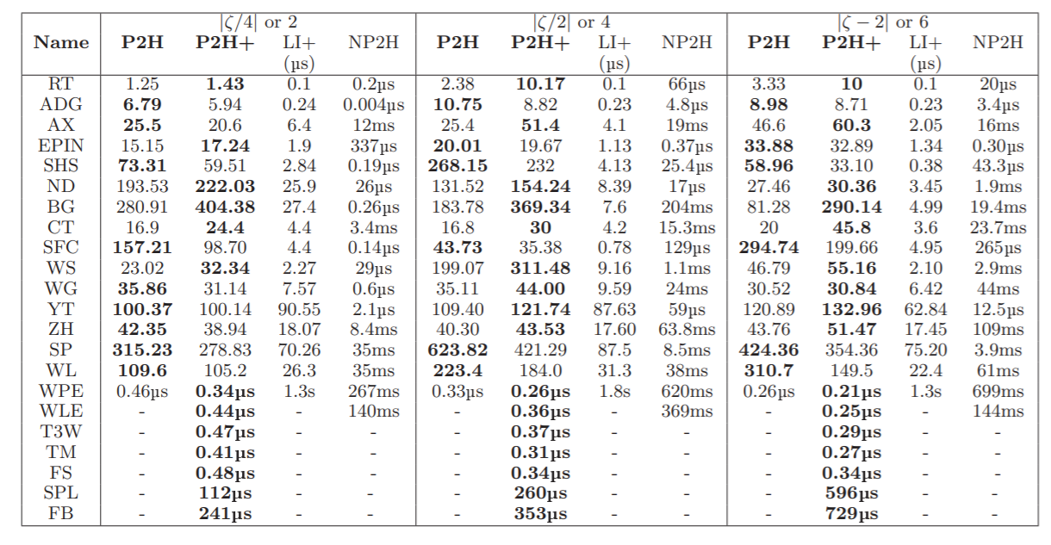
Performance
Query Time(speed-ups on LI+)

Slide 14
Conclusion and future work
Conclusion
We study the problem of LCR.
We propose 2-hop based algorithms
We develop advanced BFS search order and Vertex Order, which is the first work dealing with billion-scale LCR.
We have conducted an extensive experimental evaluation
Future work
Investigate the LCR problem on dynamic graphs.

