Slide 1
Efficient Bitruss Decomposition for Large-scale Bipartite Graphs
Kai Wang, Xuemin Lin, Lu Qin, Wenjie Zhang, Ying Zhang

Slide 2
Outline
Introduction
Solutions
Experiments
Conclusion

Slide 3
Introduction
A bipartite graph/network:
u0
u1
u2
u3
Papers
Authors
v0
v1
v2
v3
v4
Notes:
When modelling relationships between two dierent types
of entities, the bipartite network arises naturally as a data
model in many real-world applications. For example,
in online shopping services (e.g., Amazon and Alibaba),
the purchase relationships between users and products can
be modelled as a bipartite network, where users form one
layer, products form the other layer, and the links between
users and productions represent purchase records. Other examples include author-paper relationships,actor-movie networks/

Slide 4
Introduction
Butterfly: the smallest non-trivial biclique in a bipartite graph/network.
u0
u1
u2
u3
Papers
Authors
v0
v1
v2
v3
v4
Notes:
When modelling relationships between two dierent types
of entities, the bipartite network arises naturally as a data
model in many real-world applications. For example,
in online shopping services (e.g., Amazon and Alibaba),
the purchase relationships between users and products can
be modelled as a bipartite network, where users form one
layer, products form the other layer, and the links between
users and productions represent purchase records. Other examples include author-paper relationships,actor-movie networks/

Slide 5
Introduction
k-bitruss: the cohesive subgraph where each edge is contained in at least k number of butterflies. Consequently, the bitruss number of an edge e, denoted by φ_{e}, is defined as the largest k such that a k-bitruss contains e.
u0
u1
u2
u3
Papers
Authors
v0
v1
v2
v3
v4
Notes:
Since network motifs (i.e., repeated sub-graphs) are regarded
as basic building blocks of complex networks,
nding and counting motifs of networks is a key to network
analysis.

Slide 6
Introduction
Bitruss decomposition of the bipartite graph G is to compute the bitruss number for each edge in G.
u0
u1
u2
u3
Papers
φ_{e} = 2
φ_{e} = 1
φ_{e} = 0
Authors
v0
v1
v2
v3
v4
Notes:
Since network motifs (i.e., repeated sub-graphs) are regarded
as basic building blocks of complex networks,
nding and counting motifs of networks is a key to network
analysis.

Slide 7
Applications
The study of bitruss decomposition can be easily adopted in many applications:
Fraud detection on user-page networks (i.e., social networks).
Identifying nested research groups on author-paper networks.
Finding users/items at different similarity levels on user-item networks to support the construction of recommendation system.
Notes:
In social media such as Facebook, there exist fraudulent users who give fake “like”s. Also, with the improvement of the fraud detection techniques, the cost of opening fake accounts is increased, thus frauds cannot rely on too many fake accounts [10]–[12]. Therefore, these malicious users tend to form a closely connected group. Although the size of the cluster of frauds is unknown, the output of bitruss decomposition applied on the bipartite network (e.g., user-page network) can reveal the close communities at different levels of granularity for further investigation.

Slide 8
Related Works
Unipartite networks
- cohesive subgraph models: k-core [23, 24], k-truss [1, 2, 5], clique [6, 7],…
Bipartite networks
- truss-like model: k-bitruss/k-wing [3, 4], …
- core-like models: (α, β)-core [8], (p, q)- core [9], …
- clique-like models: (p, q)-biclique [10], quasi-biclique [11], …
[1] J. Cohen, “Trusses: Cohesive subgraphs for social network analysis,” National security agency technical report, vol. 16, pp. 3–1, 2008.
[2] J. Wang and J. Cheng, “Truss decomposition in massive networks,” PVLDB, 2012.
[3] A. E. Sarıyuce and A. Pinar, “Peeling bipartite networks for dense subgraph discovery,” in ACM WSDM, 2018, pp. 504–512..
[4] Z. Zou, “Bitruss decomposition of bipartite graphs,” in International Conference on Database Systems for Advanced Applications. Springer, 2016, pp. 218–233. [5] F. Zhang, C. Li, Y. Zhang, L. Qin, and W. Zhang, “Finding critical users in social communities: The collapsed core and truss problems,” IEEE TKDE, 2018. [6] R. D. Luce and A. D. Perry, “A method of matrix analysis of group structure,” Psychometrika, vol. 14, no. 2, pp. 95–116, 1949.
[7] Y. Fang, K. Yu, R. Cheng, L. V. S. Lakshmanan, and X. Lin, “Efficient algorithms for densest subgraph discovery,” PVLDB, 2019.
[8] B. Liu, L. Yuan, X. Lin, L. Qin, W. Zhang, and J. Zhou, “Efficient (α, β)-core computation: An index-based approach,” in WWW. ACM, 2019, pp. 1130–1141.
[9] M. Cerinsek and V. Batagelj, “Generalized two-mode cores,” Social Networks, vol. 42, pp. 80–87, 2015.
[10] M. Mitzenmacher, J. Pachocki, R. Peng, C. Tsourakakis, and S. C. Xu, “Scalable large near-clique detection in large-scale networks via sampling,” in SIGKDD.
[11] K. Sim, J. Li, V. Gopalkrishnan, and G. Liu, “Mining maximal quasi-bicliques: Novel algorithm and applications in the stock market and protein networks,”SADM.

Slide 9
State-of-the-art
BiT-BS [3]
Follows a two-step framework: step 1: counting process; step 2: peeling process.
Counting process: for each edge e, count the number of butterflies containing e – the butterfly support of e, denoted as e.
$$⋈$$
u0
u1
u2
u3
Papers
$$⋈$$
= 3
e
$$⋈$$
= 2
e
$$⋈$$
= 1
e
$$⋈$$
= 0
e
Authors
v0
v1
v2
v3
v4

Slide 10
State-of-the-art
BiT-BS [3]
$$⋈$$
$$⋈$$
Peeling process: iteratively removes the edge e with minimum and assigns the bitruss number of e as . When an edge e is removed, if e' shares butterflies with e and > , update .
e
e
$$⋈$$
$$⋈$$
$$⋈$$
e'
e
e'
u0
u1
u2
u3
Papers
$$⋈$$
= 3
e
$$⋈$$
= 2
e
$$⋈$$
= 1
e
$$⋈$$
= 0
e
Authors
v0
v1
v2
v3
v4

Slide 11
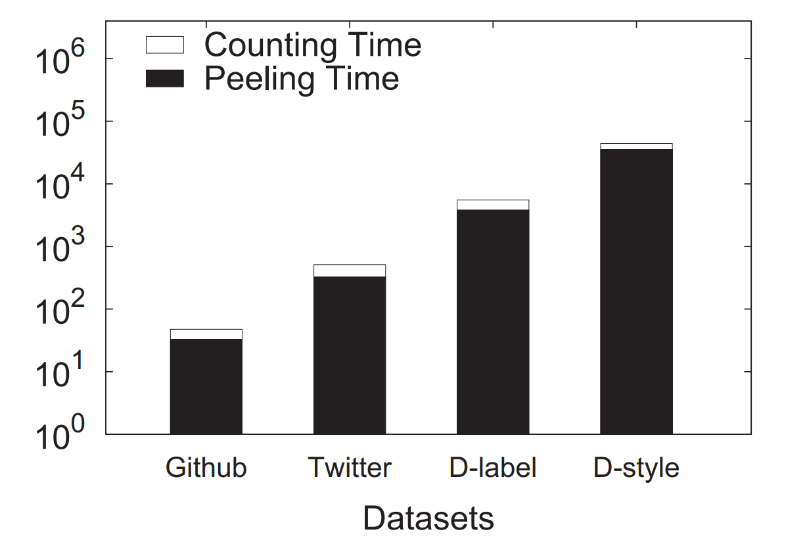
State-of-the-art
Analyse Performance Bottleneck of BiT-BS
Time cost of BiT-BS on different datasets
Time complexity of the counting process using the algorithm proposed in VLDB 2019*: O($\sum_{\text{(}\text{u}\text{,}\text{v}\text{)}\text{∈}\text{E}\text{(}\text{G}\text{)}}{\text{min}\text{\{}\text{deg}\text{(}\text{u}\text{)}\text{, }\text{deg}\text{(}\text{v}\text{)}\text{\}}}$)
Time complexity of the peeling process: O($\sum_{\text{(}\text{u}\text{,}\text{v}\text{)∈}\text{E}\text{(}\text{G}\text{)}\text{, }\text{w}\text{∈}\text{N}\text{(}\text{v}\text{)}}{\text{max}\text{\{}\text{d}\text{eg}\text{(}\text{u}\text{), }\text{d}\text{eg}\text{(}\text{w}\text{)\}}}$)
*Vertex priority based butterfly counting for large-scale bipartite networks, VLDB 2019.

Slide 12
State-of-the-art
Analyse performance bottleneck of the peeling process
When an edge e is removed, the butterfly supports of the edges which share butterflies with e need to be updated correspondingly. This edge removal operation needs to enumerate all the butterflies containing e.
u0
u1
u2
u1000
u1001
u2000
When edge (u1, v1) is removed, BiT-BS enumerates butterflies containing (u1, v1). In BiT-BS, it enumerates the combinations of four vertices with three edges first, then check whether there exists the fourth edge to form a butterfly. However, only one butterfly exists - [u0, v0, u1, v1].
U(G)
L(G)
v0
v1
v2
v1000
v1001
v2000

Slide 13
Challenges
When performing edge removal operations, it is a challenge to efficiently find those affected edges.
It is also a challenge to efficiently handle edges with high butterfly supports (i.e., hub edges).

Slide 14
Solutions
To conquer Challenge 1: we propose a novel online index - Bloom-Edge-Index and propose a bottom-up index-based algorithm BiT-BU.
To conquer Challenge 2: we propose the progressive compression approach BiT-PC.

Slide 15
BE-Index
A k-bloom is a (2, k)-biclique which contains exactly k*(k-1)/2 butterflies.
*
u0
u1
u2
u1000
u1001
u2000
B0
bloom
U(G)
L(G)
edges
v0
v1
v2
v1000
v1001
v2000
(u0,v0)
(u0,v1)
(u1,v0)
(u1,v1)
A bipartite graph and its BE-Index

Slide 16
BE-Index
Another example which shows that we can use bloom structure to compact the butterflies.
u0
u1
*
B0
v0
v1
v999
v1000
e0
e1
e2000
e2001
(a)
(b)
Another bipartite graph and its BE-Index

Slide 17
Analysis of BE-Index
Time Efficient:
Time complexity of constructing BE-Index: O($\sum_{\text{(}\text{u}\text{,}\text{v}\text{)}\text{∈}\text{E}\text{(}\text{G}\text{)}}{\text{min}\text{\{}\text{deg}\text{(}\text{u}\text{)}\text{, }\text{deg}\text{(}\text{v}\text{)}\text{\}}}$)
(same as the butterfly counting process)
Given a bipartite graph G and e ∈ G, performing an edge removal operation for e based on the BE-Index needs only O( ) time.
$$⋈$$
e
Space Efficient:
Space complexity of BE-Index: O($\sum_{\text{(}\text{u}\text{,}\text{v}\text{)}\text{∈}\text{E}\text{(}\text{G}\text{)}}{\text{min}\text{\{}\text{deg}\text{(}\text{u}\text{)}\text{, }\text{deg}\text{(}\text{v}\text{)}\text{\}}}$)
On Wiki-it with 601 billion butterflies, the BE-Index only need less than 4GB space.

Slide 18
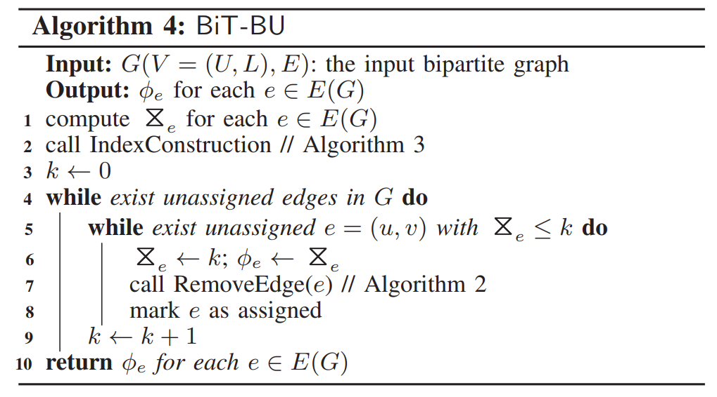
BiT-BU
Time complexity of BiT-BU: O($\sum_{\text{(}\text{u}\text{,}\text{v}\text{)}\text{∈}\text{E}\text{(}\text{G}\text{)}}{\text{min}\text{\{}\text{deg}\text{(}\text{u}\text{)}\text{, }\text{deg}\text{(}\text{v}\text{)}\text{\}}}+$)
$$⋈$$
(u,v)
Based on the BE-Index
BiT-BU is further enhanced with two batch-based optimizations:
Batch edge processing: processing the edges with minimum butterfly support in one iteration.
Batch bloom processing: processing the update requests of a same bloom in batch.

Slide 19
BiT-PC
Observation:
Some edges can have very high butterfly supports (i.e., hub edges), though their bitruss numbers are comparatively much smaller. For example, the maximum bitruss number for an edge is only 6,638 on the Delicious dataset, while its butterfly support reaches 1,219,319.
BiT-PC aims to reduce the number of butterfly support updates for hub edges based on the following Lemma.
kmax-bitruss
$${ G}_{≥\text{k}max}$$
$${ G}_{≥\text{k}max−1}$$
$${ G}_{≥0}$$
…

Slide 20
BiT-PC

Slide 21
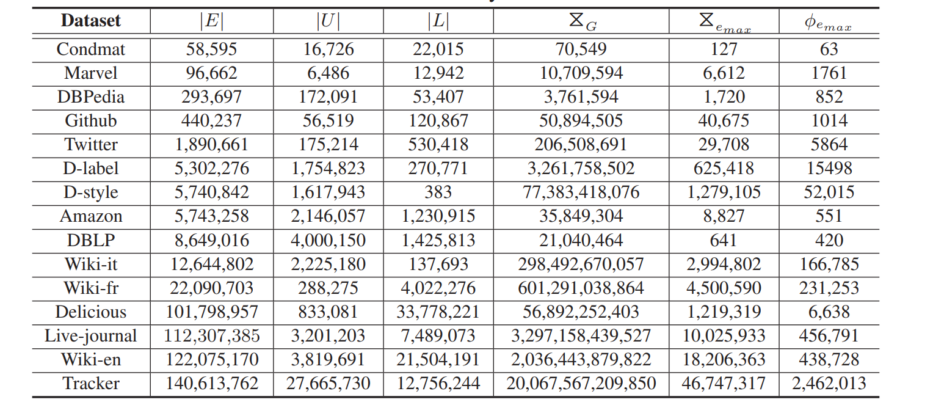
Experiments
Datasets
Algorithms: BiT-BS – Baseline, BiT-BU, BiT-BU++, BiT-PC

Slide 22
Performance Study
Performance on different datasets

Slide 23
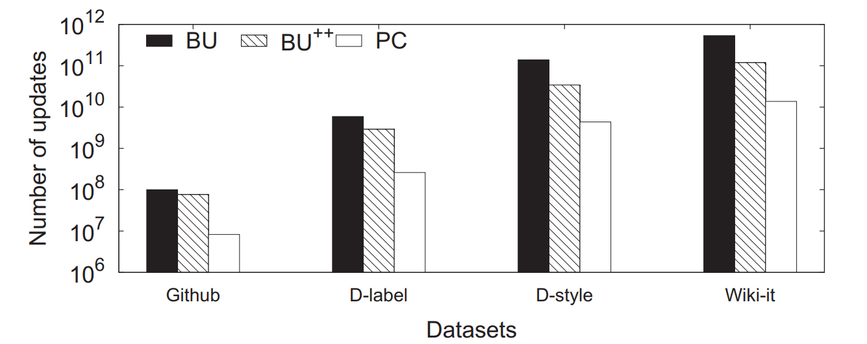
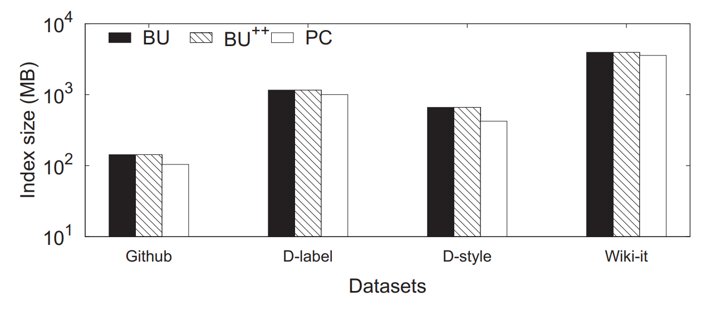
Performance Study
The total number of butterfly support updates
BE-Index size

Slide 24
Conclusion
We propose a novel online index — the BE-Index. Based on the BE-Index, our new bitruss decomposition algorithm BiT-BU significantly reduces the time complexities of the existing algorithms.
To deal with the hub edge issue, we propose the BiT-PC algorithm which processes the hub edges within cohesive subgraphs and compresses the processed edges progressively. In this manner, BiT-PC greatly reduces the number of butterfly support updates for those hub edges.
We conduct extensive experiments on real bipartite graphs. The result shows that the proposed algorithm BiT-PC outperforms the state-of-the-art algorithm by up to two orders of magnitude.

Slide 25
Thank You! Q&A
End

