Slide 1



Vertex Priority Based Butterfly Counting for Large-scale Bipartite Networks
Kai Wang, Xuemin Lin, Lu Qin, Wenjie Zhang, Ying Zhang

Slide 2
Outline
Introduction
Solutions
Experiments
Conclusion

Slide 3


Introduction
Bipartite network:
(Adam)
(Mark)
(Shego)
(Taylor)
(Balm)
(Doll)
(Hat)
(Wine)
(Carpet)
Notes:
When modelling relationships between two dierent types
of entities, the bipartite network arises naturally as a data
model in many real-world applications. For example,
in online shopping services (e.g., Amazon and Alibaba),
the purchase relationships between users and products can
be modelled as a bipartite network, where users form one
layer, products form the other layer, and the links between
users and productions represent purchase records. Other examples include author-paper relationships,actor-movie networks/

Slide 4
Introduction
The smallest non-trivial biclique: butterfly
(Adam)
(Mark)
(Shego)
(Taylor)
(Balm)
(Doll)
(Hat)
(Wine)
(Carpet)
Notes:
Since network motifs (i.e., repeated sub-graphs) are regarded
as basic building blocks of complex networks,
nding and counting motifs of networks is a key to network
analysis.

Slide 5




Introduction
Butterfly counting: compute the number of butterflies in a bipartite graph G, denoted by
$$⋈$$
$$G$$
(Adam)
(Mark)
(Shego)
(Taylor)
$$⋈$$
= 4
$$G$$
(Balm)
(Doll)
(Hat)
(Wine)
(Carpet)
G

Slide 6
Introduction
Butterfly counting: compute the number of butterflies in a bipartite graph G, denoted by
$$⋈$$
$$G$$
(Adam)
(Mark)
(Shego)
(Taylor)
(Balm)
(Doll)
(Hat)
(Wine)
(Carpet)
G

Slide 7
Introduction
Butterfly counting: compute the number of butterflies in a bipartite graph G, denoted by
$$⋈$$
$$G$$
(Adam)
(Mark)
(Shego)
(Taylor)
(Balm)
(Doll)
(Hat)
(Wine)
(Carpet)
G

Slide 8
Introduction
Butterfly counting: compute the number of butterflies in a bipartite graph G, denoted by
$$⋈$$
$$G$$
(Adam)
(Mark)
(Shego)
(Taylor)
(Balm)
(Doll)
(Hat)
(Wine)
(Carpet)
G

Slide 9
Introduction
Butterfly counting: compute the number of butterflies in a bipartite graph G, denoted by
$$⋈$$
$$G$$
(Adam)
(Mark)
(Shego)
(Taylor)
(Balm)
(Doll)
(Hat)
(Wine)
(Carpet)
G

Slide 10




Applications
Bipartite clustering coefficient (c) –
Network measurement: high bipartite clustering coefficient indicates localized closeness; a building block for creating community structure [Aksoy et. al, 2017].
K-wing – each edge in k-wing has at least k number of butterflies [Sarıyüce et. al, 2018].
Community detection; word-document clustering; viral marketing ...
$$⋈$$
$$c= \frac{4 }{}$$
$$G$$
- the number of three-paths (computed in O(m))

Slide 11
Related Works
Unipartite networks
- triangle counting: [1], [2], [3], [4], …
- other motifs: 4-vertices [5], 5-vertices [6], cycles of length k [7], …
Bipartite networks
- butterfly counting: BFC-BS [8], BFC-IBS [9], …
- other motifs: 3x3 biclique [10], 4-path [11], …
State-of-the-art
[1] M. Al Hasan and V. S. Dave. Triangle counting in large networks: a review. Wiley Interdisciplinary Reviews: Data Mining and Knowledge Discovery, 2018.
[2] L. Becchetti, P. Boldi, C. Castillo, and A. Gionis. Efficient semi-streaming algorithms for local triangle counting in massive graphs. In KDD,2008.
[3] L. Chang, C. Zhang, X. Lin, and L. Qin. Scalable top-k structural diversity search. In ICDE, 2017.
[4] X. Hu, Y. Tao, and C.-W. Chung. Massive graph triangulation. In SIGMOD, 2013.
[5] M. Jha, C. Seshadhri, and A. Pinar. Path sampling: A fast and provable method for estimating 4-vertex subgraph counts. In WWW, 2015.
[6] A. Pinar, C. Seshadhri, and V. Vishal. Escape: Efficiently counting all 5-vertex subgraphs. In WWW, 2017.
[7] N. Alon, R. Yuster, and U. Zwick. Finding and counting given length cycles. Algorithmica,1997.
[8] J. Wang, A. W.-C. Fu, and J. Cheng. Rectangle counting in large bipartite graphs. In BigData Congress, 2014.
[9] S.-V. Sanei-Mehri, A. E. Sariyuce, and S. Tirthapura. Butterfly counting in bipartite networks. In KDD, 2018.
[10] S. P. Borgatti and M. G. Everett. Network analysis of 2-mode data. Social networks, 1997.
[11] T. Opsahl. Triadic closure in two-mode networks: Redefining the global and local clustering coefficients. Social Networks, 2013.

Slide 12
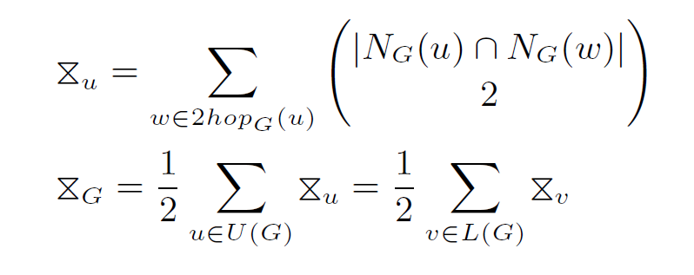
State-of-the-art
BFC-BS & BFC-IBS
u0
u1
u2
u3
(Adam)
(Mark)
(Shego)
(Taylor)
BFC-IBS improves BFC-BS in three aspects: (1) pre-choose the layer of start-vertices to achieve a lower time complexity; (2) use a hash map to speed up the implementation.
(3) avoid counting a butterfly twice (process the wedge (u, v, w) only if w.id > u.id)
v0
v1
v2
v3
v4
(Balm)
(Doll)
(Hat)
(Wine)
(Carpet)

Slide 13
State-of-the-art
BFC-BS & BFC-IBS
u0
u1
u2
u3
(Adam)
(Mark)
(Shego)
(Taylor)
BFC-IBS improves BFC-BS in three aspects: (1) pre-choose the layer of start-vertices to achieve a lower time complexity; (2) use a hash map to speed up the implementation.
(3) avoid counting a butterfly twice (process the wedge (u, v, w) only if w.id > u.id)
v0
v1
v2
v3
v4
(Balm)
(Doll)
(Hat)
(Wine)
(Carpet)
c(v0,v1)= 1

Slide 14
State-of-the-art
BFC-BS & BFC-IBS
u0
u1
u2
u3
(Adam)
(Mark)
(Shego)
(Taylor)
BFC-IBS improves BFC-BS in three aspects: (1) pre-choose the layer of start-vertices to achieve a lower time complexity; (2) use a hash map to speed up the implementation.
(3) avoid counting a butterfly twice (process the wedge (u, v, w) only if w.id > u.id)
v0
v1
v2
v3
v4
(Balm)
(Doll)
(Hat)
(Wine)
(Carpet)
c(v0,v1)= 2

Slide 15
State-of-the-art
BFC-BS & BFC-IBS
u0
u1
u2
u3
(Adam)
(Mark)
(Shego)
(Taylor)
BFC-IBS improves BFC-BS in three aspects: (1) pre-choose the layer of start-vertices to achieve a lower time complexity; (2) use a hash map to speed up the implementation.
(3) avoid counting a butterfly twice (process the wedge (u, v, w) only if w.id > u.id)
v0
v1
v2
v3
v4
(Balm)
(Doll)
(Hat)
(Wine)
(Carpet)
c(v0,v1)= 3

Slide 16
State-of-the-art
BFC-BS & BFC-IBS
u0
u1
u2
u3
(Adam)
(Mark)
(Shego)
(Taylor)
BFC-IBS improves BFC-BS in three aspects: (1) pre-choose the layer of start-vertices to achieve a lower time complexity; (2) use a hash map to speed up the implementation.
(3) avoid counting a butterfly twice (process the wedge (u, v, w) only if w.id > u.id)
v0
v1
v2
v3
v4
(Balm)
(Doll)
(Hat)
(Wine)
(Carpet)
c(v0,v1)= 3
c(v0,v2)= 1

Slide 17


State-of-the-art
BFC-BS & BFC-IBS
u0
u1
u2
u3
(Adam)
(Mark)
(Shego)
(Taylor)
BFC-IBS improves BFC-BS in three aspects: (1) pre-choose the layer of start-vertices to achieve a lower time complexity; (2) use a hash map to speed up the implementation.
(3) avoid counting a butterfly twice (process the wedge (u, v, w) only if w.id > u.id)
v0
v1
v2
v3
v4
(Balm)
(Doll)
(Hat)
(Wine)
(Carpet)
c(v0,v1)= 3
c(v0,v2)= 1
c(v0,v3)= 1
$$⋈$$
= 3 + 0 + 0 = 3
$$\text{v}\text{0}$$

Slide 18




State-of-the-art
BFC-BS & BFC-IBS
u0
u1
u2
u3
(Adam)
(Mark)
(Shego)
(Taylor)
BFC-IBS improves BFC-BS in three aspects: (1) pre-choose the layer of start-vertices to achieve a lower time complexity; (2) use a hash map to speed up the implementation.
(3) avoid counting a butterfly twice (process the wedge (u, v, w) only if w.id > u.id)
v0
v1
v2
v3
v4
(Balm)
(Doll)
(Hat)
(Wine)
(Carpet)
$$⋈$$
$$⋈$$
= 3
= 0
$$\text{v}\text{0}$$
$$\text{v}\text{1}$$

Slide 19

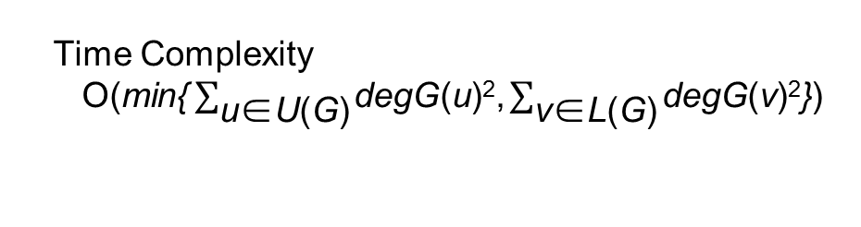







State-of-the-art
BFC-BS & BFC-IBS
u0
u1
u2
u3
(Adam)
(Mark)
(Shego)
(Taylor)
BFC-IBS improves BFC-BS in three aspects: (1) pre-choose the layer of start-vertices to achieve a lower time complexity; (2) use a hash map to speed up the implementation.
(3) avoid counting a butterfly twice (process the wedge (u, v, w) only if w.id > u.id)
v0
v1
v2
v3
v4
(Balm)
(Doll)
(Hat)
(Wine)
(Carpet)
Time Complexity
O($\text{min}\text{\{}\sum_{\text{u}\text{∈}\text{U}\text{(}\text{G}\text{)}}{\text{degG}\text{(}\text{u}\text{)}\text{2}\text{,}\sum_{\text{v}\text{∈}\text{L}\text{(}\text{G}\text{)}}{\text{degG}\text{(}\text{v}\text{)}\text{2}\text{\}}}}$)
c(v2,v3)= 2
c(v2,v4)= 1
$$⋈$$
$$⋈$$
$$⋈$$
$$⋈$$
$$⋈$$
$$⋈$$
= 4
= 1
$$G$$
= 3
= 0
= 0
= 0
$$\text{v}\text{0}$$
$$\text{v}\text{1}$$
$$\text{v}\text{2}$$
$$\text{v}\text{3}$$
$$\text{v}\text{3}$$

Slide 20
State-of-the-art
Issues in handling hub vertices:
u0
u1
u2
u1000
u1001
L(G)
R(G)
v0
v1
v999
v1000
v1001

Slide 21
State-of-the-art
Issues in handling hub vertices:
The existing algorithms need to go through u₀ (or v₁₀₀₁) as the middle-vertex if choosing L(G) (or U(G)) to start.
Regardless of whether the upper or the lower layer is selected to start, we must traverse totally C2, 1000 (= 499,500) plus 1,000 different wedges by the existing algorithms.
u0
u1
u2
u1000
u1001
L(G)
R(G)
v0
v1
v999
v1000
v1001

Slide 22
State-of-the-art
Issues in handling hub vertices:
The existing algorithms need to go through u₀ (or v₁₀₀₁) as the middle-vertex if choosing L(G) (or U(G)) to start.
Regardless of whether the upper or the lower layer is selected to start, we must traverse totally C2, 1000 (= 499,500) plus 1,000 different wedges by the existing algorithms.
u0
u1
u2
u1000
u1001
L(G)
R(G)
v0
v1
v999
v1000
v1001

Slide 23
State-of-the-art
Issues in handling hub vertices:
The existing algorithms need to go through u₀ (or v₁₀₀₁) as the middle-vertex if choosing L(G) (or U(G)) to start.
Regardless of whether the upper or the lower layer is selected to start, we must traverse totally C2, 1000 (= 499,500) plus 1,000 different wedges by the existing algorithms.
u0
u1
u2
u1000
u1001
L(G)
R(G)
v0
v1
v999
v1000
v1001

Slide 24
State-of-the-art
Issues in handling hub vertices:
The existing algorithms need to go through u₀ (or v₁₀₀₁) as the middle-vertex if choosing L(G) (or U(G)) to start.
Regardless of whether the upper or the lower layer is selected to start, we must traverse totally C2, 1000 (= 499,500) plus 1,000 different wedges by the existing algorithms.
u0
u1
u2
u1000
u1001
L(G)
R(G)
v0
v1
v999
v1000
v1001

Slide 25
Challenges
It is a challenge to effectively handle high-degree vertices.
It is also a challenge to utilize CPU cache to speed up butterfly counting.

Slide 26
Solutions
Solution 1: The vertex-priority-based algorithm
BFC-VP, to conquer challenge 1
Solution 2: BFC-VP + cache aware techniques
BFC-VP++, to conquer challenge 1 & 2

Slide 27
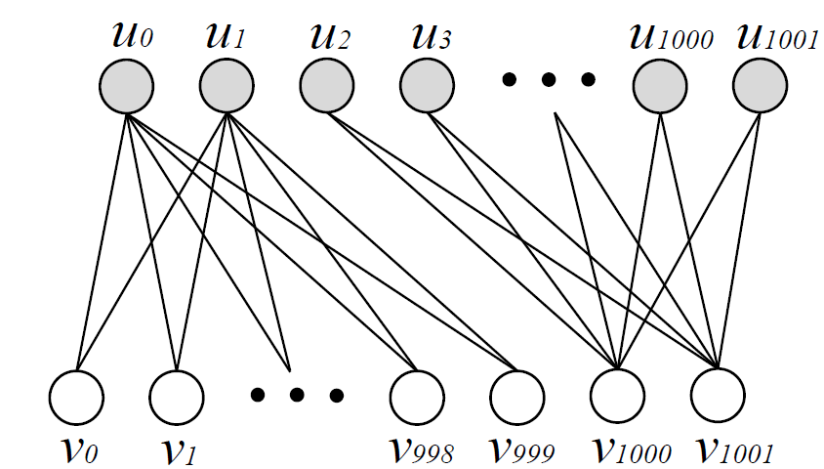
The vertex-priority-based algorithm
Motivation: a hub vertex may not always necessary to become a middle-vertex in a wedge for the construction of a butterfly.
[u0, v0, u1, v1] in the Figure can be constructed in two ways: 1) by the wedges (u0, v0, u1) and (u0, v1, u1), or 2) by the wedges (v0, u0, v1) and (v0, u1, v1).

Slide 28
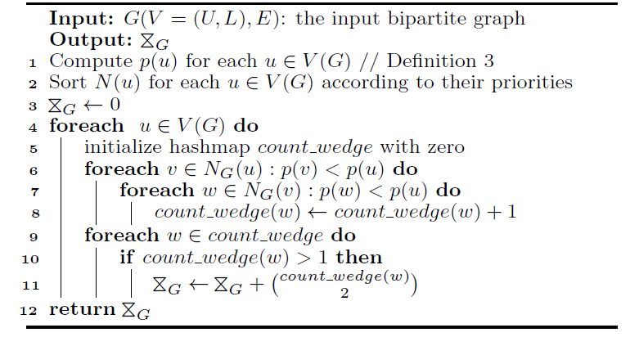
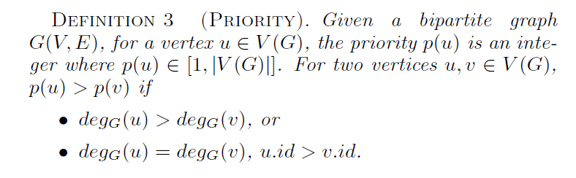
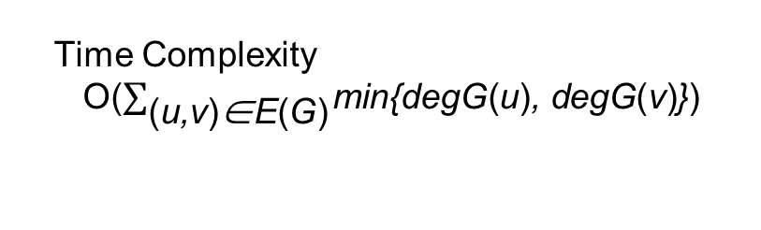
The vertex-priority-based algorithm
Assign a priority to each vertex.
Traversal necessary wedges.
Only process the wedges (u, v, w) with p(u) > p(v) & p(u) > p(w).
Count butterflies.
Time Complexity
O($\sum_{\text{(}\text{u}\text{,}\text{v}\text{)}\text{∈}\text{E}\text{(}\text{G}\text{)}}{\text{min}\text{\{}\text{degG}\text{(}\text{u}\text{)}\text{, }\text{degG}\text{(}\text{v}\text{)}\text{\}}}$)

Slide 29
Cache aware techniques
Cache aware wedge processing
Cache aware graph projection
Improve CPU cache performance, keep time complexity and space complexity unchanged.

Slide 30
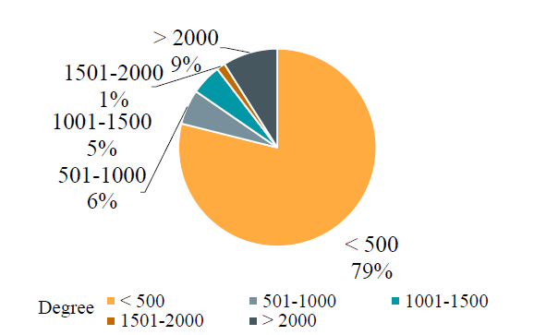
Cache aware wedge processing
The degree distribution of the end-vertex-accesses on Tracker by BFC-VP
79% of total accesses are accesses
of low-degree vertices (i.e., degree < 500)
Since the locality of accesses is a key aspect of improving the CPU cache performance, we hope the algorithm can access more high-degree vertices as end-vertices.

Slide 31
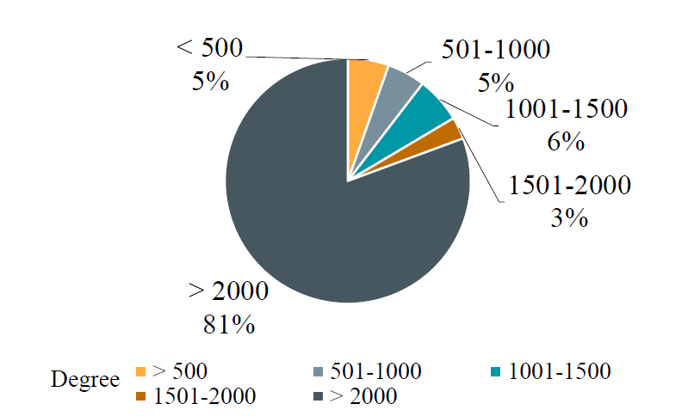
Cache aware wedge processing
New wedge processing strategy: processing the wedges where the priorities of end-vertices are higher than the priorities of middle-vertices and start-vertices.
We proved that the total access of end-vertices remaining unchanged - the time complexity unchanged.
The degree distribution of the end-vertex-accesses on Tracker using new wedge processing strategy
The percentage of accesses of high-degree vertices (i.e., degree > 2000) increases from 9% to 81%.

Slide 32
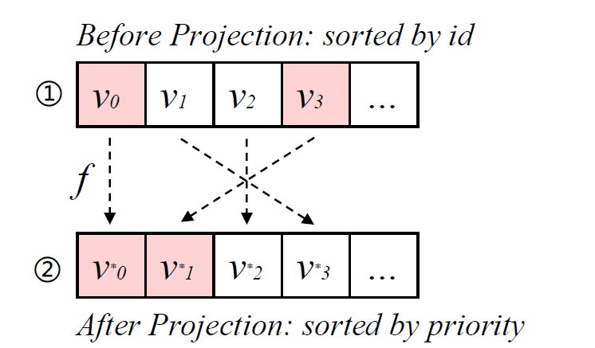
Cache aware graph projection
Generally, vertices are sorted by their ids when storing in the buffer. Although end-vertices are mostly high-priority vertices, the distance between two end-vertices (e.g., v0 and v3) can be very long.

Slide 33
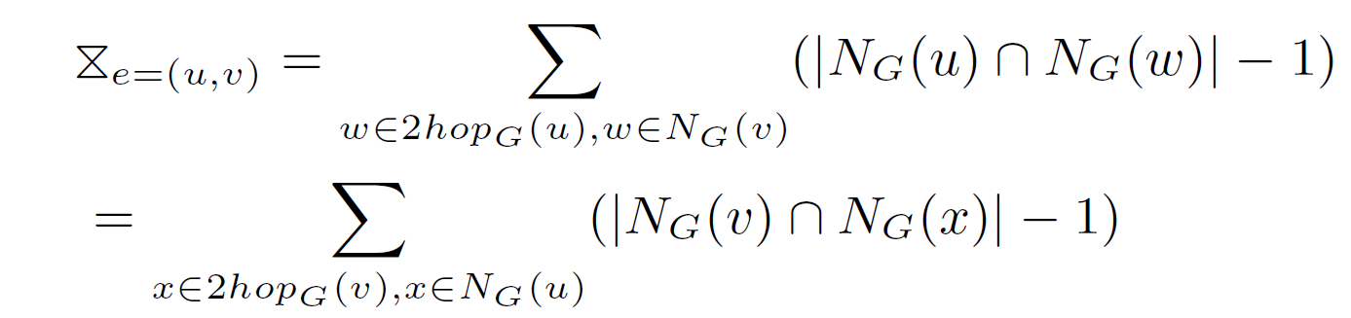
Extensions
Counting the butterflies for each edge

Slide 34
Extensions
Parallel butterfly counting – shared memory parallelization
Easily extern our algorithms into a parallel version using O(n*t+m) space.
global data space
local data space
for
thread 1
local data space
for
thread 2
local data space
for
thread 3
…

Slide 35
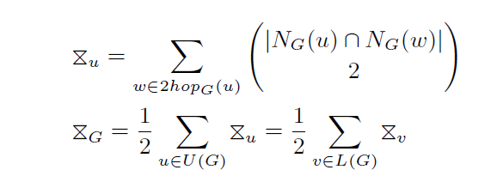
Extensions
External memory butterfly counting
1. Process wedges based on our strategy.
2. For each wedge (u, v, w), store the vertex-pair (u, w) on disk.
3. Sequentially scan these vertex-pairs and for the vertex-pair (u, w), we count the occurrence of it and compute using the following lemma.
$$⋈$$
$$G$$

Slide 36
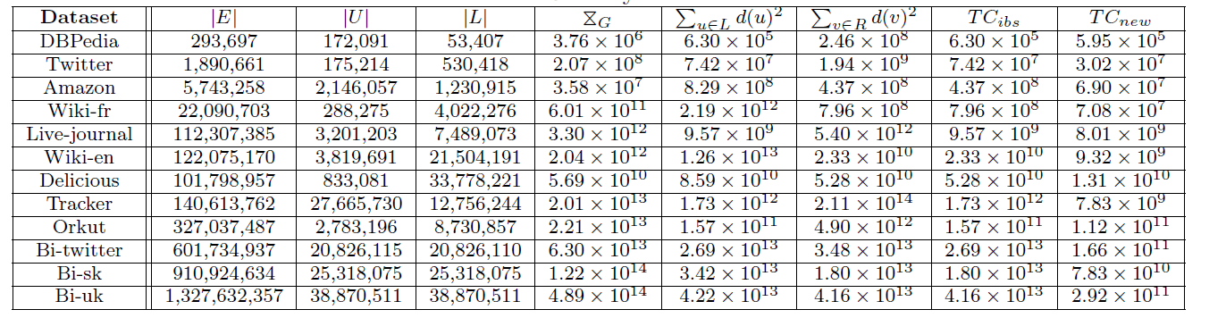
Experiments
Datasets
Algorithms: BFC-IBS – Baseline, BFC-VP, BFC-VP++

Slide 37
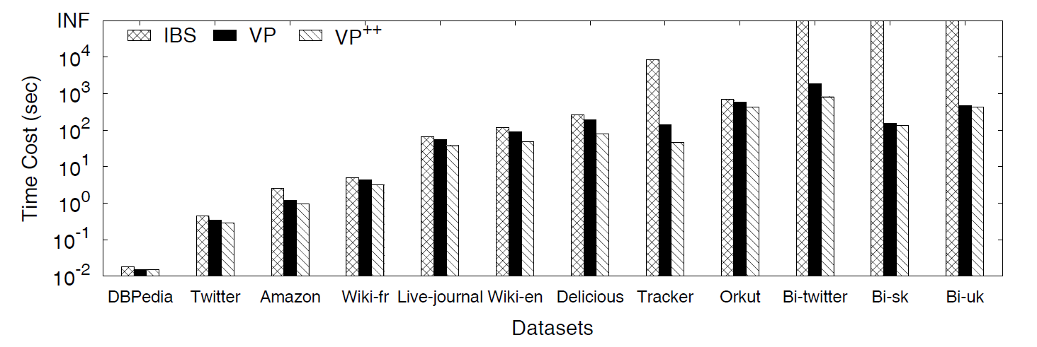
Performance Study
Performance on different datasets

Slide 38
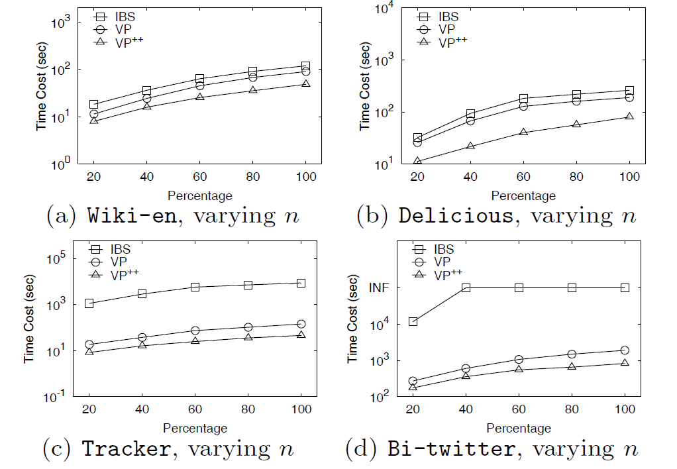
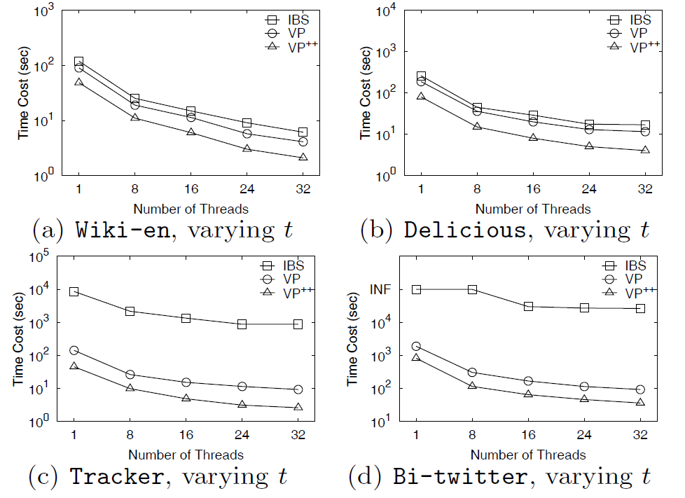
Performance Study
Scalability
Speedup

Slide 39
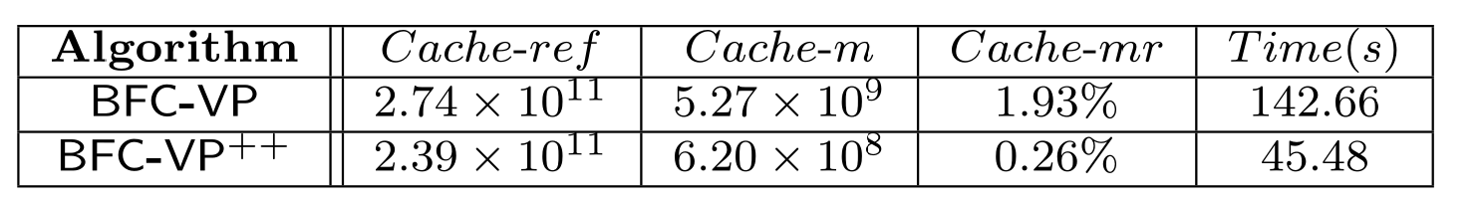
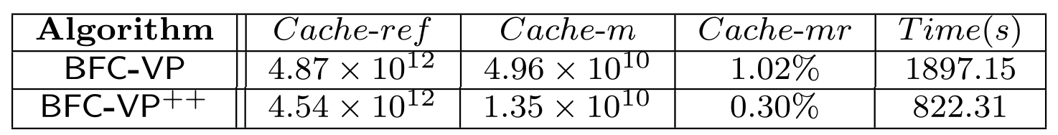
Performance Study
Cache Statistics over Tracker
Cache Statistics over Bi-twitter

Slide 40
Conclusion
We propose a vertex-priority-based butterfly counting algorithm BFC-VP which can effectively handle high-degree vertices.
We also propose the cache-aware butterfly counting algorithm BFC-VP++ which improves the CPU cache performance of BFC-VP with two cache-aware strategies.
We conduct extensive experiments on real datasets and the result shows that our BFC-VP++ algorithm significantly outperforms the state-of-the-art algorithms.

Slide 41
Thank You!
Q&A
End

