Slide 1
SKYPE: Top-k Spatial-keyword Publish/Subscribe Over Sliding Window
Computer Science and Engineering
Xiang Wang¹, Ying Zhang², Wenjie Zhang¹, Xuemin Lin¹, Zengfeng Huang¹
¹University of New South Wales, Australia
²University of Technology, Sydney, Australia

Slide 2


Introduction
Streaming geo-textual data
  Geo-textual object: spatial and textual information
  Streaming: continuous, unbounded, fast
Publish/Subscribe System
  Users register their interest as spatial-keyword subscriptions
  Publications containing spatial-keyword messages will be delivered to users continuously
  Information dissemination, Real-time recommendation

Slide 3





Real-time E-coupon Recommendation
Publications/Messages
Subscriptions/Users
textual: discount iPad
location: Opera House
textual: iPad location: City
Relevance? Millions of users? Unbounded stream?

Slide 4


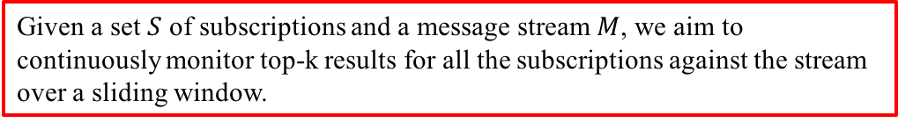
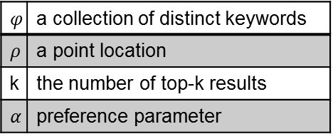
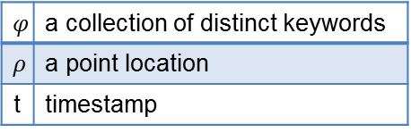
Problem Statement
$$φ$$ | a collection of distinct keywords
$$ρ$$ | a point location
k | the number of top-k results
$$α$$ | preference parameter
$$φ$$ | a collection of distinct keywords
$$ρ$$ | a point location
t | timestamp
Subscription s
Message m
Relevance?
Score-based Ranking
Unbounded?
Sliding window model
Given a set $S$ of subscriptions and a message stream $M$, we aim to continuously monitor top-k results for all the subscriptions against the stream over a sliding window.
Notes:
phi

Slide 5

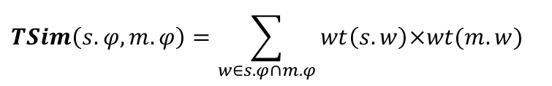
Score Function
Spatial Similarity
Textual Similarity
$$SSim\left(s.ρ,m.ρ\right)=1−\frac{Euclidean(s.ρ,m.ρ)}{MaxDist}$$
$$TSim\left(s.φ,m.φ\right)=\sum_{w∈s.φ∩m.φ}{wt\left(s.w\right)×wt(m.w)}$$
$$Score\left(s,m\right)= s.α×SSim\left(s.ρ,m.ρ\right)+(1−s.α)×TSim(s.φ,m.φ)$$

Slide 6
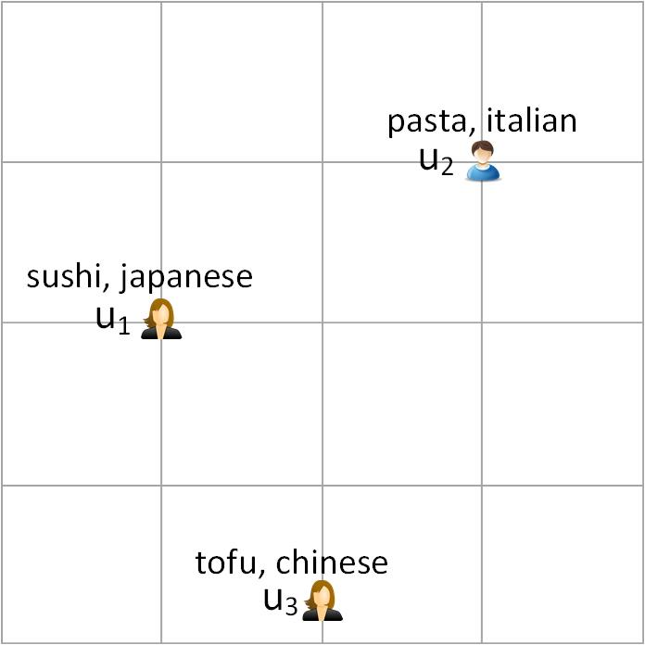












Motivating Example
sliding window size = 4, k = 1
$$u_{1}$$
$$u_{2}$$
$$u_{3}$$
$$e_{1}$$
0.6
0
0.3
$$e_{2}$$
0
0.3
0.6
$$e_{3}$$
0.4
0
0.5
$$e_{4}$$
0
0.7
0
0.6
0.7
0.6
$e_{5}$ arrives while $e_{1}$ expires
$$u_{1}$$
$$u_{2}$$
$$u_{3}$$
$$e_{1}$$
0.6
0
0.3
$$e_{2}$$
0
0.3
0.6
$$e_{3}$$
0.4
0
0.5
$$e_{4}$$
0
0.7
0
$$e_{5}$$
0
0
0.9
0.4
0.7
0.9
Notes:
1. How to efficiently deliver each new message to the affected subscriptions, given the large number of registered users?
2. How to deal with top-k re-evaluation when the window slides, given the fact that each top-k re-evaluation from sliding window is very costly?

Slide 7
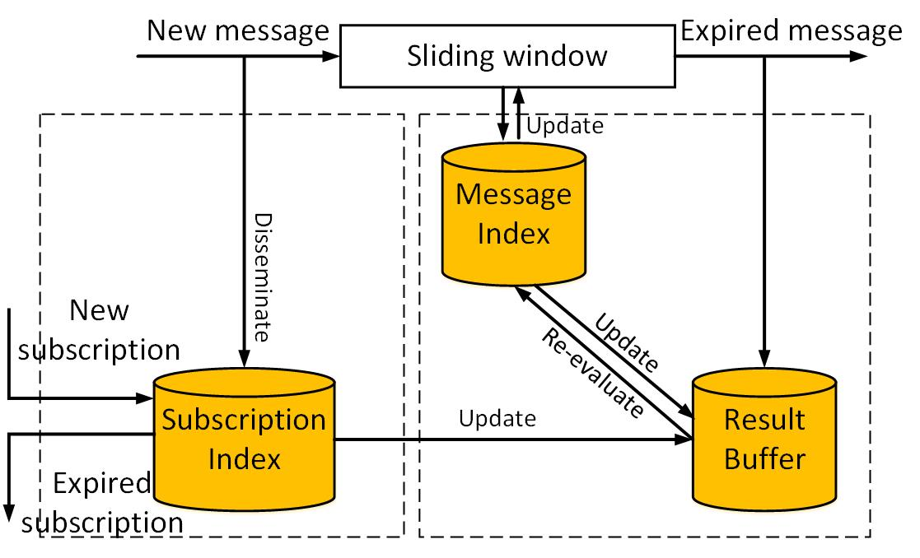
Framework
Message Dissemination
Top-k
Re-evaluation
Notes:
Message index: existing spatial-keyword index, e.g., IR-Tree

Slide 8
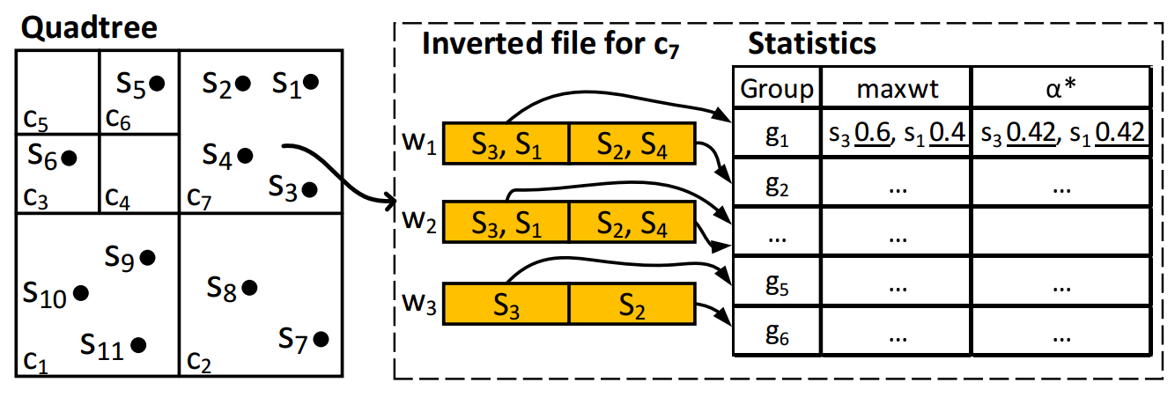
Message Dissemination
Convert top-k maintenance to set similarity search
Build Quad-tree and inverted list to index the subscriptions
Employ location-based prefix filtering for individual pruning and group pruning by visiting the inverted list in TAAT (term-at-a-time) scheme

Slide 9
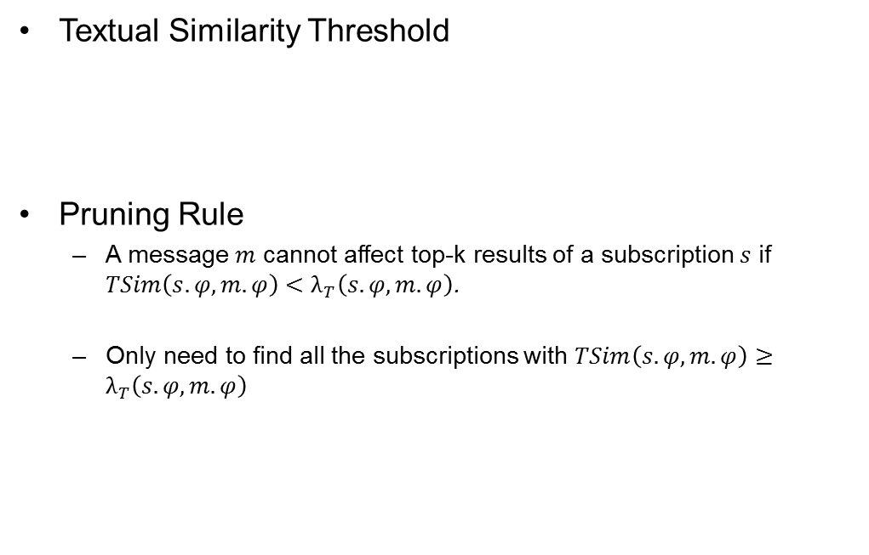

Textual Similarity Threshold
Textual Similarity Threshold
Pruning Rule
  A message $m$ cannot affect top-k results of a subscription $s$ if $TSim\left(s.φ,m.φ\right)<λ_{T}\left(s.φ,m.φ\right)$.
  Only need to find all the subscriptions with $TSim\left(s.φ,m.φ\right)≥λ_{T}\left(s.φ,m.φ\right)$
k-th highest score
$$λ_{T}\left(s.φ,m.φ\right)=\frac{kScore(s)}{1−s.α}−\frac{s.α}{1−s.α}×SSimUB(s.ρ,m.ρ)$$
Spatial similarity upper bound
Notes:
Discuss the spatial upper bound here

Slide 10
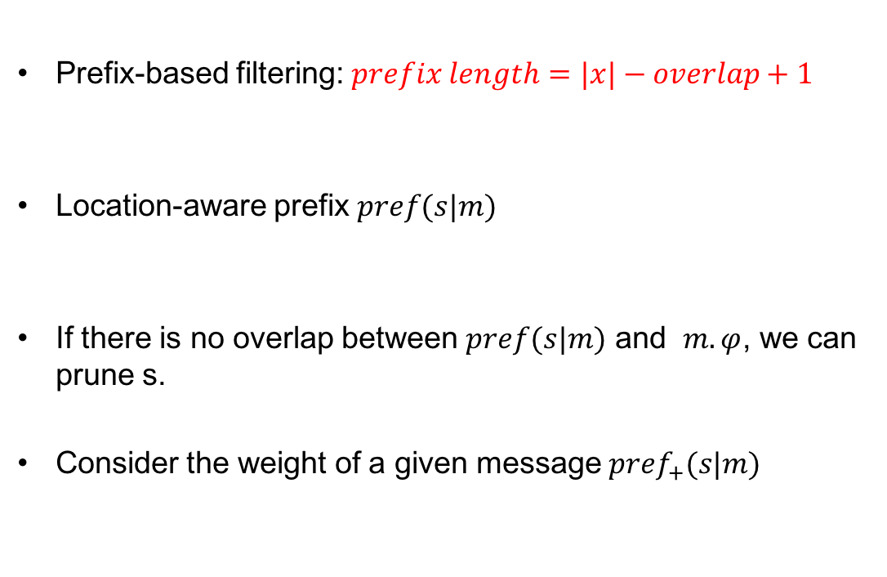






Location-aware Prefix
Prefix-based filtering: $prefix length=|x|−overlap+1$
Location-aware prefix $pref(s|m)$
If there is no overlap between $pref(s|m)$ and $m.φ$, we can prune s.
Consider the weight of a given message ${pref}_{+}(s|m)$
$$w_{1}$$ | $$w_{3}$$ | $$w_{4}$$ | $$w_{5}$$ | $$w_{6}$$
$$w_{2}$$ | $$w_{5}$$ | $$w_{6}$$
Overlap >= 3
$λ_{T}\left(s.φ,m.φ\right)$=0.32
s
$w_{1}$:0.4 | $w_{2}$:0.3 | $w_{3}$:0.2 | $w_{4}$:0.1
0.1 < 0.32
0.1+0.2+0.3 > 0.32
0.1+0.2 < 0.32
s
$w_{1}$:0.4,1.0 | $w_{2}$:0.3,0.6 | $w_{3}$:0.2,0.3 | $w_{4}$:0.1,0.1
$λ_{T}\left(s.φ,m.φ\right)$=0.5
m
$w_{2}$:0.3,0.4 | $w_{3}$:0.4,0.4 | $w_{4}$:0.1,0.1
0.6*0.4<0.5
Notes:
The idea is that if there is no overlap between m and the prefix of s, we can prune this pair.
For simplicity, the total weight is not 1 in our example
Prefix:
1. Sort the tokens by a global order
2. Index first few words of a subscription
3. Must share at least one word in prefix to be a candidate
.

Slide 11



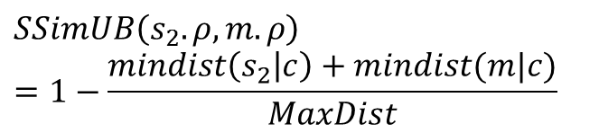








Spatial Bound Estimation
Employ spatial index, such as Quad-Tree, R-tree, to compute spatial bound.
$$s_{5}$$
Inner Spatial Bound
  irrelevant to the incoming message
  Precomputed
Outer Spatial bound
  Relevant to the incoming message
  Computed on-the-fly
$$s_{4}$$
$$s_{1}$$
$$s_{3}$$
$$s_{6}$$
$$c$$
$$s_{4}$$
$$mindist(m|c)$$
$$m$$
$$s_{2}$$
$$SSimUB\left(s_{2}.ρ,m.ρ\right)=1−\frac{mindist\left(s_{2} | c\right)+mindist(m|c)}{MaxDist}$$
$$mindist(s_{2}|c)$$

Slide 12


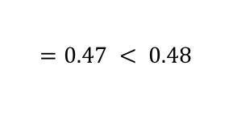

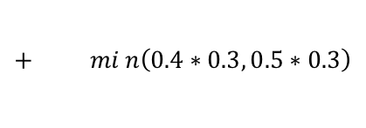
Unvisited Keywords Pruning
Estimate the textual upper bound for unvisited keywords.
If the current accumulated similarity plus this upper bound is still less than required threshold (i.e., $λ_{T}\left(s.φ,m.φ\right)$), we can safely prune $s$.
s
$w_{1}$:0.4,1.3,0.5 | $w_{2}$:0.5,0.9,0.5 | $w_{3}$:0.3,0.4,0.3 | $w_{4}$:0.1,0.1,0.1
m
$w_{2}$:0.7,1.2,0.7 | $w_{3}$:0.3,0.5,0.3 | $w_{4}$:0.2,0.2,0.2
$λ_{T}\left(s.φ,m.φ\right)$=0.48
$$0.5∗0.7$$
$$+ min\left(0.4∗0.3, 0.5∗0.3\right)$$
$$=0.47 < 0.48$$
0.9: sum of weight from current word to the end
0.5: max among the weights from current word to the end

Slide 13






Group Pruning
Previous techniques only prune one subscription at a time
Subscription-dependent Prefix ${pref}_{+}(m|s)$
If max(0.8*0.4, 0.8*0.3) < min(0.35,0.4), we can skip $s_{1}$ and $s_{2}$ at the same time.
$$s_{1}$$
$w_{1}$:0.3,0.4 | $w_{3}$:0.4,0.4 | $w_{4}$:0.1,0.2 | $w_{5}$:0.2,0.2
$λ_{T}\left(s_{1}.φ,m.φ\right)$=0.35
m
$w_{2}$:0.3,1.1 | $w_{3}$:0.3,0.8 | $w_{4}$:0.4,0.5 | $w_{5}$:0.1,0.1
0.1*0.2<0.35
0.5*0.2<0.35
0.8*0.4<0.35
$$s_{2}$$
$w_{1}$:0.5,0.5 | $w_{3}$:0.3,0.3 | $w_{4}$:0.2,0.2
$λ_{T}\left(s_{2}.φ,m.φ\right)$=0.4
0.8*0.3<0.4
0.8*max(0.4, 0.3)
materialized
on-the-fly

Slide 14
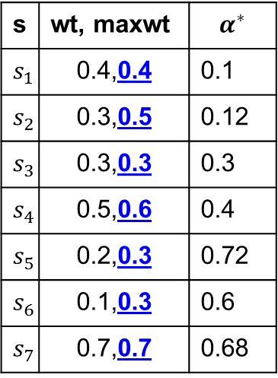



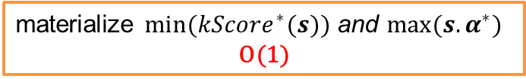



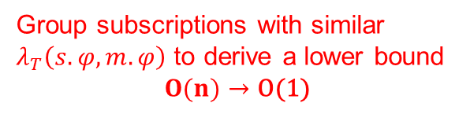
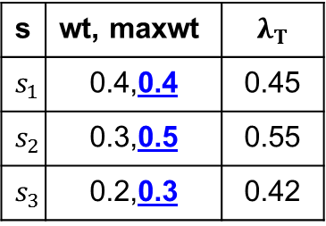
$α$-Partition Scheme
m
… | $w_{3}$:0.3,0.8 | …
s | wt, maxwt | $$α^{∗}$$
$$s_{1}$$ | 0.4,0.4 | 0.1
$$s_{2}$$ | 0.3,0.5 | 0.12
$$s_{3}$$ | 0.3,0.3 | 0.3
$$s_{4}$$ | 0.5,0.6 | 0.4
$$s_{5}$$ | 0.2,0.3 | 0.72
$$s_{6}$$ | 0.1,0.3 | 0.6
$$s_{7}$$ | 0.7,0.7 | 0.68
$w_{3}$ posting list
$$G_{1}$$
s | wt, maxwt | $$λ_{T}$$
$$s_{1}$$ | 0.4,0.4 | 0.45
$$s_{2}$$ | 0.3,0.5 | 0.55
$$s_{3}$$ | 0.2,0.3 | 0.42
$$G_{2}$$
$$G_{3}$$
Group subscriptions with similar $λ_{T}\left(s.φ,m.φ\right)$ to derive a lower bound
$$O(n)→\text{O}\text{(1)}$$
materialize $min⁡({kScore}^{∗}(s))$ and $max⁡(s.α^{∗})$
$$\text{O}\text{(1)}$$
Notes:
We initially try to organize $λ_{T}$ based on both kScore and $α$. However, it would lead to too many groups.

Slide 15




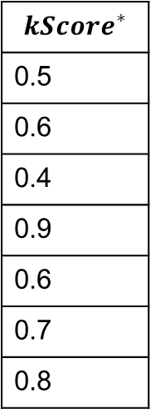
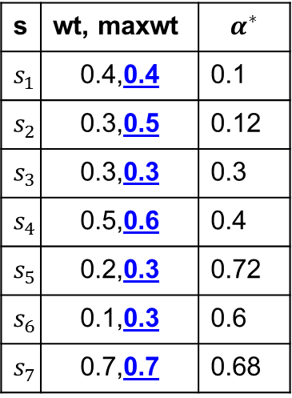
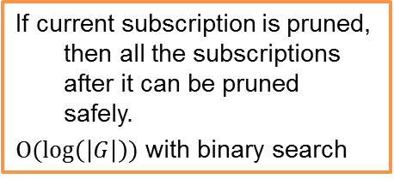
Early Termination
m
… | $w_{3}$:0.3,0.8 | …
s | wt, maxwt | $$α^{∗}$$
$$s_{1}$$ | 0.4,0.4 | 0.1
$$s_{2}$$ | 0.3,0.5 | 0.12
$$s_{3}$$ | 0.3,0.3 | 0.3
$$s_{4}$$ | 0.5,0.6 | 0.4
$$s_{5}$$ | 0.2,0.3 | 0.72
$$s_{6}$$ | 0.1,0.3 | 0.6
$$s_{7}$$ | 0.7,0.7 | 0.68
$${kScore}^{∗}$$
0.5
0.6
0.4
0.9
0.6
0.7
0.8
$$G_{1}$$
$$G_{2}$$
If current subscription is pruned, then all the subscriptions after it can be pruned safely.
$O(\log\left(\left|G\right|\right))$ with binary search
$$G_{3}$$

Slide 16







Top-k Re-evaluation
What if a message expires from the sliding window?
How do we alleviate this?
  Kmax algorithm (Yi et al, ICDE 2003)
    Contain redundant elements
  (Partial) k-Skyband (Mouratidis et al, SIGMOD 2006)
$s_{1}$:{$m_{6}$, $m_{10}$, $m_{13}$}
Message index
$s_{1}$:{$m_{1}$, $m_{6}$, $m_{10}$}
$m_{3}$(0)
score
$m_{4}$(0)
(2)
(0)
$$m_{5}$$
(1)
top-k=3 => 2-skyband
$$m_{1}$$
(0)
(1)
$$m_{2}$$
(3)
(2)
timestamp
Notes:
K-skyband: a set of points which are dominated by at most k other points
We assume a count-based sliding window, first in first out.
Full k-Skyband is expensive to maintain
Partial k-Skyband: Only keep elements with score not lower than the most rent kScore.

Slide 17
Cost-based K-Skyband
score
Partial k-Skyband
K-th highest score from the most recent top-k re-computation
Cost-based k-Skyband
Determined by message workload with a cost model
Full k-Skyband
Usually contain lots of useless messages due to freshness
0
timestamp

Slide 18
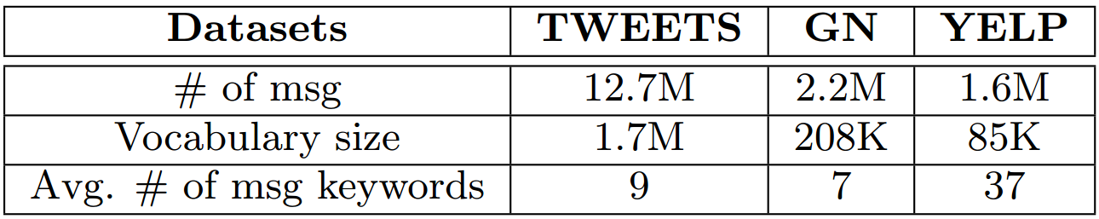
Experiments
Baselines
  Message Dissemination
    CIQ: Chen et al, ICDE 2015
    IGPT: Ours
  Top-k Re-evaluation
    k-Max: Yi et al, ICDE 2003
    Partial Skyband: Mouratidis et al, SIGMOD 2006
    Cost Skyband: Ours
Datasets
Subscriptions are sampled from datasets

Slide 19
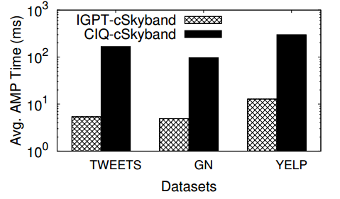
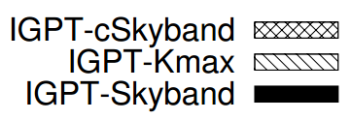
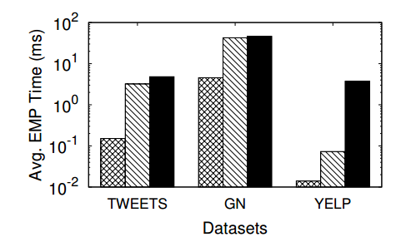
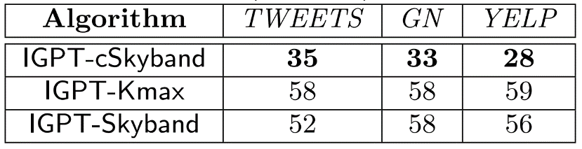
Compare Message Dissemination Algorithm
Compare Top-k Re-evaluation Algorithm
Buffer size

Slide 20
Conclusion
Top-k spatial-keyword Publish/Subscribe over sliding window
  How to efficiently match each incoming message to relevant subscriptions?
  How to efficiently deal with expired messages?
Prefix-based individual pruning and group pruning techniques
Cost-based skyband model

Slide 21
Thanks!
Q&A
Notes:
add some details for possible questions?
Add more details to cost-based skyband
Add CIQ algorithm at the beginning?

